Slide 1
Today’s SDFM Virtual Luncheon
Topic:
Beyond the Urgent
12 Aug, 2026
11:30am -1:00pm EDT
CHAPLAIN, CAPTAIN VICTOR MARRERO
88 ABW/CH
WPAFB
EARN 1 CLP !

Slide 2
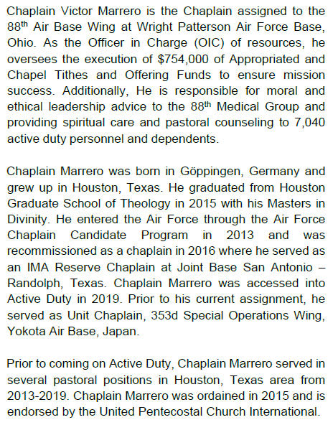
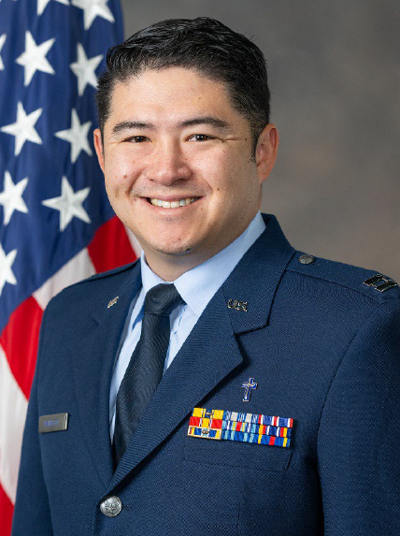

Slide 3


Slide 4


Slide 5


Slide 6


Slide 7


Slide 8


Slide 9


Slide 10


Slide 11


Slide 12


Society of Defense Financial Management
Aviation Chapter
PRESENTS THIS CERTIFICATE OF APPRECIATION TO
Chaplain, Capt Victor Marrero
WITH A DONATION TO
WPAFB Operation Warm Heart
IN HONOR OF YOUR PRESENTATION
12 Aug 2026
Jonathan Pepples
Jonathan Pepples, President, Aviation Chapter

Slide 13

⚠ This deck may contain links or images from external sources. Please review them before opening.
SDFM Aviation Chapter
Upcoming Volunteer Activities
AUGUST EVENT
SEPTEMBER EVENT
Feed the Creek
Air Force Marathon
Support our local community by participating in the Feed the Creek initiative. Your volunteer work directly helps children and families in need.
Join us in volunteering for the prestigious Air Force Marathon. A fantastic opportunity to support runners and represent our chapter.
Friday, August 21, 2026
Saturday, September 19, 2026
12:00 PM - 1:30 PM
5:00 AM - 11:00 AM
Register Here
Register Here

Slide 14
SDFM Aviation Chapter
      Learn more about the
      the SDFM Aviation Chapter at
      https://www.sdfm-aviation.org/

