Slide 1
FM at the Speed of Defense What Does That Mean??
Marjana Zupcsan, SES, USAF
Director, AFLCMC/FM-FZ
6 May 2026

Slide 2
Why Is Speed of Defense Important?
Our adversaries are modernizing at unprecedented speed
Commercial technology cycles (e.g., AI and microchips) move much faster than the 10-15 year traditional defense program cycle
Rapid technology changes drive new threats and need for new capabilities…swarm drones, interoperability, cyber
Unable to sunset legacy platforms when replacement platforms take decades to produce
Recent world events highlight the need to get aircraft, equipment, parts, munitions out to field at a much faster rate

Slide 3
Rate of Change Increasing
Speed of Technology Driving Rapid Change
An estimated 90% of the world’s data has been generated in the last two years
Artificial Intelligence – A Game Changer
"hyper-exponential" growth rates, with compute capacity increasing by 240% to 400% annually”
Pentagon signed agreements with 7 companies to add AI to classified networks
“Pentagon workers vibe-code 100,000 AI ‘agents’ to use on unclassified networks”

Slide 4
What Does This Mean To Me??
Just another “Rah-Rah” slogan. I’ll ignore it until it goes away (Accompanied with eye roll).
Not another reform! This is stupid and I’m not doing it! (Angrily stomps out of room).
I’ll make some small changes - that’s enough, right? (Feeling proud for playing along)
Ugh…more change. I don’t think I can do this. (Head down on desk and a small whimper)
Hmmm…maybe this is an opportunity to make things better (Light bulb moment)

Slide 5

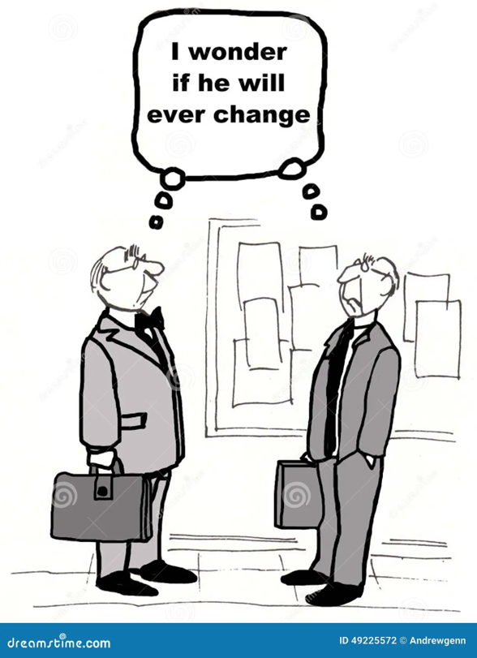
I move fast…it’s everyone else who’s the problem!

Slide 6
I Know How to Speed Things Up!
I don’t have to follow the laws anymore!! I just have to be fast!! WRONG!!
I don’t have to do quality work anymore!! I just have to be fast!! WRONG!!
I’m not sure this process is value-added. I’ll talk to my leadership to determine if it’s still relevant. RIGHT!!
There are ways technology can help this process move faster. I’m going to talk to my boss and volunteer to make it happen. RIGHT!!

Slide 7
What Does FM Need From You?
Be Open to Change…If you want your team to accept new ideas, you must be open to new ideas!
Be Curious - Old dogs can learn new tricks!!
Support Standardization
Be Data Driven and Ensure Your Data is Accurate
Whenever Possible, Offer Solutions, not just Problem
Impact where you can…not everything has to be a “Big Bang”
Notes:
To change top and bottom markings to CUI – use Slide Layout and select CUI Title or Content Master

Slide 8
We Are Force Multiplier Warfighters
Stewards of the Taxpayer Dollars/Financial Accountability
Develop and Provide Resource Options
Analytical Rigor
Problem Solvers!!

Slide 9
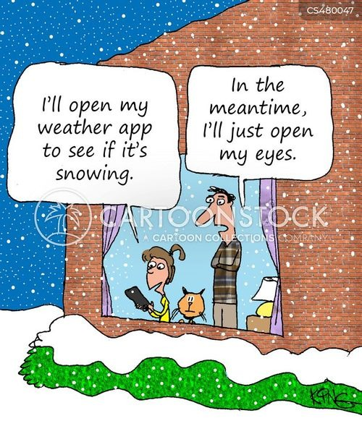
Technology gives us tools to help with repetitive processes, but it doesn’t replace good old-fashioned thinking, common sense, and experience!!

