Slide 1


A FERS BENEFITS EDUCATION SERIES
Understanding
Your FERS Benefits
A practical guide for federal employees at every stage of their career
PRESENTED BY
Sergio Reyes
President / CEO • District Mutual • American Benefits Exchange

Slide 2
ABOUT US
Who is American Benefits Exchange?
1
EDUCATE
AT A GLANCE
We train federal employees on the benefits and retirement system they actually have — not what they think they have.
National
Corporate Partner of SDFM
Federal
Benefits & Retirement Focus
Nationwide
Events & Trainings
2
GUIDE
We surface the gaps in your benefits structure and offer practical solutions tailored to where you are right now.
3
SHOW UP
We attend and present at local, regional, and national events because face-to-face education works.
DISTRICT MUTUAL • AMERICAN BENEFITS EXCHANGE
2

Slide 3
PRESENTER
Who Am I?
SR
20+ YEARS
Specializing in federal employee benefits and retirement planning.
PRESIDENT / CEO
District Mutual — affiliate of American Benefits Exchange.
CREDENTIALS
Chartered Financial Consultant and Chartered Life Underwriter.
Sergio Reyes
OFF THE CLOCK
Coaches high school and college flag football.
ChFC • CLU
DISTRICT MUTUAL • AMERICAN BENEFITS EXCHANGE
3

Slide 4





WHAT WE'LL COVER
The Five Pillars of Your FERS Future
01
02
03
04
05
PENSION
SOCIAL SECURITY
TSP
FEGLI
TAXES
How the FERS annuity is calculated and when you can claim it.
Including the FERS Annuity Supplement — who qualifies and when.
The 5% match, Roth vs. Traditional, and your distribution options.
What's covered, what it costs, and when to consider replacing it.
The Tax Diversification Triangle — and where your benefits live.
Plus: survivor benefits, FEHB into retirement, military buyback — and why none of this is one-size-fits-all.
DISTRICT MUTUAL • AMERICAN BENEFITS EXCHANGE
4

Slide 5
01
PILLAR ONE
OF FIVE
The FERS Pension
A guaranteed lifetime income paid by the federal government. The cornerstone of your retirement.

Slide 6
THE BIG PICTURE
FERS is a Three-Legged Stool
Your federal retirement income comes from three distinct sources. Each one has different rules, different tax treatment, and different decisions to make.
LEG 1
LEG 2
LEG 3
FERS Pension
Social Security
Thrift Savings Plan
Defined benefit. Calculated by formula. Lifetime, government-paid annuity.
Earned through 40 quarters of credits. Plus the FERS Annuity Supplement if you qualify.
Your 401(k)-style account, with up to 5% government match. You control how it's invested.
DISTRICT MUTUAL • AMERICAN BENEFITS EXCHANGE
6

Slide 7
HOW IT'S CALCULATED
The FERS Pension Formula
Years
×
High-3
×
1%
=
Pension
Creditable Service
Top 3 Salary Years
(or 1.1%)
Annual Annuity
1.1% multiplier applies if you retire at age 62 or later with at least 20 years of service. Otherwise it's 1%.
EXAMPLE • RETIRE AT 62
EXAMPLE • RETIRE AT MRA
30 yrs × $90,000 × 1.1%
= $29,700 / year
≈ $2,475 / month for life
25 yrs × $85,000 × 1.0%
= $21,250 / year
≈ $1,770 / month for life
DISTRICT MUTUAL • AMERICAN BENEFITS EXCHANGE
7

Slide 8
WHEN CAN YOU RETIRE?
FERS Immediate Retirement Eligibility
MRA (Minimum Retirement Age): 55 if born before 1948 → gradually rising → 57 if born in 1970 or later.
AGE
AGE
AGE
AGE
MRA
Age 60
Age 62
MRA + 10
30+ yrs
20+ yrs
5+ yrs
10–29 yrs
of service
of service
of service
of service
Full immediate, unreduced
Full immediate, unreduced
Full — gets 1.1% multiplier with 20+ yrs
Reduced 5% per year under age 62
Other paths: Deferred Retirement, Postponed Retirement, Disability Retirement, and special provisions for LEO/FF/ATC.
DISTRICT MUTUAL • AMERICAN BENEFITS EXCHANGE
8

Slide 9
02
PILLAR TWO
OF FIVE
Social Security
Plus the FERS Annuity Supplement — the bridge that fills the gap before age 62.

Slide 10

THE BRIDGE BENEFIT
The FERS Annuity Supplement
WHAT IT IS
WHEN IT ENDS
A monthly payment from OPM that approximates the Social Security benefit you've earned through your federal service — paid until you turn 62.
Age 62
Stops automatically — even if you don't claim Social Security yet.
WHO QUALIFIES
Retire at MRA with 30+ years of service
EARNINGS TEST
Retire at age 60 with 20+ years of service
If you take a post-retirement job, the Supplement is reduced $1 for every $2 earned over the annual SS earnings limit.
Special provision (LEO / FF / ATC) — any age
DISTRICT MUTUAL • AMERICAN BENEFITS EXCHANGE
10

Slide 11
03
PILLAR THREE
OF FIVE
The Thrift Savings Plan
Your 401(k)-style account — where free government money meets your own discipline.

Slide 12
TSP MATCH
The 5% Match Is Free Money
Instantly 100% return on your contribution.
YOU CONTRIBUTE
5%
1
1% Automatic
The government deposits 1% of your salary whether you contribute or not.
2
Dollar-for-Dollar
GOVERNMENT MATCHES
On the next 3% you contribute, the government matches 100%.
5%
3
Fifty-Cents
On the 4th and 5th percent, the government matches 50%.
Contribute less than 5% and you leave guaranteed money on the table — every paycheck, for the rest of your career.
DISTRICT MUTUAL • AMERICAN BENEFITS EXCHANGE
12

Slide 13
AT RETIREMENT
Your TSP Distribution Options
There is no single right answer. The best option depends on your tax picture, income needs, longevity expectation, beneficiary plan, and risk tolerance.
1
LEAVE IN TSP
2
FULL WITHDRAWAL
3
INSTALLMENTS
Lowest fees in the industry, but limited withdrawal flexibility and fund choices.
Cash out everything. Triggers a large tax bill and ends tax-deferred growth.
Set monthly amount or based on life expectancy. Adjustable annually.
4
METLIFE ANNUITY
5
ROLL TO IRA / ROTH
Convert to lifetime income. Irrevocable — your money leaves the TSP forever.
More investment options, more flexibility, and access to specialized strategies.
Among the most consequential — and only sometimes reversible — decisions you'll ever make.
DISTRICT MUTUAL • AMERICAN BENEFITS EXCHANGE
13

Slide 14
04
PILLAR FOUR
OF FIVE
FEGLI
Federal Employees' Group Life Insurance — what's covered, what it costs, and when to walk away.

Slide 15
WHAT IS FEGLI?
The Four Coverage Types
FEGLI is term life insurance offered through your employer. It's automatic for most new hires, but the costs and coverage you actually need are not.
BASIC
OPTION A
OPTION B
OPTION C
COVERAGE
COVERAGE
COVERAGE
COVERAGE
Salary + $2,000
$10,000 flat
1×–5× Salary
Family coverage
Low when young
Low cost
Costs EXPLODE
Capped
Required to elect any other FEGLI option. Premiums grow modestly with age.
A small additional benefit. Costs increase with age but stay modest.
Premiums rise every 5 years starting at age 40. The biggest cost surprise in FEGLI.
Spouse capped at $25,000 / child at $12,500. Coverage on children ends at age 22.
DISTRICT MUTUAL • AMERICAN BENEFITS EXCHANGE
15

Slide 16
FEGLI OPTION B
Why Costs Explode After Age 40
Option B premiums rise every five years. The same coverage costs almost 100× more in your 80s than in your 40s.
AGE GROUP | PER $1,000 | BIWEEKLY ($490K)
Under 35 | $0.02 | —
35 – 39 | $0.02 | —
40 – 44 | $0.03 | $14.70
45 – 49 | $0.06 | $29.40
50 – 54 | $0.10 | $49.00
55 – 59 | $0.18 | $88.20
60 – 64 | $0.40 | $196.00
65 – 69 | $0.48 | $235.20
70 – 74 | $0.86 | $421.40
75 – 79 | $1.80 | $882.00
80 + | $2.88 | $1,411.20
AT AGE 43
$14.70
biweekly for $490,000 of coverage
AT AGE 60
$196.00
biweekly for the same $490,000
DISTRICT MUTUAL • AMERICAN BENEFITS EXCHANGE
16

Slide 17


DECISION FRAMEWORK
When to Consider Replacing FEGLI
FEGLI is a useful default — but it's a default, not a fit. Run through this checklist before your next premium increase.
CONSIDER REPLACING IF…
FEGLI MAY STILL FIT IF…
Approaching 40, 45, or 50 and your premium just jumped
Health conditions prevent private underwriting
In good health — can underwrite a private term policy
Under 40 and the cost is still very low
Need coverage to last past retirement, locked in today
You only need a modest, short-term safety net
Your spouse needs more than $25,000 of coverage
Past 65, where new private policies aren't cost-effective
Children need more than $12,500 — or past age 22
Never cancel FEGLI before private coverage is approved and in force.
DISTRICT MUTUAL • AMERICAN BENEFITS EXCHANGE
17

Slide 18
05
PILLAR FIVE
OF FIVE
Understanding Taxes
Where your retirement dollars actually live — and why mixing buckets matters.

Slide 19
THE TRIANGLE
Three Tax Buckets, Three Outcomes
TAX • TAX • TAX
DEFER • DEFER • TAX
TAX • FREE • FREE
TAXABLE
TAX-DEFERRED
TAX-FREE / FAVORABLE
Tax going in. Tax growing. Tax coming out.
No tax now. Grows tax-free. Taxed at withdrawal.
Tax now. Grows tax-free. Distributes tax-free.
Stocks
Bonds
Brokerage / Mutual Funds
Crypto
Checking / Savings
Real Estate Equity
Traditional TSP
Traditional 401(k) / 403(b)
Traditional IRA
Annuity
FERS Pension
Social Security (mostly)
Roth TSP
Roth 401(k)
Roth IRA
Municipal Bonds
Permanent Life Insurance
Service-Connected Disability
The goal isn't to be in one bucket — it's to have flexibility across all three.
DISTRICT MUTUAL • AMERICAN BENEFITS EXCHANGE
19

Slide 20
MAPPING YOUR BENEFITS
Where Each FERS Benefit Lives
Most federal employees retire heavily concentrated in the tax-deferred bucket. That looks fine on a statement — and creates real problems in retirement.
TAXABLE
TAX-DEFERRED
TAX-FREE / FAVORABLE
Outside investments
Traditional TSP
Roth TSP
Brokerage, savings, crypto
The default for most feds
Available — and underused
Real estate equity
FERS Pension
Roth IRA
Net of mortgage
Fully taxable as ordinary income
If under income limits
Annuity Supplement
Permanent life insurance
Taxable until age 62
Cash value, tax-favored
Social Security
VA disability
Up to 85% taxable
Tax-free if service-connected
If 90% of your retirement income is taxable, your tax bill in retirement could be larger than it is today.
DISTRICT MUTUAL • AMERICAN BENEFITS EXCHANGE
20

Slide 21



DON'T OVERLOOK
Three Decisions That Move the Needle
ESSENTIALLY IRREVOCABLE
5-YEAR RULE
ADD YEARS TO YOUR PENSION
SURVIVOR BENEFIT
FEHB IN RETIREMENT
MILITARY BUYBACK
Reduces your annuity by 10% (full) or 5% (partial) — but your spouse's FEHB depends on this election. The wrong choice can leave a surviving spouse without health coverage.
You must be enrolled in FEHB for the 5 years immediately before retirement to carry it into retirement. Once you lose it, you can't get it back. Treat this rule like a tripwire.
Buying back prior military service adds creditable years to your FERS calculation, can move retirement eligibility up, and raises your annuity for life — typically a strong return.
DISTRICT MUTUAL • AMERICAN BENEFITS EXCHANGE
21

Slide 22
THE BIG IDEA
There is no
one-size-fits-all
federal retirement.
Two FERS employees with the same job, the same salary, and the same years of service can — and should — make completely different decisions.
Age
Health
Spouse
Children
Debt
Savings
Taxes
Goals

Slide 23
QUICK RECAP
10 Mistakes Federal Employees Make
If anything you've heard tonight feels familiar — these are the patterns we see most often.
1
Never attending a federal benefits & retirement training
6
Not purchasing back prior military time
2
Paying way too much for FEGLI Option B
7
Making the wrong survivor's benefit selection
3
Not maximizing the 5% TSP match
8
Not having a plan to pay off debt
4
Not understanding all the TSP distribution options
9
Failing to properly insure spouse & children
5
Neglecting to save & plan well enough for retirement
10
Skipping a personalized benefits review
It's not your fault — federal employees simply don't know what they don't know.
DISTRICT MUTUAL • AMERICAN BENEFITS EXCHANGE
23

Slide 24
WHAT NOW?
Your Next Step: A Personalized Review
A 30–45 minute conversation that puts your specific numbers into your specific situation. No cost. No pressure.
Step 01
Step 02
Step 03
GATHER
ANALYZE
REVIEW
We pull your benefits statement, TSP, FEGLI selections, and service computation date.
We model your pension, supplement, and tax picture across three retirement scenarios.
We walk you through what's working, what's not, and the specific moves available to you.
Schedule yours: Sergio.reyes@districtmutual.com • (202) 431-3957
DISTRICT MUTUAL • AMERICAN BENEFITS EXCHANGE
24

Slide 25
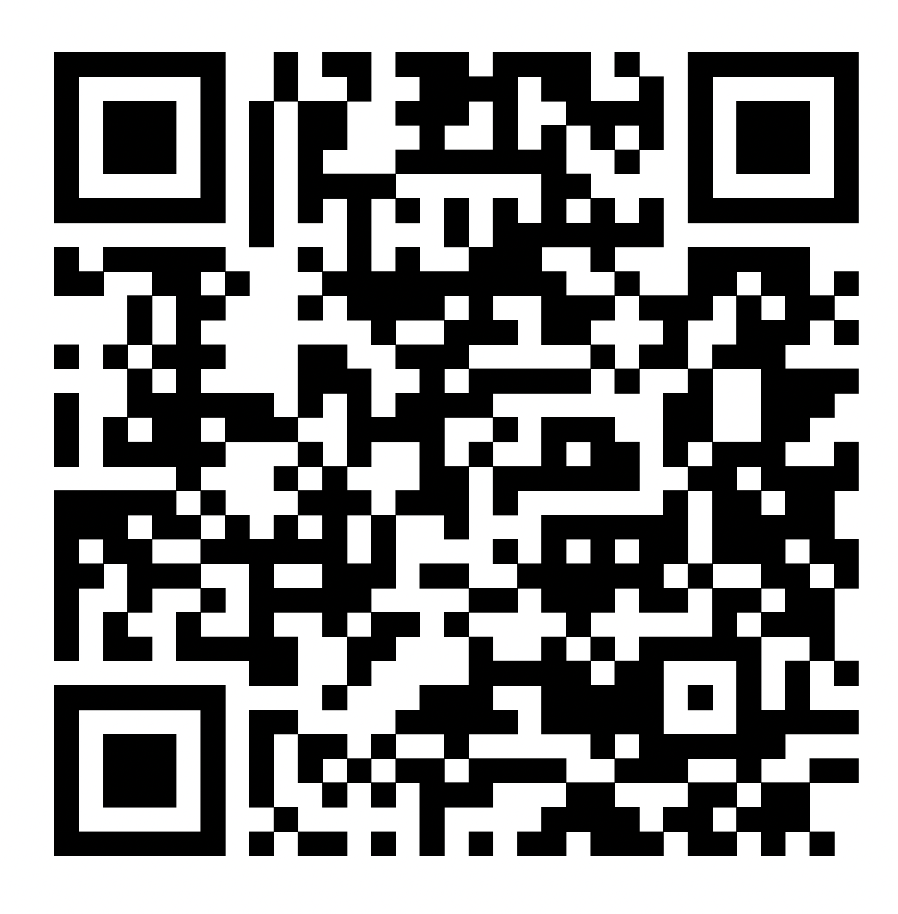
THANK YOU
Plan early.
Plan often.
Plan personally.
Sergio Reyes • ChFC, CLU
District Mutual / American Benefits Exchange
Sergio.reyes@districtmutual.com • (202) 431-3957

