Slide 1


From Manual to Modern:
Using AI and DAF365 to Drive Financial Management Efficiency
Ms. Erin Marks
AFMC/FMC
6 May 2026

Slide 2
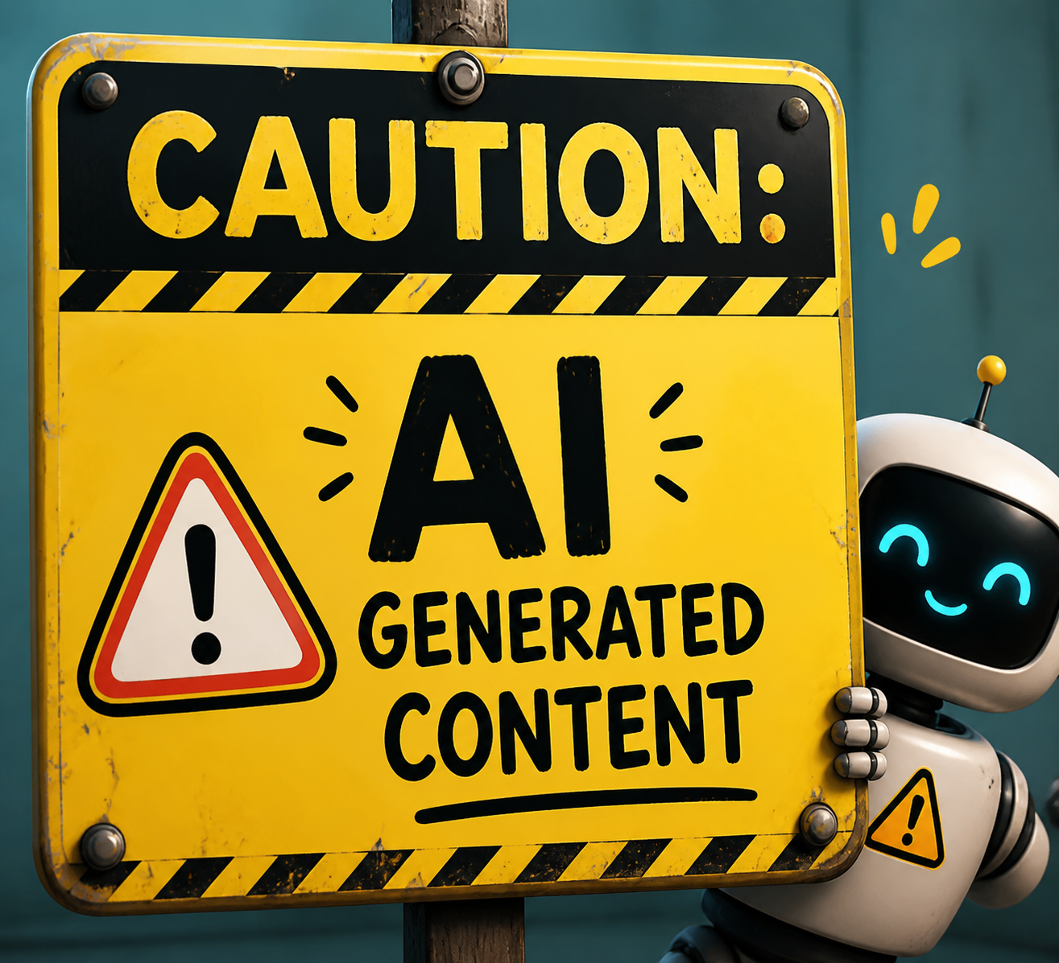
Overview
Considerations
Tools
Working Smarter

Slide 3
Framing
Financial management is about maximizing impact, not just completing tasks
Many low-value tasks consume disproportionate time
AI and DAF365 can help speed up processes, improve accuracy, and free time for higher-value work

Slide 4
The Reality of AI
AI vs. Automation
AI isn’t magic → it only improves human performance when used correctly
Substitution myth: tech doesn’t replace humans; it often changes workflows
Need to account for new tasks created by AI (cleanup, validation)
Don’t overlook the human aspect

Slide 5
Appropriate Use
Not every task is automation or AI-appropriate
Rules of thumb:
  Automate high-volume, repetitive, or rules-based tasks
  Use AI to augment structured or pattern-recognition tasks
  Humans should lead context-dependent or judgment-heavy tasks
Automate | Use AI to Augment | Best Performed by Humans
Data aggregation of multiple sources | Answering common queries | Strategic budget decisions
Standardized report generation | Predictable trend analysis | Interpreting ambiguous data
Routine data validation/error checking | Simple anomaly detection | Assessing risk/impact
Approvals/routing/notifications | Summarizing structured data | Policy interpretation
Formatting tables or documents | Drafting documents | Leadership briefings

Slide 6




















DAF365 Tools to Speed Processes
Office Applications
Excel, PowerPoint, OneNote, Word, & Visio
File Storage and Content Management
OneDrive & SharePoint
Communication
Outlook, Teams, People, & Bookings
Organization
Calendar, Lists, Planner, & To Do
Analytics and Automation
Power BI, Power Apps, Forms, Power Automate & Power Query
Additional Tools
Insights & Stream
Notes:
Credit for this visual goes to Dr. George Diehl

Slide 7








Zero to Hero in 10 Minutes
Join the “IIP: Innovation Improvement Programming” Team and watch the “Zero to Hero in 10 Minutes” video
  Use GenAI.mil (or any other model) to generate HTML, PowerShell, VBS, and VBA scripts
  Observe, orient, decide, act and keep iterating → the basics of process improvement
IIP: Innovation Improvement Programming
DAF Process
Improvement Professionals
DAF FM Data Analytics Community
AF Power BI
GenAI Collaboration
AF Power Automate
AFMC Automation Community
AF Power Apps
Notes:
Credit for “Zero to Hero in 10 Minutes” goes to SMSgt Frederick Esser

Slide 8
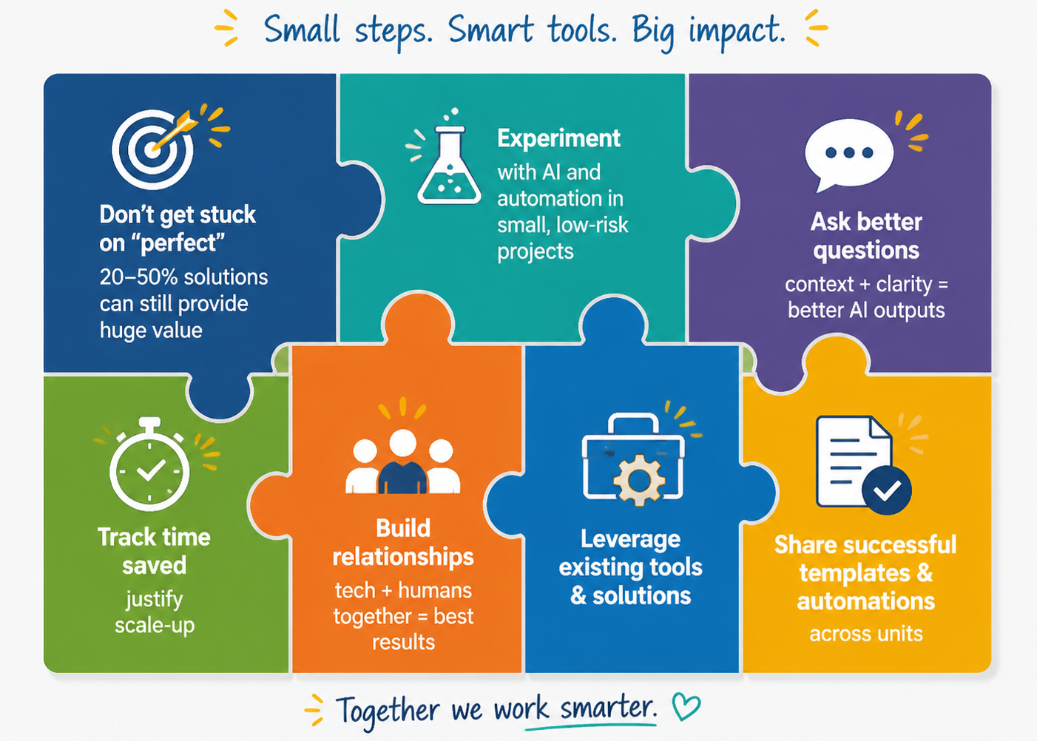
Principles for Smarter Work
Notes:
This image was generated by ChatGPT

Slide 9
Key Takeaways
AI + DAF365 = smarter, faster, high-value work
  Automate vs. AI Augmented vs. Human-led
  Use AI to teach you to use DAF365 and coding
Small improvements scale → big impact on FM processes
Experiment and share across units

Slide 10

Final Thoughts
Erin Marks, erin.marks@us.af.mil
Challenge: By the end of next week, pick one thing in your work processes that could be improved and identify the first step to make the improvement
Notes:
Topic could be anything that interests you… use it as an excuse to learn about something you’re curious about, or just fix something that’s been bugging you for years
Alternate challenges: reach out to someone and ask if they know of a tool or a better way to do something, or share something you built/changed with others

