Slide 1
SDFM Mini-pDI 6 May 2026
Emily Duke, director
Financial management

Slide 2
“The world hates change, yet it is the only thing that has brought progress.” – Charles Kettering

Slide 3
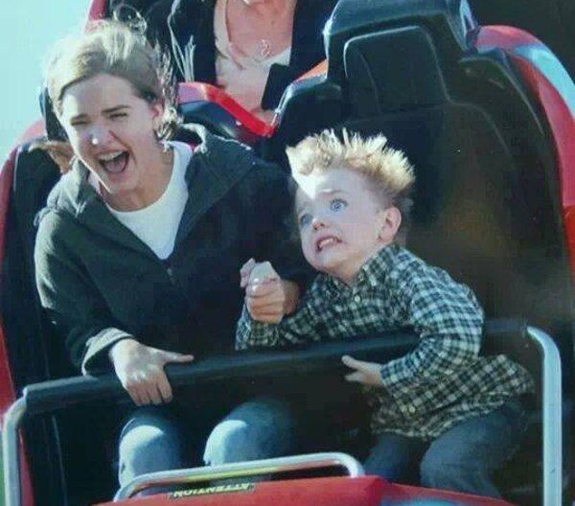

Slide 4
An Individual Lens on Change

Slide 5
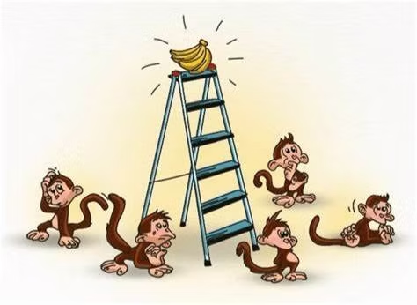
Five Monkeys. . . Thousands of Staffing Packages

Slide 6


What’s Your Mindset?
Embrace Opportunity
Reframe:
“We can’t” to “We can’t yet”
“No” to “Yes, if”
Celebrate Progress
Treat Failure as Learning
Welcome Feedback
Seminal Researcher: Carol Dweck

Slide 7

Heuristics and Cognitive Distortions
Common Workplace Cognitive Distortions
All or none thinking
“This will fail”
Overgeneralization
“This slows everything down”
Catastrophizing
“We are losing our jobs”
Mental filtering
Seminal Researchers: Aaron Beck & David Burns

Slide 8
Leadership Lens on Change

Slide 9
I’ve Never Heard That Before!
Message
Receiver
Feedback
Sender
Channel
Noise
encode
decode
decode
encode

Slide 10
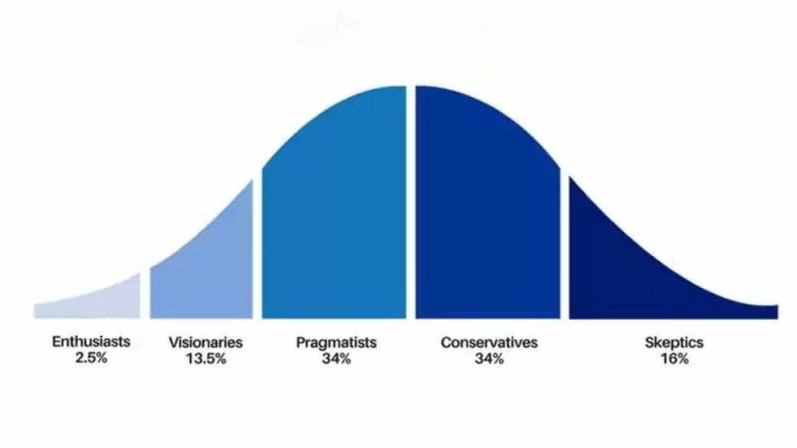
Why Is There So Much Resistance?!
Time
Seminal Researcher: Everett M. Rogers

Slide 11


Plumbing and Poetry
Creation of systems, processes, & structure
Efficiency and performance measurement
Management of resources
Articulating vision and inspiring action
Storytelling and symbolism
Creates sense of belonging
Seminal Researcher: James G. March

Slide 12
“Alone we can do so little; together we can do so much”
- Helen Keller

