Slide 1
FM Systems Update SDFM Mini-PDI
Todd M. Baker, SL, DAF
Senior FM Operations and Business Transformation Advisor
May 2026

Slide 2
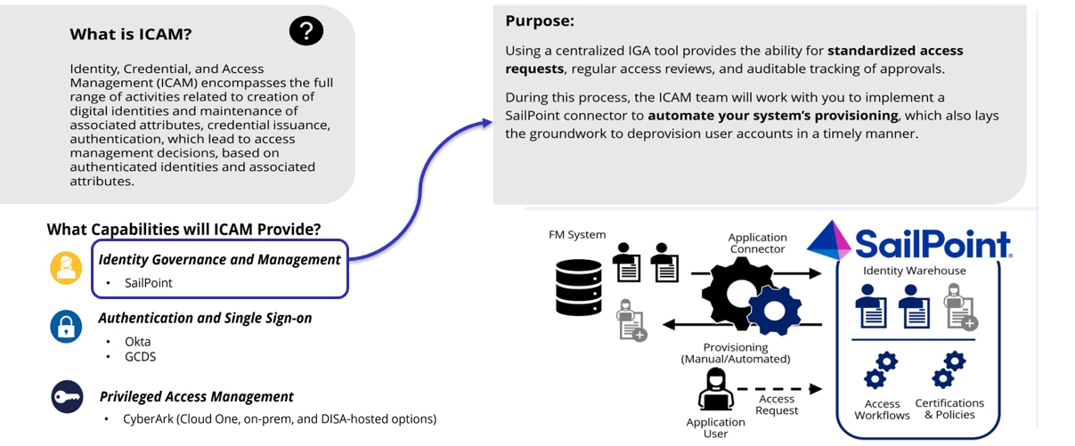
ICAM
Systems
FMSuite
CON-IT
AROWS-R
ILS-S
TICMS
NexGenIT
EESOH-MIS
DEAMS
AFM
REMIS
PBASWeb
UTAPSWeb
PMRTCCaR
AFPROMS
MilPDS
EBIS
FMWorkflow

Slide 3



DEAMS Capability Update
Fielding
G-Invoicing Buyer-side – Eliminates Reimbursable DD 448 Obligation Process
International Payments through Treasury – Eliminates fund balance reconciliation
Piloting
G-Invoicing Seller-side – Eliminates Reimbursable DD 448 Acceptance Process
Integration with JOCAS II and AFM – Eliminates manual data entry processes
Developing
Purchase Request (Form 9) interface to contracting – Eliminates DD 448 Direct Cite MIPR
Developing remaining G-Invoicing (7600EZ, DLA/Interfund, GSA Fleet, etc.)
Accounting for complex MOCAS entitled contracts
Automated contract closeout

Slide 4
Upcoming DEAMS Deployments
COMPLETED
Throughout FY
Oct 25: ~170 users/$2.8B
May 26: ~335 users / $31.2B
Oct 26: ~784 users / $29.5B
Black: USSF
Blue: AFMC

Slide 5
J-Books Consolidation
The Challenge
Enterprise Perspective
Multiple fragmented systems
Non-integrated / non-standardized data sets
Absence of an end-to-end data thread
Threatens statutory financial auditability
Jeopardizes budget defensibility before Congress
Operational Impacts
Labor-intensive / Error-prone processes
Multiple system inputs required and manual integration of programs that cross appropriations
Manual reconciliation / validation of exhibits
Adverse impacts to local funding levels
AF MIDAS
BRS
EAS
IDECS
KDSS
The Targeted Solution
Centralized Platform
Collaborative Budget Formulation
Enhanced Compliance
AI-Decision Support
Automated data integration
Standardized data across appropriation
Single source of truth
Streamlined processes
Automated workflows
Real-time tracking across the enterprise
Version control
Improved transparency and accuracy
Audit trails
Automatic updates to regulatory requirements
Al-assisted narrative development
Dynamic modeling
AI-powered sentiment analysis / scanning of Congressional hot topics

Slide 6


FAMS to FMSuite
DD 577 and Key Signatory functionality will move from FAMS to FMSuite
Data Retention
FMSuite will migrate ALL legacy documents from FAMS; no need to redo!
Active documents as of 20 Feb 26: 577’s = 92,383, Key Signatories = 16,056
New Appointments
SAF/FMFA-QA program will be the process owner for new appointments module
User Access
Basic users will NOT need to request access
QA’s and Provisioners will need to request roles via SailPoint if not already registered in FMSuite
Go-live Jun 26

Slide 7


myPCS
Projected Onboarding Schedule for AFMC Bases
Bases | Onboarding Date
Wright Patterson AFB | Aug 26
Hanscom AFB, Eglin AFB, Robins AFB, Kirtland AFB | Oct 26
Tinker AFB, Edwards AFB, Hill AFB, Arnold AFB | Dec 26
System Summary..
myPCS is the automated solution for PCS travel that digitizes the claim process through automated calculations, routing, and record keeping
V1.0 End-to-end traveler and technician allowance vouchering capabilities for accounting and payment of active-duty CONUS-CONUS PCS moves
Base onboarding will be supported by:
CBT and Job Aids
Training team-lead virtual training sessions
Training team in-person support

Slide 8


CRIS to FASTR
CRIS Decommissioning & Transition to FASTR Data Warehouse (FDW)
CRIS will be decommissioned
Users must complete registration in FDW to maintain access to former CRIS reports
FDW Deployment Schedule
Additional FY26 Enhancements:
FM Suite Data
DTS & AROWS interfaces
Planned FY27 Enhancements:
Subsume FMDQS
4 New & 10 enhanced UoT interfaces
Planned FY28 Enhancements:
KDSS Transition
2 New and 11 enhanced UoT interfaces

Slide 9



Way Forward
Expand strategic partnerships
Ensure early and active stakeholder engagement
Drive continuous business process re-engineering and modernization
Minimize customization to support audit, accelerate delivery, and reduce costs
Execute a deliberate, user-focused organizational change management strategy
Empower leadership to set the tone and shape our organization for the future

