Slide 1
Topic:
Workforce Management Updates
Jan 21, 2026
11:30am -1:00pm EDT
Today’s SDFM Virtual Luncheon
Mr. Carl Urbanas
AFMC HQ AFMC/FMFW
EARN 1 CLP !

Slide 2
MR. CARL J. URBANAS
Mr. Carl J. Urbanas is the Chief, Workforce Management Branch, Financial Management Directorate, Headquarters Air Force Materiel Command. In this capacity, he is the principal advisor for workforce management matters for over 3,100 Financial Management personnel across Air Force Materiel Command. He provides effective coordination, communication and integration of key human capital planning and development initiatives, ensuring the long-term viability of the FM workforce within AFMC.
Mr. Urbanas entered federal civil service in 2008 as a Financial Management trainee at Wright-Patterson AFB, Ohio. He held several positions within the Financial Management Directorate at Headquarters Air Force Materiel Command before being selected as the Comptroller of the 445th Airlift Wing under Air Force Reserve Command. In 2016, he moved to the Program Execution Branch at Headquarters Air Force Materiel Command, managing execution of over $300M annually and subsequently served as a Project Manager for the $496M renovation of the campus of Headquarters Air Force Materiel Command. In 2021, he returned to Financial Management, overseeing execution of over $3B as the Branch Chief of the Financial Operations Branch and over $2.1B within the Centralized Asset Management Division at Headquarters Air Force Materiel Command.

Slide 3


Workforce Management Updates
Mr. Carl Urbanas
HQ AFMC/FMFW
21 Jan 26

Slide 4
Classification
The classification of the brief is UNCLASSIFIED.
UNCLASSIFIED
Briefer: Urbanas (HQ AFMC/FMFW)

Slide 5
Purpose
To provide an update on Workforce Management to the
Aviation Chapter of SDFM
UNCLASSIFIED
Briefer: Urbanas (HQ AFMC/FMFW)

Slide 6
Overview
Development Opportunities within Financial Management
  AY27 Civilian Development (CD) Call
  Empower FM
  AFMC Shadowing Initiative
DAF FM Workforce Overview
FM Development Team
  Civilian Development Team Advisory Committee (CDTAC)
  Considerations for Development Opportunities
FY25 Recap
Two-page resume
Shared Services Overview
Final Thoughts
UNCLASSIFIED
Briefer: Urbanas (HQ AFMC/FMFW)

Slide 7
AY27 CD Call
19 Nov 25: Academic Year 2027 CD Call Kick-Off
7 Jan 26: MyVector Opens
13 Feb 26: Applicant Deadline
6 Mar 26: Endorser Deadline; MyVector Closes
Apr-Jun 26: Functional Development Team (DT)
3-5 Aug 26: DAF Civilian Development Selection Board
5 Aug 26: AF/A1 review/approve selections
11 Aug 26: DAF Civilian Development Selection Board Out-brief
Sep 26: Civilian Development selections announced
UNCLASSIFIED
Briefer: Urbanas (HQ AFMC/FMFW)

Slide 8
Empower FM
FM-specific vectoring opportunity
Connects our workforce with the optimal development path
Provides personalized career guidance, connecting individuals with senior leaders
Empower FM Benefits
  Gain clarity on career goals
  Build confidence in your trajectory
  Receive tailored feedback from senior leaders
  Grow your network with mentors and key decision-makers
Applicant window opens in June
UNCLASSIFIED
Briefer: Urbanas (HQ AFMC/FMFW)

Slide 9
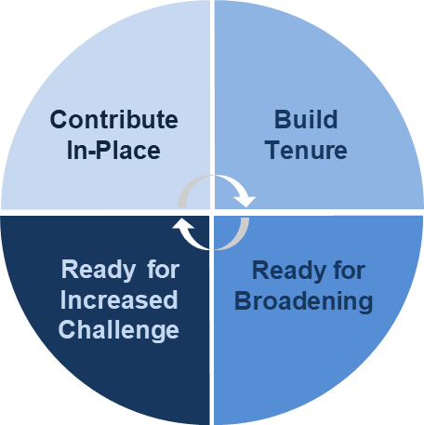
Empower FM
Vectoring Assessments
Contribute In-Place (0-2 Yrs)
Grow within current position
Address experience or education gaps
Identify career roadmap
Connect with Coach/Mentor
Build Tenure / Experience (2+ yrs)
Continue development at current level
Address skill gaps
Consider job shadowing
Ready for Increased Challenge
Ready for increased responsibility
High performance record demonstrated
Prepare for future leadership roles
Ready for Broadening Experiences
Ready for lateral move/new challenge
Ready for leadership/supervisory
Pursue CD and CB opportunities
UNCLASSIFIED
Briefer: Urbanas (HQ AFMC/FMFW)

Slide 10
AFMC Shadowing Initiative
Shadow Initiative Objective:
  Gain insight of other organizations day-to-day practices/mission
  Enhance professional career development
  Earn up to 80 hours of direct exposure to another FM job
Target Audience
  Personnel with a basic foundational knowledge of the FM career
  Civilian employees
  Company Grade Officers
  Enlisted personnel (E-4 through E-6)
  Not open to contractors or developmental/force renewal positions (PCIP, PAQ, Summer Interns, etc.)
UNCLASSIFIED
Briefer: Urbanas (HQ AFMC/FMFW)

Slide 11
DAF/FM Workforce Overview
FM “Spaces”
Civilian “Faces”
~43% of Civilian “Spaces” are located within AFMC
UNCLASSIFIED
Briefer: Urbanas (HQ AFMC/FMFW)

Slide 12
FM Development Team
Air Staff / COCOM
MAJCOM Level
Center below MAJCOM
Civilian Development Team (DT): Most senior level committee that advocates GS-14/GS-15 (equiv grades) and all boarded programs
Civilian Development Team Advisory Committee (CDTAC): Sub-committee to Development Team (DT) that advocates GS-13 and below non-boarded programs
UNCLASSIFIED
Briefer: Urbanas (HQ AFMC/FMFW)

Slide 13
Considerations for Development Opportunities
CD | Vectoring | PFMC/DFMC
Duty History | Nearly identical to CD | Center Rank
PME | Four basic assessments | Timing/Years of Experience
Functional Training |  | Certifications
Goals |  | Education Level
Certifications |  | Career Objective
Awards |  | Supervisor Assessment
Job Performance! |  | Professional Development
Endorsements |  | Self Development
Career Timing
UNCLASSIFIED
Briefer: Urbanas (HQ AFMC/FMFW)

Slide 14
FY25 Recap
Executive Orders/Workforce Shaping Directives
  Return to In-Office Work
  DOGE
  Hiring Freeze
  Deferred Resignation Program
  Flattening the hierarchy
  Government Shutdown
UNCLASSIFIED
Briefer: Urbanas (HQ AFMC/FMFW)

Slide 15
Two-Page Resume
OPM (9/25/2025): Resumes used when applying for federal jobs cannot exceed two pages
Content to include
  Contact information (name, email address, phone number)
  Skills relevant to target job
  Work experience
  Education/Certification/Licensure
  Optional details (security clearance, relevant training, organizations/affiliations, etc.)
Recommendations to consider
  Prioritize most relevant and recent experience
  Use concise, results-focused language
  Align with language from the job announcement
  Focus on demonstrating skills and competencies
  Remove outdated or unrelated experience
USAJobs resume builder exists to help job applicants capture relevant experience/quals
Work Smarter, Not Harder…Think AI!
UNCLASSIFIED
Briefer: Urbanas (HQ AFMC/FMFW)

Slide 16
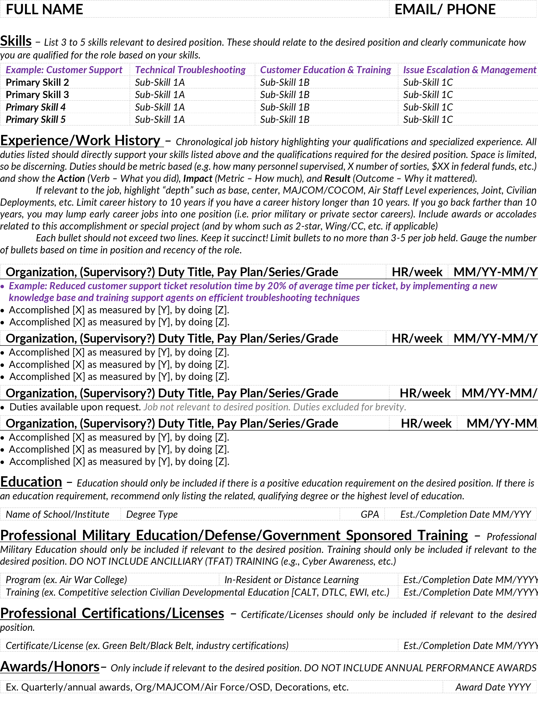
Two-Page Resume
AFPC-Provided Template
UNCLASSIFIED
Briefer: Urbanas (HQ AFMC/FMFW)

Slide 17
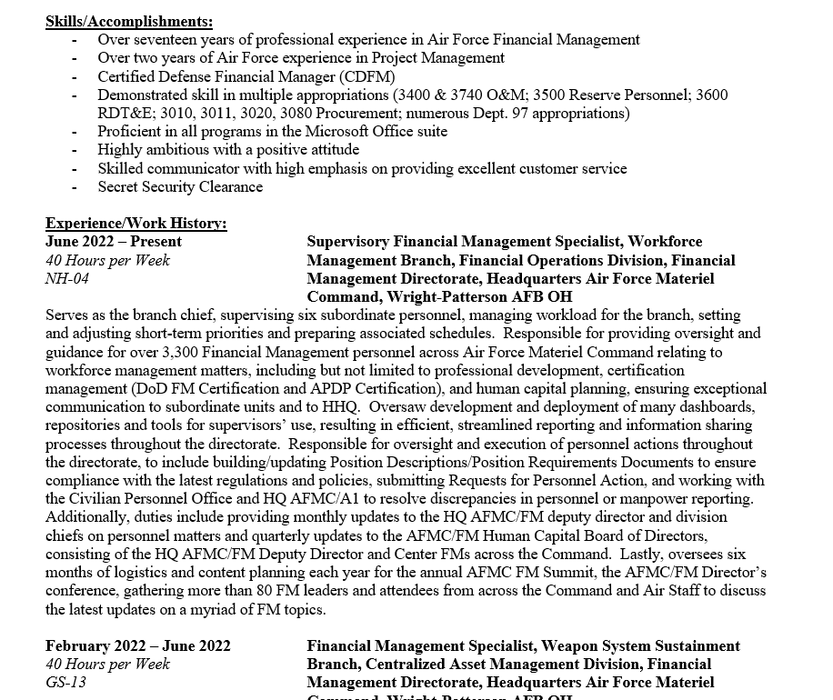
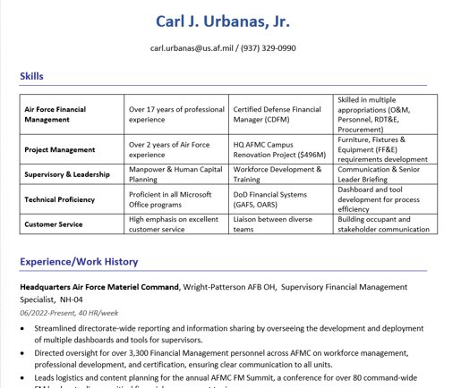
Two-Page Resume
Gemini AI-Generated Resume
UNCLASSIFIED
Briefer: Urbanas (HQ AFMC/FMFW)
Notes:
Provided the Template Resume…I copied and pasted because it would not let me attach the template
My prompt to AI:
Here is a template for a resume and notes were also provided to help distinguish what is needed and how it should be formatted. Once you have analyzed and understand the template let me know and I will add a resume for you to summarize and turn into 2 pages to match the template that I am sending
I added screenshots of the resume format to ensure it was not lost between me copying and pasting…my prompt with the screenshot:
One more update to the template...because I copied and pasted the information to the chat it did not keep the formatting. I have attached an image that shows the formatting which is what I will want the resume to look like when you update it. Are you able to do that?
I added the attachment of the resume…my prompt:
I have attached the word document that includes all of the resume details. Are you able to provide me a word document as well with the updated resume following the previous template i showed you that will fit in 2 pages
It gave me a resume that was a little bit on the 3rd page. So I added another prompt:
That was a good start but it has a little bit of information on the 3rd page. The 2 page limit is very strict. Please update again and make it two pages
Then it provided a resume that fit on 2 pages as a word attachment.

Slide 18
Shared Services Update
Problem Statement
  Current AFMC FM business processes are complex and highly manpower-intensive, hindering overall efficiency. Recent staffing reductions of 20% coupled with hiring restrictions will significantly strain our capacity to effectively manage financial operations going forward. Additionally, our ability to field new capabilities lags behind our competition by several years (roughly 17 years vs. 7 years) and is likely to get worse with reduced manpower.​
AFMC/FM has identified five initial areas for improvement:​
  Funds Control/Distribution​
  Cost/DA Resource Optimization​
  General Personnel Alignment Construct​
  Centralized Revenue-side WCF Ops​
  Reduce/Eliminate Intra-AF Reimbursables
Plans must maintain fiduciary responsibility, achieve the AFMC mission, and have a neutral or positive impact on audit
UNCLASSIFIED
Briefer: Urbanas (HQ AFMC/FMFW)

Slide 19
Final Thoughts
Seek out education/chances for development
Get a mentor
Look for opportunities to excel, differentiate yourself
Think outside the box
Take care of yourself and your teammates
Keep the Warfighter at the forefront of your mind every day
UNCLASSIFIED
Briefer: Urbanas (HQ AFMC/FMFW)

Slide 21

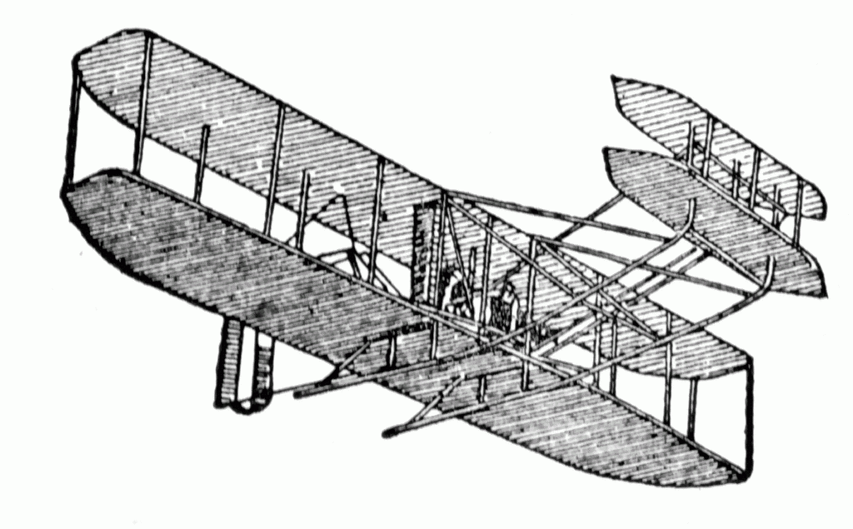
Society of Defense Financial Management
Aviation Chapter
PRESENTS THIS CERTIFICATE OF APPRECIATION TO
Mr. Carl Urbanas
WITH A DONATION TO
Fisher-Nightingale Houses, Inc
Thomas Giovingo
IN HONOR OF YOUR PRESENTATION
21 JANUARY 2026
Thomas Giovingo
President, Aviation Chapter

Slide 22
UPCOMING EVENTS/VOLUNTEER OPPORTUNITIES
Crayons to Classrooms
Feb 6 1300-1500
April 3 1300-1500
Dayton VA Flag Placement
May 23rd Time TBD
Save the Date
Dayton Food Bank
TBD - Look for announcement
Lunch & Learn
In collaboration with the Utah Chapter presents:
Brig Gen Jason Corrothers
25 Feb 11:30 am – 1:00 pm
Save the Date – don’t want to miss this

Slide 23
SDFM Aviation Chapter Updates
      Learn more about the
      the SDFM Aviation Chapter at
      https://www.sdfm-aviation.org/

