Slide 1
FM Change
Readiness Study
Dr. George Diehl
AFMC/FMC
31 July 2025

Slide 2
Purpose
Provide a summary of FM personnel change readiness study and findings based on the results
Notes:
Investigate change readiness among employees in a military support organization.
The question:
How can leadership styles shown by supervisors change the employee’s change readiness while accounting for the supervisor-employee relationship and the motivation of the employee?
The key focus is to explore the interactions between change readiness and leadership styles.
To take a more comprehensive look at this interaction, employee motivation and the supervisor-employee relationship will be considered as mediating variables that are a part of the relationship between leadership style and change readiness.

Slide 3
Agenda
Background and purpose
Key elements of study
Design and findings
Takeaways

Slide 4
Background and Purpose

Slide 5
Study Background
FINANCIAL MANAGEMENT HAS BEEN UNDERGOING CHANGE
CHANGE EFFORTS ARE NOT NEW BUT CONTINUE TO STRUGGLE EVERYWHERE
DOD ORGANIZATIONS ALSO FACE COMPLEX BUREAUCRATIC STRUCTURES
Notes:
Background and Rationale:
This study is focused on Fostering Change Readiness in Military Support Organizations
Empirical evidence that will contribute to theory: Enrichment of understanding interaction between leadership styles and change readiness.
Practical implications: Inform bureaucratic supervisors in military support organizations on the impact of their style.
Change continues to fail to produce meaningful change. And lack of change readiness of the employee is often cited as cause.
Military support organizations also have:
Complex bureaucratic hierarchical structures with many layers that often slow the decision-making processes. High resistance to change is a common issue that comes from all of this.
A historical preference for authoritarian leadership in military contexts exist. Overuse of this style in support organizations can hinder adaptability.

Slide 6
Study Purpose
INVESTIGATE CHANGE READINESS AMONG FM PERSONNEL
EXPLORE INFLUENCE OF LEADERSHIP STYLE
SHARE FINDINGS AND INFORM STRATEGIC EFFORTS
Notes:
Purpose:
Investigate change readiness among employees in a military support organization.
The question behind my study that drove a lot of what I have done is:
How can leadership styles shown by supervisors change the employee’s change readiness while accounting for the supervisor-employee relationship and the motivation of the employee?
The key focus is to explore the interactions between change readiness and leadership styles.
To take a more comprehensive look at this interaction, employee motivation and the supervisor-employee relationship will be considered as mediating variables that are a part of the relationship between leadership style and change readiness.

Slide 7
Key Elements of Study

Slide 8
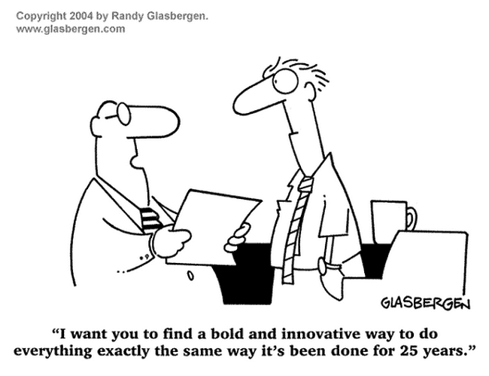
Organizational Change
An ongoing process within an organization
Driven by external and internal pressures
Drives changes in structures, behaviors, or policies
Notes:
Organizational change has increased at an accelerated rate and is expected to continue for now
To discuss Change Readiness, we need to have a shared understanding of what Organizational Change is.
Organizational change: is an ongoing process, within organizations, driven by external and internal pressures that necessitate modifications in organizational structures, behaviors, or policies (Kelly et al., 2017

Slide 9

Employee Change Readiness
Extent employees are prepared to implement changes within an organization
Change commitment (resolve)
Change efficacy (belief)
Lack of change readiness cited for failure to change
Notes:
Change readiness: is the extent to which an organizations’ members are psychologically and behaviorally prepared to implement change (Weiner, 2009).
Change Commitment: The collective resolve of members to implement change.
Change Efficacy: Collective belief in the organization's capability to change.
High failure rate in change efforts due to lack of readiness for change and difficulty in aligning employees' commitment and efficacy.
Image by Alexas_Fotos from https://pixabay.com/

Slide 10

Leadership Style
Employees implement and maintain change
Supervisors are “point of contact”
Servant and transformational leadership
Inspire and empower
Promote development
Enhance communication
Employee needs
Notes:
Leadership: is a practice of influencing people to follow a line of action (Copeland, 2021).
Leadership style: is the deliberate behaviors and actions used by a leader to “influence a group of people in an organization to a widely understood future state that is different from the present one” (Gandolfi & Stone, 2017).
Transformational leadership: is described as possessing individualized consideration, intellectual stimulation, inspirational motivation, and idealized influence, which enable it to inspire and empower employees (Bass B. M., 1985).
Individualized consideration for employees, focus on inspiring and empowering employees to meet the needs of the organization.
Promotes employee development. Enhances communication and employee performance. Charismatic, inspires and empowers employees.
Servant leadership: is defined by the character of a leader and a commitment to serving others through narrative examples (Parris & Peachey, 2013).
Defined by commitment to serving others and supporting the community.
Emphasis on empowerment and meeting employees’ needs. Encourages employee development and increased performance.
Inspirational and empowering.
Image by GrumpyBeere from https://pixabay.com/

Slide 11

Additional Elements
Countless drivers beyond leadership style
Leader-member exchange (relationship)
Public service motivation (drive)
Notes:
Leader-member exchange: balance of contributions, respect, and support between supervisor and employee
Public service motivation: individual motivation for service, self-sacrifice, and supporting the public’s interests
Social exchange theory: is a relationship-based approach that views relationships between leaders and employees as a two-sided rewarding process (Zhang et al., 2018).
Leader-member exchange: is an application of social exchange theory where leaders do not treat all employees the same and do not put the same number of resources, such as time and effort, into their relationships with each of their employees (Graen & Uhl-Bien, 1995).
Public service motivation: is an individual’s motivation, which is “grounded primarily or uniquely in public institutions and organizations” (Perry & Wise, 1990).
Employee’s intrinsic motivation of self-sacrifice and compassion to support the public’s interests.
Interacts differently with each leadership style.
Transformational leaders align employees' PSM with organizational missions through clear vision.
Servant leaders enhance PSM by fostering a supportive, community-focused environment.
Motivation more aligned with goals of federal government.
Image by geovanaegilsonsilva from https://pixabay.com/

Slide 12
Design and Findings

Slide 13

Survey
Measured employee perception
Comprised of 40 Likert questions
Sample: AFMC FM military and civilians
Conducted during January 2025
Notes:
Permissions obtained include:
Air Force Materiel Command Comptroller approval
Air Force Survey Office Survey Control Number (DAF24-040AFMC )
Air Force Component Office of Human Research Protections (FSG20250019 )
Image by Clker-Free-Vector-Images from https://pixabay.com/

Slide 14
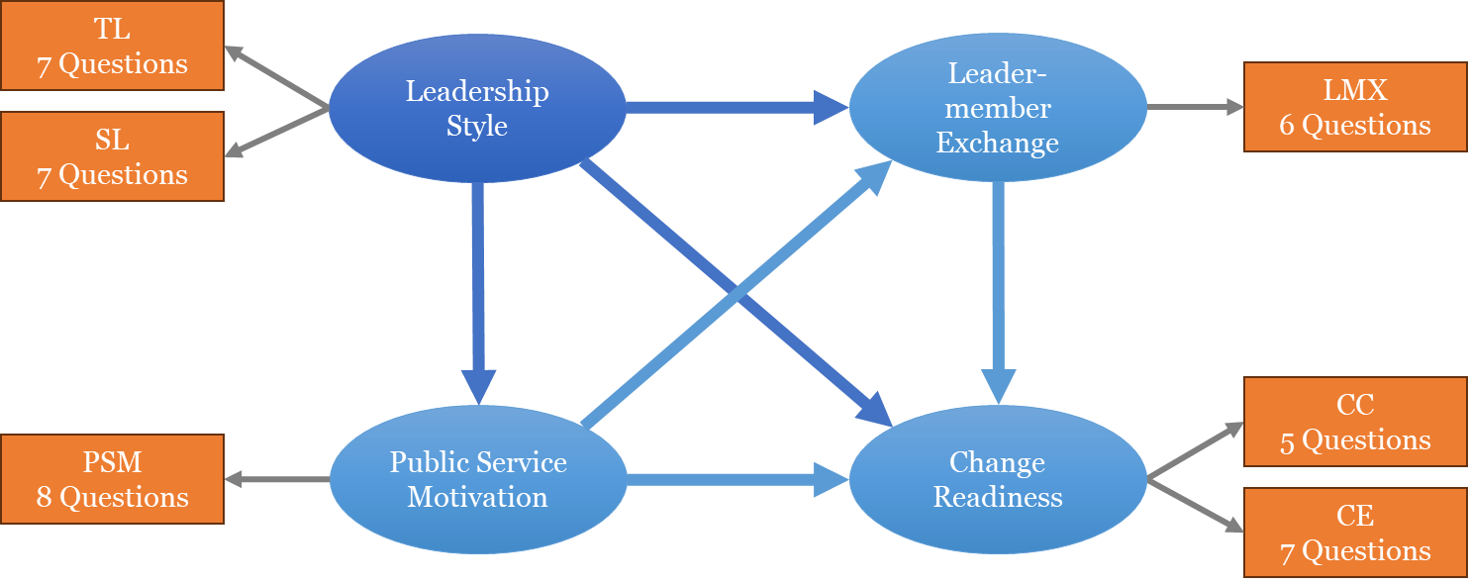
Methodology
Based on theory
Structural equation modeling
366 responses used
CC = Change Commitment
CE = Change Efficacy
LMX = Leader-Member Exchange
PSM = Public Service Motivation
SL = Servant Leadership
TL = Transformational Leadership
Notes:
Full study details covered: http://rave.ohiolink.edu/etdc/view?acc_num=wright1743543033147735
Structural equation modeling allowed for the simultaneous evaluation of multiple variables and their relationships.
Limitations:
Quantitative Methodology Limited & Statistical Assumption Limitations – could affect the validity of the results despite standard diagnostic checks.
Data Collection Method:
Risk of self-selection and response bias, affecting generalizability (Bethlehem, 2010).
Subjective Responses: Employee perception-based scales introduce subjectivity and possible measurement error (Alwin, 2007).
Common Method Bias: Voluntary survey method could inflate relationships between variables.
TL = Avg of 7 questions
SL = Avg of 7 questions
LMX = Avg of 6 questions
PSM = Avg of 8 questions
CR (Change Readiness) = Avg of 12 questions

Slide 15

Findings
Leadership styles have positive and significant effect
Unexpected negative relationship due to rapport
Negligible difference in responses between mil & civ
Notes:
Civ vs Mil distribution representative of AFMC’s population
Majority of responses positive
Indicates measured traits are mostly present as perceived by employees
Model fit the data well; no modifications needed
Evaluated model explained 49% of variance in change readiness
Leadership style had significant positive effect
Employee motivation strengthened the effect
Unexpected negative effect of LMX on readiness
Image by Mohamad_hassan from https://pixabay.com/

Slide 16
Takeaways

Slide 17

Implications
Build trust, clarify vision, align tasks to mission, clearly communicate
Incorporate trust-building, communication, and motivation strategies
Constrained resources and high workload negate positive leadership behavior
Notes:
FM organizations can benefit from building trust, clarifying vision, aligning tasks to the mission, and clearly communicating to the field
Leadership that incorporates trust-building, communication, and motivation strategies into their style improve effectiveness of employees
Constrained resources and high workload can negate positive leadership behavior effects
Risks perception of unfairness or lack of support
Leadership influences trust, motivation, and mission alignment
Unexpected LMX result may stem from:
High workload
Perceived unfairness or lack of support (Corduneanu et al., 2020)
Reinforces need to examine relational dynamics in context
Develop transformational and servant leadership traits
Use leadership and climate assessments to tailor change strategies
Address LMX fairness concerns during change initiatives
Align changes with public service values to reduce resistance
Leadership style, motivation, and supervisor relationships explain nearly half of change readiness
Organizational change success relies on:
Trust-building
Motivation alignment
Leadership development
Image by Elf-Moondance from https://pixabay.com/

Slide 18

Thoughts?
Notes:
Image by Microsoft

Slide 19
Leadership Behaviors
Behaviors assessed in survey include:
-Communicates a clear and positive vision of the future
-Treats staff as individuals, supporting, and encouraging development
-Fosters trust, involvement, and cooperation among team members
-Encourages thinking about problems in new ways and questions assumptions
-Is clear about values and practices what they preach
-Instills pride and respect in others
-Provides support when I face challenges
-Gives me the freedom to handle difficult situations the way I feel is best

Slide 20
Leader-Member Exchange
Characteristics of supervisor and employee rapport assessed in survey include:
-Mutually supportive working relationship
-Trust in supervisor to provide support when needed
-Balance of contributions and recognition
-Taking initiative is recognized

Slide 21
Public Service Motivation
Aspects of public service motivation assessed in survey include:
-Interest in sharing views on policy and guidance
-Satisfaction in seeing success of DAF programs
-Public service is a civic duty that is important
-Prefer seeing DAF leadership do what is best for all Airmen over my personal interests
-Recognition of how dependent we are one each other as Airmen
-Supporting the DAF Mission is more important than personal achievements
-Belief in service before self

