Slide 1
Department of the Air Force
One Team, One Fight!
DoD Fraud
Risk Management
Angela Palma
Associate Director
Financial Management Division
Air Force Audit Agency
11 June 2025

Slide 2
Overview
Intro
Background
DoD FRM
DAF FRM
Wrap up
Resources
2

Slide 3
Intro
House Subcommittee on Government Operations
4 June 2025 hearing on
“DoD Fraud Risk Management Needs Improvement”
https://www.youtube.com/watch?v=ANGDgSIMw_4
https://www.youtube.com/watch?v=MZJ-ii7QDPk

Slide 4
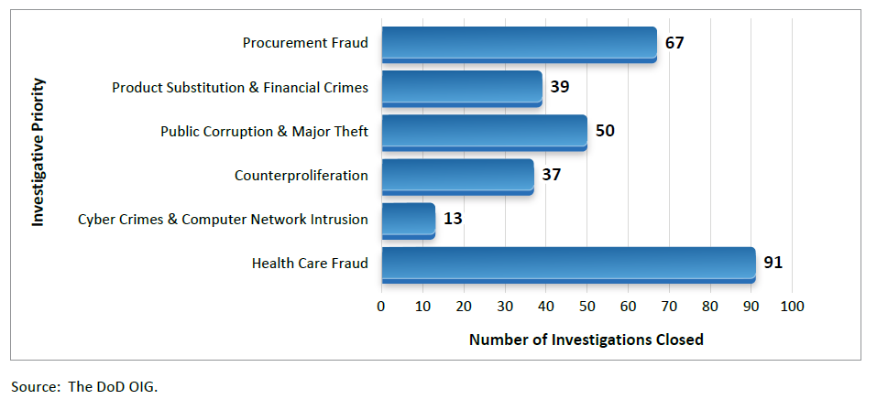
Intro
From FY 2017-2024,
DoD reported approx. $10.8 billion in confirmed fraud!
From 10/1/24 -3/31/25, the Defense Criminal Investigative Service Issued 297 Investigative Reports; mostly fraud-related!

Slide 5
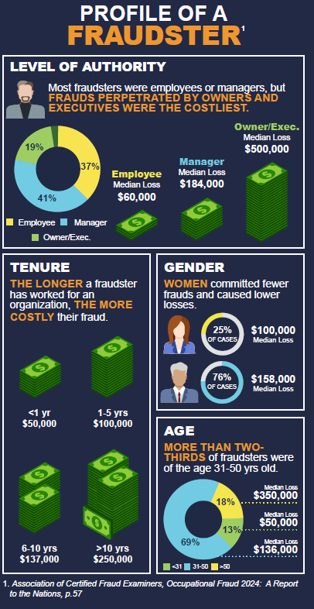
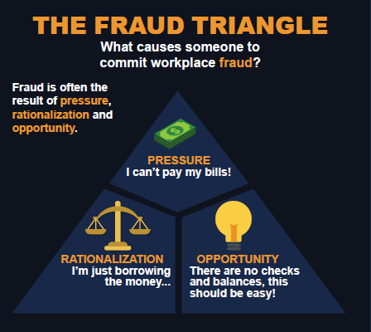
Background
Refresh
Fraud: Obtaining something of value through willful misrepresentation

Slide 6
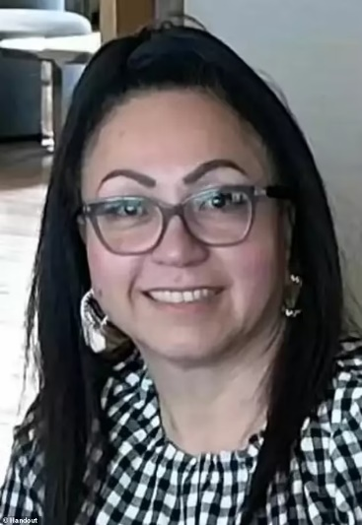
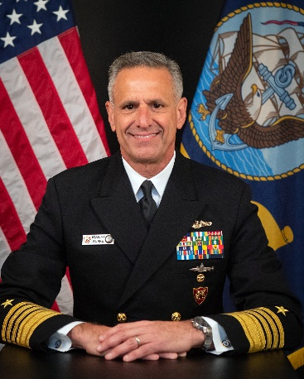
Background
Refresh
Who are they?

Slide 7
Background
Refresh
Fraud Indicators
Suspicious warning signs or red flags that fraud might be present
Point to possible fraudulent activities
Cues for management and personnel to investigate further
Important: If you see something,
say something!!

Slide 8
Background
DoD FRM Requirements
2015 GAO Report, A Framework for Managing Risks in Federal Programs published. | 2015 Fraud Reduction and Data Analytics Act (FRDAA) released requiring Federal agencies to prevent, detect, and respond to fraud. | 2016 Office of Management and Budget (OMB) Circular No. A-123 highlights the GAO Framework to manage fraud. | 2019 Payment Integrity Information Act (PIIA) was released in 2019 to reinforce FRDAA. | 2019 - 2025 Multiple GAO audits on FRM and analytics efforts. DoD FRM included in GAO High Risk Report. | Future Increased media and congressional scrutiny and inquiry of the DoD FRM efforts.
Source: OUSD(C)

Slide 9
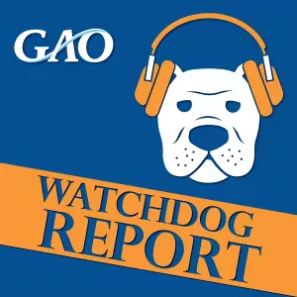
Background
GAO FR Framework
The Government Accountability Office (GAO)
Independent, non-partisan agency that works for Congress
Examines how taxpayer dollars are spent and provides Congress and federal agencies with information to help the govt save money and work more efficiently
Includes Fraud and Improper Payments
GAO Fraud Risk Framework (GAO-15-593SP)
Created to help combat fraud and preserve integrity in agencies and programs
Includes leading practices for managing fraud risks
Activities to prevent, detect, and respond to fraud

Slide 10
Background GAO FR Framework
Commit
Assess
Design & Implement
Evaluate & Adapt
Commit to combatting fraud by creating an organizational culture and structure conducive to fraud risk management
Commit
Plan regular fraud risk assessments and document key fraud risks in a strategic fraud risk profile
Assess
Design &
Implement
Design and implement a strategy with specific control activities to mitigate key fraud risks and collaborate to help ensure effective implementation
Evaluate &
Adapt
Evaluate outcomes using a risk-based approach and adapt activities to improve fraud risk management

Slide 11
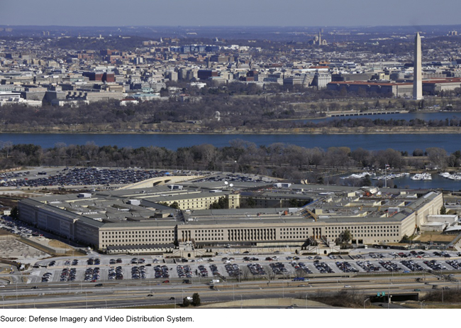
Background
GAO Reports
GAO Reports
GAO-21-309, DoD Fraud Risk Management, found DoD took initial steps to align with the GAO Fraud Risk Framework but had no comprehensive approach (participation, fraud risk assessments)
GAO-24-105358, DoD FRM: Enhanced Data Analytics Can Help Manage Fraud Risks, found DoD’s FRM Strategy lacked data analytics requirements, unclear responsibilities, and had no timeline for implementation
New for 2025: GAO expanded DoD’s Financial Management High Risk Area to include FRM.

Slide 12
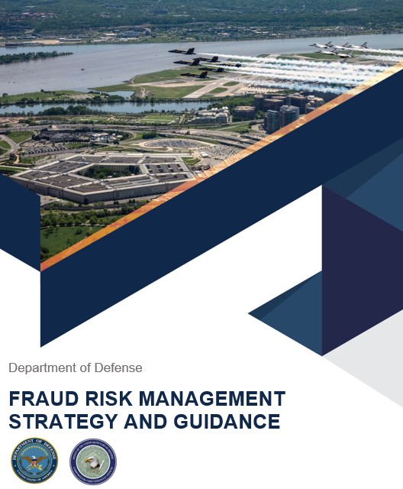
DoD FRM
GAO FR Framework Implementation
Commit (task force, strategy, comms)
Assess (risk & control assessments)
Design and Implement (risk register, dashboards)
Evaluate and Adapt (training, focus areas)
Working Groups
Confirmed Fraud
Military Departments and DoD OIG
Effort to streamline and share data
Procurement Fraud
OUSD Acquisition and Sustainment
Information Sharing

Slide 13
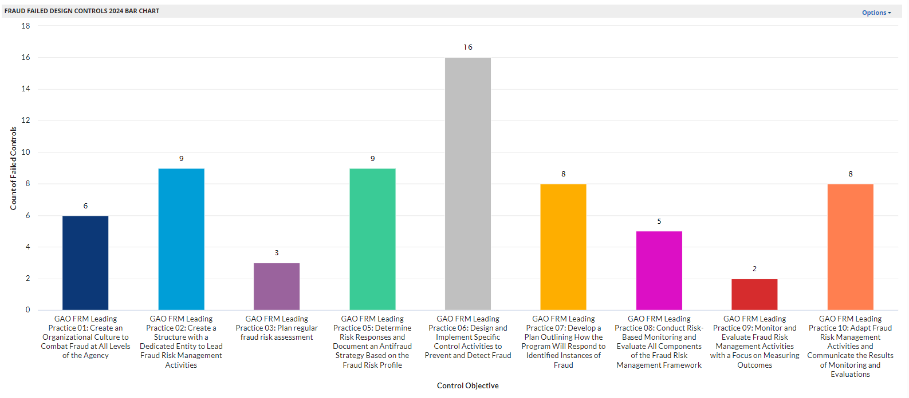
DoD FRM
1,060 Fraud risks identified by 46 Reporting Entities in FY24, of which 809 had mitigation strategies to reduce overall agency impact
Risks
Top 5 most inherent DoD-Wide fraud risk areas include:
Asset Safeguards
Information Technology and Security
Procurement
Commissary
Travel
Risk Categories
43 Reporting Entities submitted results to the GAO FRM Framework Assessment
95% of the controls mapped to GAO best practices passed test of design and effectiveness.
Fraud Controls
Source: OUSD(C)

Slide 14
DoD FRM
DoD Fraud Prevention Week
2024 1st Year
4 days of Connect and Learn sessions, 1,200 in attendance
Save the Date: 4-8 August 2025
Fraud Prevention is
Everyone’s Responsibility!

Slide 15
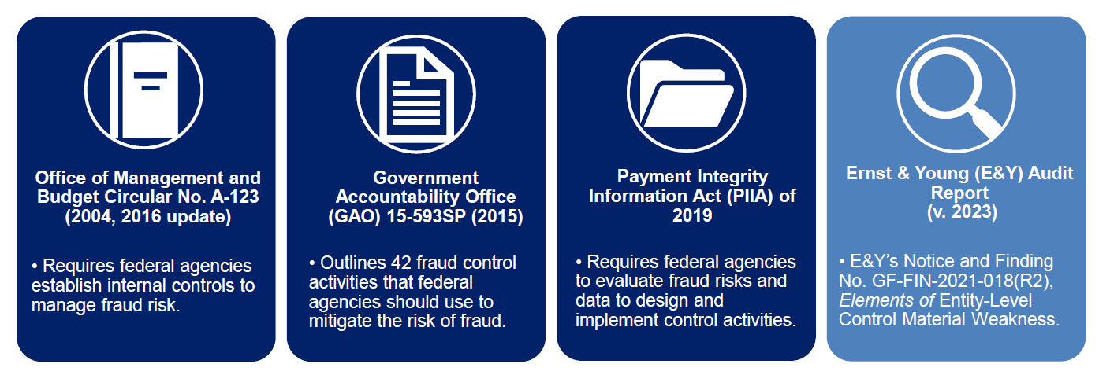
DAF FRM
In 2023, the DAF’s Independent Public Accountant, Ernst & Young, noted the DAF lacks a comprehensive FRM program and governance IAW below:
Source: SAF/GC

Slide 16
DAF FRM
Result: DAF amplified efforts to institute the GAO Framework:
Conducted a complete fraud control assessment
Conducted a complete fraud risk assessment
DAF established the Fraud Risk Oversight Committee (FROC) - March 2024
Governed by SAF/GC, SAF/FM, SAF/AQ, SAF/AG and others
Innovative; separate from DAF Risk Management and Internal Control Program
Two Core Objectives
Analyze design and effectiveness of DAF fraud risk controls
Bolster existing efforts to identify and prevent fraud across enterprise

Slide 17
DAF FRM
Implementation Actions
DAF Fraud Risk Management Strategy – June 2024
Compliant w/DoD FRM Strategy and Guidance
Big Rocks
Organization, Governance, and Responsibilities
Communication and Training
Fraud Risk Assessment
GAO FRM Framework Assessment
Self-identified Deficiencies and Corrective Action Plans
Data Analytics
Monitoring and Evaluation
Timeline
Commit
Assess
Design & Implement
Evaluate & Adapt
Source: SAF/GC

Slide 18
DAF FRM
Implementation Actions, cont’d.
SAF/AG to perform testing on DAF FRM controls; audits on asset safeguarding, special contracts, counterfeit and product substitution, and construction fraud
Source: SAF/GC

Slide 19
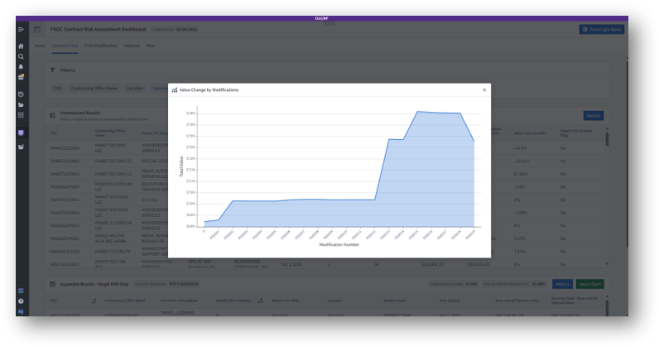
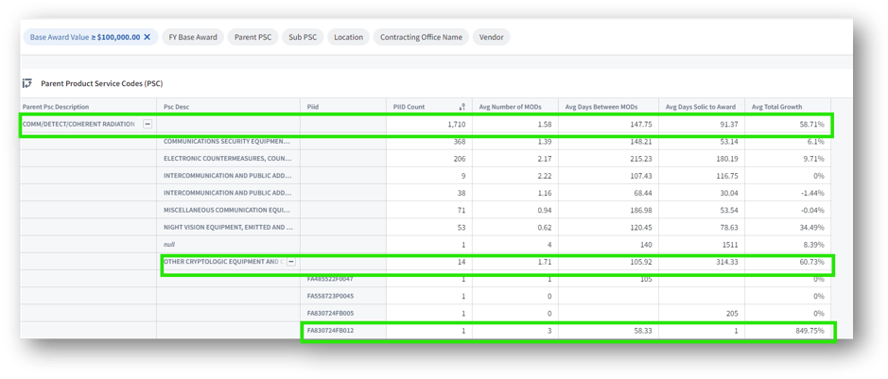
DAF FRM
Implementation Actions, cont’d.
SAF/AG to provide data analytics support and apply continuous auditing tools
Analytics - Contract Dashboard
Summarized dashboard metrics
Visualization/Charting; contract cost growth over time
Comparisons to category averages, highlight outliers, and illuminate trends
Source: SAF/GC

Slide 20
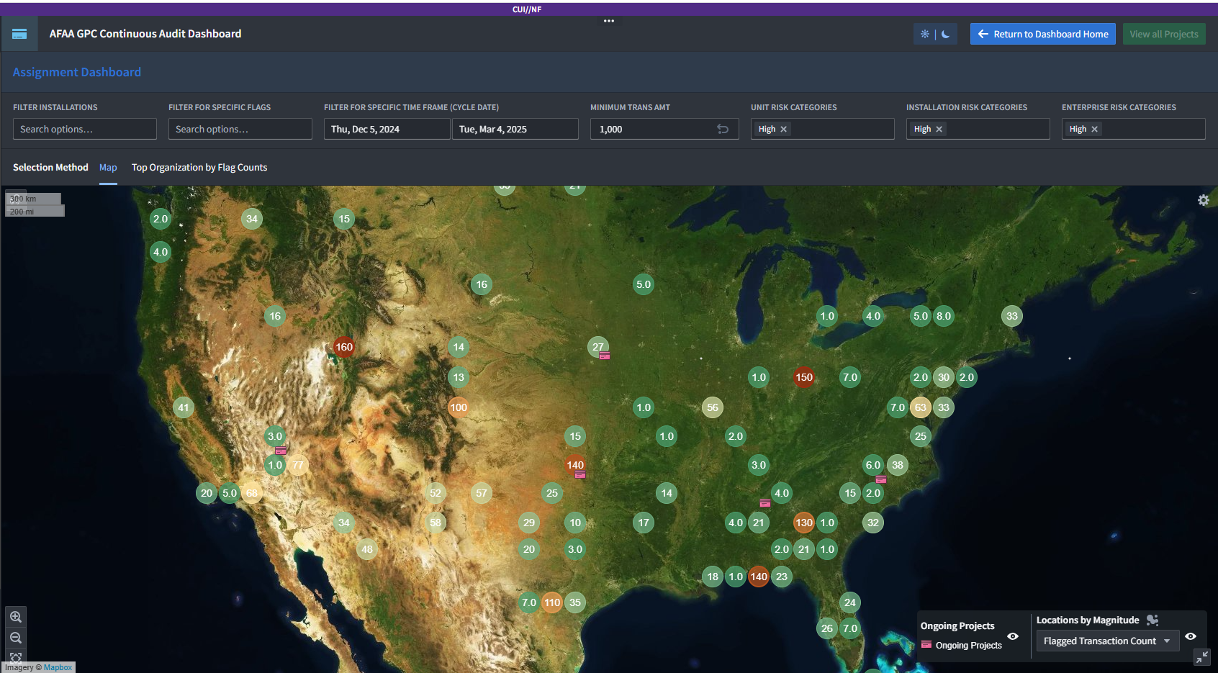
DAF FRM
Implementation Actions, cont’d.
Continuous Audit Tools - Government Purchase Card & Travel Vouchers
IDs suspicious or unusual activity
Real-time risk assessments
Saves audit time by focusing resources on risk-based transactions
Source: SAF/GC
20

Slide 21
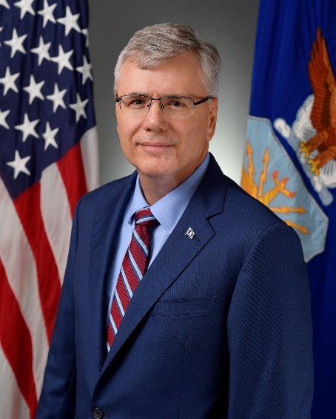
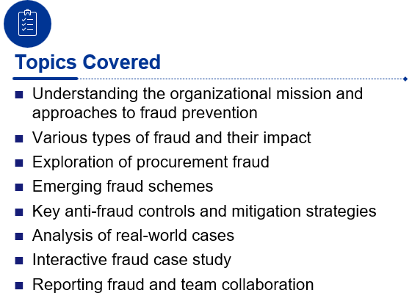
DAF FRM
Implementation Actions, cont’d.
SECAF Tone at the Top Memo
Commitment and Expectations
Risk Reporting in DAF’s Enterprise Governance, Risk and Compliance (eGRC) tool
DAF Anti-Fraud Training
1-day course; pilot in May 2025
Audience: AFAA, AQC, OSI, PMs, and CORs
Potential Roadshow - WPAFB
POCs: Darrell Allen (AFAA) and Deborah Houchins (SAF/GC)

Slide 22
Wrap up

Slide 23
Questions

Slide 24
Resources
GAO Framework
https://www.gao.gov/products/gao-15-593sp
4 June 2025 Hearing on DoD FRM
https://oversight.house.gov/release/hearing-wrap-up-dod-fraud-risk-management-needs-improvement/
DoD OIG Fraud Scenarios, Indicators, etc.
https://www.dodig.mil/Resources/Fraud-Detection-Resources/
DoD Fraud Prevention Week (Aug 2025)
osd.pentagon.ousd-c.mbx.odcfo-rmic@mail.mil
Office of the Under Secretary of Defense Comptroller / CFO: Posts | LinkedIn
Association of Certified Fraud Examiners
https://www.acfe.com

Slide 25
Resources
Air Force IG Hotline
https://www.dodig.mil/Components/Administrative-Investigations/DoD-Hotline/
AFOSI Submit A Tip
https://www.osi.af.mil/Submit-a-Tip/
AFAA Audit Requests:
saf.ag.afaa-doo.workflow@us.af.mil
AFAA Financial Management Division: Contact me anytime!
angela.palma.1@us.af.mil

