Slide 1
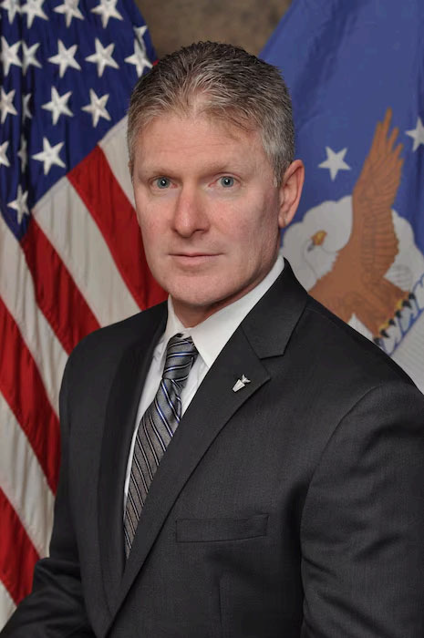
Bio

Slide 2
Leading FM’s System Transformation: The FMI IT Roadmap
SES, Mr. Eddie Lewis
SAF/FMI
24 Apr 2025

Slide 3
Agenda
Current FM System Challenges
Vision for FM IT Transformation
Key Components of Transformation
FM’s NorthStar Implementation Plan
Desired Outcomes
Next Steps

Slide 4
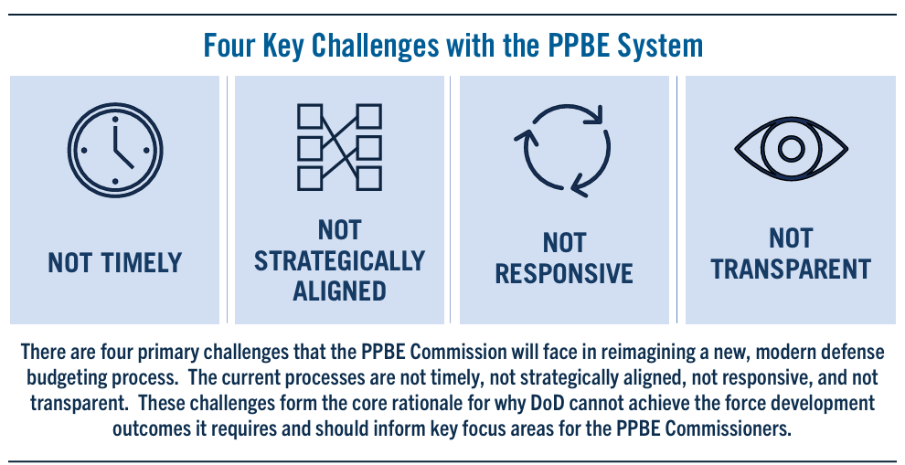
Current FM System Challenges
Systems Key to a Clean Audit Opinion
Lack of a clean audit opinion raises concerns about the reliability of financial data used for decision-making and resource allocation. It also hinders efforts to improve efficiency and reduce waste.
Modernizing of FM Systems
DoD and DAF still rely on aging legacy systems that are difficult to maintain, integrate, and secure. Efforts to modernize FM systems have been slow and plagued by cost overruns, delays, and integration challenges.
Data Quality and Availability
Fragmented data across disparate systems prevents accurate and timely reports and analysis. Inconsistent data standards lead to errors and discrepancies compromising decision support.
Financial Management Workforce
DoD faces challenges in attracting, retaining, and developing a financial management workforce with the skills needed to operate and maintain modern IT systems.

Slide 5
Where We’re Headed…
Where We Are…
Too many systems with redundant capabilities resulting in:
Insufficient resource to meet current Mission Directives (both dollars and manpower)
Non-alignment with strategic imperatives
Unaddressed technical debt
Security and audit risks
Multiple, non-standard data sources yielding differing answers to the same question
Customized systems and dependence on specific developers
Shadow IT due to lags/delays in implementing enterprise solutions
Increased FM CIO oversight responsibilities
An optimized FM Portfolio will enable:
Compliance with DoD/AF IT, Data, and FM Guidance and Policy
Modernized AI/ML/RPA enable systems which reduce workload and improve effectiveness.
Migration toward shared responsibility model (SaaS)
Simplified FM systems portfolio and governance to transition capabilities, sunset legacy systems
Alignment with strategic imperatives
Reduced technical debt
Reduced security and audit risks
One correct answer per question based on clean, accurate, reliable data
Modern, sustainable functional and system architectures

Slide 6
Vision for IT Transformation
SAF/FM Operational Concept – “OV-1”
FM’s Alignment with “Ideal” CFO Tech Stack

Slide 7
SAF/FM Operational Concepts (FM Exec Session Approved on 29-Oct-2024)
NEW SAF/FM Operational Concept Graphic (OV-1)
High-level depiction of FM operational activities
Identifies mission/scope of the entire FM IT environment.
Seven operational concepts
Accounting
Financial Operations/Services
Budget Formulation (added)
Execution & Reporting (added)
Financial Audit
Cost Estimation
Quality Assurance (added)
These are supported by two cross-cutting services--Analytics & Reporting and FM Information Technology Services.
Notes:
The revised SAF/FM Operational Concept Graphic (OV-1) represents a high-level depiction of the operational activities performed to support today’s FM Mission. It is intended for presentation to senior decision makers and identifies the mission/scope of the entire FM IT environment.
There are seven (7) operational activities:
Accounting
Financial Operations/Services
Budget Formulation
Execution & Reporting
Financial Audit
Cost Estimation
Quality Assurance
These are supported by two (2) cross-cutting services--Analytics & Reporting and FM Information Technology Services.
The SAF/FM Operational Concept Graphic (OV-1) offers a high-level overview of how the Financial Management (FM) IT environment operates.
It visually outlines the seven core operational activities that FM undertakes, which include: Accounting, Financial Operations/Services, Budget Formulation, Execution & Reporting, Financial Audit, Cost Estimation, and Quality Assurance.
Additionally, it highlights the two cross-cutting services that support these activities: Analytics & Reporting and FM IT Services.
This graphic is crucial as it provides senior decision-makers with a clear and concise understanding of the mission and scope of FM IT, enabling them to make informed decisions regarding resource allocation, strategic planning, and modernization efforts.
By presenting this comprehensive overview, the OV-1 fosters transparency and facilitates communication between FM leadership and key stakeholders.
In essence, the SAF/FM OV-1 serves as a strategic tool for aligning FM IT capabilities with the broader goals and objectives of the Air Force.

Slide 8
FM’s OV-1 Alignment with Ideal CFO Tech Stack (Northstar)
Enterprise Resource Planning (ERP)
Corporate Performance Management (CPM)
Low-Code
No-Code
(LCNC)
Analytics &
Data Management
(CDMS)
Business Processes:
Operational & financial activities
General ledger
Accounts receivable/payable
Financial reporting
Example System:
DEAMS
Business Processes:
FY Close
Planning
Budgeting
Forecasting
Reporting
Analysis
Example System:
PBES
Business Processes:
Process automation
Workflows
CRM
Ad hoc development
Incident management
Example System:
CSP
Business Processes:
Extract, Transform, Load (ETL)
Data storage
Data analytics
Data science
Machine Learning/AI
Example System:
Advana/FASTR
Notes:
This slide shows the CFO "Northstar" Tech Stack, representing industry best practices. This simplified technology stack is significantly more streamlined and efficient compared to the current SAF FM IT landscape. The current landscape is characterized by a fragmented array of systems, leading to redundancies, inefficiencies, and increased security risks. In contrast, the "Northstar" model consolidates functionalities into core areas like ERP, CPM, and Low-Code/No-Code platforms, supported by robust analytics and data management.
This comparison highlights the need for modernization efforts to focus on:
System Rationalization: Reducing the number of redundant and outdated systems to achieve a more streamlined architecture.
Integration: Ensuring seamless data flow and interoperability between remaining systems.
Standardization: Implementing common data standards and business processes to improve efficiency and reduce errors.
Automation: Leveraging automation technologies to eliminate manual tasks and improve productivity.
Cloud Adoption: Migrating to cloud-based solutions for enhanced scalability, flexibility, and cost-effectiveness.
By aligning with the "Northstar" Tech Stack, the SAF FM can achieve significant benefits, including reduced costs, improved audit posture, enhanced decision-making, and better resource allocation. The modernization efforts will enable the SAF FM to become more agile, efficient, and responsive to the evolving needs of the Air Force.

Slide 9
FM’s NorthStar Implementation Plan
Phased Approach
Key milestones and timelines (notional)
Stakeholder Participation

Slide 10
Capabilities | FY 24 | FY25 | FY26 | FY27 | FY28 | FY29 | FY30+
ERP Accounting
CPM Budget Formulation & Congressional Reporting
CPM Execution Management
CPM Cost-Estimation
DEAMS (GF)
CHECKBOOK ???
AFM ???
GAFS, IAPS, CDS, DCMS, DTIM (Fourth Estate – Partial – GF Accounting Capability to DEAMS, WCF Capabiliy to MRO)
NAF Accounting (A1/AA)
CCAC (Complete)
MRO (WCF)
APO
SMAS
CPM High Side (PBES – Formulation & Reporting)
EAS
BRS
KDSS
CROSS DOMAIN
AF MIDAS
IDECS
AF MIDAS
APPS
CMS
CPM Low Side (NIPR Formulation & Reporting)
CPM Low Side (NIPR Execution Management)
AFBEAT
BEAST
KDSS
RESPLAN
BRS
PBAS WEB
AFTOC
JOCAS II
Remaining Systems
39
37
28
18
9
Notes:
So, how do we get there? First, we mapped out all of the systems and some related systems in the FM portfolio and aligned them by function and purpose. For example, systems supporting FY Close, Planning, Programming, Budgeting, Budget Forecasting were aligned under the CPM area.
You will notice some systems are listed more than once, that is because a lot of our FM systems support multiple functions. If a system color matches the capability column on the left, that is our target enduring system. The goal is to rationalize all related systems into that target system.
Under the ERP Capability area, you will see an FM Target system, which is DEAMS, but we also show a non-FM target system, MRO. Both are show because some of these capabilities exist in the current FM portfolio, but may transfer out of the portfolio in the future
Within the CPM area, we have the unusual challenge of both NIPR and SIPR systems. We have been in discussions with the AF Cloud One team about leveraging a cross-domain solution they are working to implement, thus finally allowing these system to share some data more efficiently

Slide 11
Capabilities | FY 24 | FY25 | FY26 | FY27 | FY28 | FY29 | FY30+
LCNC Audit
LCNC Other
LCNC Financial Service
CDMS Tool Analytics & Reporting
Cross Functional Portfolio (Non-FM ERP CMP)
EGRC
Other Low Side (FM SUITE)
PCS-A
eFIN
FM WORKFLOW
RTS
CSP
ITSM SERVICE NOW
Data Visualizations with Drill – Down Capabilities and Dashboards (FASTR)
FACTS (Complete) AFBEAT
DQS
QA METRICS
CRIS
ACC TOOL
KDSS
RESPLAN
BRS
Acquisition Portfolio
AUS
FMRPT
JON MGMT
FINCON
HCM CPM Low Side (AFIPPS)
LEAVEWEB (Capabilities)
AFMTS
ATAAPS
JOCAS II T&A
Remaining Systems
39
37
28
18
9
Notes:
On this slide we continue the rationalization by focusing on opportunities to leverage Low Code-No Code applications, standardize reporting and analytics with FASTR. Additionally, this shows some system capabilities which are targeted to be transferred outside of the FM portfolio.

Slide 12
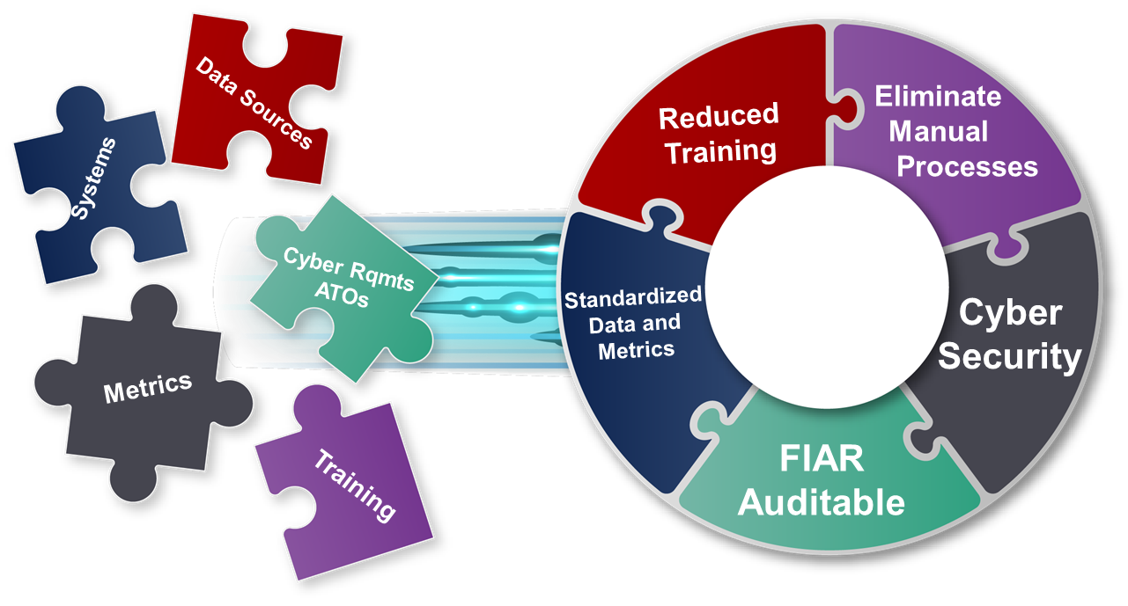
One Team, One Mission
CIO’s Pledge
Deliver functional requirements
Communicate changes
Gradual transition - no capability lost
Education and Training
Alignment with missions – processes will be updated with system changes to ensure all teams can focus on mission
+
We need your help!
Need the best to volunteer
Knowledgeable, available, authoritative representation from all organizational level
=
Results
Increased system knowledge
Reduced learning curves and training requirements
Manual processes eliminated
Enhanced decision making
Consistent, accurate source data
Faster future upgrades to new technologies
Cost and time savings
Enhanced cybersecurity and audit posture
INTENT IS TO REDUCE SYSTEMS, NOT PEOPLE
Merge capabilities into modern, efficient, cost effective, industry standard platforms
Notes:
As the FM CIO prepares to embark on their transformation journey, there are some ground rules that need to be established. This is a partnership, and we all have an important role to play in this process.
The CIO’s Pledge to you:
Given requirements, we will deliver on needs
We will communicate changes and expectations
Gradual Transition and Flexibility - No capability will be lost until new functionality established
Education and training will be put into place for transitioning functions and new systems
Alignment with your missions – Processes will be updated with system changes to ensure your teams can focus on your mission
But, we need your help!
We need your best to volunteer
Knowledgeable, Available, Authoritative Representation from Your Organization
Working together, we will achieve the results shown, and possibly many more.
Increased System Knowledge w/ Standardization
Reduced Learning Curves for New Employees
Reduced Training Requirements
Manual Processes Eliminated
Enhanced Decision Making with Real-time Data Access
Consistent Source Data/Data Accuracy
Faster Future Upgrades & Integration with New Technologies
Cost and Time Savings
Enhanced Cybersecurity Posture
Auditable Systems
Increased System Knowledge w/ Standardization
Reduced Learning Curves for New Employees
Reduced Training Requirements
Manual Processes Eliminated
Enhanced Decision Making with Real-time Data Access
Consistent Source Data/Data Accuracy
Faster Future Upgrades & Integration with New Technologies
Cost and Time Savings
Enhanced Cybersecurity Posture
Auditable Systems

Slide 13
Desired Outcomes
Reduce Number of Systems & IT Spend
Future End-State aligned with Industry Best Practices

Slide 14
End State - Future FM Portfolio
FASTR
Analytics & Reporting (CDMS)
ENTERPRISE RESOURCE PLANNING (ERP)
CORPORATE PERFORMANCE MANAGEMENT (CPM)
LOW CODE NO CODE/
OTHER
General Fund
Accounting
Ad hoc Business
Tools
Program & Budget
Formulation
Execution
Management
Cost Support
Budget
Execution
Audit
Travel
DEAMS
WCF
Accounting
PBES
NIPR/SIPR
CPM NIPR
AFTOC &
JOCAS II
FM SUITE
EGRC
PCSA
RPA’s
MRO
FM IT SERVICES & CSP
Customer Service Workflows
OTHER NON-FM
SYSTEMS
AFIPPS ARTEMIS
CON-IT
ATAAPS
FM CIO Transformed based on industry best practices
Notes:
This slide highlights the exciting future state that awaits us at the end of this FM system rationalization journey. The FM community will benefit from a Streamlined System Landscape. Imagine a world where we've significantly reduced the number of FM systems in our organization. This streamlined landscape will bring numerous benefits, including reduced sustainment costs, enhanced efficiency, improved security, simplified training, enhanced audit posture, and improvements in resource allocation. And most importantly, the FM community will benefit from systems that are aligned with strategic goals, enabling leaders at all levels to make more informed decisions and achieve organizational objectives more effectively.
The path to this future state is clear, but it will require commitment and collaboration from all of us. We'll need to work together to develop and implement detailed plans, secure the necessary resources, and manage the change effectively.
We are confident that by working together, we can achieve this ambitious goal and create a more efficient, secure, and effective FM IT environment that supports our organization's mission.

Slide 15
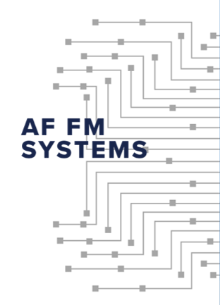
Potential Rationalization Path
^{75% REDUCTION}
Following industry best practices while ensuring support for FM mission sets, there is a possibility of reducing the current FM portfolio by nearly 75% over the next FYDP.
This would result in significant long-term IT spend savings, improved security posture, lower IT learning curve, and standardize data and reporting across the enterprise. All while supporting FM’s path to clean audit report.
39
37
28
18
9
FYxx
FYxx
FYxx
FYxx
FYxx
Notes:
Dramatic reductions in:
Software/Hardware maintenance costs
Number of systems and licensing
Custom code
Cybersecurity threat vectors
System training
Dramatic improvements in:
FM strategic alignment
Standardized processes/workflows
Data quality and integration
Financial audit posture
Simplified user training
Resources allocated for mission

Slide 16
Next Steps
Develop consensus on way forward
Seeking your participation with the systems Plans of Action and Milestones (POAMs)
Provide Subject Matter Experts (SME)
Experienced end users
Technical experts
Requirements and functionality reviews
System and data level architecture development in standardized formats
Realistic executable timeline
Advocate for resources to execute the plan
Facilitate organizational change management
Communications
Training
Notes:
As we move forward with this critical initiative to rationalize our FM IT systems, collaboration and a well-defined plan are essential. Here are some of the next steps we'll be taking:
●Develop Consensus: The FM CIO team will continue to work closely with all stakeholders to ensure we have a shared understanding and agreement on the proposed path forward. Your input is critical to the success of this initiative.
●Seek Participation: We'll actively engage stakeholders in the development of detailed Plans of Action and Milestones (POAMs) for each system implementation. This will ensure that the transition is smooth and aligned with your specific needs.
●Provide SMEs: We'll rely on the expertise of experienced end-users and technical experts from your teams. Their insights will be invaluable in guiding the implementation process and ensuring that the new systems meet your functional requirements.
●Conduct Reviews: The CIO team will conduct thorough reviews of system requirements and functionality to guarantee that the new solutions align with your operational needs and processes.
●Develop Architecture: The CIO team is creating comprehensive system and data-level architectures, standardizing artifact formats for consistency and ease of integration.
●Establish Timeline: Development a realistic and executable timelines for implementation is critical and must account the complexities and dependencies involved.
●Advocate for Resources: We'll actively advocate for the necessary resources to execute this plan effectively, ensuring that we have the personnel, funding, and tools required for success.
●Facilitate Change Management: Change can be challenging; therefore, we'll implement robust organizational change management strategies to support a smooth transition and minimize disruption.
●Prioritize Communications and Training: We'll develop and implement comprehensive communication and training plans to ensure that all users are informed and prepared for the new systems and processes.
The FM CIO team is committed to working hand-in-hand with you throughout this journey. Your involvement and support are crucial to achieving our shared vision of a more streamlined, efficient, and effective FM IT environment. Thank you for your partnership. We look forward to embarking on this exciting transformation together.

Slide 17
Conclusion
In today’s environment, FM cannot afford to keep funding old, unsustainable and unsecure systems
Real change and system modernization is possible
The voice & active participation of FM systems' users matters
Together, we can modernize, drive efficiencies, and improve FM’s audit and security posture

Slide 18
Questions?

Slide 19
Backup Slides

Slide 20
AFMC Specific Roadmap
Capabilities | FY 24 | FY25 | FY26 | FY27 | FY28 | FY29 | FY30+
ERP Accounting
CPM Budget Formulation & Congressional Reporting
CPM Execution Management
LCNC Other
CDMS Tool Analytics & Reporting
Cross Functional Portfolio (Non-FM ERP CMP)
MRO (WCF)
APO
KDSS
CMS
CPM Low Side (NIPR Formulation & Reporting)
CPM Low Side (NIPR Execution Management)
KDSS
Other Low Side (FM SUITE)
Data Visualizations with Drill – Down Capabilities and Dashboards (FASTR)
KDSS
Acquisition ortfolio
AUS
JON MGMT
FMRPT
FINCON

Slide 21
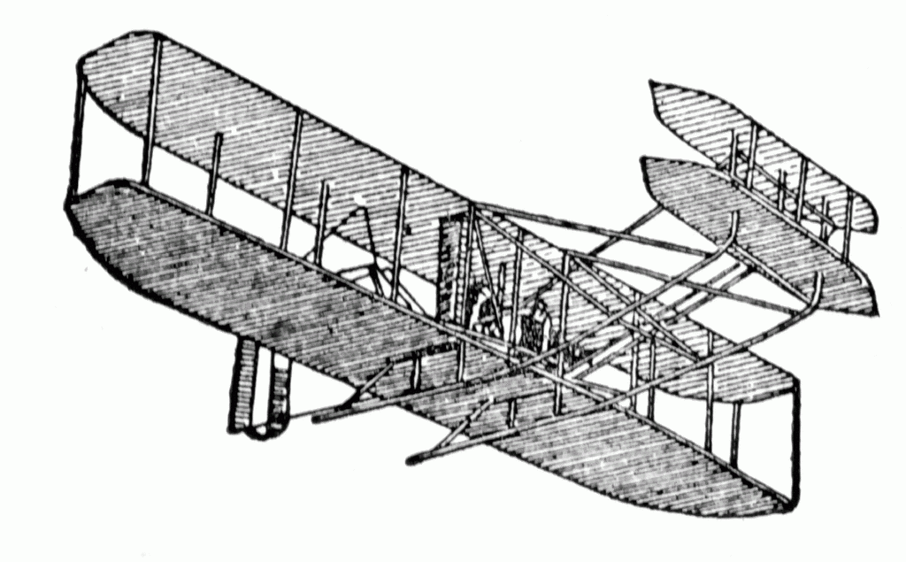
Society of Defense Financial Management
Aviation Chapter
PRESENTS THIS CERTIFICATE OF APPRECIATION TO
Mr. Eddie Lewis
WITH A DONATION TO
Habitat for Humanity
IN HONOR OF YOUR PRESENTATION
24 April 2025
Thomas Giovingo
Thomas Giovingo President, Aviation Chapter

