Slide 1
Understanding Technology Hype
Presented by
Todd M. Baker, SL, DAF
Senior FM Operations and Business Transformation Advisor

Slide 2
Background

Slide 3
Overview
What is Technology Hype?
Why does it take so long to see new technologies in my DoD workplace?
What happens to technological breakthroughs before we see them again?
Where do new technologies go before becoming useful?
Why do some technologies disappear all together?

Slide 4
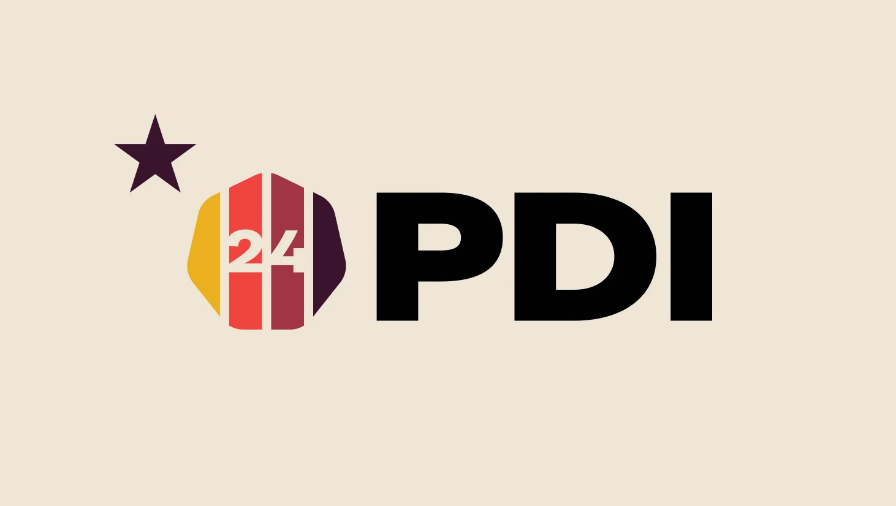
What is Hype?
PDI 2024 General Sessions
5 Accounting
4 Budgeting
9 Cost and Economics
19 Data Analytics!
PDI 2025 Prediction:
Artificial Intelligence

Slide 5
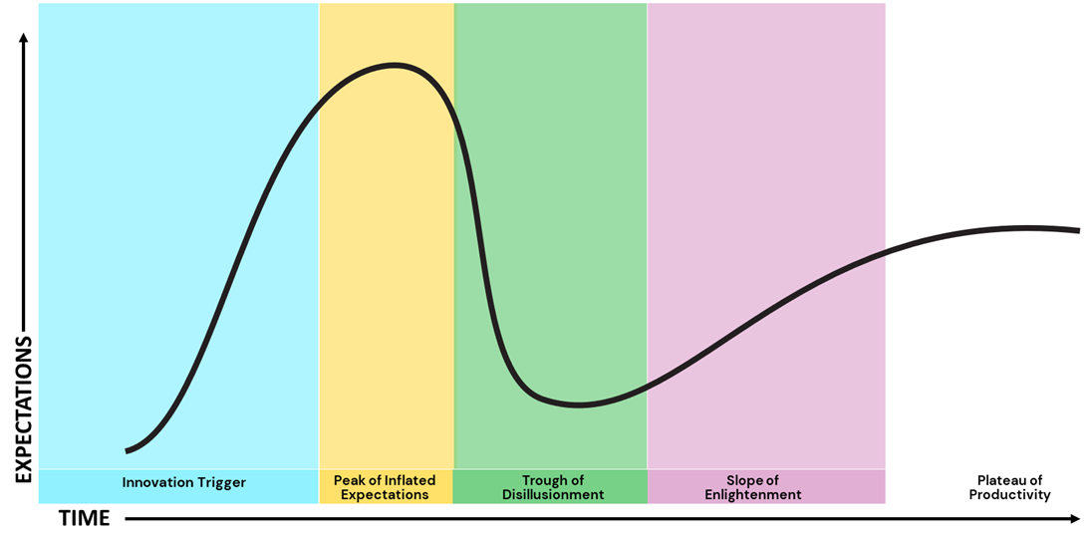
Hype Cycle
An innovation typically transitions through five stages on its path to productivity:
Innovation Trigger
Peak of Inflated Expectations
Trough of Disillusionment
Slope of Enlightenment
Plateau of Productivity
Innovation Trigger
Peak of Inflated Expectations
Trough of Disillusionment
Slope of Enlightenment
Plateau of Productivity

Slide 6
Hype Cycle Examples in Transportation/Energy
Wireless EV Charging
Electric Aircraft
Wind Power Generation
EV Charging Infrastructure
Hydrogen Vehicles
EXPECTATIONS
Innovation Trigger
Peak of Inflated Expectations
Trough of Disillusionment
Slope of Enlightenment
Plateau of Productivity
TIME

Slide 7
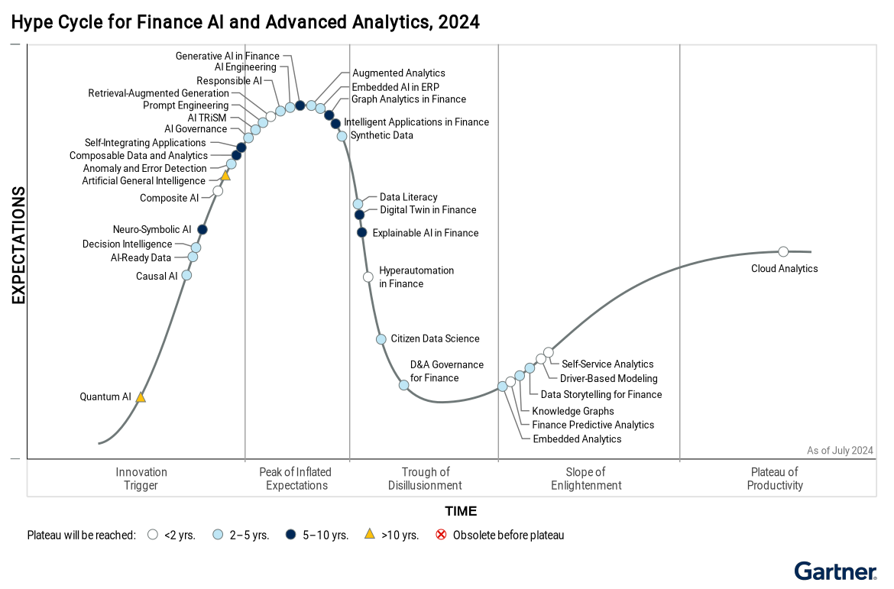
AI Hype in Finance
Key observations:
Innovation Trigger | Causal AI Self-Integrating Applications
Peak of Inflated Expectations | Generative AI in Finance Retrieval-Augmented Generation
Trough of Disillusionment | Explainable AI in Finance Citizen Data Science
Slope of Enlightenment | Embedded Analytics Finance Predictive Analytics
Innovation Trigger
Peak of Inflated Expectations
Trough of Disillusionment
Slope of Enlightenment
Plateau of Productivity

Slide 8
Resources
https://sdfm.org/professional-development/professional-development-institute/
Flyvbjerg, B., & Gardner, D. (2023). How Big Things Get Done. Currency.
https://chat.niprgpt.mil/
https://www.gartner.com/

