Slide 1
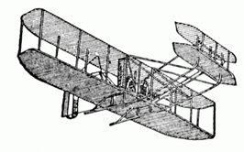
AVIATION CHAPTER LUNCH and LEARN
Please join us on 29 Jan 25 for another informative Lunch and Learn at 11:30 to 1:00
Ms. Sheila Giovingo AFDW SAF/FMIN/AFFSO
Topic: The Financial Liability Investigation (FLI)/Report of Survey (ROS) System overview
You can earn 1 CLP for your full attendance
Find us on TEAMS: https://dod.teams.microsoft.us/l/meetup-join/19%3adod%3ameeting_bcf52205822249b1a0e474c5951da4b4%40thread.v2/0?context=%7b%22Tid%22%3a%228331b18d-2d87-48ef-a35f-ac8818ebf9b4%22%2c%22Oid%22%3a%2287e26c44-d3ae-420c-9ad3-bdb4321f521c%22%7d

Slide 2
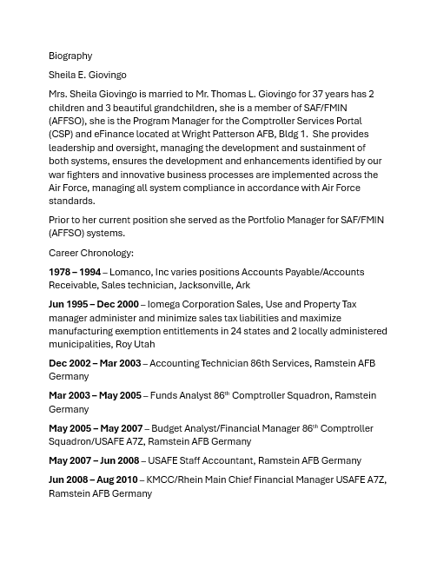

Slide 3
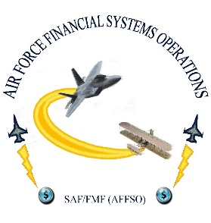
Comptrollers Services Portal FLI/ROS Module
FLI/ROS Module
Jan 29, 2025
I n t e g r i t y - S e r v i c e - E x c e l l e n c e
3

Slide 4
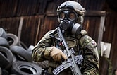
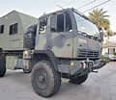
Topics
FLI/ROS what is it?
System Highlights
Benefits
Where to find Instructions
I n t e g r i t y - S e r v i c e - E x c e l l e n c e
4
Notes:
The Financial Liability Investigation (FLI)/Report of Survey (ROS) module is an innovative approach created for the CSP application in 2024 for overseeing investigations related to the loss, damage, or theft of equipment.
The FLI/ROS module digitalizes the current paper-based FLI/ROS process and provides a centralized location for the management of investigative documentation and communications, providing a level of oversight to installations which was previously unattainable.
The ultimate product of the FLI/ROS process is the generation of the DD Form 200 (Financial Liability Investigation of Property Loss).

Slide 5
What is the FLI/ROS Module?
The Financial Liability Investigation (FLI)/Report of Survey (ROS) module is an innovative approach created for the CSP application in 2024 for overseeing investigations related to the loss, damage, or theft of equipment.
The FLI/ROS module digitizes the current paper-based FLI/ROS process and provides a centralized location for the management of investigative documentation and communications, providing a level of oversight to installations which was previously unattainable.
The ultimate product of the FLI/ROS process is the generation of the DD Form 200 (Financial Liability Investigation of Property Loss).
I n t e g r i t y - S e r v i c e - E x c e l l e n c e
5
Notes:
The Financial Liability Investigation (FLI)/Report of Survey (ROS) module is an innovative approach created for the CSP application in 2024 for overseeing investigations related to the loss, damage, or theft of equipment.
The FLI/ROS module digitalizes the current paper-based FLI/ROS process and provides a centralized location for the management of investigative documentation and communications, providing a level of oversight to installations which was previously unattainable.
The ultimate product of the FLI/ROS process is the generation of the DD Form 200 (Financial Liability Investigation of Property Loss).

Slide 6
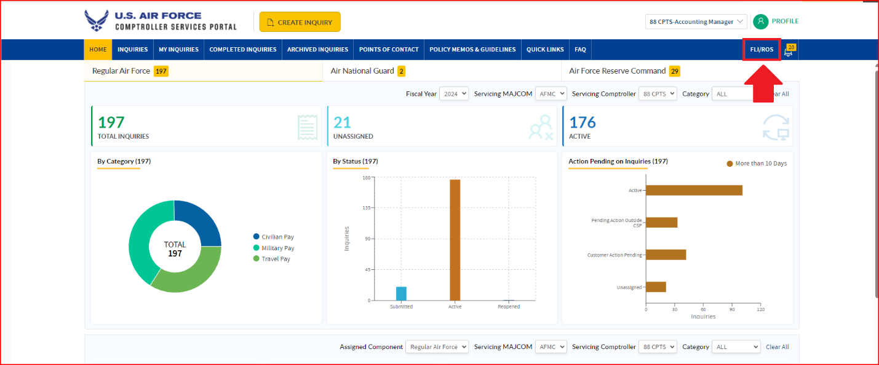
System Highlights – Home Page Dashboard
At-a-glance Entering the FLI/ROS module
I n t e g r i t y - S e r v i c e - E x c e l l e n c e

Slide 7
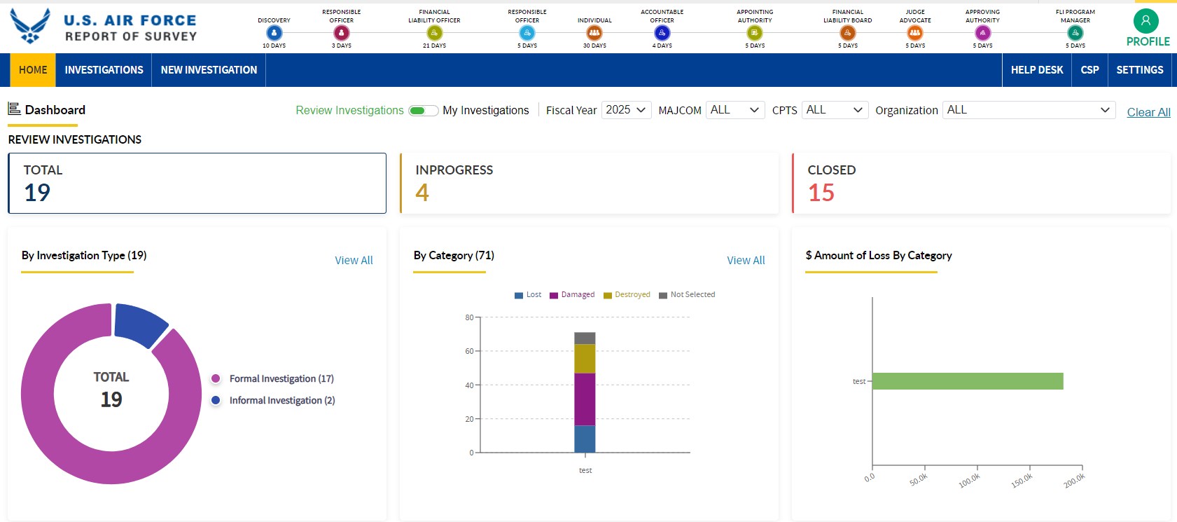
System Highlights – Home Page Dashboard
At-a-glance view of investigation count, type, category and Amount
I n t e g r i t y - S e r v i c e - E x c e l l e n c e

Slide 8
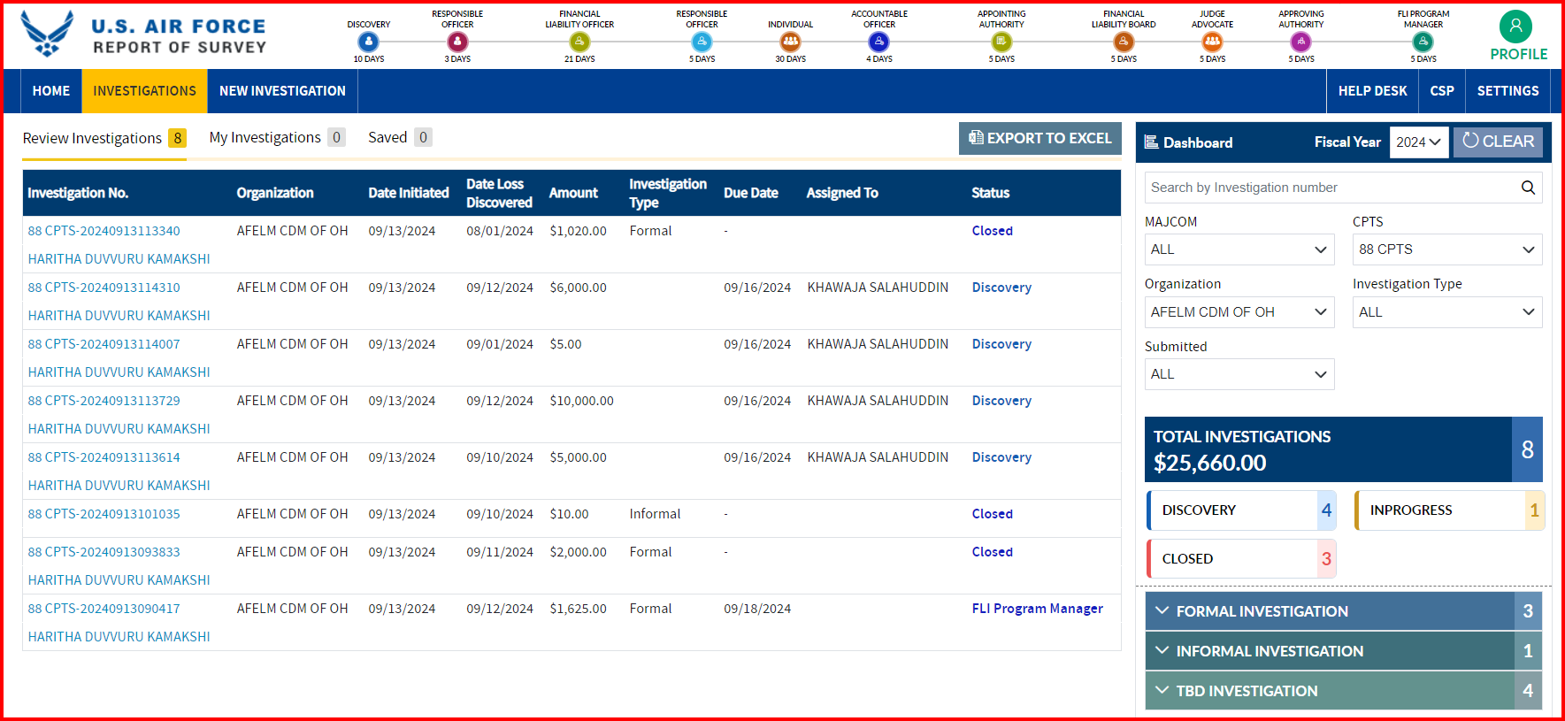
System Highlights – Home Page Dashboard
At-a-glance view of investigations and Dashboard

Slide 9
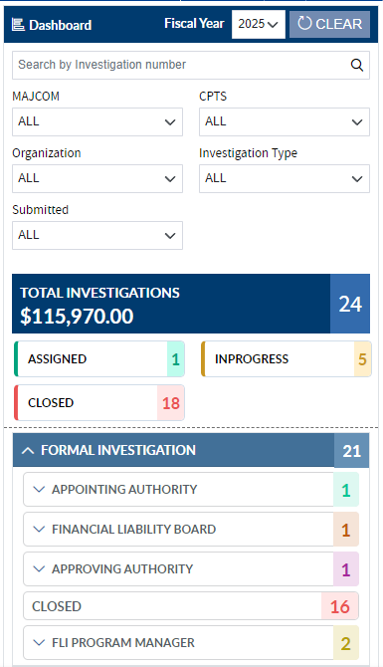
System Highlights – Investigation Dashboard
Investigations Dashboard Provides Investigation Status, Counts and Total Cost by MAJCOM, CPTS and other factors

Slide 10
System Highlights
The Financial Liability and the Financial Liability Board appointment letters are captured
1

Slide 11
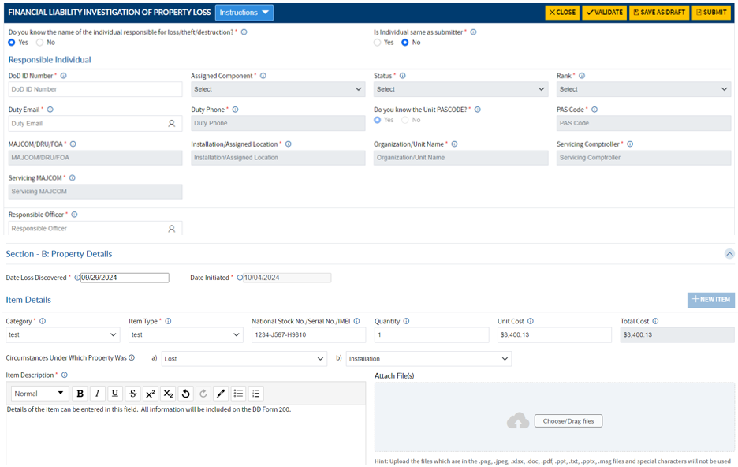
System Highlights – Submit Investigation
A submitter can identify the person responsible for the lost or damaged item(s).
Notes:
One or more items may be logged on an investigation

Slide 12
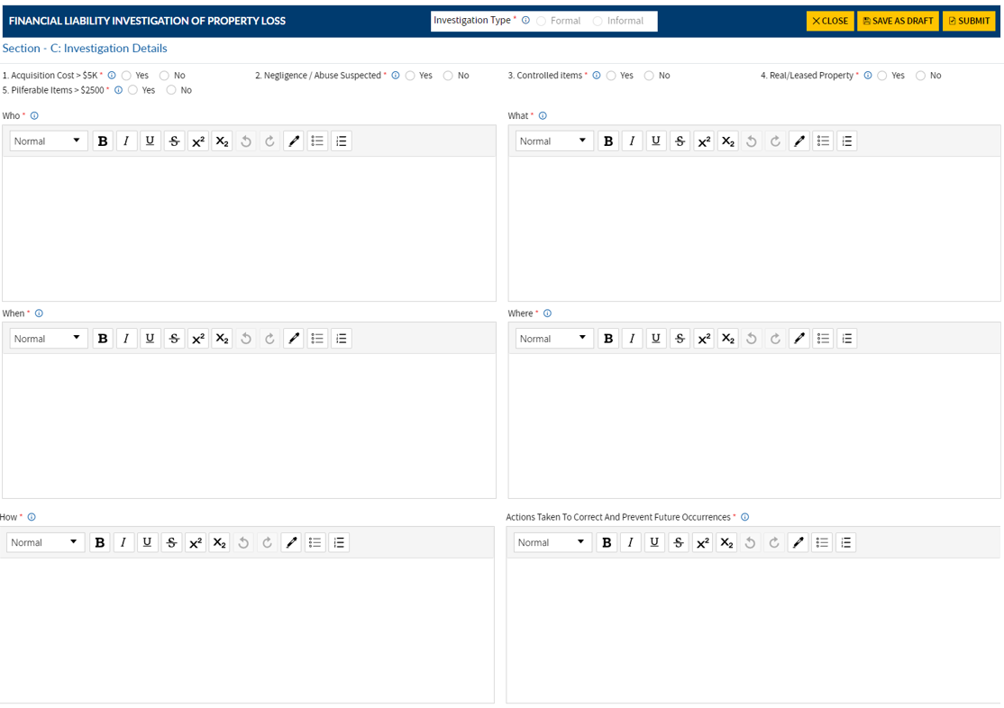
System Highlights – FLO Investigation Details
Acquisition Cost > 5k
Negligence or Abuse Suspected
Controlled Items
Real/Leased Property
Pilferable Items >$2500
I n t e g r i t y - S e r v i c e - E x c e l l e n c e
Notes:
Financial Liability Investigator will complete the details of the investigation. By selecting yes to any of the following, the investigation will follow the Formal Investigation workflow.

Slide 13
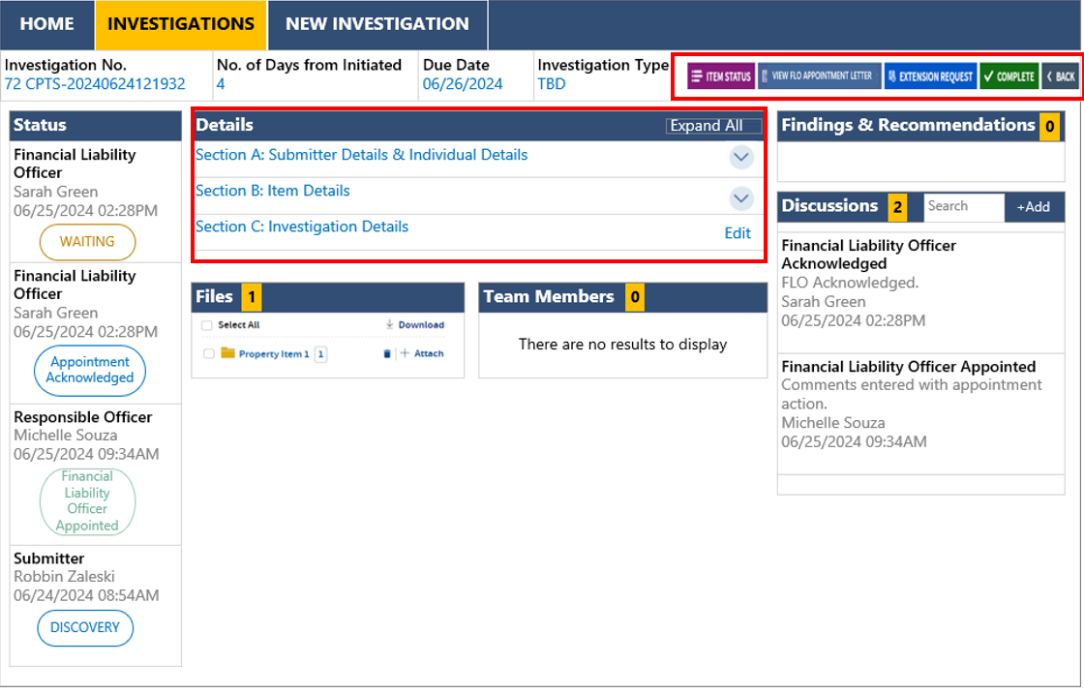
System Highlights – Report Findings
Investigation Overview
I n t e g r i t y - S e r v i c e - E x c e l l e n c e
Notes:
Status bar, details, files, findings and recommendations, discussions

Slide 14
System Highlights - Workflows
When FLO Recommends Financial Liability
The Responsible Officer will review the investigation details, findings and recommendation.
The Responsible Individual has 30 days to either submit a rebuttal or voluntarily pay.
The Accountable Officer will be tasked with adjusting records as required.
When a rebuttal is submitted, the Appointing Authority reviews and approves the recommendations or returns to FLO for further investigation. When Approved, the Appointing Authority will assign the FLB.
The FLB recommends the Liability cost to be charged to the individual.
The Judge Advocate reviews the investigation and recommended liability.
The Approving Authority will accept or reject the rebuttal. The Approving Authority can modify the liability cost.
The FLI Program manager will close the case and obtain signatures on the DD Form 200.
When FLO Does Not Recommend Financial Liability
The Responsible Officer will review the investigation details, findings and recommendation.
The Accountable Officer will be tasked with adjusting records as required.
The Appointing Authority reviews and approves the recommendations or returns to FLO for further investigation
The Approving Authority will approve the recommendations or return to the Appointing Authority.
The FLI Program manager will close the case and obtain signatures on the DD Form 200.
When Investigation is Informal
The Responsible Officer will review the investigation details, findings and recommendation.
The Accountable Officer will be tasked with adjusting records as required.
The FLI Program manager will close the case and obtain signatures on the DD Form 200.
I n t e g r i t y - S e r v i c e - E x c e l l e n c e

Slide 15
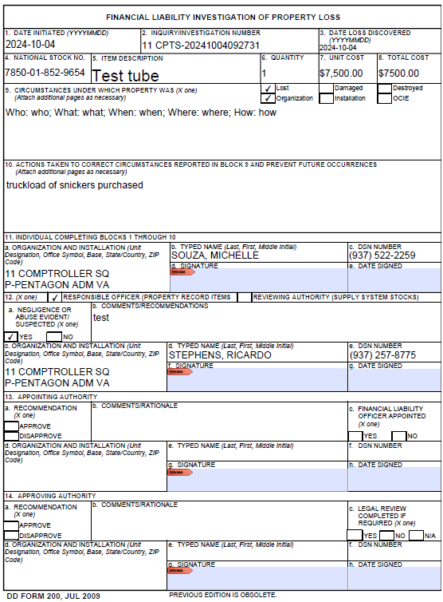
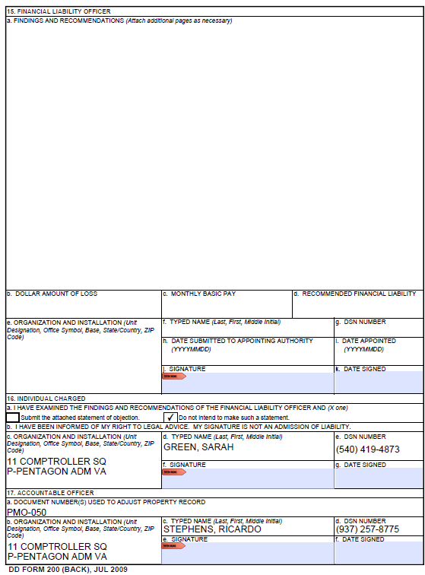
System Highlights – DD Form 200
DD Form 200 is generated from the closed investigation
I n t e g r i t y - S e r v i c e - E x c e l l e n c e

Slide 16
Key Features and Benefits
The FLI/ROS module offers several key benefits, including:
System is consistent with new Air Force FLI/ROS guidance
Simplified and digitized process management
Enhanced documentation format with improved search and audit capabilities
Increased efficiency in investigation management and commander visibility to cost tracking for all lost, damaged or stolen items
Improved collaboration and knowledge sharing among ROS managers through the Microsoft Teams collaboration channel
I n t e g r i t y - S e r v i c e - E x c e l l e n c e
16

Slide 17
Where Do I Find More Instructions?
I n t e g r i t y - S e r v i c e - E x c e l l e n c e
17
Notes:
The Financial Liability Investigation (FLI)/Report of Survey (ROS) module is an innovative approach created for the CSP application in 2024 for overseeing investigations related to the loss, damage, or theft of equipment.
The FLI/ROS module digitalizes the current paper-based FLI/ROS process and provides a centralized location for the management of investigative documentation and communications, providing a level of oversight to installations which was previously unattainable.
The ultimate product of the FLI/ROS process is the generation of the DD Form 200 (Financial Liability Investigation of Property Loss).

Slide 18
Where Do I Find More Instructions Cont’
CSP PMO is hosting more training sessions – Check the Teams “FLI/ROS Collaboration” for upcoming drop-in sessions!
Unit and personal instruction available per request.
milBook and MyLearning courses are in production (as of Nov2024) and will be available as completed.
I n t e g r i t y - S e r v i c e - E x c e l l e n c e
18
Notes:
The Financial Liability Investigation (FLI)/Report of Survey (ROS) module is an innovative approach created for the CSP application in 2024 for overseeing investigations related to the loss, damage, or theft of equipment.
The FLI/ROS module digitalizes the current paper-based FLI/ROS process and provides a centralized location for the management of investigative documentation and communications, providing a level of oversight to installations which was previously unattainable.
The ultimate product of the FLI/ROS process is the generation of the DD Form 200 (Financial Liability Investigation of Property Loss).

Slide 19
Requesting FLI/ROS Owner Role
This is a RESTRICTED role specific to the FLI/ROS module. A DD2875 is required to be assigned this role.
Applicant must have a CSP profile registered to be assigned role.
Recommended to submit a separate DD2875 for the ROS Owner role if you’re already assigned CSP elevated roles.
If combining access requests for an update, in block 13 for CSP roles and block 21 for FLI/ROS roles
I n t e g r i t y - S e r v i c e - E x c e l l e n c e
19
Notes:
The ROS Owner role is a RESTRICTED role specific to the FLI/ROS module. As mentioned before, a DD2875 is required to be assigned this role.
The Applicant must have a CSP profile registered to be assigned role.

Slide 20
Submitting Completed DD2875
1. Go to https://c1snow.cce.af.mil/saffm
2. Select ‘Open a Ticket’.
Select the ‘CSP’ system tile.
Some demographic information auto-populates for submitter. If the default email is incorrect, please update the government email, as applies.
4. Select ‘Account Management’ under ‘Option’ drop-down.
5. Select ‘Account Creation’ or ‘Account Modification’ under ‘Account Management Options’ drop-down, as applies to having existing CSP roles assigned.
7. Upload required Attachment: DD 2875 for ‘ROS Owner’ role.
8. Select ‘Submit’. A conformation email with the ServiceNow ticket number will be sent to the Submitter’s designated email address for tracking. Processing is typically completed within 1-2 business days.
I n t e g r i t y - S e r v i c e - E x c e l l e n c e
20
Notes:
Go to the ServiceNow ticketing system. The link on the slide is clickable
Select ‘Open a Ticket’.
3. Select the ‘CSP’ system tile. Some demographic information auto-populates for submitter. If the default email is incorrect, please update the government email, as applies. This is where emails from ticketing system about the access request are sent!
4. Select ‘Account Management’ under ‘Option’ drop-down.
5. Select ‘Account Creation’ or ‘Account Modification’ under ‘Account Management Options’ drop-down, as applies to having existing CSP roles assigned. Either option will be processed.
7. Attach the DD 2875 to the ticket.
8. Select ‘Submit’. A conformation email with the ServiceNow ticket number will be sent to the Submitter’s designated email address for tracking. Processing is typically completed within 1-2 business days.

Slide 21
Need More Assistance?
ServiceNow ticketing system (https://https://c1snow.cce.af.mil/saffm) Steps to open a helpdesk ticket here.
Contact the CSP PMO:
Sheila Giovingo (sheila.giovingo@us.af.mil)
Ricardo Stephens (ricardo.stephens.1@us.af.mil)
Adriana Seppala (adriana.seppala.1@us.af.mil)
Sarah Green (sarah.green.14.ctr@us.af.mil)
Michelle Souza (michelle.souza.1.ctr@us.af.mil)
I n t e g r i t y - S e r v i c e - E x c e l l e n c e

Slide 22
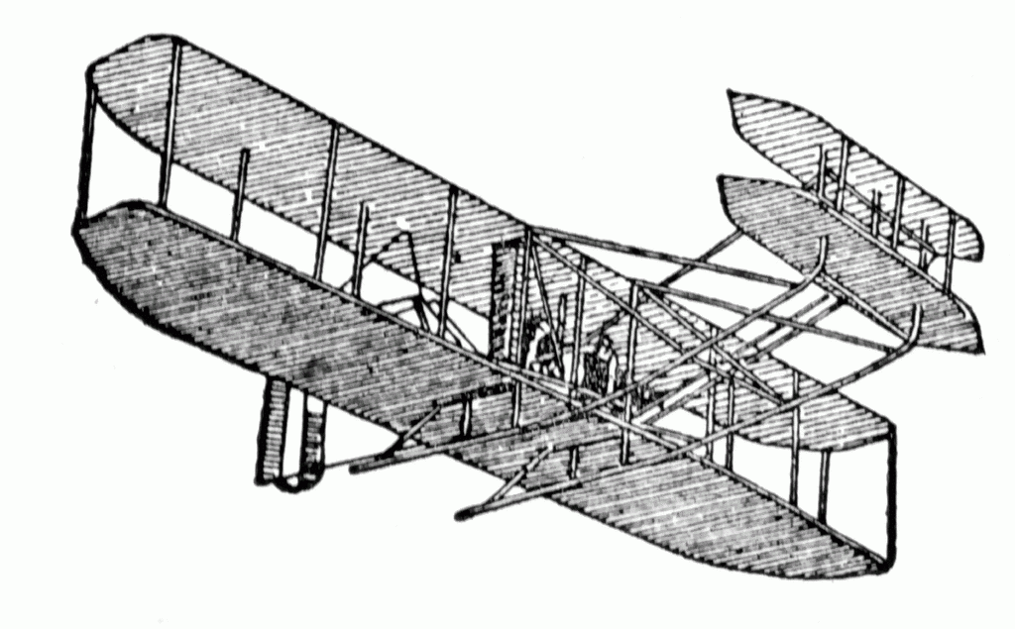
Society of Defense Financial Management
Aviation Chapter
PRESENTS THIS CERTIFICATE OF APPRECIATION TO
Ms. Sheila Giovingo
WITH A DONATION TO
Fairborn Fish Food Pantry
Thomas Giovingo
Thomas Giovingo - President, Aviation Chapter
IN HONOR OF YOUR PRESENTATION
29 January 2025

