Slide 1
Topic:
Top Five Things I’ve Learned
Oct 31, 2024
11:30am -1:00pm EDT
Today’s SDFM Virtual Luncheon
Col Stephen Gray
AFMC HQ AFMC/FMA
EARN 1 CLP !

Slide 2
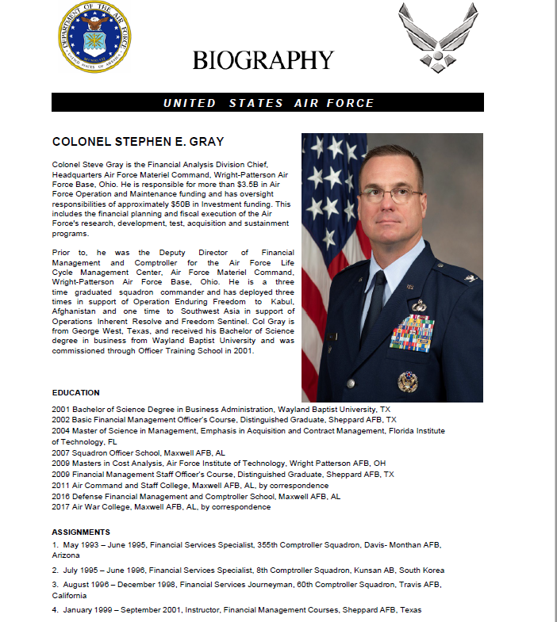
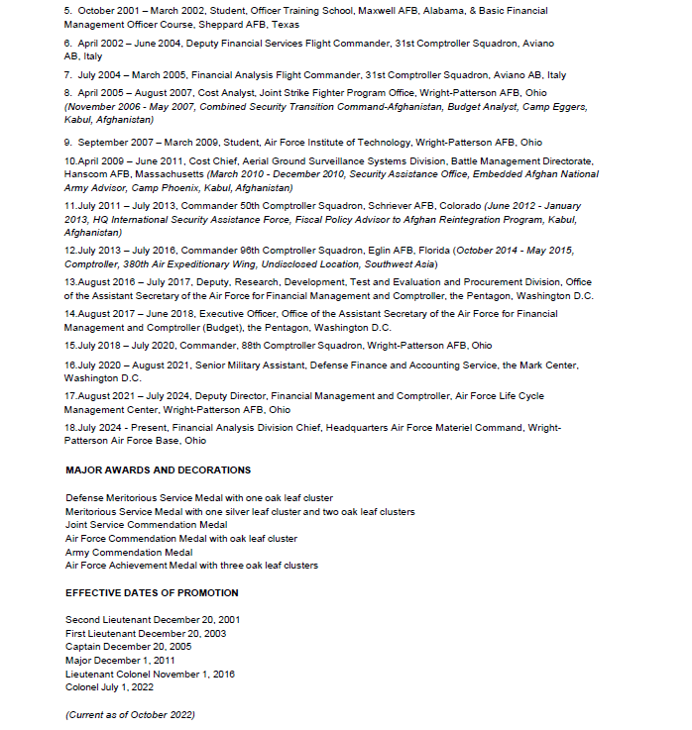

Slide 3


Top 5 Things I’ve Learned
Col Steve Gray, HQ AFMC/FMA
31 October 2024
Controlled by: HQ AFMC/FM
Category: Budget
Limited Dissemination Control: FEDCON
POC: HQ AFMC/FM

Slide 4
Classification
UNCLASSIFIED
The classification of the brief is CONTROLLED UNCLASSIFIED INFORMATION, and the discussion can go up to CONTROLLED UNCLASSIFIED INFORMATION

Slide 5
Overview
UNCLASSIFIED
FY24 Recap
View from my seat in AFMC/FMA
Recommendations for you to consider

Slide 6
FY24 Recap
UNCLASSIFIED
Investment
Procurement
  FY22 Obligations: 98.96%
  $100.8M held for contingent liabilities
  $126.0M declared excess—over 80% Congressional Add or OOC funds
    $114.2M 3010 C-130 Congressional Add
    $6.9M 3080 OOC funds which AQ could not repurpose for Operation Inherent Resolve or European Deterrence Initiative
RDT&E
  FY23 Obligations: 99.95%
  $2.6M held for contingent liabilities
  $8.7M declared excess
    $4.7M denied omnibus source
O&M
AFMC USAF Obligations: 99.9%
AFMC USSF Obligations: 100%
$3.2M held for contingent liabilities
$1.0M declared excess
$42M of UFRs funded since MYR
  $8.8M for EOL Tech Refresh & IT support
  $7.2M for MSTTE
  $4.6M for CRA
  $3M in Quality-of-Life projects
$12M received in the last 72 hours of FY

Slide 7

Show me the Money!
UNCLASSIFIED

Slide 8
O&M Overview
UNCLASSIFIED
O&M makes up about one-third of the AFMC portfolio, or about $32B.
10% is for HQ AFMC, Centers, and Installations

Slide 9
Funding vs Requirements
UNCLASSIFIED

Slide 10
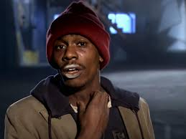

But Another Paper Cut…
UNCLASSIFIED
…Additional ~4% tax from Air Staff to cover GPC bills in FY25
Y’all got any more of that GPC money?
…because of you

Slide 11
FMers
UNCLASSIFIED
Find Money
Force Multipliers
Food Management, especially in September
Y’all got any more of that GPC money?

Slide 12
Top 5 Things I’ve Learned
Respect
Relationships
Results
Responsive
Relax….Have Fun/Core Values

Slide 13
Top 5 Things I’ve Learned
Respect
  Golden rule
  We all put our pants on the same way (military/civilian/contractors/foreign nationals)
  Don’t ever ask anyone to do something you aren’t willing to do yourself
  Humility is a very endearing quality
  Your side vs my side vs the truth
  Get out and see the mission
Relationships
  EIQ
  SEE
  Trust is the oxygen of all relationships
  Boundaries are good
  Harmonize work/life…not balance
  Train them well enough they can leave but treat them well enough so they don’t leave

Slide 14
Top 5 Things I’ve Learned
Results
  Change is Constant
  Growth = Being uncomfortable
  Lowest level empowered…you’ll be surprised
  Leave it better than you found it
  What have you done for me lately (Former Wing/CC)
  Small details matter (basic training; e-mail etiquette; trivial stuff like CETs)
  It’s easy to be bold when it’s not hard…but there’s always “what’s right” at the end of the day
Responsive
  Communicate, communicate, communicate
  If you don’t know, say, “I don’t know.”
  It’s ok to make a mistake (school of hard knocks)…just don’t get a PhD in it
  “got it…give me a xx minutes/hours/days/? to get back to you”
  TW (you have to figure out how to operate effectively: accountability, how to have a hard conversation, give effective feedback via Teams, calendar surfing)

Slide 15
Top 5 Things I’ve Learned
Relax…Have Fun/Core Values
  Integrity is FIRST (former Wing CC told me you can’t teach it)
  Strive for perfection, settle for excellence
  Service before self doesn’t ALWAYS mean sacrifice self
  Strength is not always physical; asking for help = strength (lifeguard)
  If you’re having fun is it really a job?

Slide 16

Recap
FY24 Summary
Big AFMC Budget but smaller subset in O&M
Top 5 things I’ve Learned

Slide 18
O&M Program Categories
UNCLASSIFIED

Slide 19

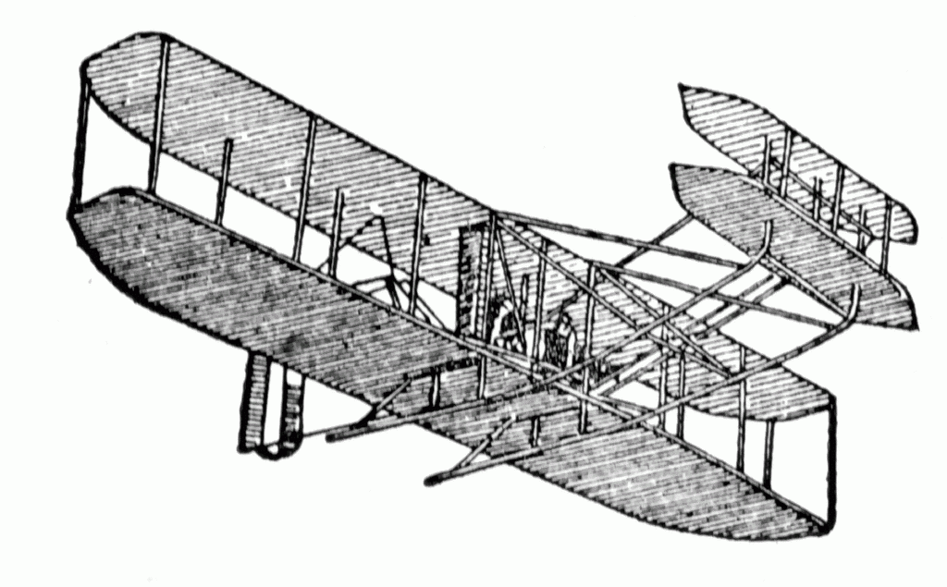
Society of Defense Financial Management
Aviation Chapter
PRESENTS THIS CERTIFICATE OF APPRECIATION TO
Col Stephen E. Gray
WITH A DONATION TO
Tunnel to Towers Foundation
Thomas Giovingo
IN HONOR OF YOUR PRESENTATION
31 OCTOBER 2024
Thomas Giovingo
President, Aviation Chapter

Slide 20
UPCOMING EVENTS/VOLUNTEER OPPORTUNITIES
Crayons to Classrooms
Nov 8th 1300-1500
https://www.signupgenius.com/go/10C094FA8AA2AABF4C16-52094418-asmc
Wreaths Across America
Dec 14th Time TBD
Save the Date
Holiday Party
Nov 19th 10:30am – 3:00pm
$30 per person, Venmo-or cash (by request)
Lunch & Learn
Next event in November 2024

Slide 21
SDFM Aviation Chapter Updates
      Learn more about the
      the SDFM Aviation Chapter at
      https://www.sdfm-aviation.org/

