Slide 1


Comprehensive Cost and Requirement (CCaR™) System
CCaR™ Overview
Integrated Data Services
www.get-integrated.com
16 July 2024
Copyright © 2024 Integrated Data Services All Rights Reserved

Slide 2
Integrated Data Services (IDS) Overview
Software provider founded in 1997
Delivers software products, software development services and support services to the United States Air Force (USAF), United States Space Force (USSF), United States Army, United States Special Operations Command (USSOCOM), Defense Security Cooperation Agency (DSCA), Defense Health Agency (DHA), Joint Strike Fighter (JSF), United States Cyber Command (USCYBERCOM) and other DoD/Fed Civ agencies
Comprehensive Cost and Requirement (CCaR™) is our flagship Enterprise Requirements Management product
  Used by the DoD and other federal departments to provide cradle-to-grave program management capability
  Serving as the single source of truth for program managers, CCaR™ automates otherwise manually intensive processes, integrates siloed program and financial management functions and provides extensive re-porting and analytics capabilities throughout all levels of an organization.
Project Management Resource Tools (PMRT) offers a platform for the development of mission-critical applications utilized by the acquisition workforce to automate day-to-day business processes and leverage data analytics to facilitate oversight requirements
  Integrates authoritative data to deliver enterprise reporting and analytics capabilities
  Fully configurable deployment to support organizations unique processes while supporting enterprise standards
  Primarily used by Air Force, Space Force, Army and USSOCOM Acquisition Executive and Program Offices charged with the delivery and sustainment of the nations most preeminent defense systems

Slide 3

Integrated Data Services
Company Overview
Presenter
Founder-led, bootstrapped software provider, headquartered in El Segundo, CA
  Founded as a Veteran Owned Small Business (VOSB)
Comprehensive Cost and Requirement (CCaR™), our flagship software offering, has and continues to be a cornerstone of program and financial management operations in the Department of Defense (DoD)
  Primarily utilized by Program Offices to automate historically manually-intensive processes centered around program portfolio management, including requirements tracking, funding execution, financial reconciliation and contract management
  Serves as a single source-of-truth for program management, capturing transaction-level program data and providing cradle-to-grave visibility, reporting and analytics throughout all levels of the Program Office
Project Management Resource Tools (PMRT) offers a platform for the development of mission-critical applications utilized by the acquisition workforce to automate day-to-day business processes and leverage data analytics to facilitate oversight requirements
  Integrates authoritative data to deliver enterprise reporting and analytics capabilities
  Fully configurable deployment to support organizations unique processes while supporting enterprise standards
Primarily serves Air Force, Space Force and Army Acquisition Executive and Program Offices charged with the delivery and sustainment of the nations most preeminent defense capabilities
  Other customers include U.S. Special Operations Command, U.S. Cyber Command, Defense Security Cooperation Agency, Defense Health Agency and Department of Energy
Michael King is the Director of Customer Acquisition at Integrated Data Services Inc (IDS) where he is responsible for increasing CCaR™ usage across the DoD and FedCiv customer bases. In addition to this role, Mike also serves as a subject matter expert for both CCaR™ and PMRT. He is a recognized expert in Acquisition, Contracting, Logistics, Manpower, and Financial Management systems and processes.
Prior to his current position, Mike has held multiple leadership positions in the company including; Business Area Manager, Regional Director, Director of Special Projects, and Director of Data Analytic Operations.
Prior to his 22 years at IDS, Mike has held senior positions with Bearing Point, KPMG, EDS, and Lexis-Nexis. Mike holds a BS in Computer Science from the University of Pittsburgh.
LinkedIn Profile

Slide 4
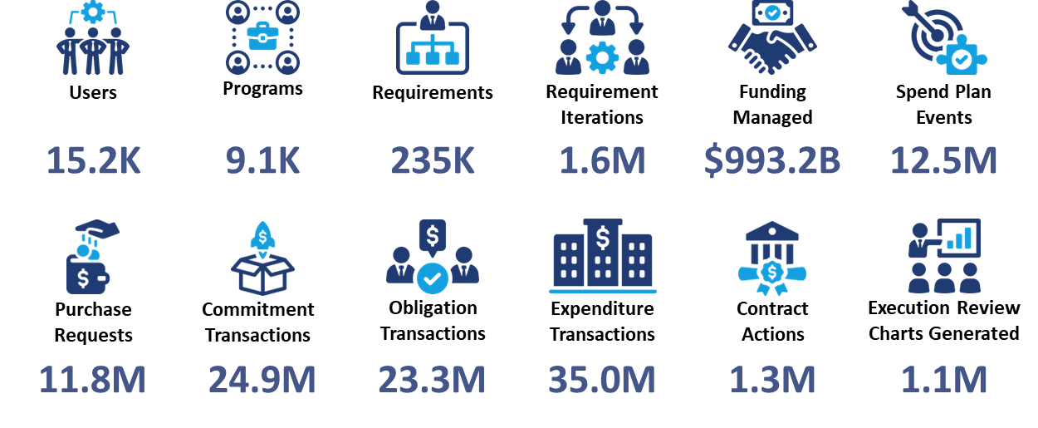
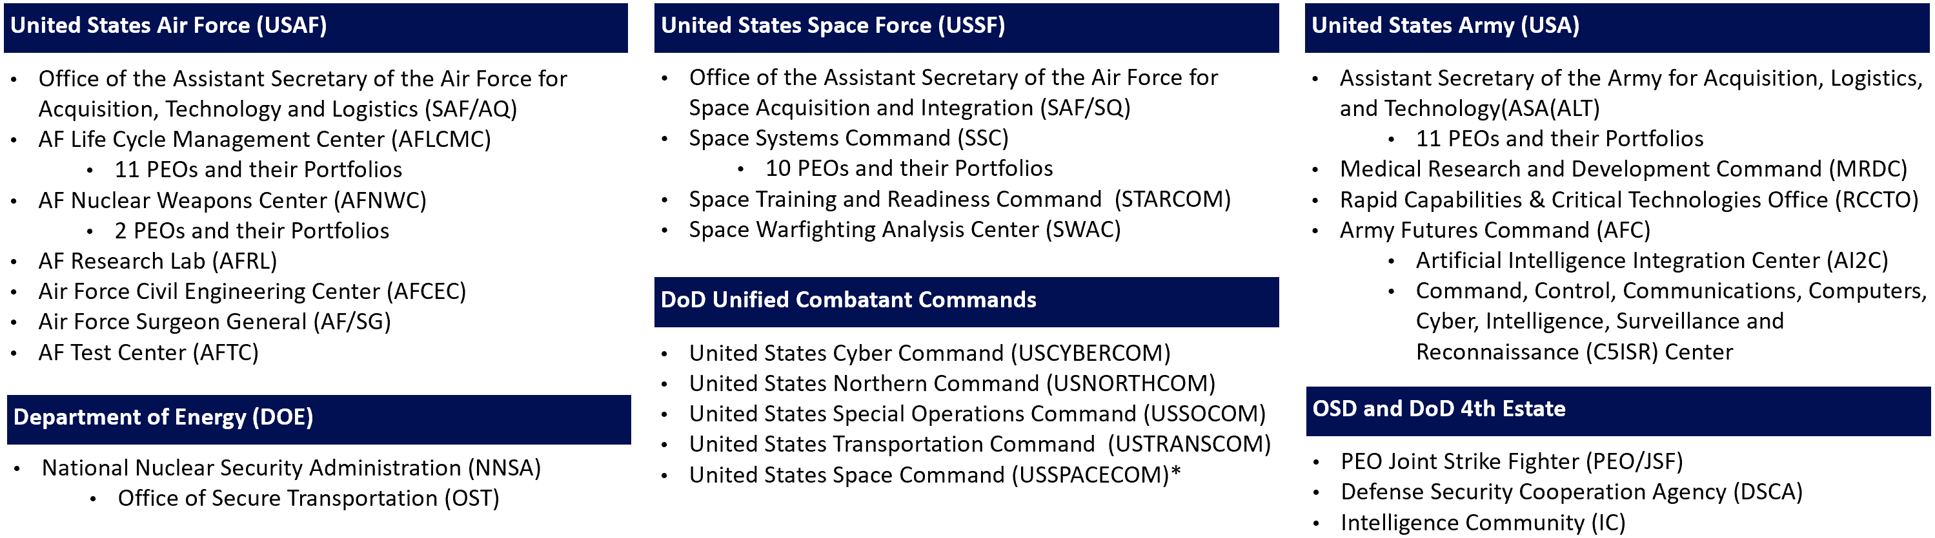
CCaR™ Overview
1997 - CCaR™ deployed to AF Titan PMO
1998 - CCaR™ deployed to the AF Space and Missiles System Center (SMC)
2001 - CCaR™ deployed to the AF Electronic Systems Center (ESC)
2002 - CCaR™ deployed to the AF Aeronautical Systems Center (ASC)
2009 - AF mandates CCaR™ and Executive CCaR™ for AF AML Reporting
2012 - PMRT System established to host CCaR™ and Executive CCaR™
2019 - Army SAE mandates CCaR™ use by PEOs and Program Offices
2021 - CCaR™ Technical Refresh deployed – New UI and Middle Tier
2022 - CCaR™ deployed to DOE OST
2023 - CCaR™ deployment for USSOCOM
*USSPACECOM CCaR™ use scheduled to start 3 Jun 2024

Slide 5
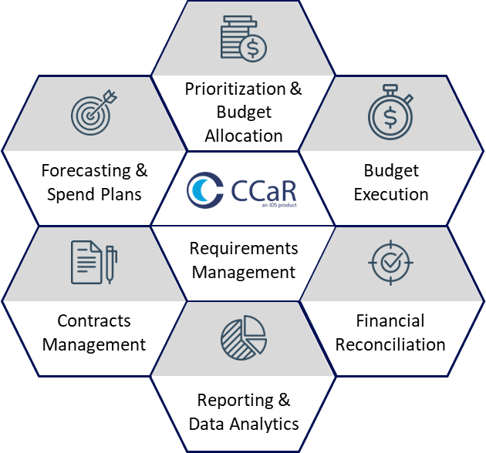
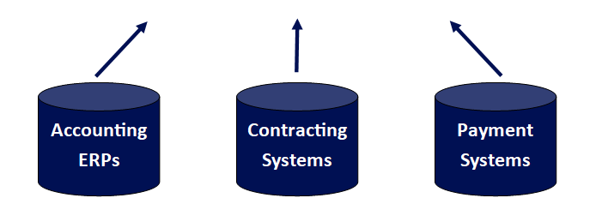
CCaR™ Overview
The CCaR™ Solution
CCaR™ is an enterprise requirements management application used by the DoD and other federal departments to provide cradle-to-grave program management capability.
Serving as the single source of truth for program managers and program offices, CCaR™ automates otherwise manually intensive processes, integrates siloed program and financial management functions and provides reporting and analytics capabilities throughout all levels of an organization.
Integrated, auditable requirements management tool covering all aspects of program management
Problems that CCaR™ Solves
Lack of an enterprise requirements management system leads to organizations using non-standardized processes and tools across their organizations.
Leadership reliant on financial ERPs lacking visibility into requirement level detail.
Pre-decisional, working level data captured in tools like Excel and is neither standardized nor available across the enterprise.
Data gathering and cleansing efforts are resource intensive.
Program management functions, from requirements formulation and prioritization to budget execution and contracting, are siloed.
Integrated with authoritative data sources
Replace Spreadsheets - Augment Your ERPs

Slide 6
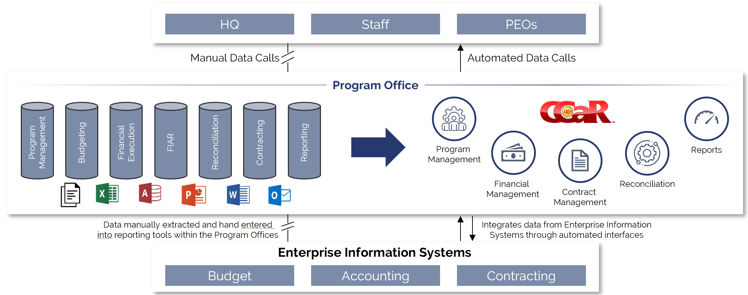
CCaR™ Overview – Challenge -- Solution -- Results
Challenge
Solution
Results
Intensive manual data gathering efforts from multiple internal and external sources required to respond to data calls
Time consuming reconciliations required to validate data from disparate systems used across various Program Offices
Mission-critical software automates working-level processes capturing, documenting, prioritizing and coordinating financial requirements
Standardized tool, data and processes across the organization resulting in the eliminating of tedious manual processes
Users can intuitively and comprehensively define and coordinate financial requirements, formulate budgets, track execution and manage contracts
Real-time information is available to leadership and decision makers for oversight and analytics

Slide 7

CCaR™ Requirements Management
Congress, OSD and the Military Services track data at this level
Budget Lines (example for GPS)
Appn 3620F: Research, Development, Test & Evaluation, Space Force / BA 7: Operational Systems Development / PE 1203265SF: GPS III Space Segment
Appn 3620F: Research, Development, Test & Evaluation, Space Force / BA 5: System Development & Demonstration (SDD) / PE 1203269SF: GPS III Follow-On (GPS IIIF)
Appn 3022F: Procurement, Space Force / BA 01: Space Procurement, SF / BSA 10: Space Programs / BLI GPSIII: GPS III Space Segment
Appn 3022F: Procurement, Space Force / BA 01: Space Procurement, SF / BSA 10: Space Programs / BLI GPS03C: GPSIII Follow On
Appn 3022F: Procurement, Space Force / BA 01: Space Procurement, SF / BSA 10: Space Programs / BLI SPCMOD: Space Mods
Appn 3022F: Procurement, Space Force / BA 02: Spares / BSA 20: Spares / BLI SSPARE: Spares and Repair Parts
DoD Budget Systems and Accounting ERPs align data to Budget Lines
Program Offices/Organizations use CCaR™ to manage requirements for discrete activities/deliverables and create spend plans to forecast budget execution
Enables traceability of low-level requirements and spend plans to budget lines
- Budget Line 1
- Program A
- Requirements 1 .. n
- Spend Plan Events 1.. n
- Program B
- Requirements 1 .. n
- Spend Plan Events 1.. n
- Budget Line 2
- Program B
- Requirements 1 .. n
- Spend Plan Events 1.. n
Without CCaR™ the ability to leverage this data is limited because of non-standardized data sets in spreadsheets.
The requirement management, prioritization/ budget allocation, and forecasting capability do not reside in any other system of record

Slide 8
CCaR™ Alignment to the DOD Data Strategy
“Data Collection – DoD must enable electronic collection of data at the point of
creation and maintain the pedigree of that data at all times.”
DOD 2020 Data Strategy
CCaR™ provides a standardized approach to requirements management and fills a critical capability gap not met by existing PPBE supporting systems
  Budget/Budget Submission systems provide data at a high-level, but do not have backwards traceability to the underlying, lower-level requirements
  Accounting ERPs track commitments, obligations and expenditures but do not tie back to the underlying, lower-level requirements nor do they forecast obligations and expenditures
CCaR™ provides a bottoms-up look at requirements, how requirements are forecasted to execute and how requirements are executing. CCaR™ answers questions that other systems can not
  What requirements are unfunded in the current fiscal year?
  What requirements are unfunded across the FYDP?
  What requirements are unfunded if a Congressional mark reduces the requested amount for a specific budget line?
  Under CRA, which requirements are new starts and shouldn’t be allotted CRA funding for execution?
  What month is my program Procurement Budget forecasted to be ahead of the OSD Obligation execution goals?
  What month is my program RDT&E Budget forecasted to be ahead of the OSD Expenditure execution goals?
  What is the forecasted unexecuted amount at month-end July that increases my INV-001 risk?
  Are my actual Obligations behind or ahead of my Program/Organization’s spend plan?
  Are my actual Expenditures behind or ahead of my Program/Organization’s spend plan?

Slide 9
CCaR™ Alignment to the DOD Data Strategy
“Data Collection – DoD must enable electronic collection of data at the point of
creation and maintain the pedigree of that data at all times.”
DOD 2020 Data Strategy
CCaR™ data is currently being shared with Advana through systems acquisition data sources from the Air Force, Space Force and Army
CCaR™ data is used for the generation of Air Force and Space Force Selected Acquisition Reports (SARs) that are provided to Congress
CCaR™ can be leveraged to support the Commission on PPBE Reform Recommendations
  Recommendation #21 - Strengthen Governance for DoD Business Systems
  Recommendation #26 - Streamline Processes and Improve Analytic Capabilities
Organizations using CCaR™ have a historic documentation of their requirements management actions performed in CCaR™ which supports DoD Financial Improvement and Audit Readiness (FIAR) traceability of budget expenditures to Program/Organization requirements

Slide 10
CCaR™ Manages Requirements for Programs Below the Budget Line
Budget Lines Fund Multiple Programs -- Programs Use Multiple Budget Lines
B-2 Procurement & RDT&E Budget Lines
B-2 Acquisition Programs and Investment Activities
Appn: 3600 Budget Activity: 07
PEC: 0101127F Line Item Title: B-2 Squadrons
AF PEC: 11127F
Project(s)/BPAC(s): 675345, 676021
Program | Program Type
B-2 Display Modernization Program (B-2 BDM) | Acquisition Program (ACAT II)
B-2 Adaptable Communications Suite (B-2 ACS) | Acquisition Program (ACAT III)
B-2 Common Very Low Frequency Receiver (B-2 CVR) | Acquisition Program (ACAT III)
B-2 Identification Friend or Foe (IFF) Mode 5/S (B-2 IFF Mode 5/S) | Acquisition Program (ACAT III)
B-2 Joint Air-to-Surface Standoff Missile-Extended Range Integration (B-2 JASSM-ER) | Acquisition Program (ACAT III)
B-2 Low Cost Mods (B-2 LCM) | Acquisition Program (ACAT III)
B-2 Low Observable Signature & Supportability Mods (B-2 LOSSM) | Acquisition Program (ACAT III)
B-2 Military Global Positioning System User Equipment Production (B-2 MGUE) | Acquisition Program (ACAT III)
B-2 Trainer System Upgrade (B-2 ATS/MTS) | Acquisition Program (ACAT III)
B-2 Flight Test Support (B-2 Flight Test Support) | Investment Activity
B-2 Weapon System Support Center Labs (B-2 WSSC) | Investment Activity
1
1
2
3
4
5
1
2
3
Appn: 3010
Budget Activity: 05 Budget Sub Activity: 01
Line Item/WSC: B00200 Line Item Title: B-2A
AF PEC: 11127F AF BPAC: 11B02A
2
3
4
5
2
2
Appn: 3010
Budget Activity: 06 Budget Sub Activity: 10
Line Item/WSC: 000999 Line Item Title: Initial Spares/Repair Parts
AF PEC: 11127F AF BPAC: 16B02A
1
3
2
3
Appn: 3010
Budget Activity: 07 Budget Sub Activity: 02
Line Item/WSC: B00200, B002B0 Line Item Title: B-2A, B-2B
AF PEC: 11127F AF BPAC: 13B02A
1
2
4
2
3
4
5
1
2
3
Appn: 3010
Budget Activity: 07 Budget Sub Activity: 05
Line Item/WSC: 000075 Line Item Title: Other Production Charges
AF PEC: 11127F AF BPAC: 190000
5
1
4

Slide 11
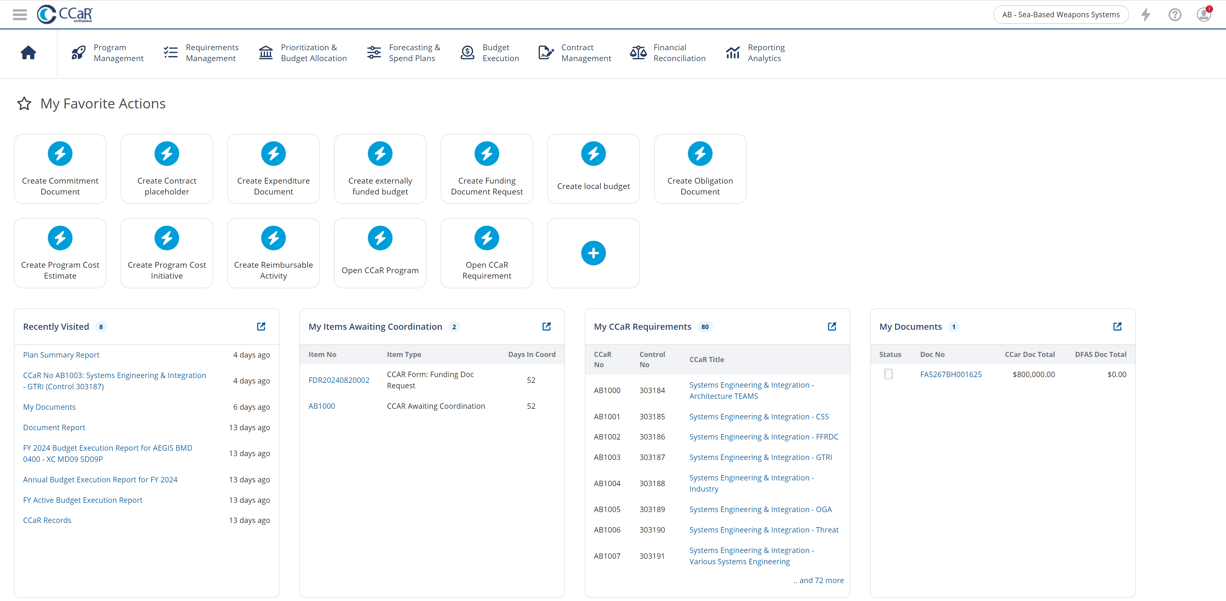
CCaR™ Overview

Slide 12
CCaR™ Roadmap
Requirement Prioritization Tool
  Machine-assisted prioritization and what-scenarios to allow Programs to conduct tradeoffs, define courses-of-actions and make decisions
Unfunded Requirements (UFR) Submission Package
Program Office Action Items/Taskers
Budget Submission P-Docs/R-Docs
Program Review 4th Gen automated PowerPoint generation
Large language model (LLM) AI integration to provide knowledge-intensive natural language processing (KI-NLP)

Slide 13





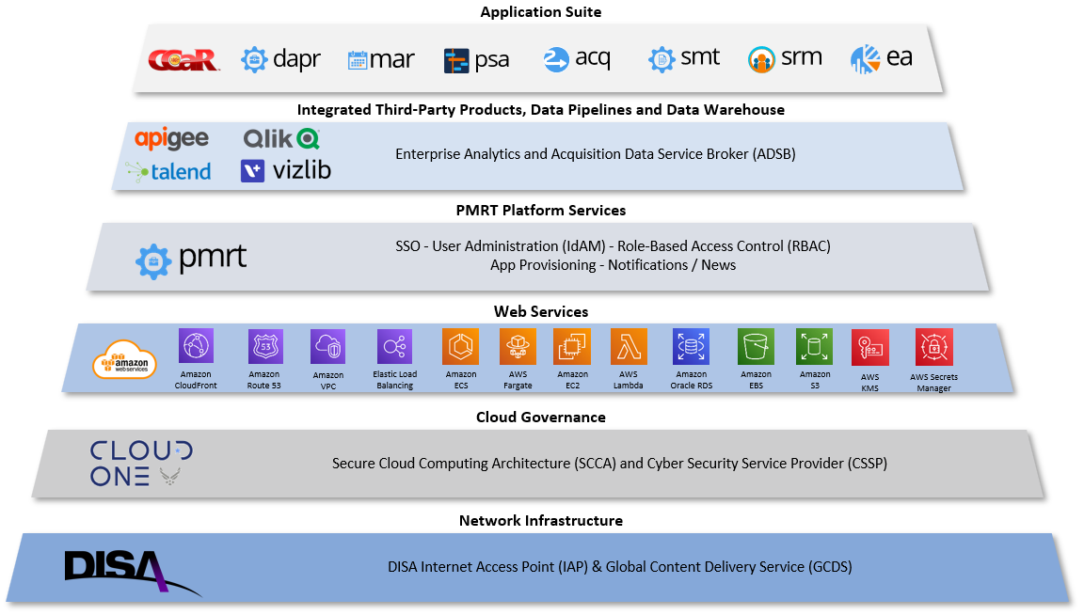
PMRT Overview
PMRT Overview
PMRT Governance & Hosting
The Project Management Resource Tools (PMRT) System is a suite of enterprise applications designed to support DoD program management, financial management, acquisition reporting and program oversight
  The Air Force, Space Force and Army mandate the use of CCaR™ and other PMRT applications to capture and manage Systems Acquisition Programs and Science & Technology (S&T) Projects and their associated investment appropriations (RDT&E and Procurement)
PMRT provides a platform for the deployment of mission-critical applications utilized by the acquisition workforce to automate day-to-day business processes and leverage data analytics to facilitate oversight requirements
  Captures the authoritative data from the PMRT applications
  Interfaces with and integrates data from Air Force, Army and DoD Systems
  DAVE, Advana, Envision, Vantage, GAFS, DEAMS, GFEBS, Navy ERP, MOCAS, FPDS-NG, PBIS, FSRS, SAM.GOV, EVM-CR, CON-IT, CONWRITE, CBIS, SPS, etc.
Reduces the need for program offices to answer headquarter data calls
Provides senior acquisition leadership and program analysts insight and visibility to Acquisition Programs and Investment Activities
Program Management Office (PMO): AFLCMC/GBBX, WPAFB
DAF Functional Lead: SAF/AQXS CIO
Space Force Functional Lead: SAF/SQXE
Army Functional Lead: OASA(ALT) DASA PPR ADFO
USSOCOM Functional Lead: SOF AT&L

Slide 14
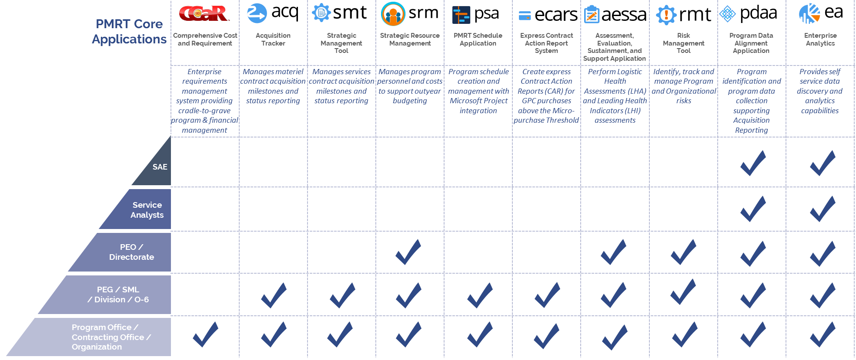
PMRT Overview - Core Applications

Slide 15

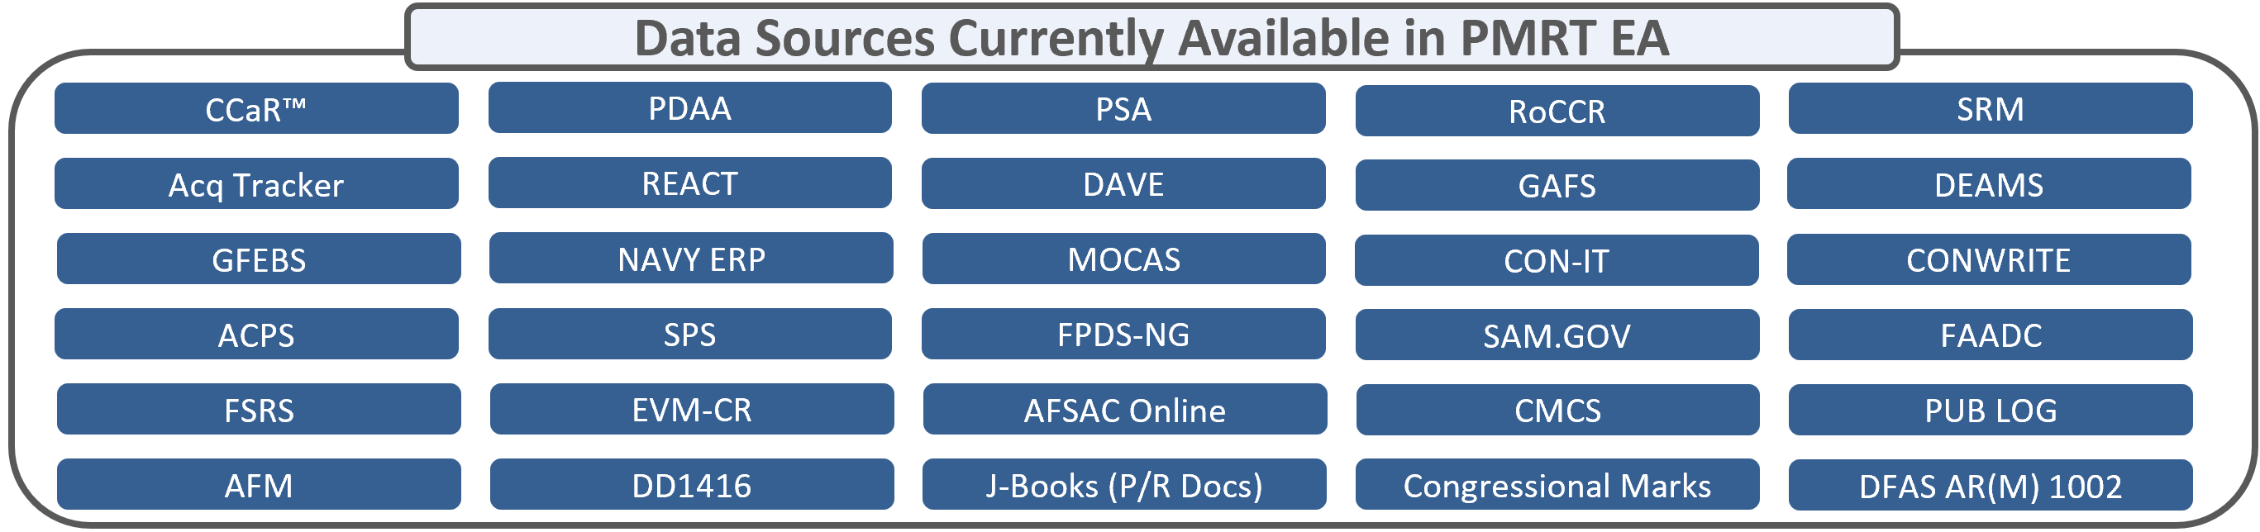

PMRT Overview – PMRT EA
Program, financial and contracting data is extracted, cleansed and stored in the PMRT Data Warehouse, reducing data transfers to external systems to ensure data accuracy
PEOs and PMOs access the same data set as SAF/AQ and SAF/SQ to avoid unexpected outcomes during program reviews
USAF and USSF acquisition enterprise capability available at no added cost to Acquisition Centers, PEOs, PMOs and Research Labs
Authoritative Data Sources from Automated Interfaces
CAC Single Sign-On Access through the PMRT Portal
Self-Service Data Discovery, Analytics, Business Intelligence and Visualization

Slide 16
PMRT Roadmap

Slide 17
DEMONSTRATION

Slide 18
CCaR™ Roadmap
BACKUP

Slide 19

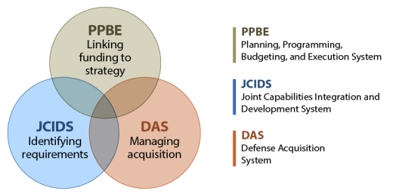


CCaR™ PPBE Touchpoints
Funding Policies
CPR, IPLs, DPG, Fiscal Guidance, Budget Review, RMD, FYDP
POM BES
Strategic Guidance
NSS/NDS/NMS, DPG, GEF
Capability Requirements and Solutions
Programs
S&T, Acquisition, Sustainment
Cost & Financial Requirements APB
Threats/Conditions
Joint Operating Environment (JOE)
Capability Requirements
JCIDS Urgent/Emergent/Deliberate
Missions / Planning / Operations
OPLANs, Scenarios, CONOPs
ICDs, CCDs, CPDs
Life Cycle Cost
Weapons System Sustainment
DAS
Managing Acquisition
President’s Budget
Budget Authority / TOA
Treasury Warrant
OMB Apportionment
OUSD(C) Allocation
Services Sub-Allocation to MAJCOM & Acquisition Centers
Congressional Enactment
HBC, SBC, HASC, SASC, HAC-D, SAC-D
Authorization Appropriation
Spend Plans -- Target Loads -- Commit, Obligate, Expend
Execution Reviews – Program Reviews – INV-001 -- Reprogramming

Slide 20
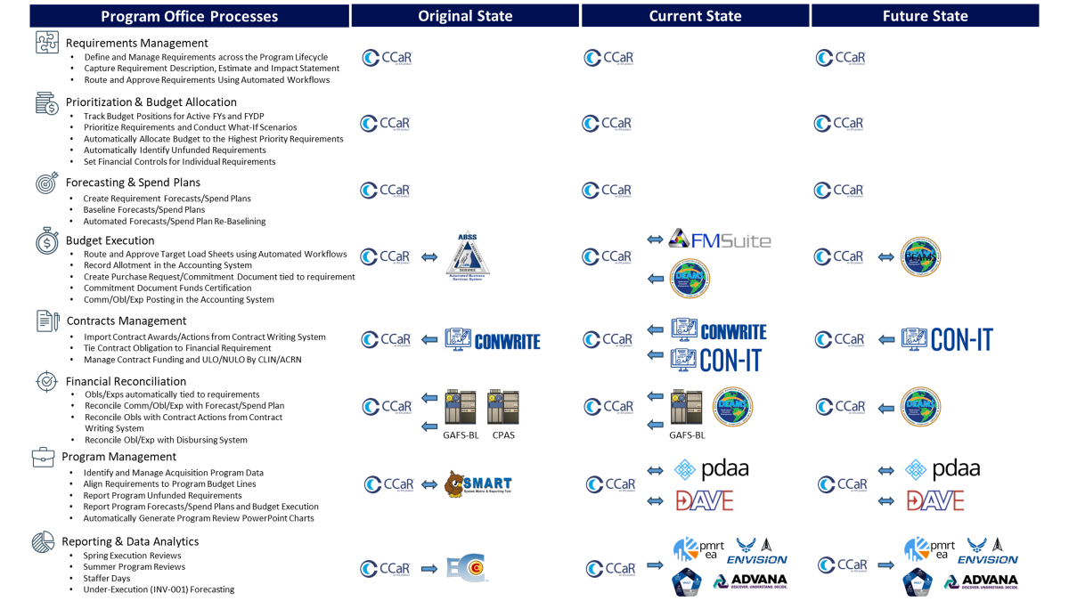
CCaR™ Processes

Slide 21

CCaR™ Requirements Management
In the context of CCaR™, a “Requirement” represents the lowest level at which a discrete activity/deliverable is planned and managed by the Program Office.
Requirements exist across fiscal years and throughout the PPBE process, so that a Requirement can be tracked through planning and execution, from inception until completion.
RDT&E, Procurement, O&M, etc . . .
Funding Sources
Defense Working Capital Funds
Foreign Military Sales (FMS)
International Partner Program Funding
Program Inception
Funds From External Organizations
Prime Contract - RDT&E
S&T/Research
Modeling & Simulation
Prime Contract - Production
Support Equipment
Hardware/Software
Spares
Prior FYs
Active FYs
Engineering Support
Engineering Change Orders
Test Facilities
Test Support
FYDP
Requirement 1
Requirement … n
Beyond FYDP
Requirement 2
Requirement 3
Requirement 4
Requirement 5
Requirement 6
Requirement 7
Requirement 8
Requirement 10
Contractor Logistics Support (CLS)
Centralized Asset Management (CAM)
Training
Requirement 11
Advisory and Assistance Services (A&AS)
Travel
Supplies
Program Disposal
Lifecycle
FY Phasing
Financial Requirements

Slide 22
CCaR™ – Budgeting
Tracks Standard Financial Information Structure (SFIS) compliant appropriated budgets, Foreign Military Sales (FMS) cases and International Partner funds
Tracks funding from external organizations (aka Incoming Documents)
Track and adjust programmed funding and budget authority across Program Requirements
Drill-down into Program Requirements and transaction-level details
Budget Builder Tool used to build-up budget positions and conduct what-if drills

Slide 23
CCaR™ – Spend Plans/Forecasting
CCaR™ Forecasting Tools simplify the creation of Commitment, Obligation and Expenditure Spend Plans and identify requirements with at-risk spend plans
  Forecast events have sperate Suggested, Current and Baseline dates/amounts
As plans change, CCaR™ provides a revised forecasting capability, while still maintaining the original baseline forecast
Actual execution transactions are tied to plan events, identifying when forecasted events are complete

Slide 24
CCaR™ – Budget Execution
CCaR™ Funding Document Requests automate the Purchase Request (PR) package process that links the requirement to the PR, collects supporting documentation and provides an auditable authorization to create a PR
CCaR™ automatically generates DoD Purchase Request Data Standard (PRDS) compliant PRs and submits the PRs to the accounting system for funds certification
CCaR™ interfaces with several SFIS-compliant DoD accounting systems including Defense Enterprise Accounting and Management System (DEAMS), General Fund Enterprise Business System (GFEBS) and Navy Enterprise Resource Planning (ERP)
CCaR™ identifies programs behind forecast and below OSD execution goals to re-program funds within the portfolio and reduce the likelihood that HQ/OSD will direct funding cuts based on poor execution

Slide 25
CCaR™ – Contracts Management
CCaR™ interfaces with Contract Writing Systems and integrates with the DoD Global Exchange (GEX) to import DoD Procurement Data Standard (PDS) compliant contract/order awards and modifications
CCaR™ manages the contract value and funding by Contract Line Item Numbers (CLIN), SubCLINs and Accounting Classification Reference Numbers (ACRN)
CCaR™ identifies contract funding shortages, Unliquidated Obligations (ULO) and Negative Unliquidated Obligations (NULO), and automatically links the contract data to their corresponding accounting transactions to allow contracts to be reconciled in real-time resulting in streamlined contract closeout
The contract data in CCaR™ also ties back to the original requirement to provide an auditable trace of contract spend

Slide 26
CCaR™ – Financial Reconciliation
CCaR™ ingests U.S. Standard General Ledger (USGL) Commitment, Obligation and Expenditure accounting transactions and performs automated reconciliation with PRs created in CCaR™
  Discrepancies automatically flagged for analysis and corrected
CCaR™ ingests contract obligations from contract writing systems to reconcile against postings in the accounting system
  Each accounting transaction ties back to the original requirement providing an auditable trace to support the expense of every dollar.
MOCAS interface supports reconciliation of conformed contract with DFAS and MOCAS obligations/expenditures

Slide 27
CCaR™ – Reporting and Data Analytics
CCaR™ provides real-time financial and program management reporting with intuitive filtering, sorting and grouping capabilities as well as one-click exporting to Microsoft Excel
CCaR™ ad hoc reporting allows users to define their own reports and share them with others
CCaR™ also generates native PowerPoint presentations with standard financial and program management charts
This integrated capability results in significant time savings to financial analysts who can accomplish higher priority tasks rather than manually building time-consuming charts
CCaR™ Enterprise Analytics (EA) also enhances leadership decision-making by leveraging AI-assisted data analytics
These powerful visualizations present CCaR™ requirements and execution data in various formats and views allowing key decision-makers to extract meaningful insights across their portfolios
CCaR™ Application Programming Interfaces (APIs) with Advana, Qlik Sense®, Tableau® and Power BI allow the customer to choose which data analytics platform(s) they want to leverage to seamlessly utilize the data captured within CCaR™

