Slide 1
Intelligence Resource Management @ NASIC
UNCLASSIFIED
Overall Classification for this Briefing is UNCLASSIFIED
David Arvin
Comptroller, NASIC
26 June 2024
UNCLASSIFIED

Slide 2
Agenda
UNCLASSIFIED
NASIC Overview
Intelligence Resource Management Overview
Financial Management @ NASIC
Unique Civilian Pay Challenge at NASIC
Personal Reflections
UNCLASSIFIED

Slide 3
NASIC Overview
UNCLASSIFIED
UNCLASSIFIED

Slide 4
Our Organization
UNCLASSIFIED
Workforce Demographics |  | ~ 4,000
 | Civilians | 42% | 1,700
 | Contractors | 29% | 1,150
 | Active Duty Military | 20% | 800
 | Ohio Guard / Reserve Units | 9% | 350
Career Fields |  | > 80
 | Intel | 40% | ~ 1,000
 | Engineer /Scientist | 36% | ~ 900
 | Other | 24% | ~ 600
NASIC
Headquarters
HUMINT
Mission
Liaison
Officers
UNCLASSIFIED
Notes:
Air Force’s service intelligence center
Primary source for foreign air and space threat analysis.
Field Operating Agency reporting to the Deputy Chief of Staff for ISR, and Cyber Effects Operations
Operational wing in the AF ISR enterprise
4 groups, 18 squadrons

Slide 5
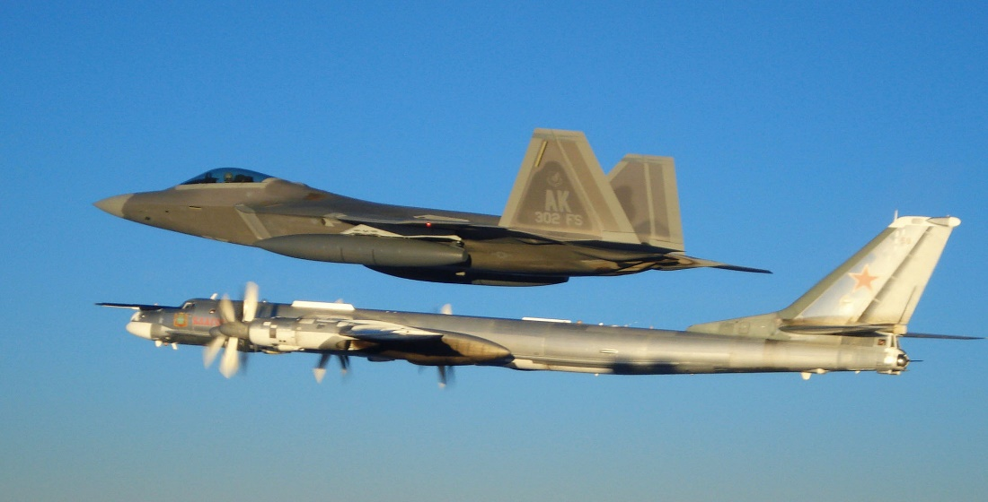

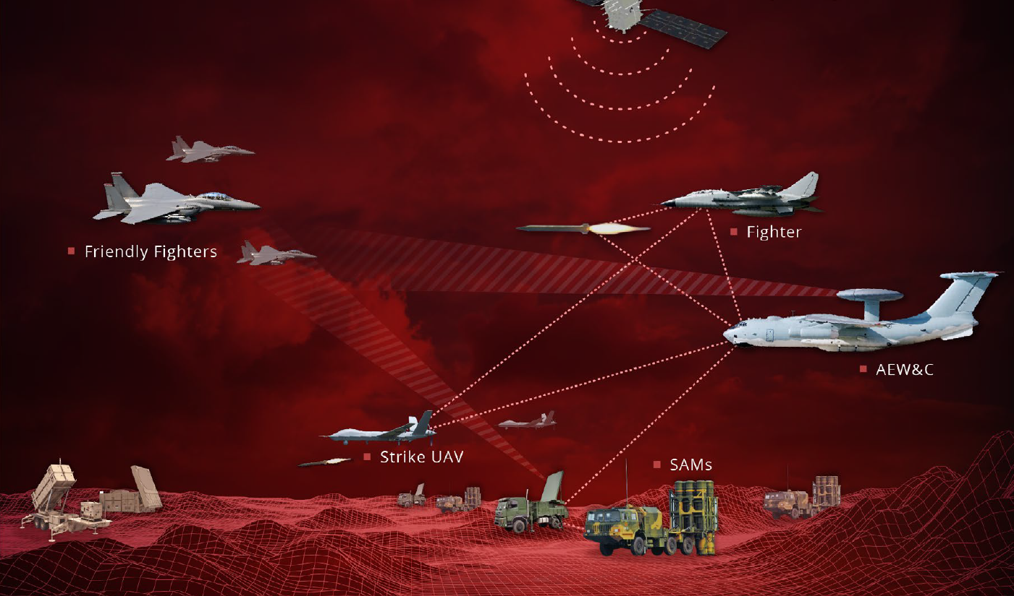
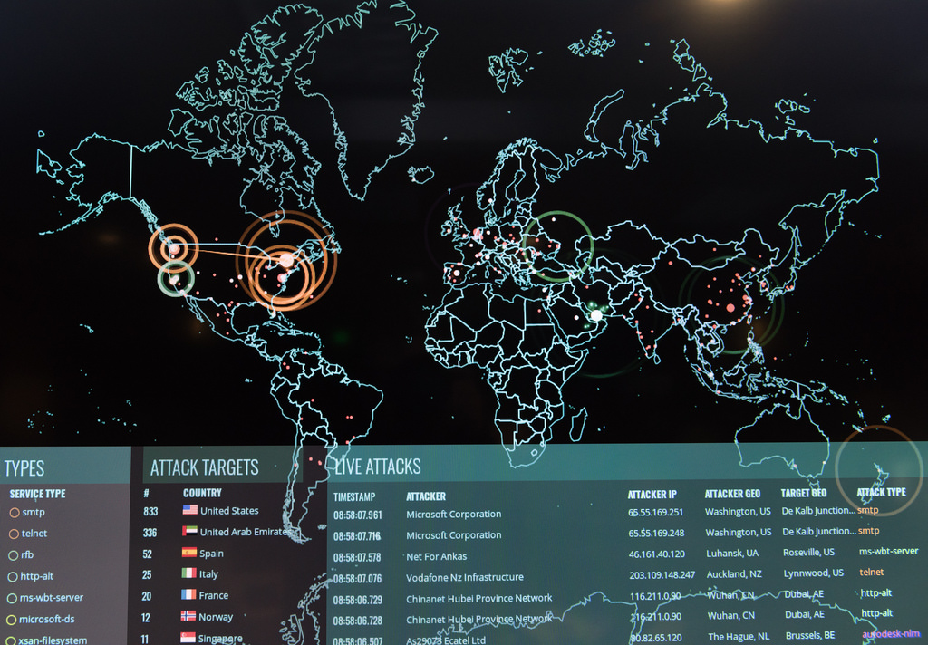
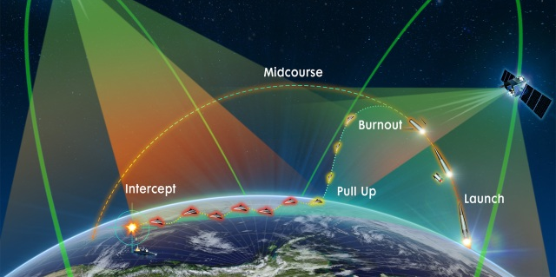
What We Do
UNCLASSIFIED
AIR
MISSILE
C4ISR
CYBER
FROM SPACE
UNCLASSIFIED
Notes:
Provides authoritative, engineering-level scientific and technical intelligence on air, space, missile, and cyber threats.
Trusted SMEs deliver unique collection, exploitation, and analytic capabilities not found elsewhere
Discover and characterize advanced threats to enable full-spectrum, multi-domain operations against peer adversaries

Slide 6

Who We Support
UNCLASSIFIED
UNCLASSIFIED
Notes:
NASIC creates advantage that gives policymakers, warfighters, and the acquisition community a war-winning edge.

Slide 7
Intelligence Resource Management Overview
UNCLASSIFIED
UNCLASSIFIED

Slide 8
The US Intelligence Community
UNCLASSIFIED
Defense Department
Components
Independent Agencies
Components
in other Departments
Central Intelligence Agency
Defense Intelligence Agency
Department of State
Intelligence and Research Bureau
National Security Agency
Department of Homeland Security
  Office of Intelligence & Analysis
  U.S. Coast Guard Intelligence
Office of the Director of National Intelligence
National Reconnaissance Office
Department of Treasury
Office of Terrorism & Financial Intelligence
National Geospatial- Intelligence Agency
Department of Energy
Office of Intelligence and Counterintelligence
Army Intelligence
Department of Justice
Federal Bureau of Investigation Intelligence Branch
Drug Enforcement Administration
Office of National Security and Intelligence
Navy/USMC Intelligence
Air Force/Space Force Intelligence
UNCLASSIFIED
Copyright 2024 | The Intelligence & Security Academy, LLC® | All Rights Reserved

Slide 9
Overlapping Communities
UNCLASSIFIED
Intel
Community
Dept. of
Energy
Department of
Defense
DOE/
OICI
DIA
OSD
NGA
NSA
OJCS
Dept. of
State
DOS/
INR
NRO
CIA
USAF
DLA
Army
ODNI
Treasury/
OTFI
Navy
DCSA
Dept. of
Treasury
USMC
USSF
MDA
DEA/INSI
FBI/IB
USCG/IN
DHS/I&A
Dept. of
Justice
Dept. of Homeland Security
Defense Intelligence
UNCLASSIFIED
Copyright 2024 | The Intelligence & Security Academy, LLC® | All Rights Reserved

Slide 10
Management & Oversight of National Security Intelligence
UNCLASSIFIED
SECDEF
DNI
USD(I&S)
CJCS
Defense Department
Policy
Military
Operations
National
Priorities
Intelligence support
DoD components of
the Intel Community
Sources of Funding
Sources of Funding
Military Intelligence Program (MIP)
National Intelligence Program (NIP)
UNCLASSIFIED
Copyright 2024 | The Intelligence & Security Academy, LLC® | All Rights Reserved
Notes:
The box in the center of the chart represents the eight components of the IC and DoD that fell in the cusp of the two overlapping circles in the previous slide.
Being components of both the IC and DoD, these organizations work for both the SECDEF and the DNI.
On the DoD side, we see that there are two sets of concerns of these components–the implementation of and compliance with DoD policy (which is overseen by the USD[I]) and support to military operations (which is of prime importance to the JCS and their Chairman). On the right side, we see that the DNI is most concerned about national priorities.
The DoD components of the IC are responsible for providing intelligence support to all these priorities–to military operations, compliant with and supportive of DoD policies, and to national priorities.
It costs money to provide this support. This money comes primarily from two broad sources. The primary sources of funding for intelligence support to military operations are those portions of DoD components’ budgets that are referred to collectively as the Military Intelligence Program (MIP); the primary sources of funding for intelligence support to national priorities are several component programs within the National Intelligence Program (NIP).
We’ll now examine these broad funding sources, starting with the NIP.

Slide 11
NIP and MIP Process Differences
UNCLASSIFIED
 | NIP (IPPBE) | MIP (PPBE)
Governing document | Title 50 | Title 10
Span | Inter-departmental | Intra-departmental
Priorities | National/Strategic/IC-wide | Tactical/Operational/DOD-wide
Senior Official | Program Manager (DNI) | Program Executive (USD(I&S)/DDI)
Managers | Program | Component
Key Players | CFO and RCE | CFO and CAPE
Budget Structure | Expenditure Center | Program Element
Funds | “Fenced” | “Protected”
Resource Trade-offs | Intelligence vs. Intelligence | Intelligence vs. Non-Intelligence
Primary Authorizers | Intelligence Committees | Armed Services Committees
Appropriators | HAC & SAC Defense Sub-Committees | HAC & SAC Defense Sub-Committees
UNCLASSIFIED
Copyright 2024 | The Intelligence & Security Academy, LLC® | All Rights Reserved

Slide 12
NIP Programs
UNCLASSIFIED
Single-organization programs
  Office of the DNI (ODNI)
  Central Intelligence Agency Program (CIAP)
  National Reconnaissance Program (NRP)
  State Intelligence & Research Bureau NIP
  Treasury Office of Terrorism & Financial Intelligence NIP
  Energy Office of Intelligence & Counterintelligence NIP
Dual-hatted programs
  General Defense Intelligence Program (GDIP)
  Consolidated Cryptologic Program (CCP)
  National Geospatial-intelligence Program (NGP)
Intel
Community
Dept. of
Energy
DOE/
OICI
Department of
Defense
DIA
NGA
OSD
NSA
OJCS
Dept. of
State
DOS/
INR
NRO
CIA
USAF
DLA
ODNI
Army
Dept. of
Treasury
Treasury/
OTFI
Navy
DCSA
USMC
USSF
MDA
DEA/INSI
USCG/IN
FBI/IB
Dept. of
Justice
DHS/I&A
Dept. of Homeland Security
Defense Intelligence
Other Agencies
  DHS: USCG/IN and DHS Office of Intel and Analysis NIP
  DOJ: FBI/Intel Branch and DEA/Office of National Security NIP
UNCLASSIFIED
Copyright 2024 | The Intelligence & Security Academy, LLC® | All Rights Reserved
Notes:
This slide makes one very critical point regarding NIP in the Defense Dept. That point being the fact that there are three NIP component programs that are shared by multiple components of the department:
- GDIP, by DIA, the Services, and USSOCOM
- CCP, by NSA, the Services, and USSOCOM
- NGP, by NGA, the Services, and USSOCOM
It is crucial that students understand how this relates to the role of the Program Managers of these four programs, as compared to those who manage programs that belong to a single IC component. These PMs must serve as honest brokers of the funding they manage, since they represent the interests of not only their respective agencies, but also those of the Services and SOCOM.
The slide also points out that a similar situation exists in the other two departments with multiple IC components, who share single funding programs, i.e., DHS and Justice, but on a much smaller and less complex scale.

Slide 13
Intelligence Funding Sources
UNCLASSIFIED
Component | MIP Sources | NIP Sources
Services | Service MIP | GDIP, CCP, NGP
USCG |  | DHS NIP, CCP, NGP
CIA |  | CIAP
DIA | DIA MIP | GDIP
NSA | NSA MIP | CCP
NGA | NGA MIP | NGP
NRO | NRO MIP | NRP
USSOCOM | USSOCOM MIP | GDIP, CCP and NGP
Other CCMDs | DIA MIP | GDIP, NGP, CCP
DOS, DHS, DOJ, DOE, Treasury |  | Department Specific NIP
USD(I&S) | OSD MIP
ODNI |  | ODNI NIP (CMA)
UNCLASSIFIED
Copyright 2024 | The Intelligence & Security Academy, LLC® | All Rights Reserved
Notes:
Start by explaining that, to this point we have defined and described NIP and MIP, and have identified the organizations funded under each. We’re now going to look at each DOD component and see which type or types of NIP and/or MIP it has in its budget.
Explain that everything listed in the left-hand “MIP/NIP Funding Source(s)” column is integrally part of the component’s budget, while everything in the right-hand column represents that component’s share of one or more NIP funding programs. (The GDIP, CCP, FCIP, and NGP are all shared programs; the NRP has only one recipient--the NRO.)
Since the Services, DIA, NSA, NGA, NRO, and USSOCOM all have both MIP and NIP funding, each has two separate budget submissions each year—one to OSD and the other to ODNI. This means that later, when we talk about POMs/BESs and IPBSs and the processes associated with each, whatever we discuss will be pertinent to all these components. Competition for MIP funding involves everything going to OSD for approval, whether intelligence or not; items that compete successfully will be included in the budget submitted to the President by the SECDEF. Everything competing for NIP funding will go through the component’s internal approval chain, and then through a program manager and the DNI, on their way to the President and the Congress.
Thus, MIP and NIP budget items get to Congress through two different channels. Everything that makes it through Congress comes back to the components through a single channel—the DOD Budget. That is, every dollar of MIP or DOD NIP funding comes from Congress in the DOD appropriation, and that dollar will be spent according to DOD rules (with oversight by the DNI and the pertinent program manager.
Note, DIRNSA staff treat USCG as a service cryptologic element, and provides that service some CCP funding (an example of the “interdepartmental” nature of the NIP).

Slide 14
Funding Accounts in a Military Command’s Budget
UNCLASSIFIED
Accounts containing
non-
intelligence
funding
The controlling authority over expenditures from these accounts is the military commander.
Integral portions
of host organization’s budget
MIP funding
accounts
Controlled by commander, but “protected” –subject to USD(I&S) oversight & intervention.
Externally
controlled “fenced” funds
Managed by the command’s intelligence staff, under guidance/direction of the DNI, through the NIP program manager. (The controlling authority is not the commander.)
NIP funding
accounts
UNCLASSIFIED
Copyright 2024 | The Intelligence & Security Academy, LLC® | All Rights Reserved
Notes:
The chart illustrates the concept of protection of intelligence resources and compares the degree of protection enjoyed by MIP (in the middle box) and NIP (in the bottom box).
The only thing that distinguishes MIP from other accounts in the command’s budget is the potential intervention by the USD(I&S) to prevent or reverse the use of these funds for non-intel purposes. Like all other issues involving OSD intervention in the actions of military commands, the question is whether or not the problem “hits the radar scope” and warrants OSD attention and action.
The main hammer the USD(I&S) holds is the threat of action by the USD(I&S) on future budgets, as punishment for current unauthorized use of funds.
On the other hand, the DNI has statutory authorities over current execution, as well as the ability to modify future budgets in punishment for current offenses. Besides, program managers and Service intelligence chiefs can intervene at a successively lower levels to head off problems without having to elevate the issue to the DNI.

Slide 15
Intelligence Spending in Context
UNCLASSIFIED
 | FY12 | FY13 | FY14 | FY15 | FY16 | FY17 | FY18 | FY19 | FY20 | FY21 | FY22 | FY23 | FY24 | FY25
NIP | 53.9 | 49.0 | 50.5 | 50.3 | 53.0 | 54.6 | 59.4 | 60.2 | 62.7 | 60.8 | 62.3 | 67.1 | 72.4 | 73.4
MIP | 21.5 | 18.6 | 17.4 | 16.5 | 17.7 | 18.4 | 22.1 | 21.5 | 23.1 | 23.3 | 23.3 | 26.6 | 29.3 | 28.2
NIP +MIP | 75.4 | 67.6 | 67.9 | 66.8 | 70.7 | 73.0 | 81.5 | 81.7 | 85.8 | 84.1 | 85.6 | 93.7 | 101.7 | 101.6
National Defense Budget | 681 | 610 | 622 | 598 | 624 | 656 | 727 | 746 | 775 | 754 | 768 | 773 | 842 | 850
NIP/MIP % Nat’l Defense Budget | 11.8 | 11.8 | 10.7 | 11.2 | 11.3 | 11.1 | 11.2 | 11.1 | 11.1 | 11.2 | 11.1 | 12.1 | 12.1 | 11.9
Dollars in billions
Table Notes:
NIP and MIP topline numbers, with the exception of FY22 and beyond, are appropriated dollars, published by the DNI and SECDEF respectively on dni.gov and defense.gov. The numbers include base budget and OCO dollars.
National defense budget numbers reflect OMB’s published “Function 050 National Defense spending.” See Historical Tables, Table 5.1, Budget Authority by Function and Sub function: 1976-2026, available at www.whitehouse.gov.
UNCLASSIFIED
Copyright 2024 | The Intelligence & Security Academy, LLC® | All Rights Reserved

Slide 16
Financial Management at NASIC
UNCLASSIFIED
UNCLASSIFIED

Slide 17
SPPBE
UNCLASSIFIED
Strategy
Strategic Objectives Operational Objectives
Planning Priorities & GAPS
Programming Strategic Outcomes & Programmatic Activities
Budgeting Employ Specific Budget Direction
Execution
Title 50 Responsibilities: 17 Governmental Organizations; Protection of Data, Sources, Means, and Methods
IPPBE
National Intel Strategy (NIS)
Intel Planning Guidance (IPG)
Expected Accomplishments, PMRs
NIP
National Security Strategy (NSS)
Consolidated Intelligence Guidance
(CIG)
National Defense Strategy (NDS)
Defense Planning Guidance (DPG)
Expected Accomplishments, PMRs
PPBE
MIP
Title 10 Responsibilities: To Organize Train and Equip Services/Forces
UNCLASSIFIED

Slide 18
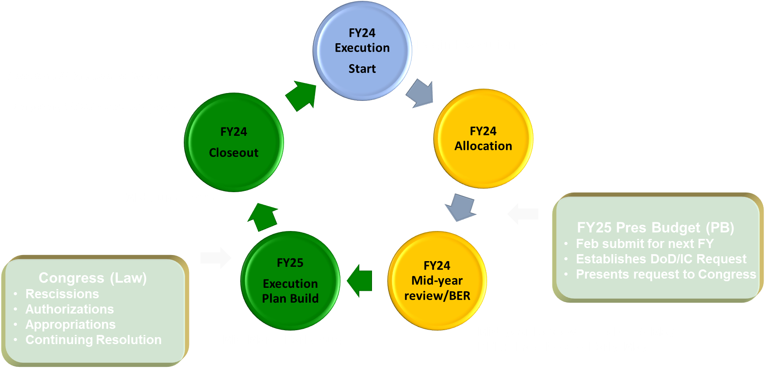
A8F - Overview
UNCLASSIFIED
Home of the NASIC Comptroller/CFO
Performs budget management and execution controls (BE of SPPBE)
Responsible for Center Civ Pay and Appropriated funds analysis and execution
Responsible for Major Budget Exercises (Explan, Allocation, MYR, Closeout)
Executes GTC/DTS Program
Center FM SMEs; Decision Support
Center’s Audit/MICP/ICF Focal Point
UNCLASSIFIED

Slide 19
A8F – Corporate Process
UNCLASSIFIED
Commander’s
Intent
(U) Financial Management Team
Schedules FWG and FMB meetings
Provides tasking format and briefs recommendations
Consolidates inputs and publishes final product
A8F Staff
Deputies
Panel
(U) Financial Working Group (FWG)
Chairperson: NASIC/Comptroller
Members: Resource Advisors/Technical Advisors
Recommends priorities to FMB
FWG
(U) Deputies Panel
Chairperson: NASIC/CoS
Members – NASIC Group & Director Deputies
Mission (vs resource)-focused
FMB
SAF/AAR
AF/A2/6OR
(U) Financial Management Board (FMB)
Chairperson: NASIC Commander
Members – NASIC Group CCs and Directors
Finalizes/approves FWG/Panel recommendations
Execution Plan/Allocation/BER/EOY Closeout
UNCLASSIFIED

Slide 20
A8F – President’s FY 2024 Budget by Appropriation (15C4 Only)
UNCLASSIFIED
$571M ^{in FY24}
Excluded from pie chart: AFPOM Civ Pay
Anticipated Allocation $563M after ERA
UNCLASSIFIED

Slide 21
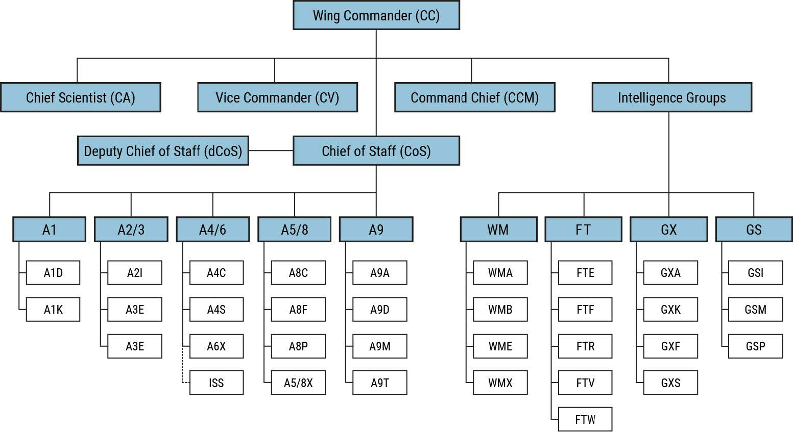
A8F – Resource Advisor (RA) Alignment to the Center
UNCLASSIFIED
Center Resource Advisors
A4/6 – Gann
A4C– Slasor
A6X - Elam
CC Staff – Wegner
FT – Franz/Brown
GS – Williams
GSI – Douglas/Garman
GSM – Prosser/(Vacant)
GSP – McKenney
GS PED - Cross
GX – Dickenson
GXA – Jones
GXF – Lively
GXK – Vacant
GXS – Vacant
WM – Barnhart/Norris
WME - Schultz
1
2
2
1
2
1
1
2
1
1
2
1
1
1
1
1
UNCLASSIFIED

Slide 22
Unique Civilian Pay Challenge at NASIC
UNCLASSIFIED
UNCLASSIFIED

Slide 23
STEM/Cyber Target Local Market Supplement (TLMS)
UNCLASSIFIED
New Pay Supplement for intelligence personnel with STEM and Cyber work roles.
Average 22% increase in pay for approximately 55% of positions
Goal to slow departure of Science & Engineering talent
Most conversions in late FY23 – early FY24
UNCLASSIFIED

Slide 24
TLMS – Financial Impact
UNCLASSIFIED
Pre-TLMS Civilian Pay budget less than total cost to fund our manpower levels
  Pre-TLMS could afford 89% of positions*
  Across all funded programs
* FY25 Programmed manpower
UNCLASSIFIED

Slide 25
TLMS – Financial Impact
UNCLASSIFIED
Pre-TLMS Civilian Pay budget less than total cost to fund our manpower levels
  Pre-TLMS could afford 89% of positions*
  Across all funded programs
Additional cost of TLMS reduces affordable positions another 10% (79%)
  Increases cost by ~$31.8M for same manpower level
  Can afford 176 less positions post-TLMS
* FY25 Programmed manpower
UNCLASSIFIED

Slide 26
Personal Reflections
UNCLASSIFIED
UNCLASSIFIED

Slide 27
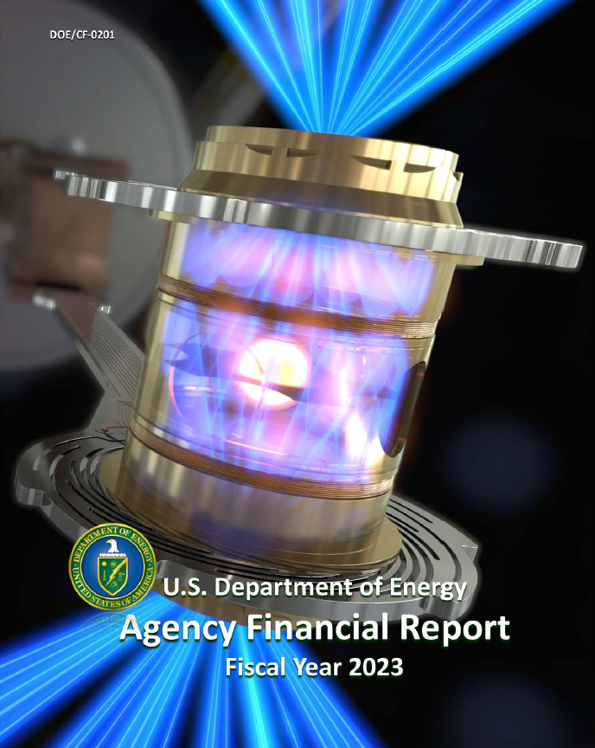
Lessons from a Civilian Agency
Humble
  Serve the Team
  Collaborative
  Affable
Hungry
  Work Hard
  Accountability
Smart
  Book Smart – wealth of qualifications and experience
  People Smart – develop connections and communicate effectively at all levels and across all disciplines
UNCLASSIFIED
14 Years as Field CFO in Department of Energy
Auditable Financial Statements
  Smaller FM Community
  Great Functional Communication
  Effective Risk Management & Internal Controls
Unique Characteristics
  Many “Integrated” Contractors
  Contractor Pension & Post-Retirement Liabilities
  Large Loan Guarantees
  US Government’s Largest “Environmental Liability” ($534B)
UNCLASSIFIED

Slide 28


The Ideal FM Teammate
Humble
  Serve the Team
  Collaborative
  Affable
Hungry
  Work Hard
  Accountability
Smart
  Book Smart – wealth of qualifications and experience
  People Smart – develop connections and communicate effectively at all levels and across all disciplines
UNCLASSIFIED
Humble
  Serve the Team/Mission
  Collaborative
  Affable
Hungry
  Work Hard
  Accountability
Smart
  Book Smart – build qualifications and experience
  People Smart – develop connections and communicate effectively at all levels and across all disciplines
UNCLASSIFIED

Slide 29
UNCLASSIFIED
Overall Classification:
UNCLASSIFIED
Classified By: Arvin, David
Derived From: Multiple Sources
Declassify On: 13 Jun 2074
The classification of this slide is UNCLASSIFIED
UNCLASSIFIED

