Slide 1
Leadership at Any Level …It Starts Early!
Kathy L. Watern, SES
Director
HQ AFMC/A1

Slide 2
Themes
1
2
3
4
5
6
7
8
Seeds are Planted Early
My Career
Embracing Career Diversification
Early Experiences Count
Lead by Example
Know Your People
Energy and Positivity
Waternisms

Slide 3
Seeds are Planted Early!

Slide 4
My Career
What’s your career?

Slide 5
Early Experiences Count…
Customer Focus / Work Ethic
Confidence / Attention to Detail
Teamwork / Collaboration
Foundation for Skill Development
Career Path Clarification
Network Building
Enhanced Employability
Resilience and Adaptability
Confidence Building
Innovation and Creativity
Leadership Skills
Long-term Career Success

Slide 6
Embracing Career Diversification
Strategies for Diversification
Continuous Learning
Networking Across Industries
Exploring Lateral Moves
Seeking Diverse Project Experiences
Professional Advancement Benefits
Broader Skill Set
More Opportunity for Growth
Enhanced adaptability to market changes
Key Benefits

Slide 7
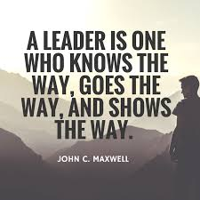
Lead by Example
Embody Core Values
Practice What You Preach
Show Commitment
Exhibit Professionalism
Foster a Positive Work Environment
Encourage Continuous Learning
Be Transparent
Empower Others
Provide Constructive Feedback
Lead with Empathy

Slide 8
Know Your People
Understand Individual Strength
Acknowledge Personal Goals
Identify Growth Opportunities
Foster Open Communications
Recognize Achievements
Understand Work-life Balance
Adapt Leadership Style

Slide 9
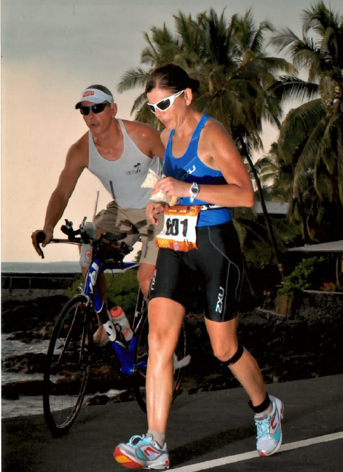
Energy & Positivity
Cultivate a Positive Mindset
Lead with Enthusiasm
Foster a Culture of Appreciation
Encourage Constructive Feedback
Create an Uplifting Environment
Promote Work-Life Harmony
Inspire Through Vision
Address Negativity Constructively
Celebrate Success Together
Encourage Healthy Lifestyles

Slide 10
Waternisms
Learn from your mistakes, issues, or problems and then move on
Personalities matter…conflicts will happen…learn how to work through issues
Don’t be afraid of new opportunities or something different…it is the “being scared or anxious” that really makes us at our best
Your heart lies where your backside sits. Don’t forget this…people are usually loyal to where they currently work

Slide 11
Thank You!
Thank you for this opportunity!
This has been some of what has worked for me and what I have learned over an amazing career
Bottom line: no secret recipe for leadership or success…work hard, take care of people, take care of yourself, and do your job – do your best!

Slide 12
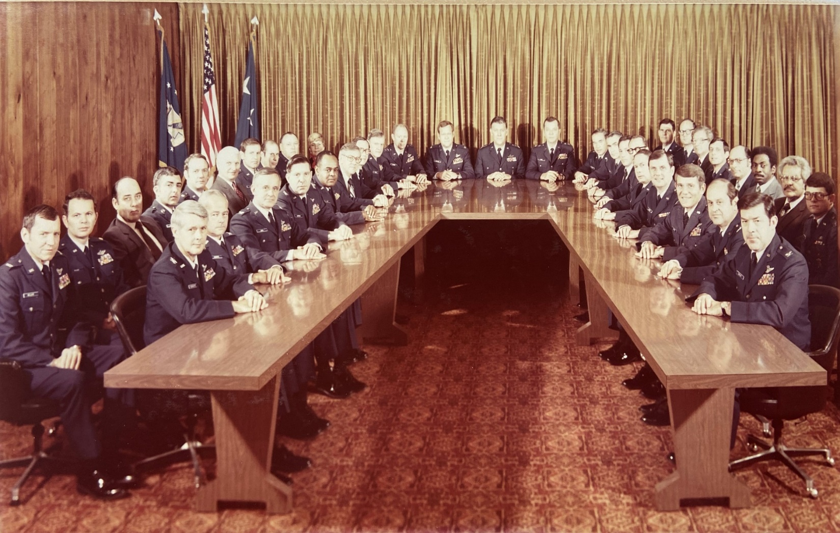
Then & Now
Duke Z. Richardson
General Commander
AFMC
Kathy L. Watern
SES Director
AFMC
Lorna B. Estep
SES Executive Director
AFMC
Leadership at All Levels!
Aeronautical Systems Division – Nov 1981

Slide 13
QUESTIONS?

