Slide 1
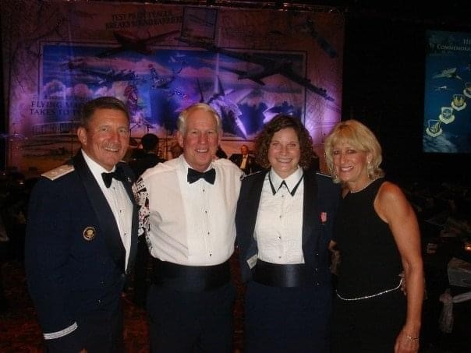
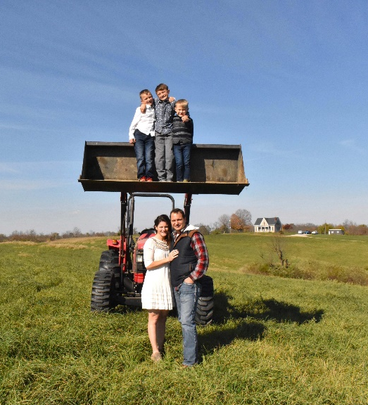
Lessons Learned along the way
Lt Col Amy Justus
AF’s 60th Birthday
2007
Family Photo
October 2023

Slide 2
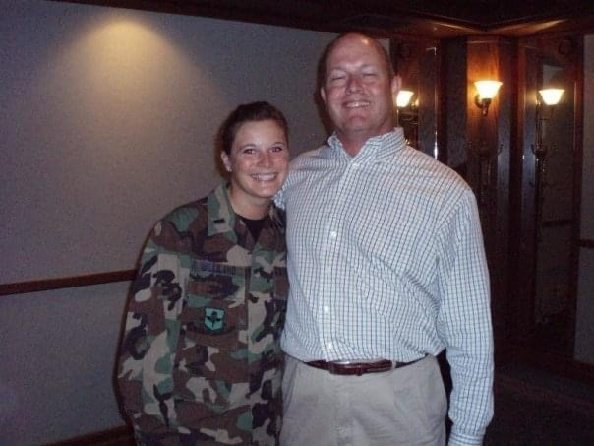
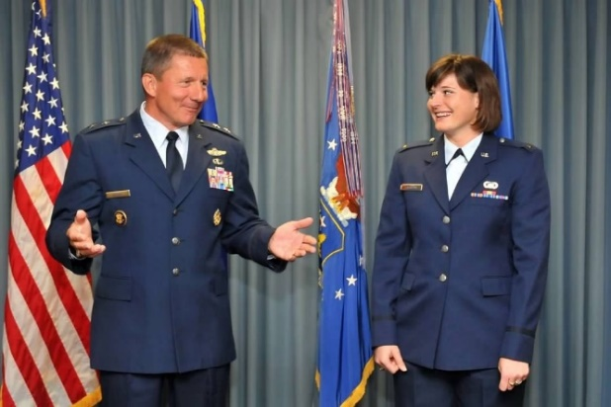
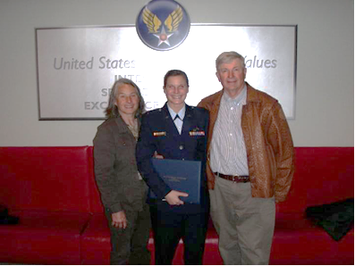
0-4 years of service
Plan your future
It’s okay to swallow your pride and say you don’t know
Stand up for what is right
Opportunities can come at any time…be ready

Slide 3
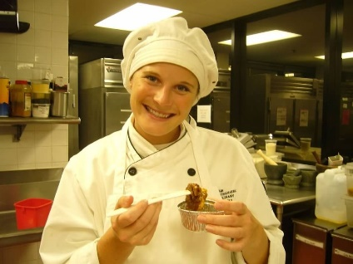
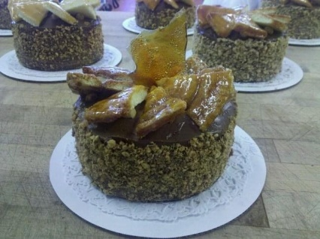
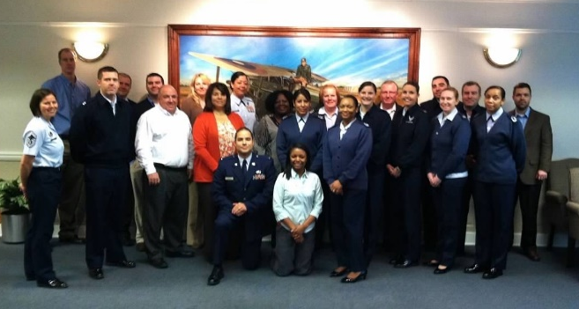
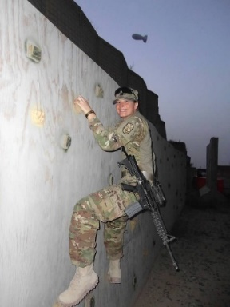
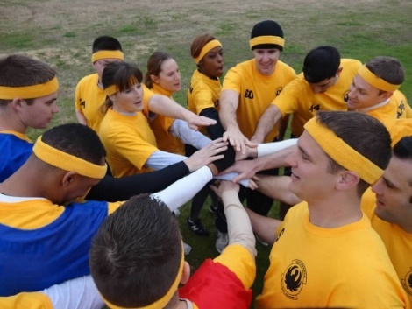
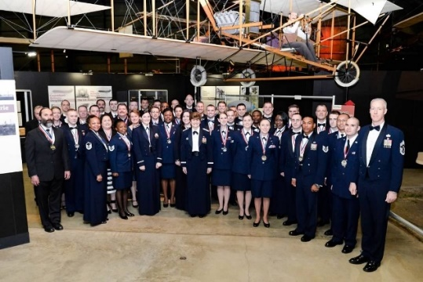
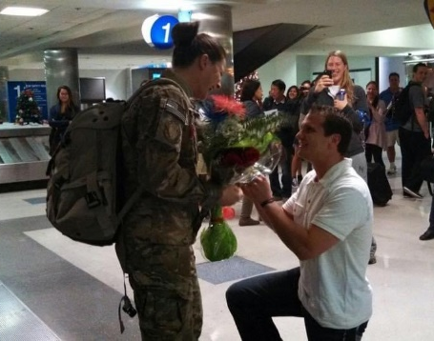
4-10 years of service
Take advantage of the opportunities around you
Team work makes the dream work
Timing is key…even if you don’t know the timeline

Slide 4
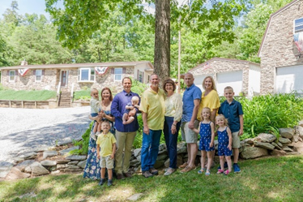
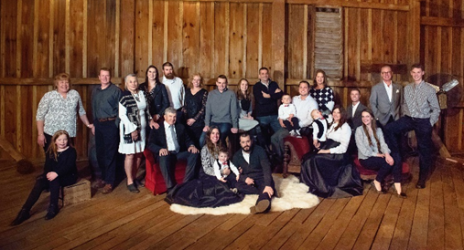
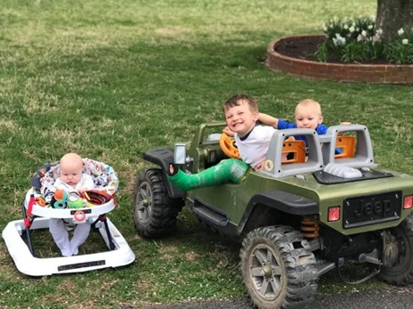
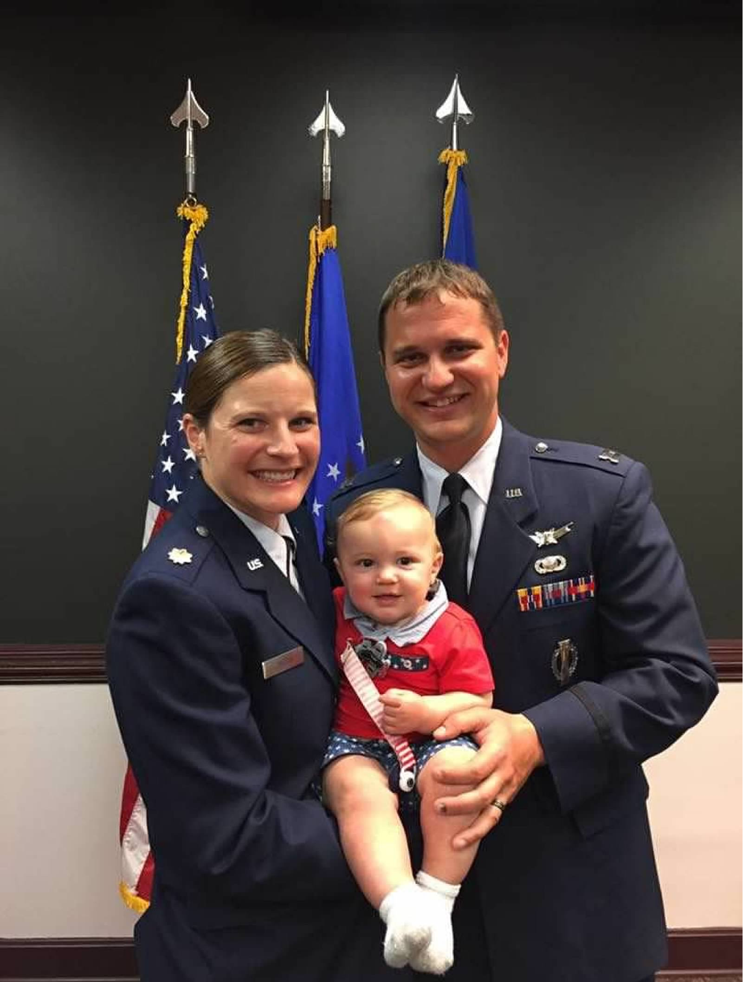
11-15 years of service
Life gets overwhelming but its okay to ask for help
Taking care of yourself isn’t selfish
Relationships you build today are the ones you will live with tomorrow

Slide 5
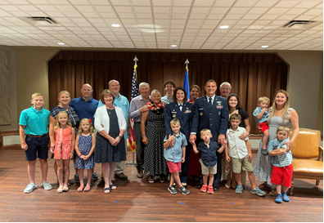
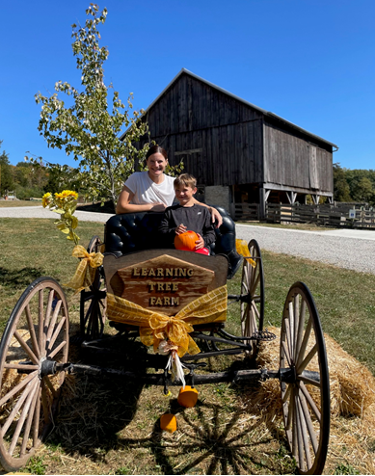
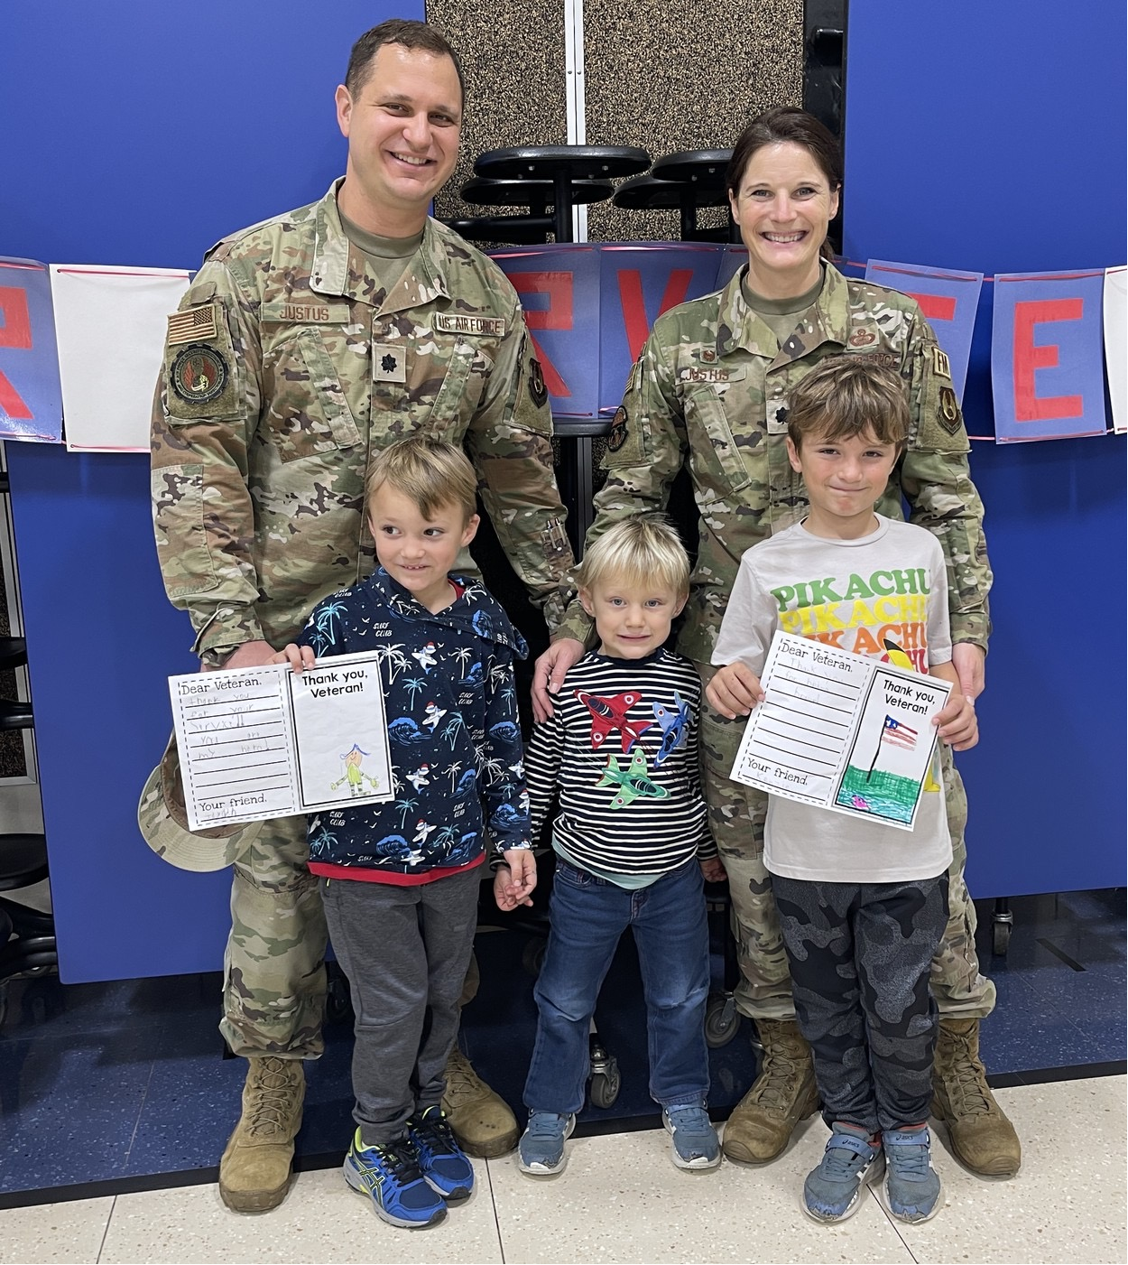
15+ years of service
We all make mistakes
You don’t have to be blooming to be growing
Be intentional

Slide 6
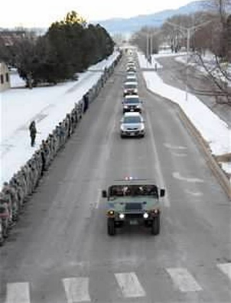
My Challenge to you
Be a better version of yourself each day
Extend grace…even if they don’t deserve it (because we usually don’t either)
Make the most of each moment as you won’t get it back

