Slide 1
ASMC Aviation Chapter Updates
Learn more about the
the ASMC Aviation Chapter at
https://www.asmc-aviation.org/

Slide 2
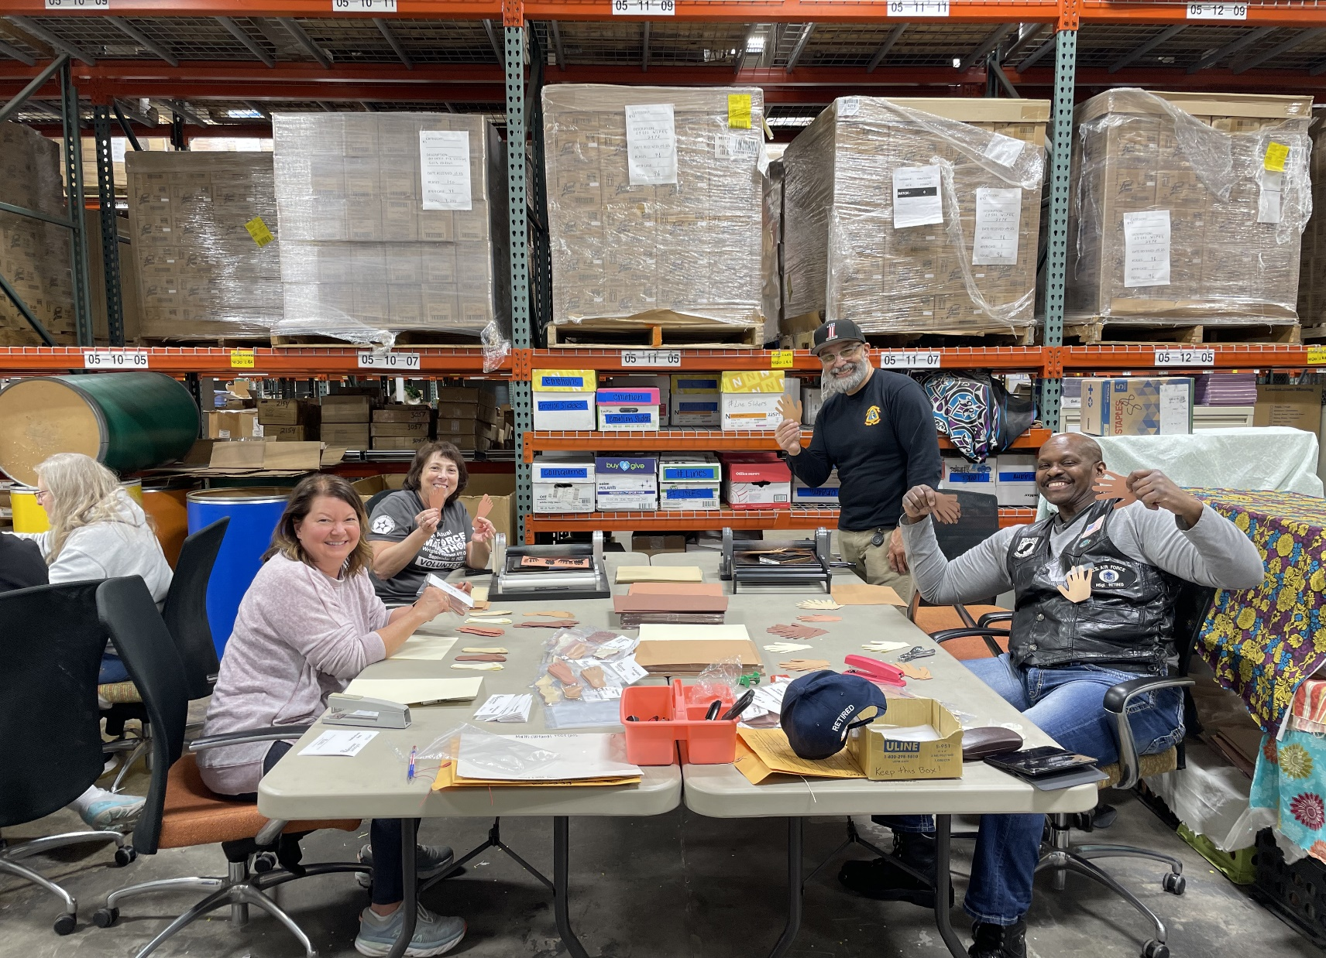
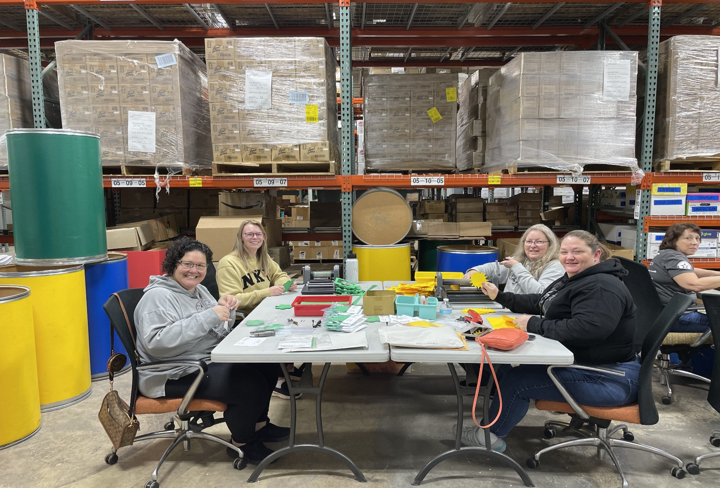
Volunteers: Crayons to Classroom
February 9th Crayons to Classroom was once again a huge success. We had 13 volunteers show up for 2 hours. Our groups were able to cut out many die cut shapes as well as cut out laminated charts for kids to reuse in the classroom to learn to write.

Slide 3
UPCOMING EVENTS/VOLUNTEER OPPORTUNITIES
Easter Egg Hunt
St. Vincent DePaul
3/23/24
9-11am
Feed the Creek
4011 Dayton Xenia Rd - Beavercreek
4/12/24
12-1:30pm
Memorial Day Flag Placement
Dayton VA
5/25/24
Time:TBD

Slide 5
Topic: Lessons Learned Along the Way February 21, 2024 11:30am-1:00pm
Today’s ASMC Virtual Luncheon
Lt Col Amy Justus
Commander, 88th Comptroller Squadron
EARN 1 CLP !

