Slide 1
ASMC Lunch & Learn AFFSO Projects & Updates
James Mason, GS-14
SAF/FMFS (AFFSO)
16 November 2023

Slide 2
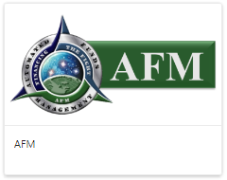
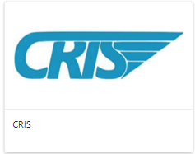
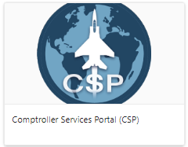
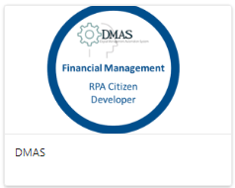
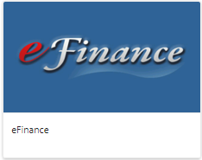
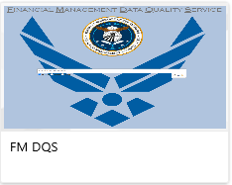
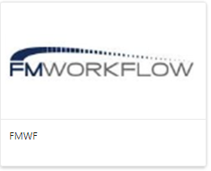
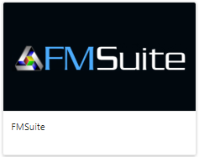
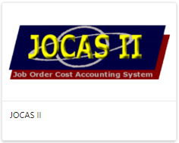
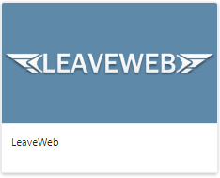
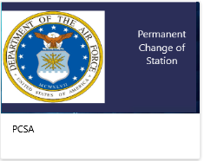
AFFSO Programs

Slide 3
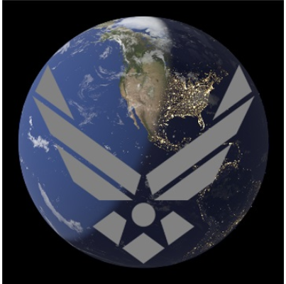
Accomplishments & Challenges
LeaveWeb
LeaveWeb Mobile App Launched September 2023, Over 27k downloads
Mobile Registration & Okta Authentication Setup Challenges
Working with A1, Okta, & AFID to resolve issues
LW Mobile Application works well; 1,500 leaves created, 6,500 actions taken
Beware of counterfeit sites; only download from Google & Apple Play stores
CSP
CSP system deployed August 2023​
Experienced several issues initially; most were resolved within 30 days
Outstanding issues related to user authentication and logging into CSP
Working with CloudOne, GCDS, & CSP Development team to resolve issues.
ICAM
FM, in particular AFFSO systems leading the charge
Okta or GCDS for Authentication; lessons learned from LeaveWeb & CSP
SailPoint for Authorization; lessons learned from FMSuite & AFM
System Access Request (2875 replace) & Annual Revalidation

Slide 4
Initiatives in Planning Phase
PCSA
Initiative to develop a PCS Automation system
Successfully completed pilot September 2023
Pilot focused on CONUS to CONUS (~80% of the vouchers)
Demo Video on MilSuite (https://www.milsuite.mil/video/watch/video/64676)
Roadmaps currently being developed to deliver initial CONUS to CONUS capabilities, with remaining travel types to follow
Coordinating with stakeholders (AFAFO, IMSC, TTPE)
CRIS
Advana FASTR identified as potential CRIS replacement
AFFSO working with FASTR team to perform analysis on transition
Volunteers needed to participate in user groups to provide feedback and perform testing
AFFSO will continue to support the FM community and advocate for the customers, ensuring all functionality is retained with required performance standards.

Slide 5
Automations & Resources
DMAS
Automations (59 Deployed)
LeaveWeb Unreconciled Leaves, over 1.6M transactions
IMSC automations downloads and publishes the IMSC date/reports
Citizen Developer and Developer Trainings Classes (CETs)
Working to get license to run unattended automations.
Will greatly expand Enterprise level solutions and time savings
Always looking for new ideas. Submit your ideas
Resources
AFFSO SharePoint (https://usaf.dps.mil/sites/saf-fm/FMF/FMFS/AFFSO)
AFFSO Systems Help Desk (https://c1snow.cce.af.mil/)
MilSuite (https://www.milsuite.mil/?pk_campaign=ghead)

