Slide 1
ASMC Aviation Chapter Updates
Learn more about the
the ASMC Aviation Chapter at
https://www.asmc-aviation.org/

Slide 2
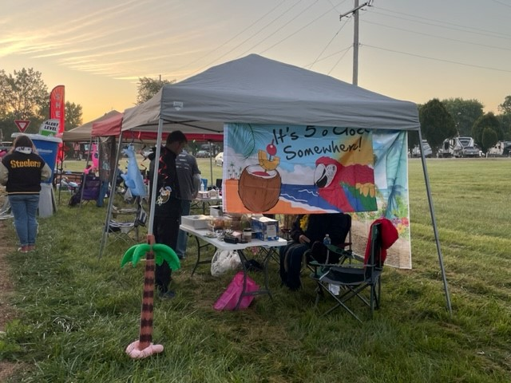
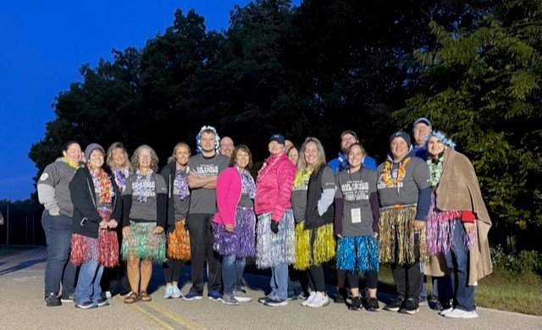
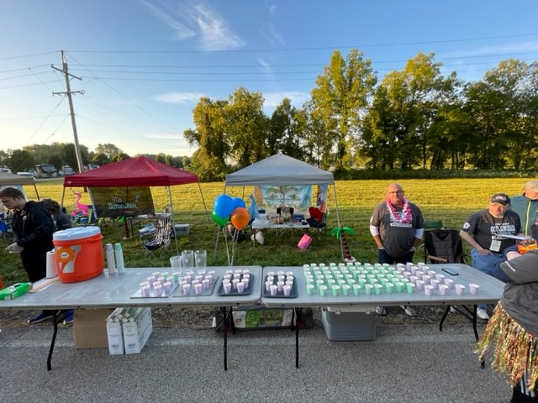
Volunteers: US Air Force Marathon
Sept 16th
5am-11am
Drink Station
Amie Satterfield
Colleen Robinson
Jamie Iaquinta
Jen Caplinger
Jessica Pauley
Stephanie Burd
Matt Janning
Matt Massie
Lindsay Holcombe
Kevin Gould
Joanne Martin
Julie Louthain
Samantha Yeihey
Leslie Abbey
George Burd
Lisa Gagel
Olivia Roland
AJ Iaquinta

Slide 3
UPCOMING EVENTS/VOLUNTEER OPPORTUNITIES
International Ball set up
October 20th
1100 – 1400 (approximately)
Crayons to Classroom
November 3rd
1300 – 1500
ASMC Social
October 12th
Venue TBD
1500 – 1700 (approximately)

Slide 4
Topic: The Future of Defense Financial Management September 20, 2023 11:00am-12:30pm
Today’s ASMC Virtual Luncheon
Mr. Rich Brady
CEO American Society of Military Comptrollers
EARN 1 CLP !

