Slide 1
AFAOC Data Analytics: Leveraging Business Intelligence
Mr. Josh Johnson, Contractor
SAF/FMF AFAOC
13 July 2023

Slide 2
AFAOC Data & Analytics Team Goal, Vision, and Ways to Success!
GOAL
Utilize technology and subject matter expertise to create value for the Air Force
VISION
Be the premier analytical organization within the Air Force Financial Management community; Force multiplier externally, efficiency driver internally, and partner development for shared success
Success
Subject Matter Expertise
Scalability
Scope Complexity
Efficiency
Subject Matter Expert
Analytical efforts that lack subject matter expertise will be inherently slower, usually leading to increased costs and decreased effectiveness
Scalability
The ability to look forward and see a path for a multitude of different data sets for countless different systems, all in different file formats, is a necessity
Scope Complexity
The inability to properly scale leads to costly solutions, longer lead times, and inevitably higher sustainment costs
Efficiency
Agile is not a noun - we are a highly responsive team

Slide 3
AFAOC Data & Analytics Team Defining Innovation
3 Qualities to be Innovative:
Original
If not original, then it would be optimization or improvement
Innovation implies being novel
Delivers Solution
If it doesn’t deliver a solution, then is it more art than innovation
Art is valuable but it doesn’t solve a problem
Provides Value
If it doesn’t provide value, then it would just be an invention
Inventions can lead to value but must be applied
Provides Value
Original
Delivers Solution
Art
Improvement
Innovation
Invention

Slide 4
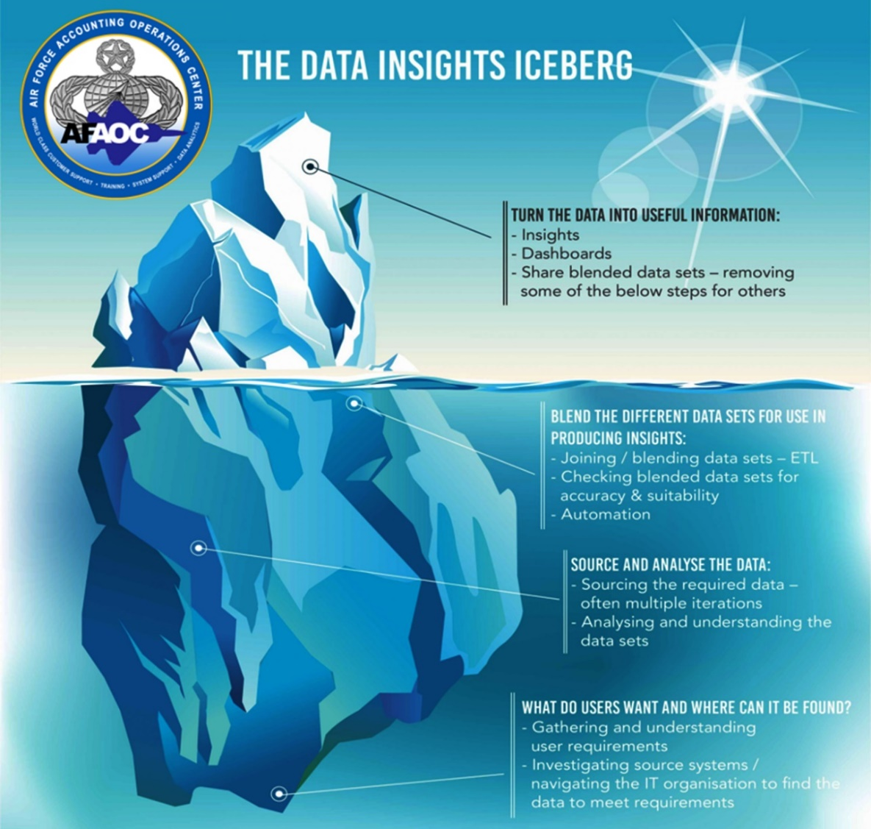
AFAOC Data & Analytics Team The Business Intelligence Iceberg
The tip of the iceberg!
Often the most used but also often the least amount of effort in the process
Benefits of seeing the same iceberg
- Single source of truth
- Quickly share, discuss, analyze & act
- Technology allows this to be accomplished across oceans instead of over the shoulder
Under the water: Out of sight, out of mind
Analysis begins with a need
Must identify the technologies available – what is the best option?
What data is required? What format?
Do we have the technical skills?
Do we have the functional knowledge?
Don’t be afraid to start again!

Slide 5
AFAOC Data & Analytics Team You WILL face hurdles along the way
Integration of data from various system
Lack of a pure data warehouse or data lake
Access to source system information directly
Level of access required to encompass your audience
Scalability
Data Quality Issues
Lack of common data elements
Lack of functional knowledge during development
Lack of future thinking in what might be needed
Overthinking of what might be needed
Data Silos
Inconsistent information from disparate systems
Systems operating independent but data that is dependent
End User Training
BI Products requires knowledge to the audience
The best products in the world can be intuitive but full capability comes from training
Low Adoption
Adoption can be a sprint; sometimes it is a marathon
Defined UX; buy-in and feedback from all levels

Slide 6
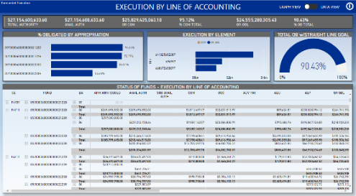
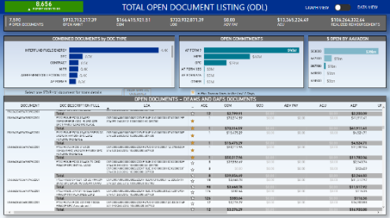
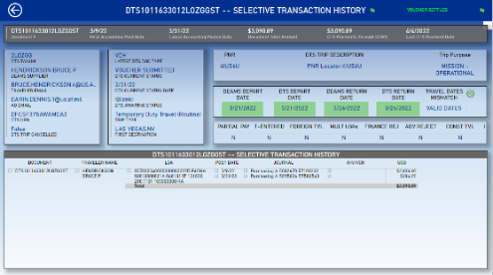
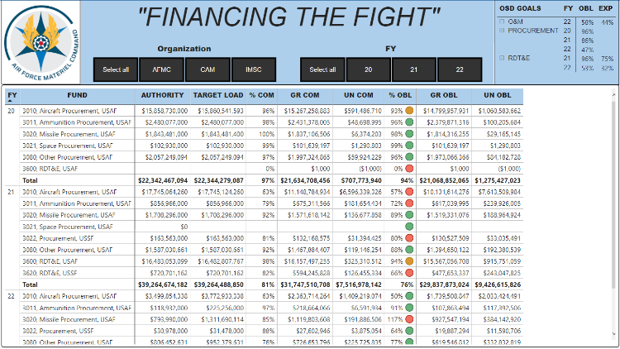
AFAOC Data & Analytics Team How the process works
DATA COLLECT EXTRACT - TRANSFORM - MODEL - ANALYZE VISUALIZE
SHARE
User problems
Data availability
Data accuracy
Redundant local processes
Miscommunication through channels
Time is not infinite
Goals
Innovate
Save time & money
Be valuable
Solution
Validated, accurate data
Cloud offering through Microsoft’s industry-leading PowerBI Service
Single source of truth
Scalable, flexible, brings silo’d systems together in new ways

Slide 7
AFAOC Data & Analytics Team What do we offer?
Hosted on Microsoft DoD GovCloud
Impact Level (IL) 5 security IAW DOD SRG
FedRAMP High including NIST 800-53 – all data hosted in US
DEAMS and Legacy Status of Funds
DEAMS from GL Lines (NO MV issues)
GAFS from PSR Refresh Perspective
DEAMS & GAFS Open Document Listing
DEAMS is accounting based (NO MV Issues)
GAFS is from DSR Refresh perspective
DEAMS & GAFS ODL Travel
DTS data details – DCMS TFO identifications
FM Morning Paper – DEAMS CTL information & more…
DEAMS Contracts
DEAMS MIPRS/MORDs
And more! Let’s take a look…

Slide 8
Questions?

Slide 9
References and Links
AFAOC ANALYTICS APPLICATION – HOSTED IN POWERBI
AFAOC ANALYTICS TRENDS APPLICATION – HOSTED IN POWERBI
AFAOC ANALYTICS milBOOK PAGE
AFAOC ANALYTICS TEAMS GROUP
FM SYSTEMS TRAINING TEAMS GROUP
AFFSO SHAREPOINT
DEAMS OUTREACH PORTAL
DEAMS USERS GROUP
AFAOC LEGACY HELP DESK milBOOK GROUP
AFAOC FM SYSTEMS TRAINING MILBOOK GROUP
SELF SERVICE PORTAL MILBOOK GROUP
AF MYLEARNING
FM SYSTEMS TRAINING PAGE ON THE DEAMS OUTREACH PORTAL

