Slide 1
Robotic Process Automation
Mr. Kyle Keegan
Ms. Leslie Wiederhold
SAF/FMF AFFSO
22 June 2023
Version 2.0

Slide 2
Agenda
Who We Are – AFFSO DMAS RPA Team
Our Journey
DMAS Capabilities
Organizational Benefits of Robotic Process Automation
Automation Examples
Turning Your Strategies into Reality
Let’s Talk
Demo
Q&A

Slide 3
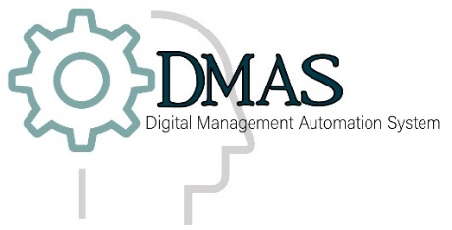


AFFSO DMAS RPA Team
Who are we?
The AFFSO DMAS RPA Team is based out of Wright-Patterson AFB.
Our team serves as the central hub for all Financial Management automations.
SAF/FMF stood up the Digital Management Automation System (DMAS) team in late 2018 to apply robotic process automation (RPA) as solution for manual, repetitive tasks performed by the Financial Management community.
DMAS has matured to a fully functioning program providing RPA solutions at NO COST to your organization.
Team Objectives:
Support FM community with dedicated staff responsible for lifecycle management of automation ideas from users in the field.
Support to Citizen Developers with training, licensing, governance documentation, and sustainment of automations.
Support to greater the Air Force RPA Center of Excellence (COE) team.
  Code sharing and user/license management
  RPA road show support and training
Our team by the numbers
Automations Deployed
50
The DMAS RPA Team provides fully-functioning FM automations and RPA support at NO COST to you. Our team is available for ALL your FM automation needs!

Slide 4
DMAS RPA Journey
Throughout the course of DMAS’s RPA efforts a total of 50 automations have been deployed leading to 411,963 cumulative automation hours. Improvements have been made to both business processes and the workforce
Process and Systems Improvements
Cleared backlogs and reduced delays
System integration, facilitating material weakness downgrades
Decreased risk to financial data integrity and cybersecurity posture
Automations are traceable, improving audit resiliency and decreasing likelihood of NFRs
Automated intermediary controls facilitate progress during migration plans
Workforce Improvements
Addresses staffing constraints, which create the need for greater knowledge sharing and FTE reallocation
Reallocates time for high-value tasks (e.g., analysis, management)
DMAS Milestones
2019
5 Automations
2020
8 Automations
2021
10 Automations
2022
15 Automations
2023 Q2
19 Automations anticipated

Slide 5
DMAS RPA Capabilities
RPA supports a wide range of FM systems and applications for complete process automation. Utilizing these capabilities provide organizations with a swift and accurate approach to common business processes within the Financial Management community.
Business Process Types
Periodic Reconciliations (Accounting/Financial) | Completeness and Accuracy of Review Controls (multiple systems)
Data Collection, Aggregation, Consolidation, and Reporting | User Account Disabling and Termination
Notice of Findings and Recommendation Remediation/Tracking | Access Revalidation
Segregation of Duties (SOD) Checks | User Account Provisioning
Auditing and Monitoring of Security Event Logs | Financial Record Creation
Applications
Enterprise FM Systems
AFM
Citi Bank Manager
ACL
Adobe
Web Browsers
JIRA
MS Access
MS Excel
CMS
CRIS
DEAMS
DMJS
DTS
FMSuite
FMWF
GAFS-R
JOCAS II
LeaveWeb
MOCAS
WebDMO
MS Outlook
Notepad
Power BI
Power Query
SharePoint
SQL

Slide 6








Organizational Benefits of RPA
Introducing RPA into an organization promotes a robust work environment that provides an added value to the workforce. From money and time savings to improved audit compliance, the benefits of RPA can be felt at all levels. Let’s look at how RPA can help your organization.
Increased Resilience
RPA bots can match the workload rhythm and prepare your organizations for unexpected demand spikes
Improved Accuracy
Process accuracy may be improved up to 99.9%, reducing the risk of human error
Enhanced Flexibility
RPA promotes organizational flexibility
by mitigating the impact of seasonality
or other surges in process demand
Decreased Processing Time
RPA can drastically reduce processing
time of tedious, manual tasks
Traceability
RPA has the capabilities to produce
comprehensive audit logs, documentation,
and credential management
Increased Overall Efficiency
Employees can complete processes quicker with consistent, high-quality outputs
Increased Available Capacity
RPA enhances the workforce by allowing more to be done with the same workforce
Refocused Employees
RPA allows employees to focus on higher value tasks by shifting them away from manual tasks

Slide 7
Automation Examples
Component | Bot/Description | Impact
Misc Pay Automation Suite (Invoices, Mord Creation, Receiving Reports, Supplier Verification, Claim Data) | The miscellaneous pay bar fees suite of automations are designed to work together to track FLPE Reimbursements for Bar fees through the entire miscellaneous pay process. The automations perform the following steps within the process: intake of voucher data, Supplier verification, MORD creation, Receipt Creation, creating invoices in DEAMS as well as notifying the DAO that the payment is ready for review. | Impacting timely reimbursement of 1200+ JAG personnel 70% improvement in process time
ATAAPS Uncertified Timecards | Automation that pulls the uncertified and retro uncertified time reports and certifier listings from ATAAPS prior to every pay period payroll run and generates an email to certifier for their action. Repeats process several times as payroll run approaches. | Automatic data pull and email generation for Certifying Officials
GTC Delinquency Reports | Automation will pull, aggregate and create a visualization of required monthly delinquency data from CITI Bank | Provides weekly visual status update to commanders on Delinquency status
Base Level Automations | Status of Funds: Multiple status of funds automations exist for different bases depending on process differences. Access multiple systems such as CRIS, Deams, Deams NRT, Power BI, etc. Can be customized to unit requirements and Commander’s preference. | QOL improvement for members in the field Decreases amount of time it takes to provide information for Commanders
 | Dependent Discrepancy Reports: Automation resolves dependent discrepancies, therefore allowing the member to receive the correct amount of BAH. Using CSP instead of email will allow for technicians/supervisors/flight chiefs the ability to track statuses and engage with customers more frequently. It will also eliminate the single point of failure that most bases have, since everyone can see the status of a Dependent Discrepancy inquiry. | Increasing efficiencies and delaying potential pay problems for members More transparent process going through CSP, directly to the member

Slide 8
Space Command and USSF Automation Efforts
Component | Bot/Description | Impact
Air Force Space Command | Canceled Year Contract Close Out: SpOC effort to closeout cancelled year contracts. CRIS ODL output is used to validate cancelled year contracts with open obligations due to DFAS not processing upon submission of 1594 (Contract Completion Record). ODL contract info is queried in EDA for the 1594, and if found, the process owner will resubmit with cover letter and IAPS print (if applicable) to DFAS via EDM for final closeout actions | Over 800,000 contracts Estimated 173,333 automation hours
United States Space Force | Aerospace Reimbursables: An automation where SSC analyst receive MIPR 448 for goods/services to be performed from customer, they log details in Excel tracker and input into CCAR where 448-2 is created. 448-2 info is added to tracker, funds are validated and acceptance is returned to customer. Upon completion of work, Aerospace bills AF and 1080 generated for collection. | 184 Customers Estimated 1,500 automation hours
 | Close-out bot: Automation will access SAM.GOV KTR data, then auto-fill the DD 1593 and calculate the suspense/anticipated dates. Automation will then set an email timer notifying the Unit’s Responsible Official. Upon receipt of the DD 1593 the automation sends DFAS an email requesting the final invoice and DD 1034, then will auto-fill the DD 1597 calculating the excess funds amount. Upon receipt of the DD 1597, the bot auto-fills the DD Form 1593, then sends it to the RA and CO for signatures. | Increased throughput from 600 to 2000 Estimated 15,800 automation hours

Slide 9
What is IA?
Intelligent Automation
Intelligent Automation
Intelligent Automation (IA) refers to the portfolio of automation technologies design to automate rules-based tasks of varying inputs and complexity. IA encompasses technologies such as Robotic Process Automation, Conversational AI, and Intelligent Optical Character Recognition
IA at a Glance
Automation enables granular process analysis such as obtaining timing data and accuracy measurements
By reducing manual and repetitive tasks, staff time can be directed to higher value and more engaging activities
Automations are built with minimal disruptions to core operations
Automations perform consistently, reducing data entry errors and allowing for logging of activity
Automate non-routine tasks involving intuition, judgment, creativity, persuasion, or problem solving
Data input and output in any format
Pattern recognition within unstructured data
Replication of judgement-based tasks
Basic learning capabilities for continuous improvement to quality and speed
Deep
Learning
Autonomous Operations
Affective
Computing

Slide 10
Future Intelligent Automation Solutions
Outside of RPA, other technologies from the Intelligent Automation portfolio can create further improvement to current processes and generate more time and cost savings
Technology | Description | Examples
Intelligent Optical Character Recognition (IOCR)
Technology that recognizes text within a digital image. It is commonly used to recognize text in scanned documents and images. Can be used to convert a physical paper document, or an image into an accessible electronic version with text.
Processing of structured (e.g., forms with standardized fields such as a DoD Form) and unstructured (e.g., invoices and pay stubs) documents
Conversational AI
(CAI)
Uses natural language processing to conduct a conversation through auditory or textual methods. It includes continuous learning and sentiment analysis.
FAQs, guided form completion, check statuses, submit information
Natural Language Processing
(NLP)
NLP is a branch of artificial intelligence that helps computers understand, interpret and manipulate human language.
Content categorization, contextual extraction, topic discovery and modeling

Slide 11




Turning Your Strategies Into Reality
The Art of the Possible
…starts with Thought Leaders
3
2
Implement & Reap Unrealized Gains
Savings
Cost savings can be achieved with every deployed automation
Efficiency
Higher level task and decision enablement for existing employees
1
Hold Ideation Sessions
Quality
Execution quality improvements can be immediately realized
Security
Robust security design and architecture
Start with the end in mind
Conduct brainstorming sessions with your team to think about where automation could be applied to fill in gaps, mitigate risks, and triage common issues. Leverage existing resources for additional training to become more well versed in the capabilities of the underlying artificial intelligence technologies.
There is always room for improvement. Knowing what leadership wants to achieve and having a clear vision of how much better things will be is key to effective change.
Scalability
Scalable automation based on anticipated demand by “turning on” capacity
Traceability
Comprehensive audit logs, documentation, and credential management
Speed
Process turnaround time can be dramatically improved
24/7 Operations
Process execution 24 hours a day, 7 days a week
Quantitative
Qualitative

Slide 12
Let’s Talk
Interested in learning more about Intelligent Automation? Contact us!
DMAS RPA Training Team: SAF.AFFSO.RPA_training@us.af.mil
Contact If:
  You need information on upcoming training dates; You need basic troubleshooting assistance with an automation you’re developing
DMAS RPA Team: SAF.AFFSO.RPA@us.af.mil
Contact If:
  You have a process in your work-center that you would like our team to automate; You have questions about the automation process
Submit process ideas for automation: DMAS - Automation Submission
Department of Air Force Bot Operations Team (DAFBOT): SAF.AFRPA.COE@us.af.mil
Contact If:
  You would like to request a UiPath License or need assistance getting software installed
Finding Information
MyFMHub: FM RPA Quick Links & DMAS Article - Contact Info
FICS 2.0: DMAS Automation Listing
AF RPA milBook: https://www.milsuite.mil/book/groups/air-force-rpa-center-of-excellence
DAFBOT SharePoint: DAFBOT

Slide 13
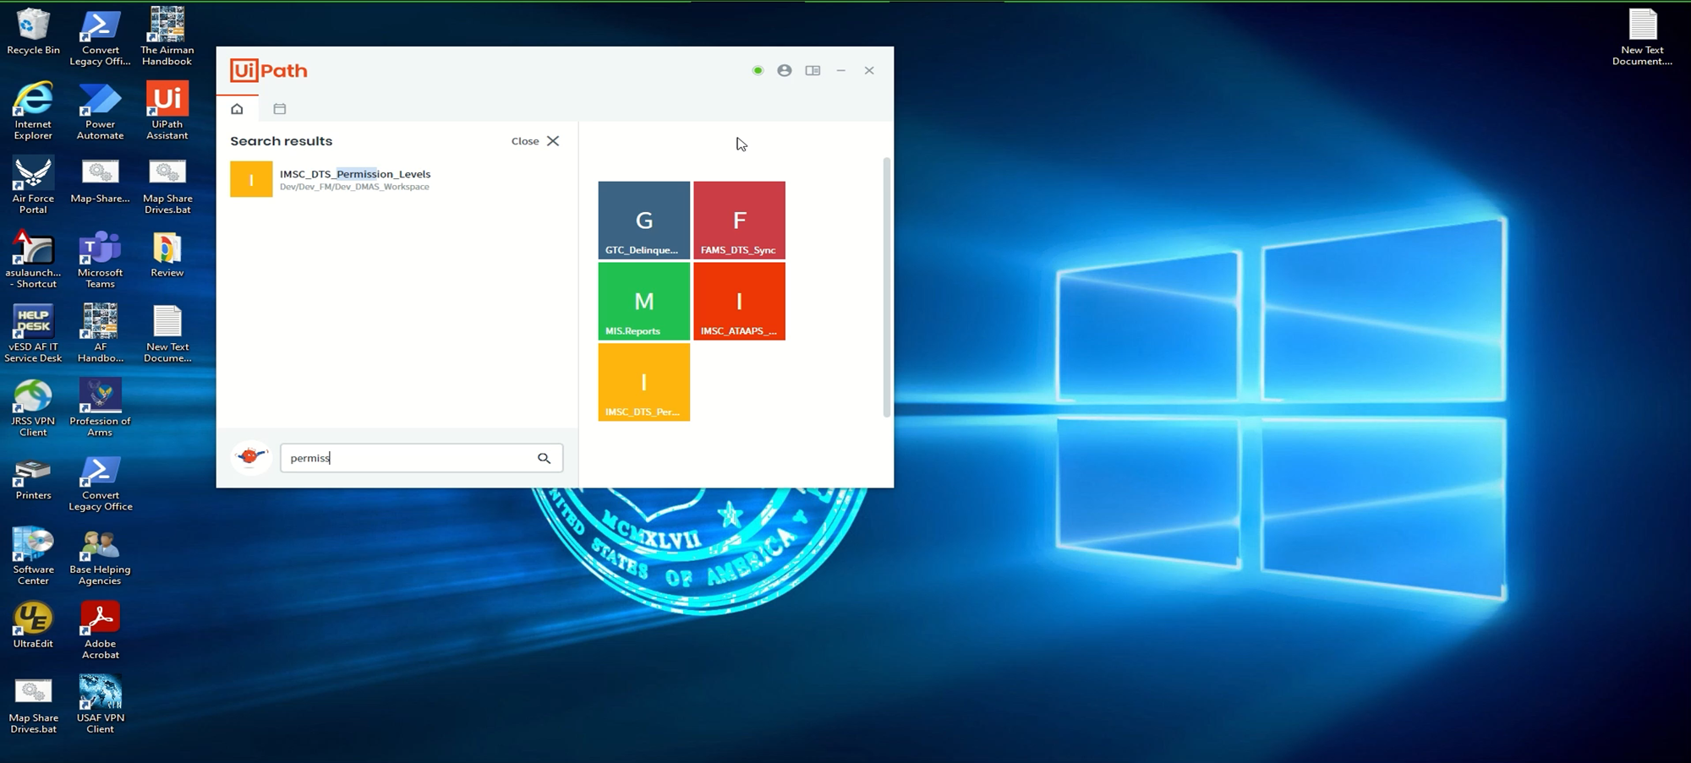
DEMO: DTS Permission Levels

Slide 14

Q&A

