Slide 1
ASMC Aviation Chapter Updates
Learn more about the
the ASMC Aviation Chapter at
https://www.asmc-aviation.org/

Slide 2
Want to be an ASMC Member?
Membership: $50 per year or $120 for 3 years
Networking with FMs in Other Commands
Leadership Experience
Professional Development
Social Events
Volunteer Opportunities
Continuous Learning Events
Resume Builder
New Friends!
To Join: https://www.asmc-aviation.org

Slide 3
WELCOME NEW ASMC MEMBERS!!
Scott A. Baltzer, CDFM
Shaina Bonvissuto
Austin Camden
Maria Cresci
David Graham
Kayla Lynn Gunter
Preston Halsey
Jacob Michael Hornbrook
Edward Hall Jackson, Jr.
Nathan Norris
Jeremy Oldham
Michael Petersen
Mike Reed
Nicholas Smith
Christina Stover
Michael Windsor

Slide 4
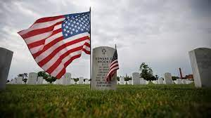
Volunteer: Memorial Day Flag Placing
May 27th
830am-11am
Dayton VA
Sign up Here: https://www.signupgenius.com/go/10C094FA8AA2AABF4C16-memorial
Place 3,000 flags on Dayton National Cemetery gravesites. Similar to wreath laying, but no ceremony.
Volunteer on SignUpGenius in chat or contact Jennifer Caplinger

Slide 5
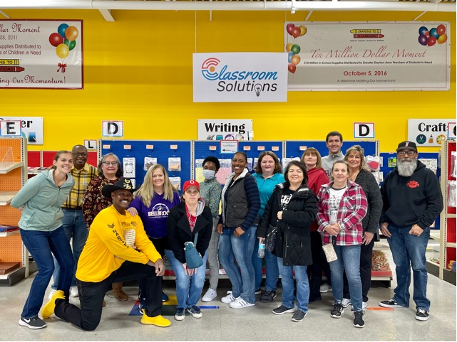
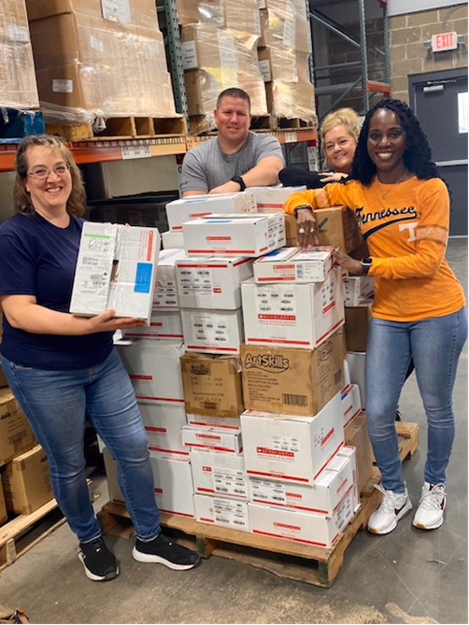
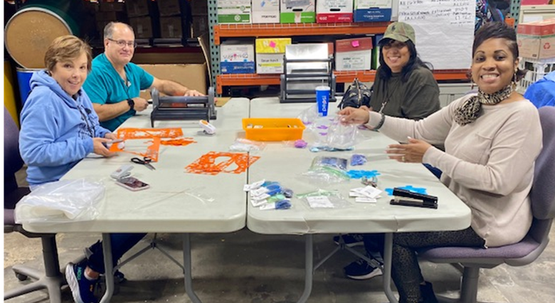
Volunteer: Crayons to Classrooms
June 16th
1pm-3pm
Sign up Here: https://www.signupgenius.com/go/10C094FA8AA2AABF4C16-asmc1
Location: 1750 Woodman Dr. Dayton, OH 45420 (by STEM school)
Volunteer on SignUpGenius in chat or contact Jennifer Caplinger

Slide 6
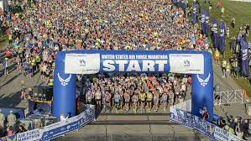
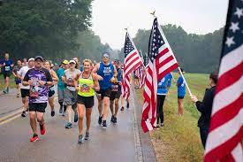
Volunteer: US Air Force Marathon
Sept 16th
6am-11am
Drink Station
Sign up Here:
https://www.signupgenius.com/go/10C094FA8AA2AABF4C16-volunteers1
Volunteer on SignUpGenius in chat or contact Jennifer Caplinger

Slide 7
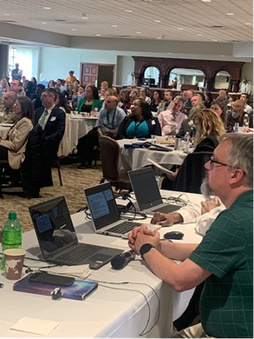
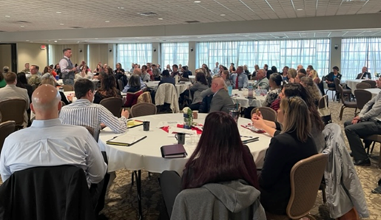
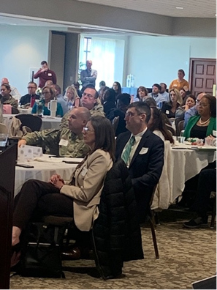
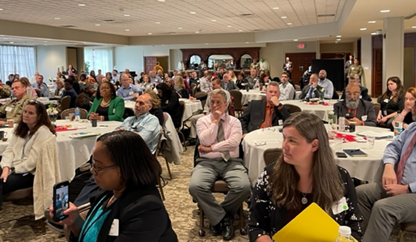
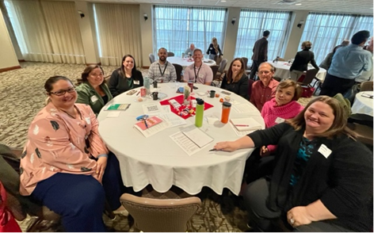
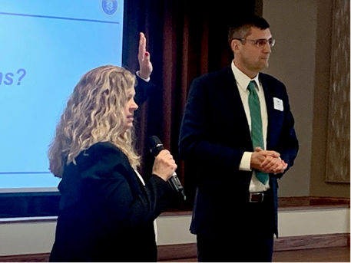
ASMC Aviation Chapter Mini PDI April 25, 2023

Slide 8
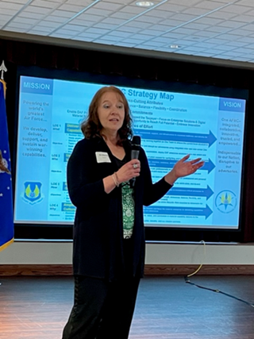
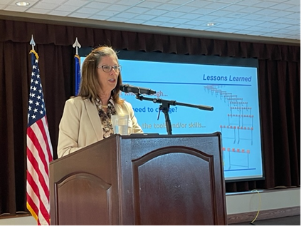
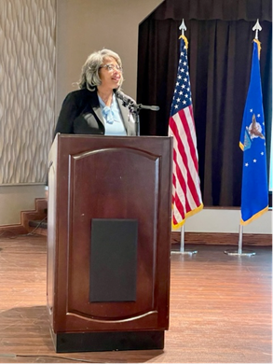
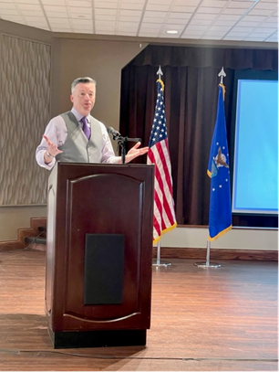
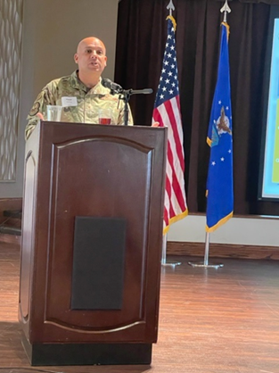
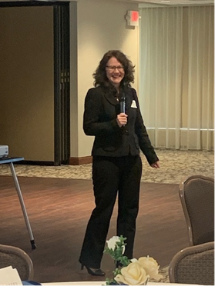
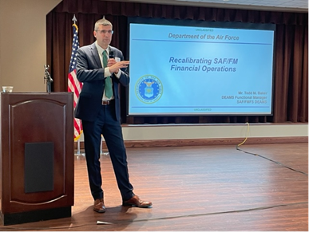
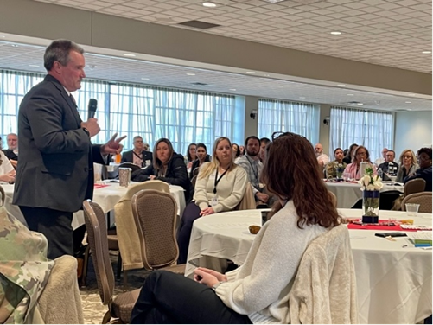
ASMC Aviation Chapter Mini PDI Speakers
Mr. Jeffery Glover, GS14
Ms. Teresa Frank, NH04
Ms. Teresa Bickett, SES
Ms. Kim Keck, SES
Brigadier General Frank Verdugo
Ms. Marjana Zupcsan, SES
Mr. Todd Baker, GS15
Mr. Ron Taylor, NH04

Slide 9
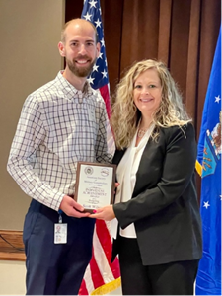
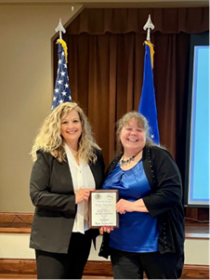
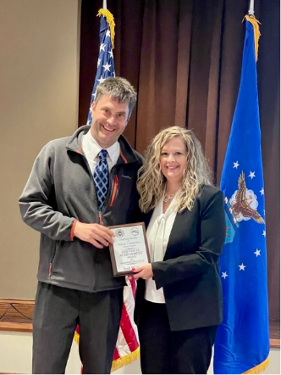
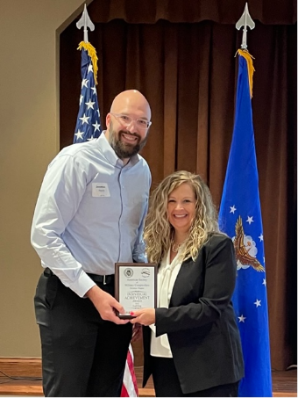
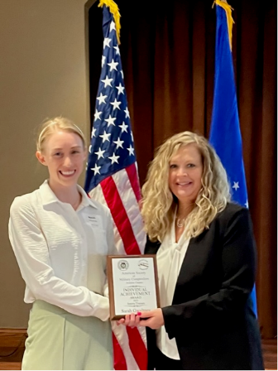
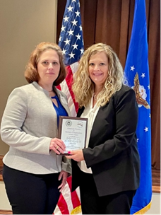
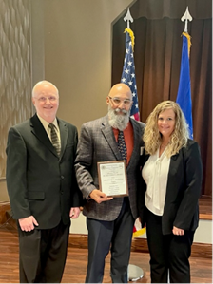
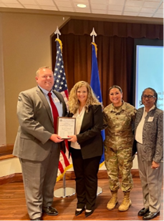
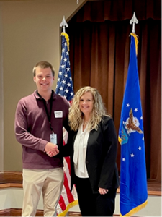
ASMC Aviation Chapter CY22 Award Winners

Slide 10
ASMC Aviation Chapter Mini-PDI 2023
THANK YOU VOLUNTEERS!
Sarah Gwaltney, Professional Development Co-Chair
Trent Harpest, Professional Development Co-Chair
Heather Brodess Lucas Compton Sheena Fast Tracey Hearns Dawn Holding Joanne Hutchison |  | Beth Jankowski Shawn Kain Anita Kerns Jenifer Klump Tracy Kremer Fernando Mason | Saundra Moncree Jonathan Paden Tammy Pendergast Colleen Robinson Amie Satterfield Scott Wilson

Slide 11
Topic: BOTS: Using Robotic Process Automation Speaker: Michael Green AFDW SAF/AFFSO
Next Luncheon: June 22nd 1130-1p
1 CLP
Follow up to Mini PDI Discussion!!

Slide 12
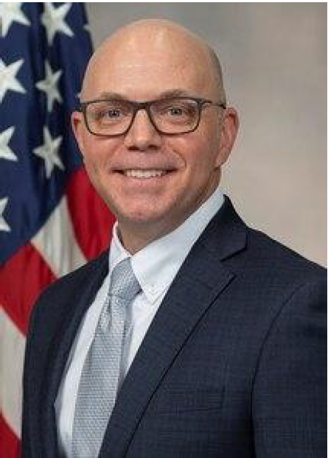
Topic: FM: A Multi-Functional Career Foundation May 18, 2023 11:30am-1:00pm
Today’s ASMC Virtual Luncheon
Mr. Gregory Leingang Director of Personnel
HQ AFMC/AFLMC/DP
EARN 1 CLP !

