Slide 1
Wartime Planning and
Contingency Operations
(FM Deployments)
Col Lance McInnish
23 February 2023

Slide 2
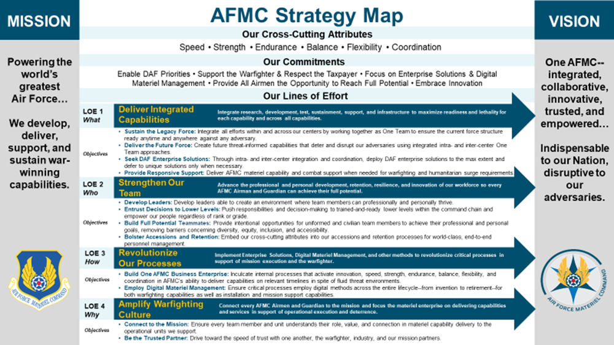
Wartime Planning and Contingency Operations
(FM Deployments)
Col Lance McInnish
February 2023

Slide 3
Who’s The Most Important
MAJCOM
DEPLOYER UDM
Combatant FINANCE Commander LOG PLANS
TRANSCOM
ETC…

Slide 4
Overview
Contingency and Crisis Action Planning
Unit Type Codes (UTC’s)
Air Expeditionary Force (AEF) Deployments: Past, Present, Future
Air Force Force Generation (AFFORGEN)
Current AEF and AFFORGEN Deployment Schedules
Types of Deployments
Civilian Deployments
Wrap-up

Slide 5
Contingency & Crisis Action Planning
Planning is used to respond globally to any event from humanitarian missions to full-scale war
Two types of planning
  Contingency planning (deliberate planning) produces “canned” plans which are often tailored at the onset of military operations
  Crisis Action Planning (CAP) used when there is no plan and is driven by current events or time-sensitive situations
Planning must be flexible to meet changing situations
Unit Type Codes (UTCs) are the basic building blocks of any Operational Plan (OPLAN)
A Force Element is a composition of multiple unit type codes (UTCs) that represents an operational capability

Slide 6
Financial Management Unit Type Codes (UTC’s)
Financial Management UTC’s:
  XFFA1: 5-lvl Cashier/Pay Agent/Customer Service (A1C/SrA/SSgt)
  XFFA2: 7-lvl FM NCO (TSgt/MSgt)
  XFFA3: Comptroller (FGO) (O4-O6)
  XFFA4: FM Officer (1st LT-Capt)
  XFFA7: 5-Level Budget Technician (SrA/SSgt)
  XFFA9: 9-Level Superintendent (SMSgt/CMSgt)
  XFFAG: LOGDET Kit: Safe, laptops, 30 days of supplies
  XFFA0: Comptroller Financial Management Operations Team
    UTC consist of (1) XFFA1, (1) XFFA2 and (1) XFFA7
    Downward substitution to A1C with 6F051 PAFSC, Cashier and Budget Technician
    No downward substitution for 7 Level Disbursing Agents
    Positions identified as lines: (1 - Cashier), (2 - Accounting Tech), (3 - Disbursing)
    Deleted for FY24 and beyond, reinstating single UTCs on the UTA

Slide 7
Unit Type Codes (UTC’s)
Four Parts of a UTC:
Title
  Example: CMP FINANCIAL MANAGEMENT OFFICER (XFFA4)
*Mission Capability (MISCAP)*
  Describes mission the UTC designed to support (what we bring to the fight)
  Type of base where the UTC can be deployed
  Other UTCs required for support of the UTC
Manpower Detail
  Lists AF Specialty Code (AFSC) and grade
  Example: AFSC: 065F4, Grade: 0-3
Logistics Detail (LOGDET)
  Identifies supplies/equipment
Notes:
Recent changes to DAF 10-401 removes the line remarks from requirements that are outside of scope within the MISCAPS.

Slide 8
XFFA4 UTC MISCAP
(Financial Management Officer)
UTC TITLE MAJCOM OFF AMN CIV TOTAL
XFFA4 CMP FINANCIAL MGMT OFFICER 0J 1 0 0 1
*** MISCAP STATEMENT ***
CAPABILITY TO IMPLEMENT AND MANAGE FINANCIAL SERVICES FUNCTIONS, PROVIDE FINANCIAL ADVICE TO THE COMMANDER ON ALL FINANCIAL MANAGEMENT ISSUES, DEVELOP BUDGET ESTIMATES, ADMINISTERAND EXECUTE OPERATING BUDGETS, SERVE AS FOCAL POINT FOR BUDGET MATTERS PERTAINING TO FINANCIAL MGMT AT ALL TYPES OF OPERATING LOCATIONS, DETERMINE FUNDING PROPRIETY IAW APPROPRIATION LAW. DEVELOP, MAINTAIN AND DISTRIBUTE FINPLANS, RECEIVE AND MAINTAIN FUNDING AUTHORITIES, AND DETERMINE PROPER USE OF FUNDS. MAY ACT AS COMPTROLLER AND TEAM LEADER IN LOCATIONS WITHOUT XFFA3. DETERMINE FUNDING PROPRIETY IN SUPPORT AGREEMENTS WITH US/FOREIGN GOVERNMENT AGENCIES AND ACCOUNT FORMONETARY PAYMENTS/REMITTANCES OF AVAILABLE APPROPRIATIONS.PROVIDE NAF OVERSIGHT. DOWNWARD SUBSTITUTION TO 1LT AUTHORIZED. AUTHORIZED AFSC SUB IS 065F4, 065W3 OR 065W4. CIVILIAN SUBSTITUTION AUTHORIZED. MANPOWER SIZING GUIDELINES AND CONOPS ARE IN ANNEX N, WMP-1. REVIEWED Aug 21.

Slide 9
FM Deployment Trends
2008-2014
* Based on AEF Tempo Band (Oct 13 – Mar 14)

Slide 10
FM Deployment Trends
2013-2023

Slide 11
FY23 Total Force Deployed FMers
Tour Length | 5-Level XFFA1/A7 | 7-Level XFFA2 | 9-Level XFFA9 | 6F000 CEM/SEL | CGO XFFA4 | FGO XFFA3 | 0-6 XFFA3 | Civ | Total
Std Rotation | 50 | 42 | 4 | 0 | 20 | 7 | 0 | 0 | 123
365-Day | 0 | 0 | 0 | 0 | 0 | 2 | 0 | 0 | 2
Red Horse | 0 | 0 | 0 | 0 | 0 | 0 | 0 | 0 | 0
Total | 50 | 42 | 4 | 0 | 20 | 9 | 0 | 0 | 125
A/O 5 Jan 23
Total Force Participation
  Active Duty: 85
  Air National Guard: 26
  AF Reserve Command: 14
97 Tasked to 16 CENTCOM Locations, 28 to All Other AORs
21 Individual Augmentee Deployments

Slide 12
Deployed Locations
DESTINATION | COUNTRY | COCOM | JUL 21 - FY21 | JAN 22 - FY22 | MAR 22 - FY22 | Sept 22 - FY23
AL DHAFRA | UAE | CENTCOM | 12 | 10 | 9 | 10
AL JABBER | KUWAIT | CENTCOM | 6 | 0 | 0 | 1
AL UDIED | QATAR | CENTCOM | 57 | 49 | 40 | 41
ALI AL SALEM | KUWAIT | CENTCOM | 11 | 14 | 14 | 11
ARIFJAN | KUWAIT | CENTCOM | 13 | 11 | 9 | 6
BAGRAM | AFGHANISTAN | CENTCOM | 10 | 0 | 0 | 0
CAMPIA TURZII | ROMANIA | CENTCOM | 0 | 1 | 1 | 0
CAMP LEMONNIER | HOA | AFRICOM | 10 | 8 | 7 | 10
CRYSTAL CITY | USA | SOUTHCOM | 2 | 2 | 2 | 2
DIORI | NIGER | AFRICOM | 0 | 2 | 2 | 2
DJIBOUTI | AFRICA | AFRICOM | 2 | 2 | 2 | 2
ERBRIL | IRAQ | CENTCOM | 0 | 2 | 2 | 2
GAROUA | CAMEROON | AFRICOM | 2 | 0 | 0 | 0
GITMO | CUBA | SOUTHCOM | 2 | 0 | 0 | 0
ISLAMABAD | PAKISTAN | CENTCOM | 2 | 2 | 2 | 2
JERSUSALEM | ISRAEL | CENTCOM | 0 | 2 | 2 | 0
KABUL | AFGHANISTAN | CENTCOM | 15 | 0 | 0 | 0
KELLY BARRACKS | GERMANY | EUCOM | 2 | 1 | 1 | 0
MANAMA | BAHRAIN | CENTCOM | 2 | 1 | 1 | 2
MANDA BAY | KENYA | AFRICOM | 2 | 2 | 2 | 2
MANO DAYAK | NIGER | AFRICOM | 4 | 2 | 2 | 2
NAIMEY | NIGER | AFRICOM | 2 | 0 | 0 | 0
SHAHEED MUWAFFAQ | JORDAN | CENTCOM | 12 | 12 | 12 | 12
PRINCE SULTAN AB | SAUDI ARABIA | CENTCOM | 9 | 4 | 5 | 8
RAMSTEIM | GERMANY | AFRICOM | 6 | 8 | 8 | 8
UNION | IRAQ | CENTCOM | 5 | 1 | 1 | 0
AL TAJI AAF | IRAQ | CENTCOM | 0 | 0 | 0 | 2
TOTALS |  |  | 188 | 136 | 124 | 125

Slide 13
Deployments: Past, Present & Future
AEF Concept developed from lessons-learned in the Persian Gulf War
Lighter, leaner fighting force vs Cold War deployment mentality
Allowed AF to cut force structure w/o decreasing capability/readiness
First implemented in the mid-1990s during the Balkan conflicts
Provided Airman:
  Predictable deployment windows (each Airman assigned an AEF Indicator)
  Equal utilization of resources/personnel
  Transparency to the deployment process
AEF concept proved difficult to clearly articulate true combat readiness
AFFORGEN is the USAF’s latest model for presenting forces to the Joint Force Commanders (Force Presentation)

Slide 14
The Present
AD military personnel are assigned an AEF Indicator (AEFI)
  Represents your deployment vulnerability/eligibility window
  Assigned by commander within 15 days of assignment
  Should consider past deployment history when posturing
  Normally remain in assigned AEF period/band for assignment duration
  Based on your career field, base and unit
Dwell Periods:
  Active Duty: Individuals assigned to 1 of 6 Posturing Bands or “P” bands and deploy at a 1:2 Deployment to Dwell (D2D)
  Institutional Forces assigned to 1 of 5 X-Bands deploy at a 1:4 (D2D)
  ARC Personnel: Units assigned to 1 of 8 Reserve Component Periods (RCP’s) and deploy at a 1:5 Mob-to-Dwell ratio that establishes a 48-month battle rhythm

Slide 15
The Future
AD military personnel are assigned to an AFFORGEN Phase
  Represents your deployment vulnerability/eligibility window
  Assigned by commander within 15 days of assignment
  Should consider past deployment history when posturing
  Will remain in assigned AFFORGEN Phase for assignment duration
  Based on your career field, base and unit
Dwell Periods:
  Active Duty: Individuals assigned to 1 of 4 Phases and deploy at a 1:3 Deployment to Dwell (D2D)
  Institutional Forces: assigned to 1 of 5 X-Bands deploy at a 1:4 (D2D)
  ARC Personnel: Units assigned to 1 of 8 Reserve Component Periods (RCP’s) and deploy at a 1:5 Mob-to-Dwell ratio that establishes a 48-month battle rhythm
  Some ANG units will provide XAB capabilities for associate RCP’s

Slide 16
Terminology
Agile Combat Employment (ACE)
  ACE is a proactive and reactive operational scheme of maneuver executed within threat timelines to increase resiliency and survivability while generating combat power throughout the integrated deterrence continuum ~ AFDN 1-21.
Multi-Capable Airmen (MCA)
  MCA are Airmen who can perform specific tasks outside their core AFSC which may or may not include cross-utilization training (CUT)
  MCA represent a shift away from traditional, large force packages of highly specialized teams toward smaller multidisciplinary teams able to provide combat support
  Once MCA are available at scale, AFFORGEN FE designs will evolve to reflect their incorporation
Expeditionary Air Base (XAB)
  Term for combined C2, EAB, & OAB Force Elements (FE)
  XAB + Msn Gen FE = the USAF version of a Carrier Strike Group or a Brigade Combat Team
  Supports ~ 4 MG FE, 1500 personnel indefinitely, at up to 3 contingency locations

Slide 17
Air Force Force Generation (AFFORGEN)
The USAF’s sustainable, capacity-driven model for presenting forces to Joint Force Commanders (Force Presentation)
Departs from Past AEF Concepts - 20-year Rotational Exercise
Built to Win Major Combat Operations (“Near Peer” Adversary)
Follows Three Principles:
  Meet Combatant Commander Requirements
  Provides Airman Deployment Predictability
  Maintain Home-Station Readiness
Organized in Four Phases Each Lasting 6 Months/24-Month Cycle
  Available to Commit: Rotational Deployments, Ready Response Force, SECDEF Taskings
  Reset: Depot Maintenance, Modernization, Basic Unit Training, Upgrade Training
  Prepare: Advanced Full Spectrum Training, Multi-Unit Tactics and Training
  Ready: Certification Training (Exercises), Maintain Peak Readiness

Slide 18
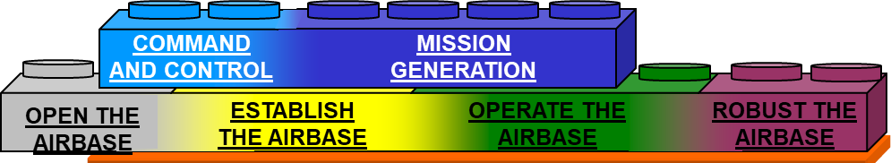
AFFORGEN 4-Phase Model
Expeditionary Air Base (XAB)
10 XABs per phase = 40
An XAB (AEW)
Includes elements:
• MG
• C2
• EAB
• OAB
• RAB
• DFT
20% Base Population Postured Per Phase
Remaining 20% Kept in “Reserve” (FIC 2)
Total of 80% Remain at Base
From One Base
to Max Extent
Possible
Requires Crowdsourcing
Force Elements
C2 • Command & Control
*EAB • Establish the Air Base
*OAB • Operate the Air Base
*RAB • Robust the Air Base
MG • Mission Generation
DFT • Demand Force Team
*Contains FM Forces
• DFT is not an XAB force element
• Requested independently

Slide 19
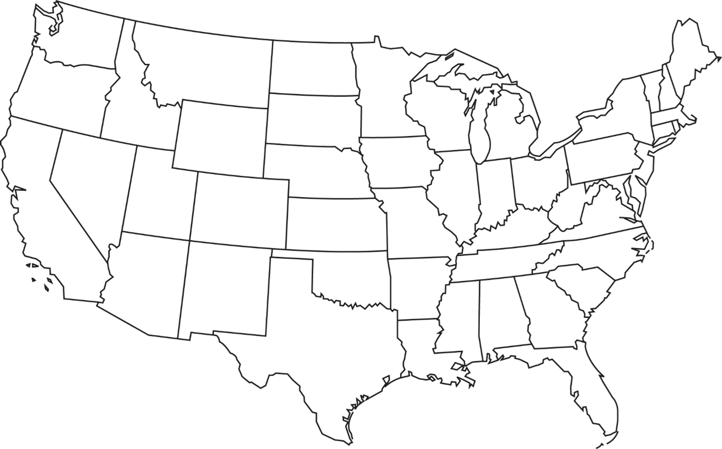












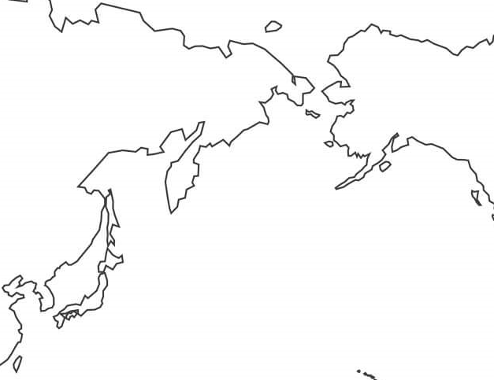



40 XAB Primary Sourcing Bases
Fairchild
McChord
Minot
Grand Forks
Mountain Home
Hill
Ellsworth
Lakenheath
Spangdahlem
Ramstein
Aviano
McGuire
Beale
Whiteman
Dover
Andrews
Nellis
McConnell
Scott
Travis
Langley
Seymour Johnson
Davis Monthan
Little Rock
Shaw
Eielson
Dyess
Barksdale
Charleston
Moody
Hurlburt
MacDill
Kunsan
Misawa
Elmendorf
Tyndall
Yokota
Kadena

Slide 20
Types of Deployments
Standard Force Solution
    Airmen execute/perform career field core mission(s)
    Typically deploy to AF unit and support AF mission
Joint Force Capability Solution /Joint Expeditionary Taskings (JET)
    Joint Force / Capability Solution: In career field but joint environment
    In-Lieu-Of (ILO): Out of career field but in a joint environment
    Ad-hoc: In career field, but part of a team compiled for specific mission
Individual Augmentee (IA)
    Fills Joint Service requirement on Headquarters Staff
    Positions filled by all services; duties compatible with their AFSCs
365-Day Deployments
    Sourced by AFPC/DPA (Assignments). Based on volunteers and Short-tour return date (STRD) rosters
Any AFSC Deployments
    AFPC and MAJCOM A1 sourced. Based on volunteers and STRD rosters
    Duties vary. Exec Officer duties, Refugee ops, COVID Vaccination teams, etc.

Slide 21
Other Deployment Opportunities
Other Country National (OCN) Escorts
  Airmen in grades E-1 through E-5 OCN
  Supervisors (E-6 through E-8)
    Any AFSC
    Monitor OCNs as they complete their duties
    Vital to installation security
Air Mobility Command Pay Agent Support
  Utilizes Active duty, AFRC and ANG FM personnel
  Short notice. Passport needed and personal affairs must be in order
Backfill and Emergent requirements
  Can only be filled by AFRC and ANG FM personnel
  Utilizes Mandays
  Supported unit pays travel and per diem

Slide 22
Volunteer Opportunities
AEF Volunteer Statement (In Deployment Cycle)
  Volunteering to deploy within assigned AEF deployment cycle
  Can be assigned to any ULN qualified to fill, regardless of location/duty title
  Could be short-notice
AEF Volunteer Statement (Outside Deployment Cycle)
  Volunteering to deploy outside assigned AEF deployment cycle
  Will not change assigned AEF Indicator
  Still eligible to deploy during originally-assigned AEF deployment period
NOTE: The current process for volunteering will remain in effect until FY24

Slide 23
FM AEF Civilian Deployments
FY23 Approved Positions
Position Title | Unit | Location | ETL | Rotation
Comptroller (Min grade GS-12 / E-7 / TS) | TF 94-7 CENTCOM | Arlington, VA | 182 DAYS | Apr 23- Sep 23
03 J8 Comptroller (Min grade GS-12) | Mil Info Supt Task Force (MISTF) | Al Udeid, Qatar | 183 days | Apr 23- Sep 23
O3 Budget Officer Dep, J8 (Min grade GS-13) | JTF-GTMO SOUTHCOM | Guantanamo Bay, Cuba | 182 DAYS | Apr 23- Sep 23
03 J8 Director (Min grade GS-12 / TS SCI) | JSOTF GCC J8 CENTCOM | Manama, Bahrain | 182 DAYS | Apr 23- Sep 23
J8 Budget Analyst (Max GS-09) | SOCCENT FWD | Al Udeid, Qatar | 183 DAYS | Apr 23- Sep 23

Slide 24
DOD Expeditionary Civilian FM Deployments
Requirements are typically 365 day tours
Contact AFPC Expeditionary Team for locations and functional area deployments: https://aef.cloud.disa.mil/Ecd.aspx
Site includes:
  Deployment Benefits
  Pay Limitation Fact Sheet
  DoD-EC Benefits/Entitlements, Deployment Checklists, etc.
Note: Individuals serving in temporary or term positions; intern programs; identified developmental program; probationary period or Dual Status National Guard or Reserve Technicians are ineligible
CONTACT INFORMATION:
AFPC Expeditionary Civilian Team (Mr. Rusty Nicholson)
Email: afpc.expeditionarycivilian@us.af.mil
Phone: COMM: 210-565-1583; DSN: 665-1583

Slide 25
DoD-EC Temp Assignment (Deployment) Opportunity Germany
PURPOSE: Assembling a team of AF Finance/Budget/Comptroller civilians with strong technical skills, competencies, and abilities, to serve on a temporary assignment (deployment), in support of the Security Assistance Group - Ukraine.
Team Positions:
  Deputy Director, GS-12, GS-13, or GS-14, 0501
  Comptroller, GS-09, GS-11, or GS-12, 0560
  Budget Officer, GS-09, GS-11, or GS-12, 0560 (two positions available)
  Budget Analyst, GS-09, GS-11, or GS-12, 0560
Individual Duties: Specific duties can be found at the following SharePoint site: https://usaf.dps.mil/teams/12852/SitePages/Home.aspx
APPLICATION PACKAGES REQUESTED NLT 10 FEB 23
Dates: 27 Mar 23 - 30 Sep 23
Location: Wiesbaden, Germany (approximately 33 miles from Frankfurt)
Clearance: SECRET
Vaccination: Required
Completed packages: Submit to afpc.expeditionarycivilian@us.af.mil or mary.church.2@us.af.mil POC: DoD-Expeditionary Civilian Team, at DSN: 665-1583; COMM: 210-565-1583

Slide 26
Application Process Information
Ensure you Unit Deployment Manager, Supervisor, Civilian personnel/pay team are aware of your deployment selection
Grade matters; position requires a GS-6; will not fill with a GS-12
Local administrative procedures dictate application processing steps
If offered a deployment, fully consider the effects a deployment may have with your family, co-workers etc.
Do not accept if not 100% committed to the deployment
AFPC EC will contact deployment candidates prior to final selection
If selected, AFPC EC will provide initial deployment notification
Notification follows same process as military deployments
Deployment Unit Line Number (ULN) will flow via SIPR, to Installation Personnel Readiness function, to the Unit Deployment Manager (UDM)
Tasking Notification Memo (official deployment notification) flow in 15-30 days

Slide 27

QUESTIONS

