Slide 1

ASMC Aviation Chapter Updates
      Learn more about the
      the ASMC Aviation Chapter at
      https://www.asmc-aviation.org/

Slide 2

Want to be an ASMC Member?
Membership: $50 per year or $120 for 3 years
      Networking with FMs in Other Commands
      Leadership Experience
      Professional Development
      Social Events
      Volunteer Opportunities
      Continuous Learning Events
      Resume Builder
      New Friends!
To Join: https://www.asmc-aviation.org

Slide 3
WELCOME NEW ASMC MEMBERS!!
Shanna Baxter
Allison Corbolotti
Michael Massie
Matthew Moore

Slide 4

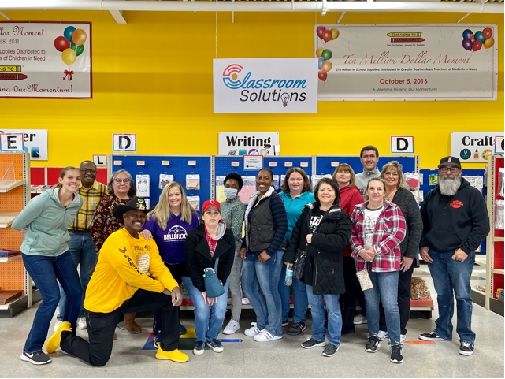
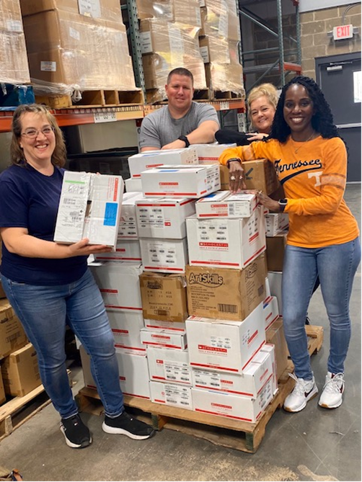
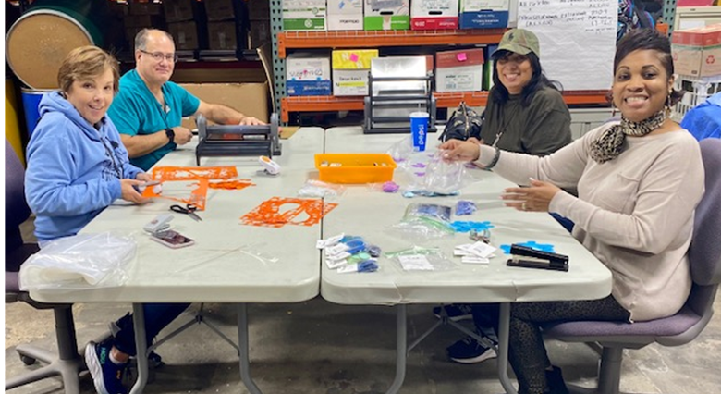
Volunteer: Crayons to Classrooms
March 10th
9am-11am
We need volunteers!
Location: 1750 Woodman Dr. Dayton, OH 45420 (by STEM school)
Volunteer on SignUpGenius in chat or contact Jennifer Caplinger

Slide 5
Topic: Professional Development Opportunities for your Career
Early Careerist Luncheon: March 9th 1130-1p
American Society of Military Comptrollers (ASMC) - Aviation Chapter
Ms. Dawn Holding
Blacks In Government - Greater Dayton Chapter (BIG/GDC)
Mr. Damon Smith
Toastmasters
Ms. Jennifer Lenz
AFLCMC Junior Force Council
Ms. Taylor Meade
Learn about WP organizations to enhance your career and networking!

Slide 6
Aviation Chapter Mini PDI
Details & Date TBA soon!
THEME: Reflect, Reconnect, Recalibrate
Currently planned for late April
or early May & in person
Want to volunteer?
Contact Sarah Gwaltney, AFLCMC/WFFI

Slide 7
Topic: FM Deployments February 23, 2023
11:30am-1:00pm
Today’s ASMC Virtual Luncheon
Col. Lance McInnish
Budget Director
HQAFMC/ FMA
EARN 1 CLP !

