Slide 1

Want to be an ASMC Member?
Membership: $40 per year or $96 for 3 years
      Networking with FMs in Other Commands
      Leadership Experience
      Professional Development
      Social Events
      Volunteer Opportunities
      Continuous Learning Events
      Resume Builder
      New Friends!
To Join: https://www.asmc-aviation.org

Slide 2
Membership Dues are
GOING UP January 1st!
Renew or become a member by December 31^{st!}
To Join: https://www.asmc-aviation.org

Slide 3
WELCOME NEW ASMC MEMBERS
Morgan Bruno
Patrick Dockery
Sarah Gwaltney
Lindsay Holcombe
Matt Stinson
Rebecca Wilkins
Mark Anthony Young
Renee Youngmeyer

Slide 4
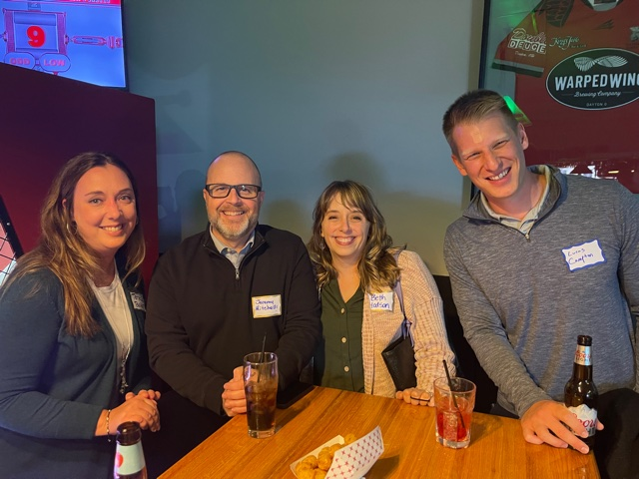
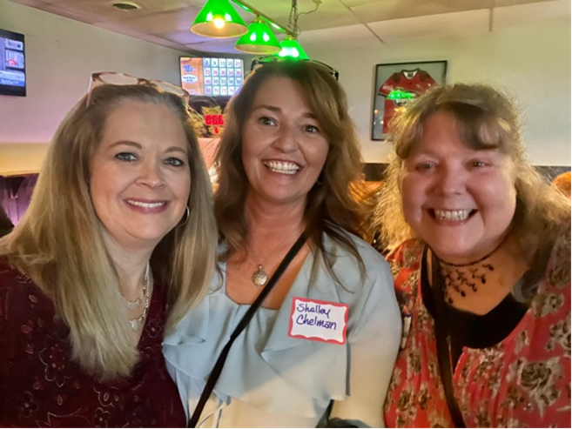
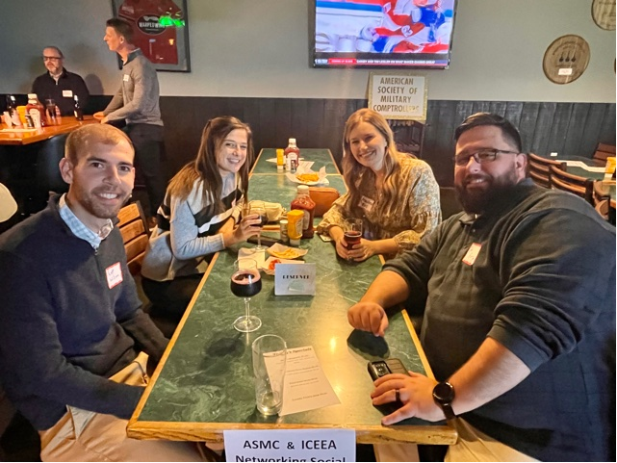

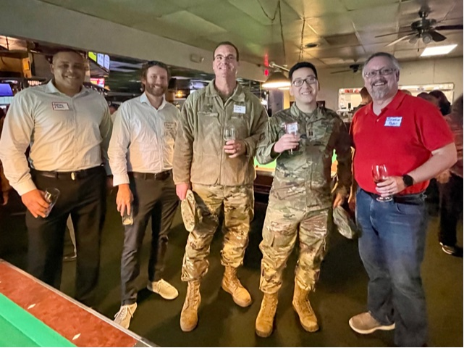
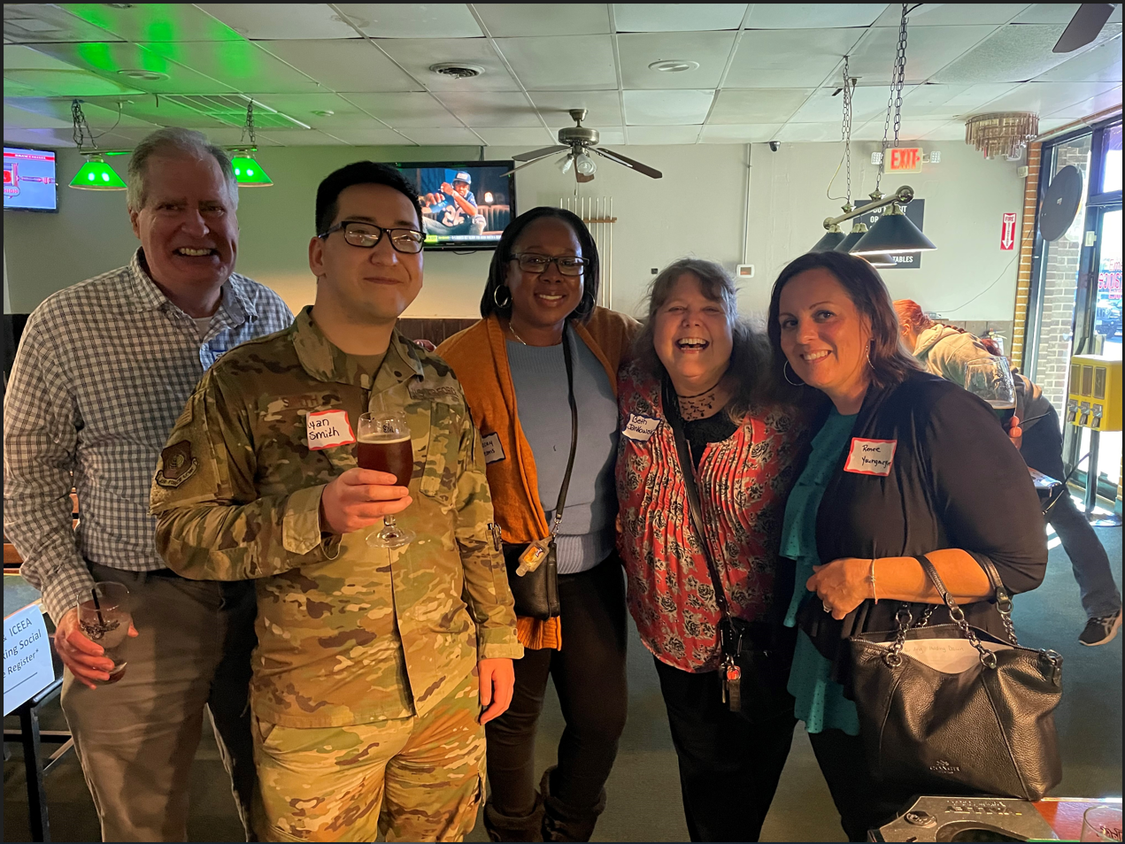
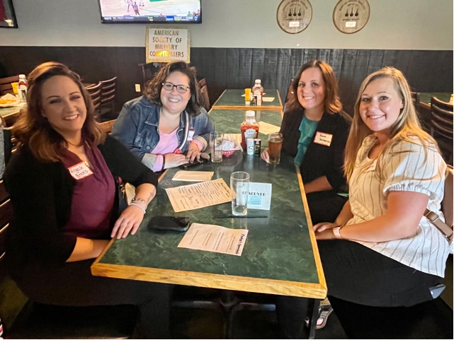

Slide 5
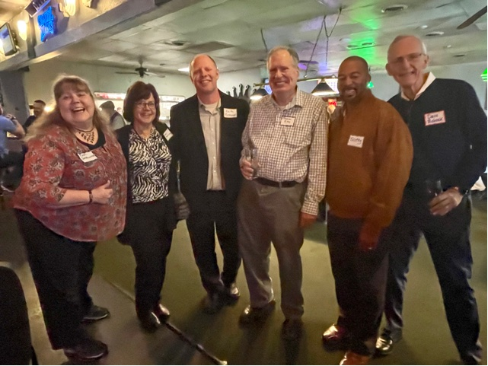
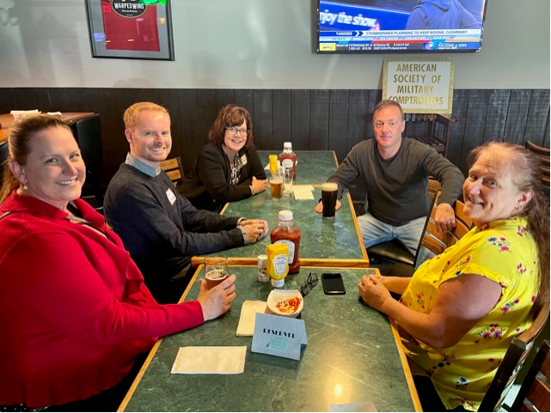
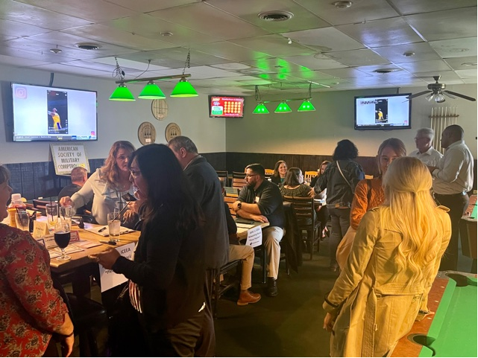
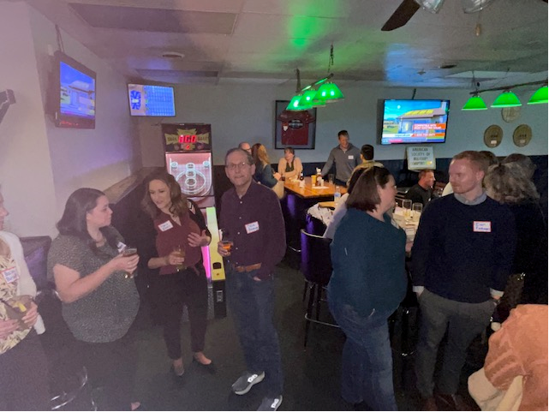
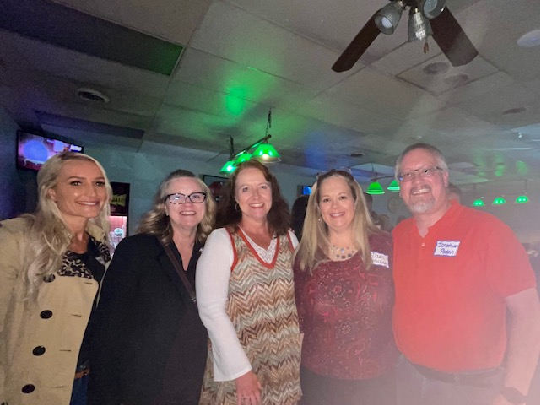

Slide 6
Thank You FM Leaders
for Attending Kings Table!
Ms. Kim Keck, SES
Col. Stephen Gray
Deanna Golem-Imlay
Jeremy Mitchell
Keith Reithman
Bob Lyons
Jodi Pierri
Emily Schreiber
Ariel Quesinberry
Wendy Duncan
Richard Scott
Chris Bozue
Teresa Baker
Trent Harpest
Beth Hodson
Debra Walter

Slide 7
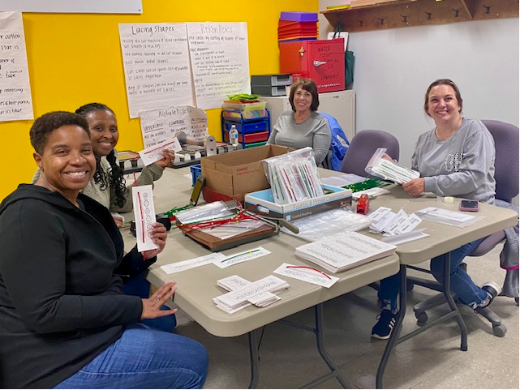

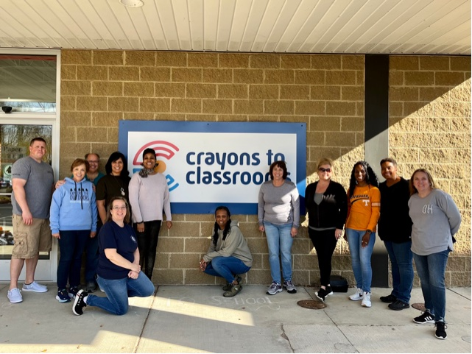
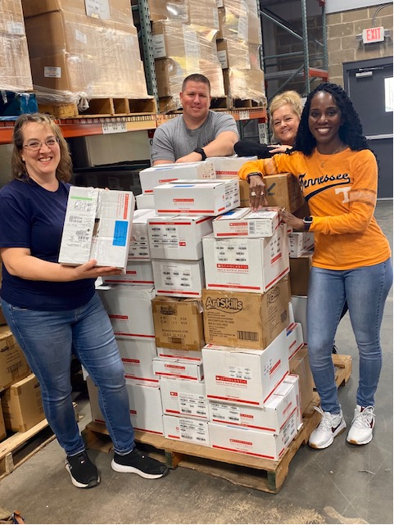
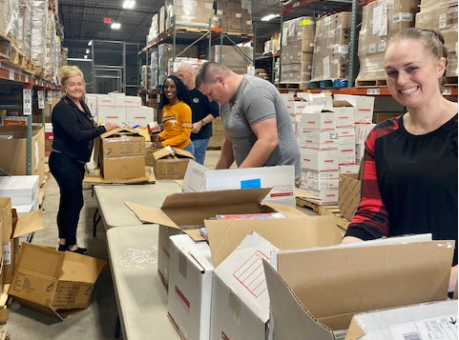
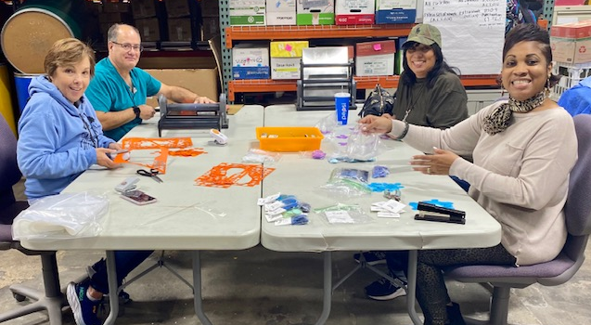
Crayons To Classrooms: Nov 4th

Slide 8
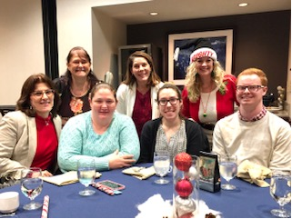
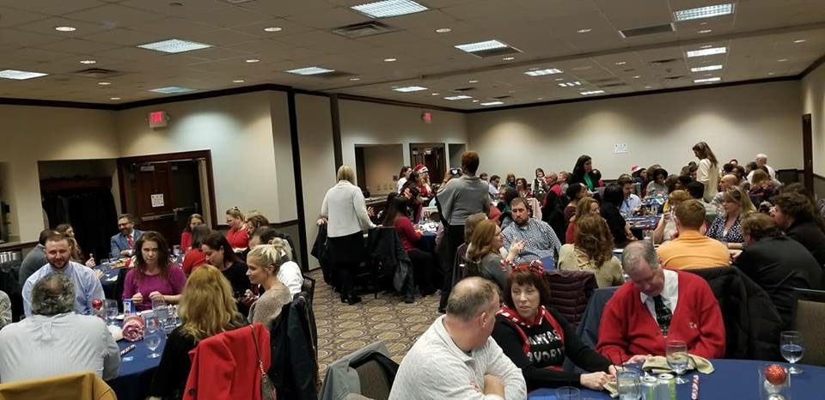
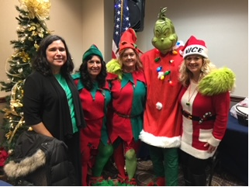
ASMC IN-PERSON Holiday Party!
December 1st 11-1pm
Presidential Banquet Center
4572 Presidential Way Dayton, OH 45429
$500 in Prizes!
INFO & SIGNUP: https://www.signupgenius.com/go/508094AA4AC29AB9-asmc1
Want to Help? Contact Tammy Pendergast, AFRL/RQF

Slide 9

ASMC Volunteer Opportunity!
November 18th
8:45am-11am
1750 Woodman Dr.
Dayton, OH 45420
Sign up to Volunteer at:
https://www.signupgenius.com/go/508094aa4ac29ab9-asmc

Slide 10

Stuffing Stockings for Deployed Soldiers!
November 19th 10am-1pm
VFW Post 3809
4541 S Dixie Hwy, Franklin, OH 45005
Volunteer: Stuffing Stockings for Deployed Soldiers w/Blue Star Families
INFO & SIGNUP: https://www.signupgenius.com/go/10c094fa8aa2aabf4c16-volunteers

Slide 11

St. Vincent DePaul Homeless Shelter Holiday Decorating
December 2nd 9:00am-12pm
Women and Families Shelter
124 W Apple St, Dayton, OH 45402
December 2nd 1:00pm-4pm
Men's Shelter
1921 S Gettysburg Ave, Dayton, OH 45417
https://www.signupgenius.com/go/10C094FA8AA2AABF4C16-stvincent

Slide 12

Ohio Army National Guard Holiday Party Volunteers
December 10th 11:00am-2pm
2555 County Line Rd
Beavercreek, OH 45430
Help serve food & pass out items to families for the party
w/Blue Star Families
https://www.signupgenius.com/go/10C094FA8AA2AABF4C16-national

Slide 13

Wreath Laying at the Dayton VA
December 17th 11:30am-3pm
4400 W Third St.
Dayton, OH 45417
Lay wreaths at the Dayton National Cemetery at the VA.
w/Blue Star Families & Wreaths Across America
https://www.signupgenius.com/go/10c094fa8aa2aabf4c16-wreaths

Slide 14
Thank You for going above and beyond with your ASMC Dedication!
Jonathan Paden
Amie Satterfield
JoAnne Hutchinson
Tammy Pendergast
Jennifer Caplinger
Heather Brodess
Colleen Robinson
Lucas Compton
Debra Walter
Darryl McFadden
Tracey Hearns
Shelley Chelman
Anna Baller
Sarah Gwaltney

Slide 15
“Budget Environment:
View from the SAF/FMB”
Today’s Virtual ASMC Luncheon
Brigadier General
Frank Verdugo
Comptroller, HQ AFMC/FM

