Slide 1
Welcome to the September ASMC
Aviation Chapter Meeting
Learn more about the
the ASMC Aviation Chapter at
https://www.asmc-aviation.org/

Slide 2
Want to be an ASMC Member?
Membership: $40 per year or $96 for 3 years
Networking with FMs in Other Commands
Leadership Experience
Professional Development
Social Events
Volunteer Opportunities
Continuous Learning Points
Resume Builder
New Friends!
To Join: https://www.asmc-aviation.org

Slide 3
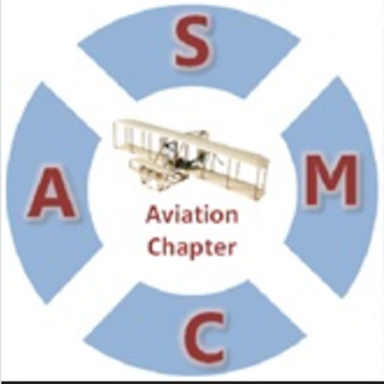
Leadership Opportunities
We need excited and motivated individuals who want to help us take ASMC to the next level!
Open Positions:
Co-Treasurer
Community Activities
Way & Means
Resume Builder * Volunteer Hours for Award Write Ups * Networking
Contact your President – Dawn Holding, AFLCMC/WFFI

Slide 4
Resources Needed
Volunteers for Christmas Party
Luncheon Speakers & Topics
Contact: Tammy Pendergast, AFRL/RQF
Community Volunteer Opportunities
Contact: Dawn Holding, AFLCMC/WFFI

Slide 5
Upcoming Events
October TBD
Networking Event at Packy’s
November 4th (12:45p-3p) & 18th (8:45a-11a)
Crayons to Classroom Volunteering Opportunities
December Date/Time TBD
In Person ASMC Member Christmas Party!!

Slide 6
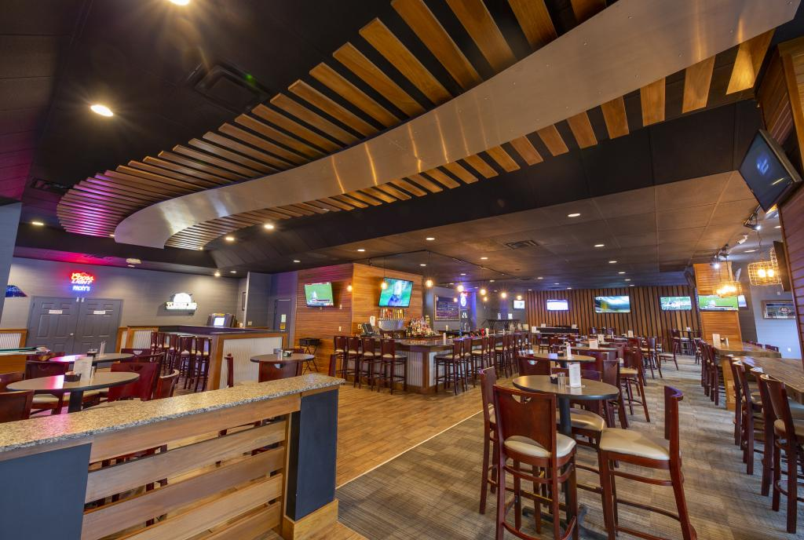
Upcoming FM Networking Event!
October TBD
At Packy’s at Hope Hotel
In person networking!! ASMC members and non-members are invited!
Numerous senior leaders will be present!
Bring a friend and see you there!
Expecting 50-75 attendees min
Want To Help? Contact: Tammy Pendergast, AFRL/RQF

Slide 7
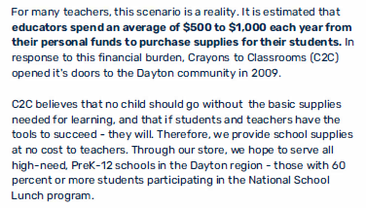
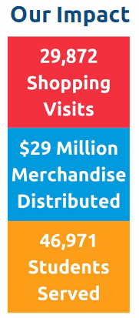
New Volunteer Partner!

Slide 8
ASMC Volunteer Opportunity!
November 4th 12:45pm-3pm
Or
November 18th 8:45am-11am
Sign up to Volunteer at:
https://www.signupgenius.com/go/508094AA4AC29AB9-asmc/69526432
More Info? Debra Walter, AFRL/RSF or Dawn Holding, AFLCMC/WFFI

Slide 9
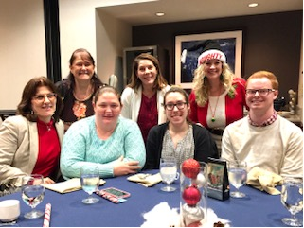
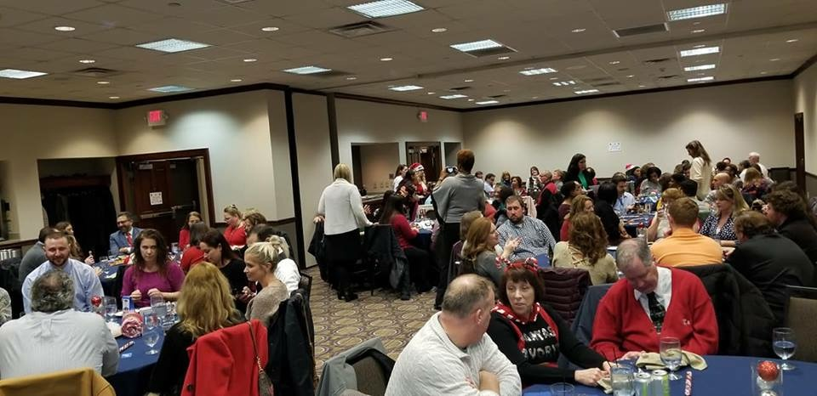
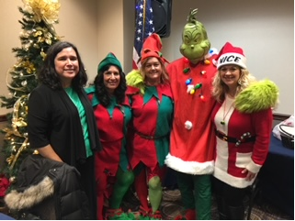
ASMC Christmas Party!
Planning for early December
Looking for volunteers to Help!
Want to Help? Contact Tammy Pendergast, AFRL/RQF

Slide 10
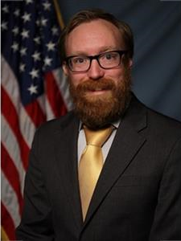
-TOPIC - Demystifying Cost: AFRL FM Training Concept Review
Today’s Virtual ASMC Luncheon
Mr. Jack Snyder Operations Research Analyst
AFRL/RQFC
Mr. Zac Newman AFRL HQ Division Chief
AFRL/FZC

