Slide 1

Benefits of Cross Functional Collaboration
Kathryn Sowers
AFMC A5/8/9
June 2022

Slide 2
“The classification of the brief is Controlled Unclassified Information (CUI) and the discussion can go up to CUI”

Slide 3

Cross-Functional Collaboration
What is it?
Collaboration involving teams, individuals, or organizations working together to achieve a common goal.

Slide 4







Decision Support

Slide 5
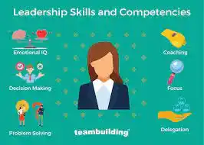


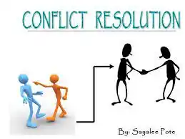


Notes:
Insight & Innovation - Creativity is a group process, when people w/unique skill sets and perspectives collaborate, creativity thrives. In addition, learning from others with different experiences and strengths broadens everyone’s perspective
Collaborative Culture – Cross-functional teams naturally create a collaborative culture because members from different offices are working together to achieve a common goal. Regular team building and shared decision making bridge the gap between siloed functionals/offices fostering a more collaborative and inclusive culture.
Colleague Appreciation – When we don’t regularly work with each other we may have formed perceptions about organizations or each other that were formed mths or years earlier. That judgement goes into over drive when we work remotely and may not see one another, even on TEAMS very often. When you work together you let go of former judgements and discover how you’re on the same team working toward the same goal.
Develops Leadership Skills – Working together allows everyone an opportunity to develop their leadership skills. For example, You may be designated the lead for the project and get an opportunity to step up and lead, whether the lead or team member you’ll have opportunities to communicate and adapt your communication skills to the needs of the team.
More Engaged Employees – Employee engagement has seen a decline in the past few years, and organizations are struggling to keep employees connected. Cross functional teams can keep employees engaged while increasing productivity across the entire organization. When cross functional teams work together they feel more connected, particularly across different departments. Studies show when members feel connected, they develop common goals and trust one another.
Conflict Resolution – With a diverse group there is bound to be conflict, but it doesn’t have to be win-lose. Differing options/thoughts often leads to new ideas as the teams expand their skills and explore more creative solutions.

Slide 6



Notes:
Improved Performance – Finally, Cross Functional Collaboration improves performance. When teams master communication, collaboration, and conflict resolution their performance skyrockets! The best teams learn to replace snap judgements with open communication and make efforts to understand each other.

Slide 7




Real Life Examples
C-17 Globemaster

Slide 8
Questions?
Information from Corestrengths.com

