Slide 1
FM Acquisition Challenges (and Opportunities!)
Marjana Zupcsan, SES, USAF
Director, AFLCMC/FM-FZ
5 May 2022

Slide 2
TOPICS
ACQUISITION JOB JAR
EXECUTION
TOPDOWN BILLS
FIAR/MEV
OTHER CHANGES
OPPORTUNITIES

Slide 3
ACQUISITION JOB JAR

Slide 4
Job Jar Challenges
Acquisition is more than Investment Funding--Acquisition is Life Cycle Management!
Even on the best of days, the job jar is big!
Throughout your career, you’ll likely execute and/or estimate multiple appropriations
FM Analysts must understand investment, O&M (CAM and non-CAM), FMS, and more
With so many funding sources, FM analysts must have a broader understanding of appropriations than just investment funds
It’s not just big aircraft! You might need to understand missiles, software, networks, sensors, support equipment, vehicles, AF uniforms, and so much more
And you need to know more than money
Schedules
Contract types – FFP, Cost….
Sustainment – CLS or Depot, Flying Hours…

Slide 5
EXECUTION

Slide 6
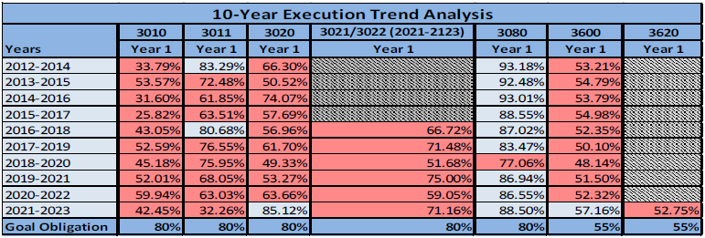
Execution Challenges
The investment appropriations have historical execution challenges.
Poor execution puts a bullseye on a program
AF, DoD, and Congress are always looking for funds for high priority efforts

Slide 7
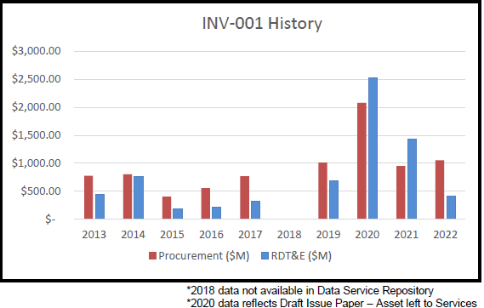
Results of Poor Execution
OSD takes funds every year based on execution as compared to OSD goals
AF has lost billions over the last few years

Slide 8
TOP DOWN BILLS

Slide 9
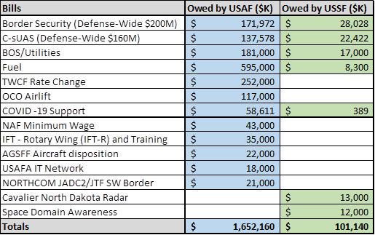
TOP DOWN REQUIREMENTS and FAIR SHARE
Directorates dealing with historic bills!
PEO | Fair-Share Adjusted
AFPEO/ACS | 117,086,000
AFPEO/BES | 0
AFPEO/Bomber | 133,123,000
AFPEO/C3I&N | 130,195,000
AFPEO/Digital | 185,293,000
AFPEO/Fighter | 63,497,000
AFPEO/ISR&SOF | 162,576,000
AFPEO/JSF | 53,521,000
AFPEO/MB | 104,303,000
AFPEO/NC3 | 4,361,000
AFPEO/PE | 0
AFPEO/SS | 26,955,000
AFPEO/WP | 273,058,000
AFOTEC/AFTC | 0
Grand Total | 1,253,968,000

Slide 10
WHY SO MANY BILLS?
PPBE process is long and AF doesn’t have insight into some needs 2-3 years in the future
FY22 PB was submitted to Congress a year ago but was built by AF months before
Nobody could have forecasted current inflation
Nobody could have forecasted current fuel prices driven by world events
DoD sends bills that the AF is required to pay
World events drive changes in priorities; AF leadership must react

Slide 11
Financial Improvement and Audit Readiness (FIAR)/ Military Equipment Valuation (MEV)

Slide 12
Financial Improvement & Audit Readiness
FIAR is a 4-Ltr Word! It takes a lot of time and resources
Important for the tax payers to know how we use our funds
Not just an FM responsibility
Driven by law:
Chief Financial Officer (CFO) Act of 1990 requires all executive agencies produce auditable financial statements
Section 1003 of the 2010 National Defense Authorization Act (NDAA) required the DOD to ensure its financial statements are ready for audit by September 30, 2017
FY18 – FY21 Audit Reports for General Fund and Working Capital Fund Financial Statements:
Result = “Disclaimers of Opinion” (translation: no opinion rendered)
Auditor cannot obtain sufficient audit evidence to render an opinion
Auditor unable to complete testing required, due to scope limitation

Slide 13
Military Equipment Valuation
MEV is a big focus area for the AF and the acquisition community in FY22 and beyond
Statement of Federal Financial Accounting Standards 6
Where accounting requirements for federally owned property, plant, and equipment (PP&E) are captured
MEVs are required for assets (i.e., Aircraft or Modification) greater than $1M
They document:
Capitalization of the total acquisition cost of the asset
Depreciating the total asset cost over its useful life

Slide 14
Military Equipment Valuation
Accountable Property System of Record – Reliability and Maintainability Information System (REMIS)
Where assets, acquisition costs, and useful life are entered for MEV
Where depreciation is calculated automatically
Feeds financial data to the AF financial statements
Ernst & Young issued the Air Force a “Material Weakness” in FY18 for not having processes/procedures in place to meet federal accounting standards
Material Weakness = a deficiency, or combination of deficiencies, in internal control, such that there is a reasonable possibility that a material misstatement of the reporting entity’s financial statements will not be prevented, or detected and corrected on a timely basis
Air Force goal is to reduce Material Weakness to “Significant Deficiency” in FY22 Audit Cycle

Slide 15
OTHER CHALLENGES
More to do than just mission requirements
DoD FM Certification
Back-to-Basics
System Changes
FAMS
ADVANA
AFIPPS
Supervisors
Take care of employees – training, career moves, well-being
Take care of self – training, career moves, well-being
Telework Posture
What is my office going to do?
Will I have a desk…do I want a desk?

Slide 16
OPPORTUNITIES
So much doom and gloom but with great challenge comes great opportunity!
ACCELERATE, CHANGE, OR LOSE!
Why can we do some much in crisis that we can’t do day-to-day?
Think outside the box…if you see an opportunity to improve a process, go to your boss with your ideas
Ask “WHY” If no one can explain why we do something, maybe it’s time to change
Don’t always look for the “Big Bang” idea. Small improvements can add up!!
1650 FMers in AFLCMC…if every person came up with an idea to save one hour a week, we save 1650 hours per week!
Challenge yourself! Challenge your teams! Challenge me!

Slide 17
SUMMARY
Don’t be afraid to come up with new ideas and don’t be afraid to ask for help!
There are a lot of challenges for the FM acquisition community…you are up for the challenge!

