Slide 1
Centralized Asset Management (CAM) 101
Ms. Carrie Denny & Ms. Tracy Cramp
AFMC/FMM
22 March 2022

Slide 2
Classification
“The classification of this brief is Unclassified (U) and the discussion can go up to For Official Use Only (FOUO).”
UNCLASSIFIED
Briefer: Carrie Denny, AFMC/FMM

Slide 3
Overview
CAM Background
Key Stakeholders
Requirements Development
  Aircraft and Missile Requirements (AMR)
  Logistics Requirements Determination Process (LRDP)
  Program Objective Memorandum (POM) Process
Risk Based Approach
Budget and Execution Year Activities
Active Duty AF Cost Per Flying Hour (CPFH) Program
Summary
UNCLASSIFIED
Briefer: Carrie Denny, AFMC/FMM

Slide 4
CAM Mission and Vision
CAM Mission Statement
Centralize and integrate the management of Air Force Sustainment to optimize warfighter capability through effective and efficient allocation of resources across the enterprise
Vision Statement
Centralize Sustainment to Optimize Warfighter Capability Through Effective and Efficient Allocation of Resources across the enterprise
UNCLASSIFIED
Briefer: Carrie Denny, AFMC/FMM

Slide 5
Definitions
Centralized Asset Management (CAM): Air Force Executive Agent for weapon system sustainment (WSS) as codified in AFI 63-101/20-101 and AFMAN 63-143
Weapon System Sustainment (WSS): the sustainment and maintenance of a weapon system, post-production; includes depot purchased equipment maintenance (DPEM), contractor logistics support (CLS), technical orders (TO), and sustaining engineering (SE)
Cost per Flying Hour (CPFH): Major aircraft components and/or consumable supplies that directly support the launch, recovery, inspection, servicing, or maintenance of an aircraft or aircraft component, and/or are required to maintain a piece of support equipment
Total Force (TF) Program Objective Memorandum (POM): plan to allocate funding for a program to meet the Service Program Guidance (SPG) and Defense Planning Guidance
Programming, Planning, Budget, and Execution (PPB&E): Department of Defense (DoD) process for allocating resources
Future Years Defense Program (FYDP): a projection of the forces, resources, and programs to support DoD operations
UNCLASSIFIED
UNCLASSIFIED
Briefer: Carrie Denny, AFMC/FMM

Slide 6
CAM Roles and Responsibilities
Air Force Executive Agent for two-of-five Readiness Levers
  #1 Flying Hour Program (FHP) & #2 Weapon System Sustainment (WSS)
CAM contains both logistics (A4F) and financial management (FMM) personnel and provides daily interface with Air and Space Force readiness stakeholders
    A4F is responsible for WSS Logistics Requirements Determination Process (LRDP), WSS Total Force (TF) Program Objective Memorandum (POM) process, advisors to the Spares Requirements Review Board (SRRB) and the Cost Review Board (CRB) in support of the AF Cost Per Flying Hour (CPFH) program, and manages the CAM IT data system and AFMAN 63-143
    FMM is responsible for the TF WSS Execution Plan and Mid-Year Program Reviews, and all Active Duty WSS and FHP budgetary activities while ensuring processes are FIAR compliant. Engages with the SRRB, CRB and AF Petroleum Agency (AFPET) as advisors in support of the CPFH
      Continuous collaboration w/FHP stakeholders & HAF/SAF; daily management of fly ops execution/needs
      Fosters efficient use of programmed funding/meets congressional limitations and operational needs
      Analyze, validate and execute funding positions in response to real-world changing AF priorities
UNCLASSIFIED
Briefer: Carrie Denny, AFMC/FMM

Slide 7
Key Stakeholders
SAF/HAF (AQ, FM, A2, A3, A4, A5, A8): Provide strategic guidance/advocacy through AF A3, Log Panel and other corporate structure forums
Lead Commands
  Set the desired capability levels, validate and prioritize WSS requirements
  Provide funding trade-off options within ‘owned’ weapon systems to minimize risk to highest prioritized weapon system(s)
  Collaborate w/CAM & Spares Requirements Review Board (SRRB) stakeholders to develop CPFH supply requirements
  Provide FH plan/actuals to support WCF billing process & AvPOL projected/actual usage for each weapon system
Program Offices: Develop detailed requirements to meet desired capabilities, spread funding to minimize risk and maximize capability to the warfighter
Funds Holders: Includes active duty AF (managed by CAM), Air National Guard, AF Reserve Command, Transportation Working Capital Fund, US Space Force (USSF), and AF Special Operations Command (only for CPFH)
UNCLASSIFIED
Briefer: Tracy Cramp, AFMC/FMM

Slide 8
CAM Office Structure and Interfaces
MAJCOM CDs
AFMC
CD/CA
CAM Governance
Air Staff
Executive Committee
Executive Steering Group
HAF/A4P
SAF/FMB & HAF/A4P
A4
FM
Advisory Council
Ctrs & Complexes
Ctrs & Complexes
MAJCOM/A4s
CAM
MAJCOM/A4’s
Execution Plans
Initial Distribution
Mid-Year Review
Unfunded Mitigation Strategy
CPFH Oversight/Execution
Funds Control
Accounting/ULO tracking
WCF Execution Year Partnership
Close-out
WSS Requirements Build
WSS POM Build
Perf Based Objectives
CAFDEx System Mgmt (SPERS)
CPFH Managers
Organic Depot Workload
A4F
FMM
Air Staff
Program Offices
Using Commands
Lead Commands
Funds Holders
SRRB & CRB
UNCLASSIFIED
Briefer: Tracy Cramp, AFMC/FMM

Slide 9


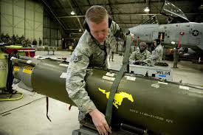
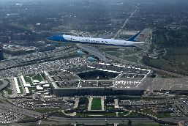
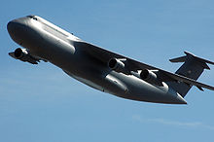



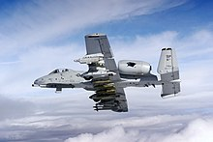







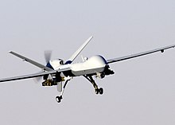








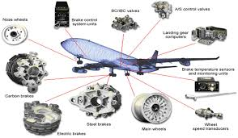

CAM Operational View(OV)-1
DPEM
Funding
Warfighter
HAF/SAF
Sustaining Engineering
Air Force Materiel Command
MAJCOMS
Contractor Logistics Support
Centralized Asset Management
Funds Holders
Program Offices
Technical Orders
Depot
File Maintainers
CPFH
DPEM: Depot Purchased Equipment Maintenance
CPFH: Cost per Flying Hour
UNCLASSIFIED
Briefer: Tracy Cramp, AFMC/FMM

Slide 10
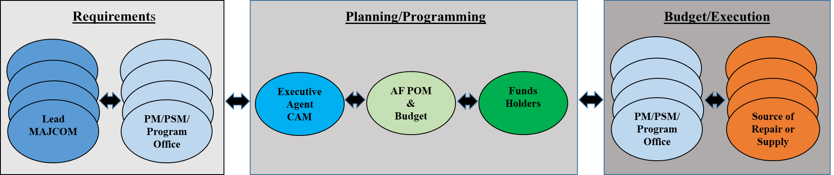
WSS Process Overview & Benefits to Air Staff
Enterprise-wide focus
Total Force fleet-wide requirements by system
Streamlined and simplified requirements generation and funding allocation
Established performance based outcomes linking requirements to capability delivered
Standard, repeatable, and auditable PPB&E
UNCLASSIFIED
Briefer: Tracy Cramp, AFMC/FMM

Slide 11
CAM Governance
CAM Executive Committee (EC)
Co-Chairs: AFMC/CD, SAF/FMB, AF/A4
Mbrs: AF/A2R, A8P, A3O, A4L, A4P, A5X, REC, SAF/AQD, AQXR,
ACC/CD, AETC/CD/CV, AFGSC/CD, AFRC/CD/CV, AFSOC/CD/CV,
AFSPC/CD/CV, AMC/CD/CV, ANG/CD, PACAF/CD/CV, USAFE/CD/CV, AFMC/CA
Advisors: AFSC/CC, AFLCMC/CC, AFNWC/CC
Within each tier of the CAM Governance Structure, each MAJCOM gets a vote during the decision making process. This ensures information is distributed across the CAM WSS portfolio and supports equitable decision making among stakeholders.
CAM Executive Steering Group (ESG)
Chair: AFMC/CA
Mbrs: AFMC/A1, A2, A3, A4, A/5/8/9, FM, EN, PK;
2-Ltr Equiv’s (A2, A3, A4, A6, A8, A10, FM)
from MAJCOMs, AFRC, ANG, AFFSA;
3-Ltr Equiv’s from Air Staff;
Weapons System PEOs;
OC/OO/WR Air Logistics Complex Commanders
CAM Advisory Council (AC)
Co-Chairs: CAM Chiefs (AFMC/FMM & AFMC/A4F)
Mbrs: 3-Ltr Equiv’s (A2, A3, A4, A6, A8, A10, FM)
from MAJCOMs, AFRC, AFMC, ACC, USSF, AFSOC, AFGSC, AETC, SAF/AQD, SAF/FM, ANG, AFFSA;
4-Ltr Equiv’s from Air Staff;
Program Office PMs/PSMs; AFSC/LG; AFNWC/LG;
AFLCMC/LG; Mission Panel Representative(s)
UNCLASSIFIED
Briefer: Tracy Cramp, AFMC/FMM
11

Slide 12
WSS Portfolio Complexity
UNCLASSIFIED
Briefer: Tracy Cramp, AFMC/FMM

Slide 13
Resourcing and Forecasting WSS
* Non-CAM process
Risk Based Assessments
Execution Tracking
*Workload D2 & Updates
*PDM/Engine Inductions
Readiness of Combat Capabilities Review (RoCCR)
*Technical Acquisition and Sustainment Review (TASR)
Identify Desired Performance Outcomes
Develop Performance Based Requirements
Optimize Performance within Constraints
Monitor Performance
Aircraft Availability (AA)
Operational Capability
System Availability
Lead Command
Program Manager
Funds Holder
Program Objective Memorandum (POM)
Execution Plan (ExPlan)
Mid-Year Review
*Depot Determination (D2 of R2D2)
Risk Based Assessments
Fiscal Year-end Close-out
Out Of Cycles/Unfunded Requests
Aircraft and Missile Requirements
Logistics Requirements Determination Process (LRDP)
*Requirements Review (R2 of R2D2)
UNCLASSIFIED
Briefer: Tracy Cramp, AFMC/FMM

Slide 14
Timing of WSS Processes and Procedures
Future Fiscal Year Planning Activities
Aircraft and Missile Requirements (AMR)
LRDP (cont.)
Logistics Requirements Determination Process (LRDP)
Program Objective Memorandum (POM)
Execution Plan
Current Fiscal Year of Execution Activities
Continuing Resolution
Initial Distribution
Mid Year Review
Closeout
Out of Cycles and Unfunded Requirements List
Oct* Nov Dec Jan Feb Mar Apr May Jun Jul** Aug Sep
*start of fiscal year **80/20 rule
UNCLASSIFIED
Briefer: Tracy Cramp, AFMC/FMM

Slide 15
High Level POM Process
The starting point for POM activities begin with program group’s published requirements
AF/A4P, SAF/FMB, and SAF/AQ provides strategic and technical POM guidance
Funds holder utilizes the current PBES file to establish initial program funding
Lead command prioritizes and weighs each program within their Mission Panel
Programs weigh risk categories and collaborate with lead command and funds holders
Program group respreads funds as they would execute and develop programmatic risk impacts
Lead command provides operational risk impacts to program group(s)
Program groups develops and briefs Senior Leader Program Review slides to include programmatic, operational and affordability impacts to WSS Senior Leadership
Lead command assesses operational risk across portfolio to optimize funding across Mission Panel
Lead command develops and briefs Lead Command Operational Review charts detailing Mission Panel program group ranking/weighting and operational impacts towards the Senior Leader Program Review funding position
CAM schedules Governance meetings to gain approval of the total force WSS POM submission
UNCLASSIFIED
Briefer: Tracy Cramp, AFMC/FMM

Slide 16
POM Process

Slide 17
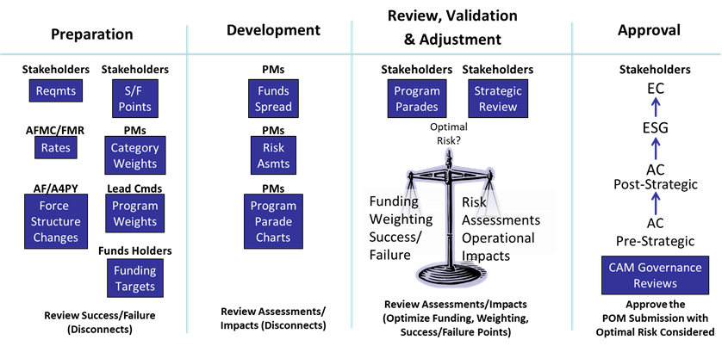
CAM WSS POM Process Approach
UNCLASSIFIED
Briefer: Tracy Cramp, AFMC/FMM

Slide 18
Aircraft and Missile Requirements (AMR) Process Overview
AMR
Engineering Requirements
Review Process (ERRP): a standardized methodology to fully define, develop, and approve scheduled maintenance tasks
AMR Work Specification
and AMR Brochure: documents depot maintenance actions and provides a means for depot and program office to collaborate on necessary tasks
Bill of Work: Identifies operations required to execute tasks and calculates the man-hours to support those tasks
Supportability Assessment: ensures tasks are supportable in terms of manpower, personnel, hazardous materials, special and common tools, Defense Logistics Agency (DLA) and Supply Chain Management (SCM) managed parts
UNCLASSIFIED
Briefer: Tracy Cramp, AFMC/FMM

Slide 19
Logistics Requirements Determination Process (LRDP)
LRDP is an annual process used to develop, set risk, collaborate, validate, prioritize and publish CAM WSS logistics requirements per AFMAN 63-143
Program offices use standard engineering and forecasting practices to build a set of requirements within in each of the four business process areas (DPEM, CLS, TO, and SE)
Each of the phases listed below allows program group stakeholders the insight into the programs requirements throughout the FYDP
This process is a collaborative effort between the program office, funds holder, as well as the lead and supported command
Prepare
Requirements
Phase
Define
Requirements
Phase
Requirements
Collaboration
Phase
Requirements
Validate and
Prioritize Phase
Publish Requirements
Start
End
UNCLASSIFIED
Briefer: Tracy Cramp, AFMC/FMM

Slide 20
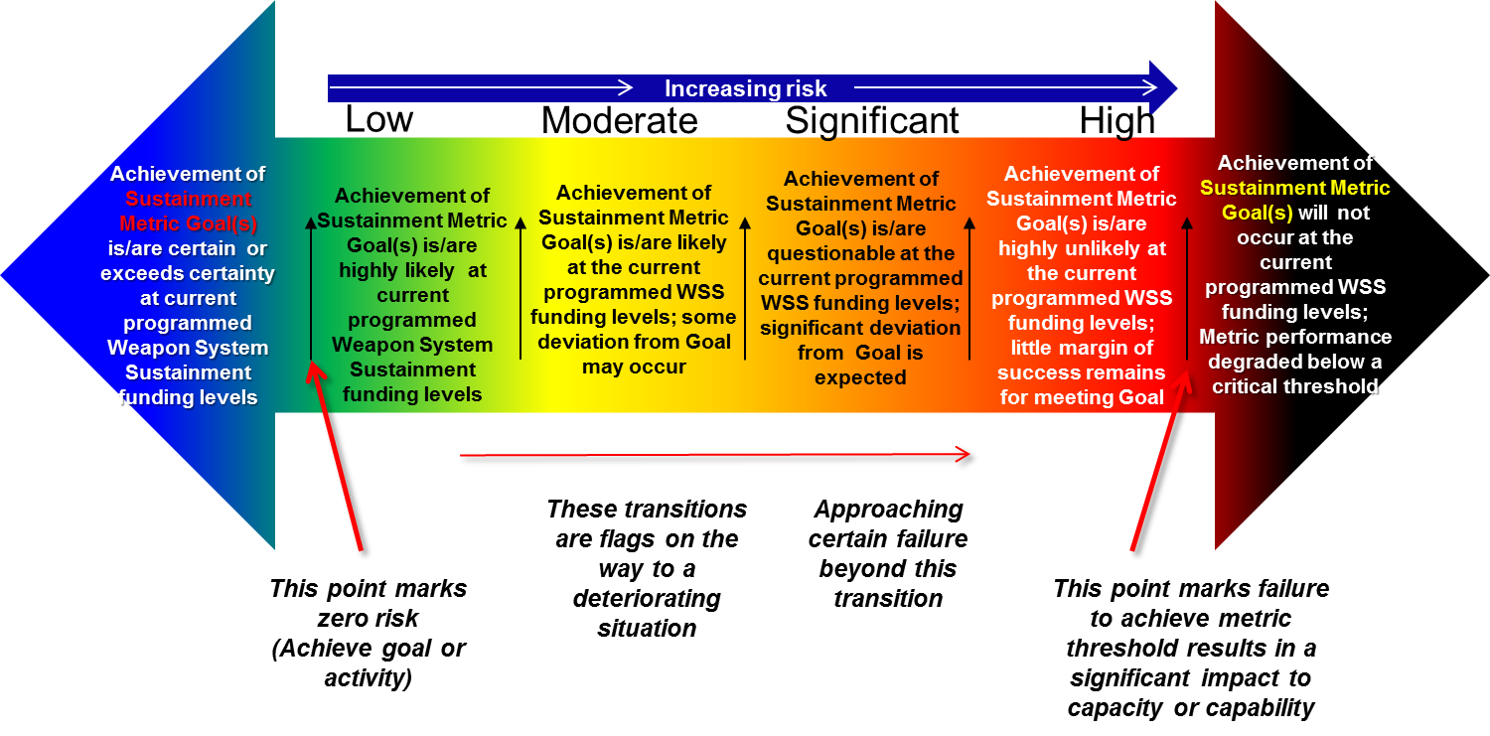
CAM Risk Based Assessment Model Overview
Risk thresholds defined by requirement during LRDP
Model provides the trade space by risk category for WSS resource allocation decisions, which minimize calculated risk
SUCCESS
FAILURE
UNCLASSIFIED
Briefer: Tracy Cramp, AFMC/FMM
14

Slide 21
CAM Risk Assessment Model Benefits
Risk based approach facilitates quick reaction to last minute changes
  Weapon System risk buy backs allows quick turn planning
  Bottom-up build provides focused analysis
    Vertical weapon system, lead command, and mission panel looks
    Horizontal commodity look
Facilitates discussion and debate on requirements
Highlights lack of flexibility and flying hour program in CLS programs
Provides senior leaders with informed cost-effective options (moved away from percent funded) – target where additional funds needed and benefit
UNCLASSIFIED
Briefer: Tracy Cramp, AFMC/FMM

Slide 22
Financial Management Overview

Slide 23
CAM Financial Management Overview
  Active engagement with MAJCOMs and program offices—optimize Total Force resource allocation maximizing warfighter readiness and sustainment
  Solid partnership with other key stakeholders to protect warfighter readiness: MAJCOMs; HAF/SAF: A4PY, A2/5, A3, FM; ANG; AFRC; AFLCMC; and, AFSC
  Data Analysis for senior leadership: Sustainment Review Team (SRT), Technical Acquisition Sustainment Reviews (TASRs), and Readiness of Combat Capability Review (ROCCR)
  Maximum adherence to imposed legal limitations (ex: CLS/DPEM/Flying Hour SAG floors, OCO, and other readiness SAG limitations)—monthly balancing, etc.
  Flying Hour Program – Pay the Active Duty WCF bill for organic supply as a Cost per flying Hour (CPFH) covering cost of AvPOL, Consumables and Depot Level Reparables, Advisors in AF SRRB and CRB processes; linked w/ AF/A3 Community and AFPET/DLA
  Accounting, Policy and FIAR POC; solid relationship w/ stakeholders, ensure prior year & reimbursement properly managed and balanced
  Execute & balance ~$600M reimbursements/disbursements with readiness partners (ANG, AFRC, MILAUG, AFSAT, ENJJPT, FMS, F-35 Trng, Launch Ranges, Airshows, NASA, etc.)
UNCLASSIFIED
Briefer: Ms. Carrie Denny, AFMC/FMM

Slide 24
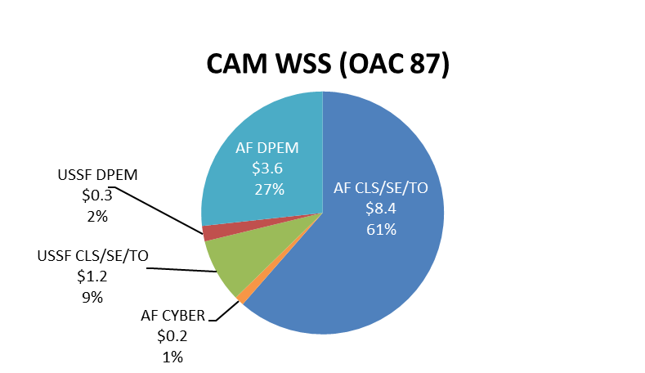
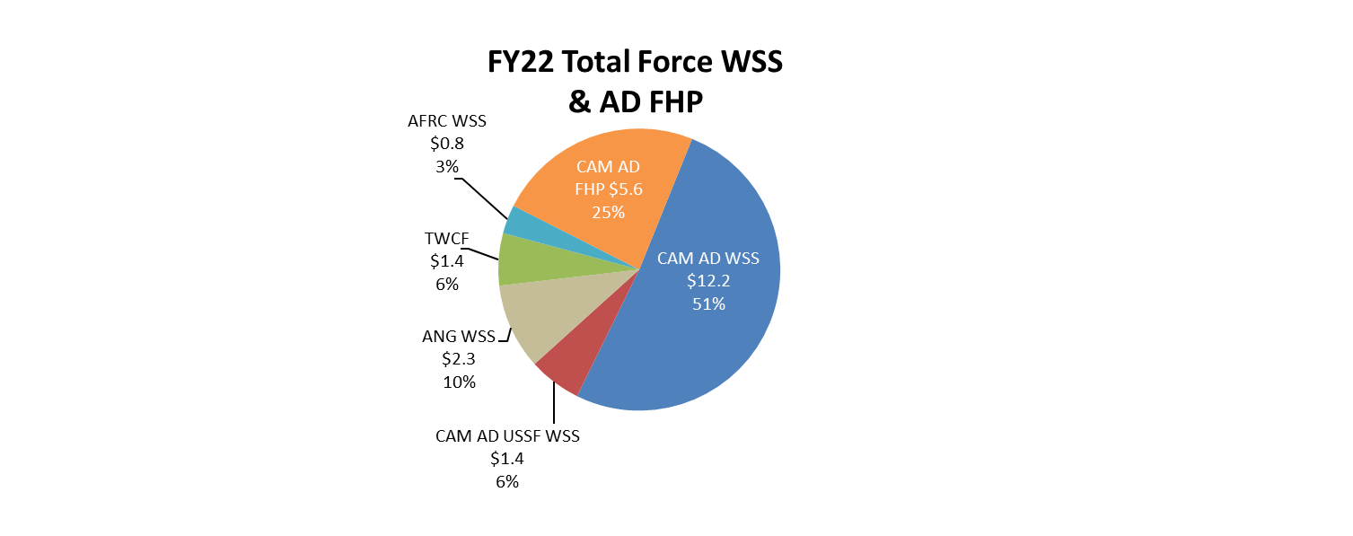
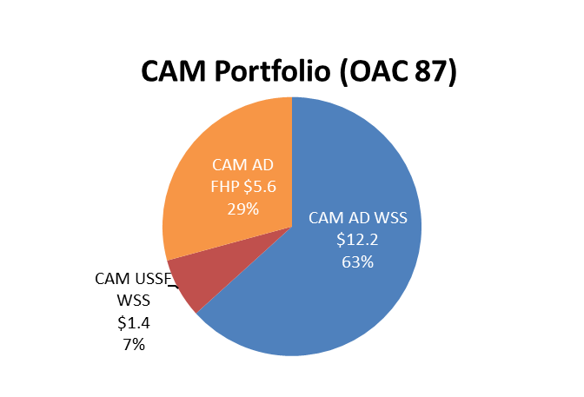
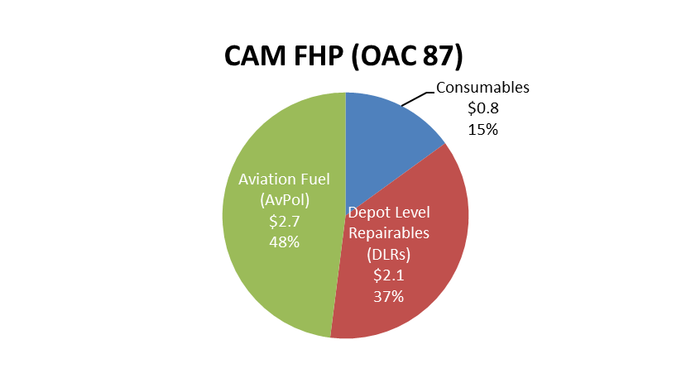
Managing CAM OAC 87 Funding & Limitations
= Fiscal Limitations
Other Limits not Shown Include:
-50/50
-MILAUG
-ESP Code FA (DWEC) (TF $1.6B)
SAG
3410 APPN
SAG
SAG
SAG
MIP Funds
$13.6B
$23.8B
118 Program Groups
Notes:
FY22 Total Force $s a/o FY22 ExPlan
FY22 Appropriation Enactment likely to see changes to AF/USSF WSS & FHP
Anticipated MILAUG reimbursements not included
$19.2B
113 Program Groups
CAM Portfolio Represented ~34% of AF & ~54% of USSF FY21 O&M Budgets
$5.2B
UNCLASSIFIED
Briefer: Ms. Carrie Denny, AFMC/FMM
24

Slide 25
TF WSS ExPlan Kickoff, Ground Rules, and Assumptions
Targets represent next FY’s PB ABIDES position & POM Rules of Engagement
Utilize risk model and the program office assessment to allocate funds
Execution planning is at a TF perspective
Adjustments to next FY’s requirements are made on a case-by-case basis
MAJCOMs will mitigate risk to programs during Strategic Review
All funding will be consolidated in Budget Activity (BA) 01 within Sub Activity Groups (SAG) 11M (DPEM) , 11W (CLS/SE/TO), 11V (Cyber), 13M (USSF DPEM) and 13W (USSF CLS/TO/SE)
Other Contingency Operations (OCO) amounts & other initiatives will be provided by HAF/SAF
UNCLASSIFIED
Briefer: Ms. Carrie Denny, AFMC/FMM

Slide 26
TF WSS Risk-Based Decision Process
Approach for Execution Plan
Review, Validation
& Adjustment
Preparation
Development
Approval
Stakeholders
Stakeholders
AFMC/FMM
Stakeholders
Stakeholders
Stakeholders
Reqmts
S/F
Points
Target/Limitations
Analysis
Strategic
Review
ExPlan Chart
Deliverables
EC
AFMC/FMR
PMs
PMs
Optimal
Risk?
ESG
Rates
Category
Weights
Funds
Spread
AC
AF/A4PY
Lead Cmds
PMs
Post-Strategic
AC
Pre-Strategic
Force
Structure
Changes
Program
Weights
Risk
Assmts
Funding
Weighting
Success/ Failure
Risk Assessments
Operational Impacts
Funds Holders
Adjustments Applied:
POM/PB
Fact of Life
Marks by SAG
Funding
Targets
from SAF
CAM Governance
Reviews
Review Assessments/
Impacts (Disconnects)
Review Assessments/Impacts
(Optimize Funding, Weighting, Success/Failure Points)
Approve the
Ex-Plan Submission with Mitigation Strategy
Review Success/Failure (Disconnects)
Maximize Capability-Minimize Risk to Warfighter Sustainment

Slide 27
Major CAM Annual Activities/Processes
Continuing Resolution – Minimal funding to continue operations until a budget is passed, typically 3-6 months
Initial Distribution – Annual authority provided to program offices and FH program, aligned with the current execution plan
POM Cycle – A4 Led w/ FMM engagement; Portfolio level programming to requirements covering the next fiscal year and FYDP. Note: Air Staff is the FHP lead
Mid Year Reviews – Statuses Weapon System funds execution to forecast, highlights major program concerns and cancelling year funding; 80/20 Rule. Note: FHP Reviews conducted monthly w/SAF
Execution Plan – Details the planned funding and corresponding risk to requirements for the upcoming fiscal year. Balance operational need with funding. Note: SAF builds FHP ExPlan
Unfunded Requirements List – Manage and re-distribute funds to meet highest operational priorities by 30 Sep—a key component to closeout
Closeout –Free up DBA by balancing reimbursements; meet SAG limitation floors; report deferrals
Daily Operations – Tactical analysis of assigned programs, tracking WSS & AvPOL execution, WCF engagement, funds allocation, SAG limitation, OOC & policy reviews, Prior Year activities, manage RBA/DBA, FIAR compliancy and validation, training
Recurring Meetings/Deliverables - Management of ongoing activities such as Air Staff Taskers, PEO Execution updates, TASRs/RoCCR support, FH Reviews, CRB
EMERGENCY Funding
Initial Distribution – MARK COAs
POM Cycle
Mid Year Reviews
Execution Plan / Spend Plan
Unfunded Requirements List
RoCCR MAJCOM 2 Star Level
RoCCR MAJCOM 2 Star Level
Continuing Resolution
RoCCR AFMC 4 Star Level
RoCCR AFMC 4 Star Level
Closeout
EOM July 86%
FHP, FIAR, RBA, Continuous Daily Processes
Funds Control & Balancing; Continuous Daily Processes
Daily
Operations
SPERS Development
Strategic Initiatives
USSF Transition
Recurring Meetings / Deliverables
ZBR/ ExPlan Revamp
Each activity impacts execution and funding at the Program Office, Lead Command, Mission Panel & portfolio level
Detailed Operational Focus for Future Fight
UNCLASSIFIED
Briefer: Ms. Carrie Denny, AFMC/FMM

Slide 28
CAM (OAC 87) Mid-Year Reviews
Scheduled each fiscal year (FY) in March-April timeframe
Weapon Systems/Program Groups brief status of systems/programs
Highlight current execution vs. forecast and illustrate the plan to meet the OSD directed the 80% obligation rate by 31 July, 100% obligation by EOY (CAM’s Goal is 86% as apposed to the 80%)
Program Manager’s/Action Officer’s Soapbox
Unfunded requirements (UFR Listing) and projected Excess
ULOs/Fall-In/Fall-Out/Open Commitments – May be moved out of MYR –
Close-out Preparations and Processes – May be moved out of MYR –
Request to process funding realignments via CCaR
Each Program Group MUST ensure ALL funding requests are created in conjunction with CAM approved FY Execution Plan Values and CAFDEx
UNCLASSIFIED
Briefer: Carrie Denny, AFMC/FMM

Slide 29
CAM Year of Execution UFR Process
Process allows for flexible, dynamic realignment of funding to most critical and time sensitive readiness needs – worked as an enterprise daily
CAM UFR process
  Prior to Mid Year Review: Fix within program within MAJCOM portfolio
  After Mid Year, UFRs will be funded via the CAM Enterprise approach
  Final option is to seek Air Force level assistance
CAM prioritized its 1-N UFR list using the following criteria:
    Operational Mission Unfunded Category (Mission Critical / Essential / Enhancement UFRs)
    Air Force Priority (e.g. Pilot Production, NDO)
    Lead Command Priority
    Need Date
Balance current operational needs with a concentrated effort to reduce impact(s) to future years
UFR Identified
Requirement Approved
UFR Funded
Funding Issued to Program
Remaining UFRs Deferred
Start
End
UNCLASSIFIED
Briefer: Carrie Denny, AFMC/FMM

Slide 30
CAM Flying Hour Program (FHP) Process
PPB, CRB, and SRRB Processes
Funding From SAF
Fiscal Year Startup
Activities
Fiscal Year Execution
(AVPOL, Reimbursements, Disbursements, and WCF Bill)
EOY Closeout
Start
End
Organic costs that directly support the launch, recovery, inspection, servicing and maintenance of an aircraft or aircraft component; a portion of support equipment; and fuel
CAM FHP - Historical avg. ~$6B per year; $600M disbursements and reimbursements
  FHP budget has 3 major components:
    Consumable Supplies - Aircraft parts that are not repaired
    Depot Level Reparables (DLRs) – Aircraft parts that when broken are removed & repaired
    Aviation Petroleum Oil and Lubricants (AvPOL), or fuel
Program excludes the following: AFMC, AFRC, ANG, ISR/Unmanned and AFSOC mission design series; CAM maintains constant engagement with AF/A3T, SAF/FM, MAJCOM/A3s, TRANSCOM, USCENTCOM, AFPET, DFAS, and DLA
Reimbursed to
WCF Monthly
{
UNCLASSIFIED
Briefer: Carrie Denny, AFMC/FMM

Slide 31
WSS FY23 POM /
FY22 Financial Execution Plan

Slide 32
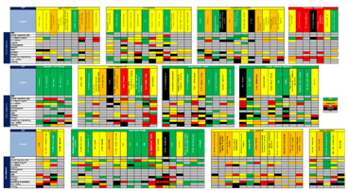
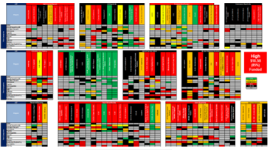
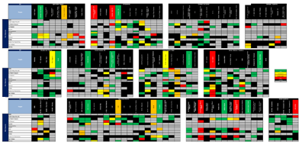
WSS POM Heat Map Trend
FY21 POM
FY22 POM
FY23 POM
AF WSS 21POM:
Requirements: 17.8B
Funded: $15.7B
FY20-21 Growth: $1.4B
Percent Funded: 88.1%
Risk: Moderate
AF WSS 22POM:
Requirements: 18.6B
Funded: $15.6B
FY21-22 Growth: $0.8B
Percent Funded: 83.9%
Risk: High
AF WSS 23POM:
Requirements: 21.0B
Funded: $15.1B
FY22-23 Growth: $2.4B
Percent Funded: 71.7%
Risk: Failure
Source: CAFDEx, FY20-23 POM RQMTs, does not include USSF
UNCLASSIFIED
Briefer: Carrie Denny, AFMC/FMM

Slide 33
FY22 Strategic Landscape
What we’re up against…
CAM, Funds Holders, and MAJCOMs will need to make difficult decisions to ensure proper resource allocation within budget limitations
Requirement growth in the WSS portfolio for FY22 was not funded during AF POM; results in AF accepting a WSS portfolio risk of HIGH for FY22
The Air Force must prioritize the sustainment of weapon systems that strengthen the nation’s ability to prosecute the fight in accordance with the NDS.
How we addressed risk…
Ensure portfolio is aligned to the latest AF strategic guidance (as outlined in ZBR) and the programmed AF force structure
Ruthlessly evaluate bogey allocation to ensure an executable enterprise portfolio
Optimize available funding through deep-dive reviews across all weapon systems, placing emphasis on capabilities that take priority across SCFs and support National Defense Strategy priorities
Desired End State
Assess program alignment to balance structural (long-term) and operational (near-term) readiness of our weapon systems
A thoroughly reviewed portfolio that maximizes every dollar to successfully execute the sustainment for weapon systems and capabilities that support the Air Force Strategic Guidance
UNCLASSIFIED
Briefer: Carrie Denny, AFMC/FMM

Slide 34
FY22 USAF WSS Execution Plan Process
Optimize Readiness Funds
FY22 POM Outcome
Requirement Growth
Force Structure
ZBR Results
FY23 POM Corporate Decisions
Prior Year Execution
Programmatic Inputs/Impacts
AF Strategic Priorities
MAJCOM Priorities
Followed standard CAM processes; with adjustments
FY23 ZBR/POM Corporate Decisions drove FY22 bogey allocations
Followed Air Force Strategic Priorities to meet NDS
  Pacing Platforms, Nuclear Deterrence, Cost Saving, Aircrew Training
Performed ruthless analysis of every program within the portfolio
  Used ZBR outcome (benefactor, recipient, rationale, data collected)
  Analyzed prior year execution
  Analyzed requirement growth without budget lead time
  Analyzed alignment to the AF force structure plans
Programs reviewed failure points & assessed program impacts
Analyzed program inputs and SCF ranking to re-prioritize funding
  Maintained Congressionally restricted SAGs
  Ensured funding was aligned to top program priorities
MAJCOM Priorities/Operational Risk
  Met with MAJCOMs and specific programs to assess risk
  Re-aligned funding as needed to define acceptable risk
UNCLASSIFIED
Briefer: Carrie Denny, AFMC/FMM

Slide 35
FY22 USAF Risk Assessment
Where We Started
Aligned funding to mirror ZBR
+$1.4B rqmt growth since 22 POM ($1.1B excluding TWCF)
Adjust Requirement/ Failure Points
($318M) Requirements (ZBR Alignment)
($572M) Failure points (ZBR Alignment)
Funding Allocations
Program Analysis
Risk Buy-Down
Program by program analysis
Reviewed ZBR decisions, historical execution, force structure alignment, and SCF priority
Scrutinize program funding to highest priorities; recommendations to improve risk
($118M) Risk reduction from buy-downs
($782M) RQMTs from execution reviews
($92M) Failure point reductions from buy-downs
($758M) Failure Pts from execution reviews
Where We Are
Program by program analysis to properly allocate funding
($1.2B) requirement reduction
($1.4B) Failure Point reduction
Collaborative and rigorous mitigation strategies results in a risk aligned portfolio for FY22
UNCLASSIFIED
Briefer: Carrie Denny, AFMC/FMM

Slide 36

FY22 DAF WSS Execution Plan Portfolio Overview
($M)
 | FY20 Ex Plan | FY21 Ex Plan | FY22 POM | FY22 POM Locked (OSD PBD) | FY22 Ex Plan Starting position | FY22 Ex Plan
CAM/ANG/AFRC Rqmt | $16,579 | $17,539 | $18,602 | $18,602 | $19,702 | $18,479
CAM/ANG/AFRC Funding | $15,241 | $15,803 | $15,818 | $15,608 | $15,612 | $15,574
% Funded to Requirements | 92% | 90% | 85% | 84% | 79% | 84%
TWCF Rqmt | $1,077 | $1,263 | $1,214 | $1,214 | $1,472 | $1,472
TWCF Funding | $1,077 | $1,150 | $1,214 | $1,214 | $1,472 | $1,430
% Funded to Requirements | 100% | 91% | 100% | 100% | 100% | 97%
USSF Rqmt | $1,582 | $1,666 | $1,817 | $1,817 | $1,834 | $1,832
USSF Funding | $1,350 | $1,376 | $1,461 | $1,445 | $1,439 | $1,439
% Funded to Requirements | 85% | 83% | 80% | 80% | 78% | 79%
TF Rqmts | $19,238 | $20,468 | $21,632 | $21,632 | $23,008 | $21,784
TF Funding | $17,668 | $18,329 | $18,493 | $18,267 | $18,523 | $18,443
% Funded to Requirements | 92% | 90% | 85% | 84% | 81% | 85%
Program Groups | 117 | 118 | 118 | 118 | 117 | 117
All positions include applicable MILAUG projections
Portfolio funded at 85%; risk level is consistent with FY22 POM accepted WSS risk
UNCLASSIFIED
Briefer: Carrie Denny, AFMC/FMM

Slide 37
Summary

Slide 38
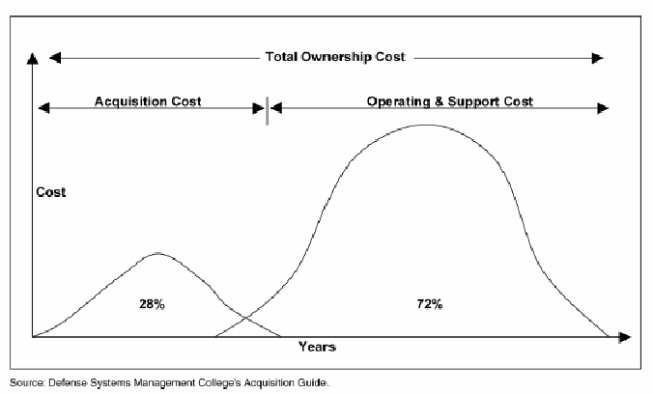
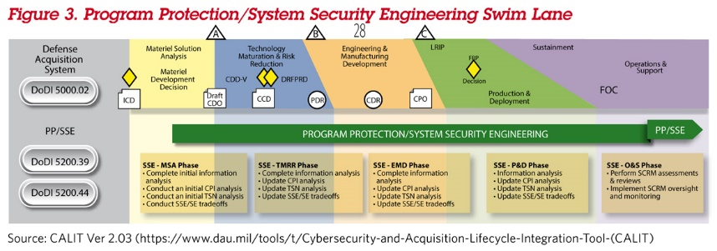
CAM Processes: Weapon System/Warfighter Enabler
The importance of understanding CAM’s processes -- A weapon system spends the majority of it’s life cycle in the Sustainment Phase
(Funding Source: Operations & Maintenance – One Year Appropriation)
CAM LRDP & Sustainment Funding
UNCLASSIFIED
Briefer: Tracy Cramp, AFMC/FMM

Slide 39
Summary
CAM is comprised of personnel from HQ AFMC/A4F and HQ AFMC/FMM
  HQ AFMC/A4F – AMR, LRDP, POM, and CPFH requirements
  HQ AFMC/FMM – Budgeting and execution of WSS and FHP (to include AvPOL)
CAM centralizes and integrates management of AF WSS to optimize warfighter capabilities through effective and efficient allocation of resources aligned against valid published requirements across the WSS enterprise
The CAM Governance is the decision authority for Total Force WSS; socializes key processes results and mitigates conflicts at lowest levels
The CAM risk based assessment model is a decision support tool that helps maximize warfighter capability & minimize risk, while supporting readiness
  Used for all CAM processes: Execution, Execution Plan, and POM
Standard repeatable process – continuous process improvements to include the Risk Based Assessment and other automation tools to optimize AF readiness
UNCLASSIFIED
Briefer: Ms. Tracy Cramp, HQ AFMC/FMM

Slide 40
Summary Cont’d
CAM is integral to the Cost per Flying Hour program for requirements development and is responsible for the budgeting and execution of the AF FHP
Judicious planning, programming, and execution of CAM and reimbursable funds essential to meeting warfighter needs
UNCLASSIFIED
Briefer: Ms. Tracy Cramp, HQ AFMC/FMM

Slide 41


Slide 42
Program Objective Memorandum (POM) Definition
The POM is a future year oriented process concerned with estimating requirements needed in advance of the current calendar year.
Requirements must be input to the POM cycles if funds are to be available across the POM & FYDP timeline. As an example:
  Prior Year - FY20
  Execution Year (budget year) - FY21
  Execution Plan (budget year +1) - FY22
  POM (budget year +2) - FY23
  Out Years - FY24, FY25, FY26, FY27
The FYDP displays total resources and force structure information for six years; current two budgeted years and four additional years.
UNCLASSIFIED
Briefer: Lauren Mancilla, HQ AFMC/A4FR

Slide 43
Risk Weighting and Success & Failure
Risk Weighting: HQ AFMC tasks lead commands for program ranking and weighting within their Mission Panel
  Program offices weigh and rank risk categories within programs
  Collaborated by lead command and funds holder reflecting the relative proportional importance or criticality to the overall mission at the risk category level
  Weighting only determines the roll-up risk assessment
Task Risk Success & Failure: Established by program office; collaborated on by lead command and funds holder
  Defined at the task level, which provides more insight and fidelity into the risk assessment process; form the basis for each programs risk assessment
  Failure points are not based on funding expectations
  Each AFEEIC of a task is mapped to a risk category; failure definition for each
Funds holders may apply funding based on success and failure points and weighting to achieve the desired risk level within their resource constraints
UNCLASSIFIED
Briefer:

Slide 44
WSS Execution Year Business Rules
Break lock in execution year: fund holders responsible for their WSS & FHP execution
  TF Mid-Year Reviews conducted to assess overall readiness
Emerging WSS requirements are a fact-of-life which may lead to execution year unfunded requests
  Budget Activity Codes (BACs), statutory floors, and 50/50 considerations affect all funding decisions
  Limited flexibility in execution year to resolve; Key is being directionally correct in POM
Process for addressing WSS funding shortfalls
  Program offices must first look internally to resolve
  Next option is to seek Lead Command support to reallocate within their WSS portfolio
  If necessary, CAM intervenes to realign across the portfolio
  Final option is to seek Air Force level assistance
Standard, Repeatable Processes, Collaboration, and Transparency are the Keys to Success
UNCLASSIFIED
Briefer: Ms. Tracy Cramp, HQ AFMC/FMM

Slide 45
CAM Risk Categories
Definitions are located at the Financial Management Data Quality Service website
UNCLASSIFIED
Briefer:

Slide 46
CPFH Exclusions
Administrative supplies (pens, pencils, paper, copiers, binder, etc)
Housekeeping or cleaning supplies
Flight simulators and trainers
Real Property
Flight suits, boots, and uniforms
Shelving
Tool Cabinets
Labor, travel, and other overhead
Vehicle/transportation maintenance
Support equipment
Capital investment items and Automated Data Processing (ADP) equipment
UNCLASSIFIED
Briefer:

Slide 47
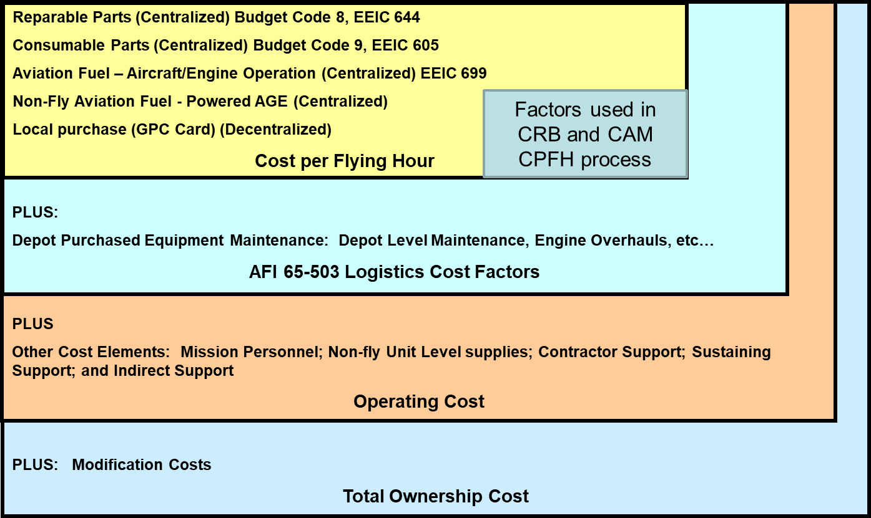
CPFH and other Ownership Cost Factors
UNCLASSIFIED
Briefer:

