Slide 1
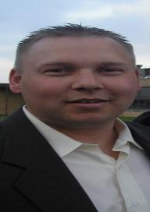
JAMES OBERG
James Oberg is a Senior Consultant with Kearney & Company and is currently the Contractor Lead for the DEAMS Deployment & Training Team. James’ primary duty is to deploy DEAMS to Air Force Active Duty, ANG, and Reserve units.
He joined Kearney after serving on active duty in the Air Force for 12 years (Enlisted) and 13 years (Officer) before retiring in 2013. He now resides in Minnesota where he owns part of his family farm, growing sugar beets, wheat, soy beans, and corn.
James has a BA in Accounting, an MBA from the Naval Post graduate School, but his most prized degree is in Welding from the University of North Dakota. He is also a Certified Defense Financial Manager-Acquisitions.
James has a wide range of interests, including sports, with hockey being his favorite, boating, hunting, fitness, and pretty much everything outdoors. He also enjoys travel.

