Slide 1
Emotional Intelligence In The Workplace
Why It Matters

Slide 2
Bringing Your Best Self To Work
Would you like to:
Have better interactions with colleagues?
Be more engaged at work?
Have more energy for work and life?

Slide 3
"We’ve found that even though most people believe they are self-aware, self-awareness is a truly rare quality: We estimate that only 10%–15% of the people we studied actually fit the criteria."
"What Self-Awareness Really Is (and How to Cultivate It)." Harvard Business Review (Eurich)

Slide 4
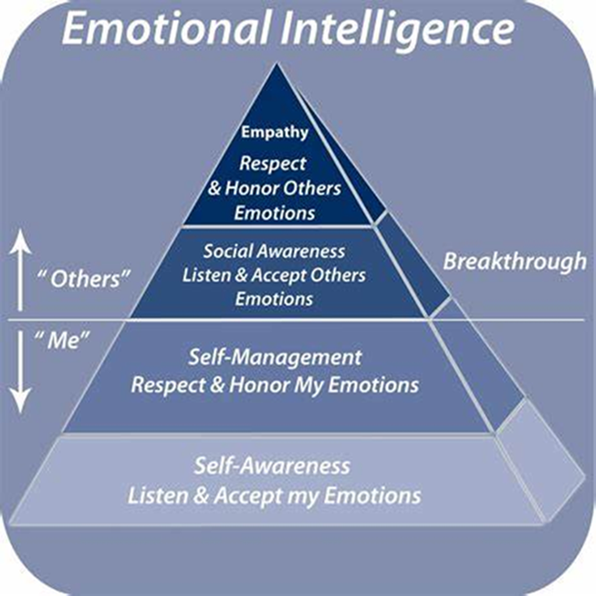
Emotional Intelligence
the ability to identify and manage one’s own emotions, and the emotions of others
identify and name one’s own emotions
harness your emotions and apply them to work and life, including thinking and problem solving
Manage/regulate your emotions, and help others do the same
https://www.psychologytoday.com/us/basics/emotional-intelligence

Slide 5
Know Your Own Emotions
Being aware of and Naming feelings helps us regulate them
Automatic pilot – blow up at someone
Conscious awareness – take a walk to calm down before talking to someone
Know how your emotions affect you
Negative emotions – fight or flight – drain energy
Positive emotions – growth mindset, grit, curiosity – create energy

Slide 6
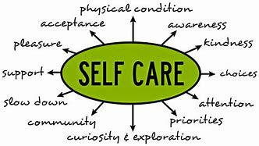
Put My Oxygen Mask On First
Routinely check in with myself – feelings? Tights muscles? Tired?
Daily meditation to “reset” - Turn on parasympathetic response and decompress
Be in nature; exercise; stretch
Connect with people and hobbies that energize and excite me
ASK: What do I need in this moment?
Be of service to others without depleting myself
Let others help – sometimes we need to ask for help
We can do anything today, but we can’t do everything today
https://www.mindful.org/a-guide-to-practicing-self-care-with-mindfulness/

Slide 7
Emotions Affect How We ALL Think And Behave
1. Journal:
What am I feeling? What event triggered that?
Imagine or ask: How did my actions make the other person feel?
2. Perspective shift – changing thoughts can change our Feelings
Is this true?
Is there another way to see this?
3. Now do this with others’ emotions and actions…

Slide 8
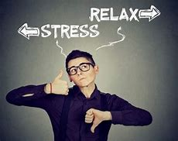
Reflection Questions
What one relationship or work situation will I commit to improving by spending time increasing my emotional intelligence in that situation?
Does my self-care routine support my emotional heath at the level at which I want to be?

Slide 9
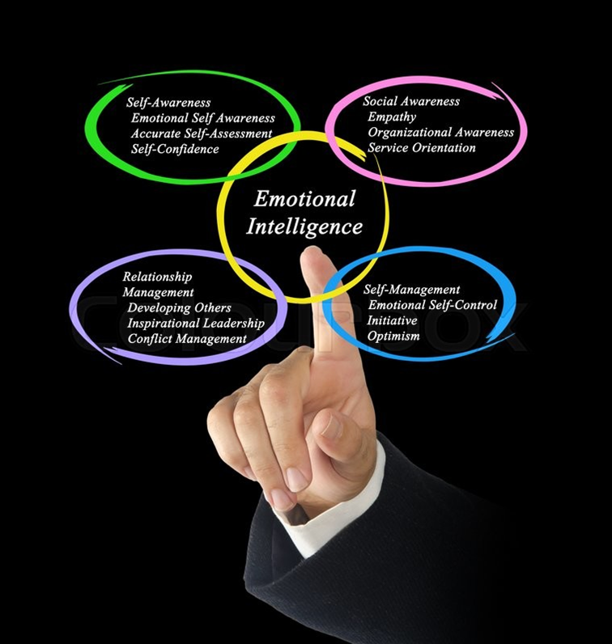
Questions?

