Slide 1
Briefing the Boss
Angela Ruter

Slide 2
No magic answer

Slide 3
Bosses are Different

Slide 4
Know your Audience
Rank
Level in the Organization
Including relative to you
Type of Breifing

Slide 5
Know your message before you start
What does the data mean
More than relaying the data

Slide 6
Goal of meeting
What do you want from the boss
Are you informing them?
Are they going to make a decision based on the data?

Slide 7
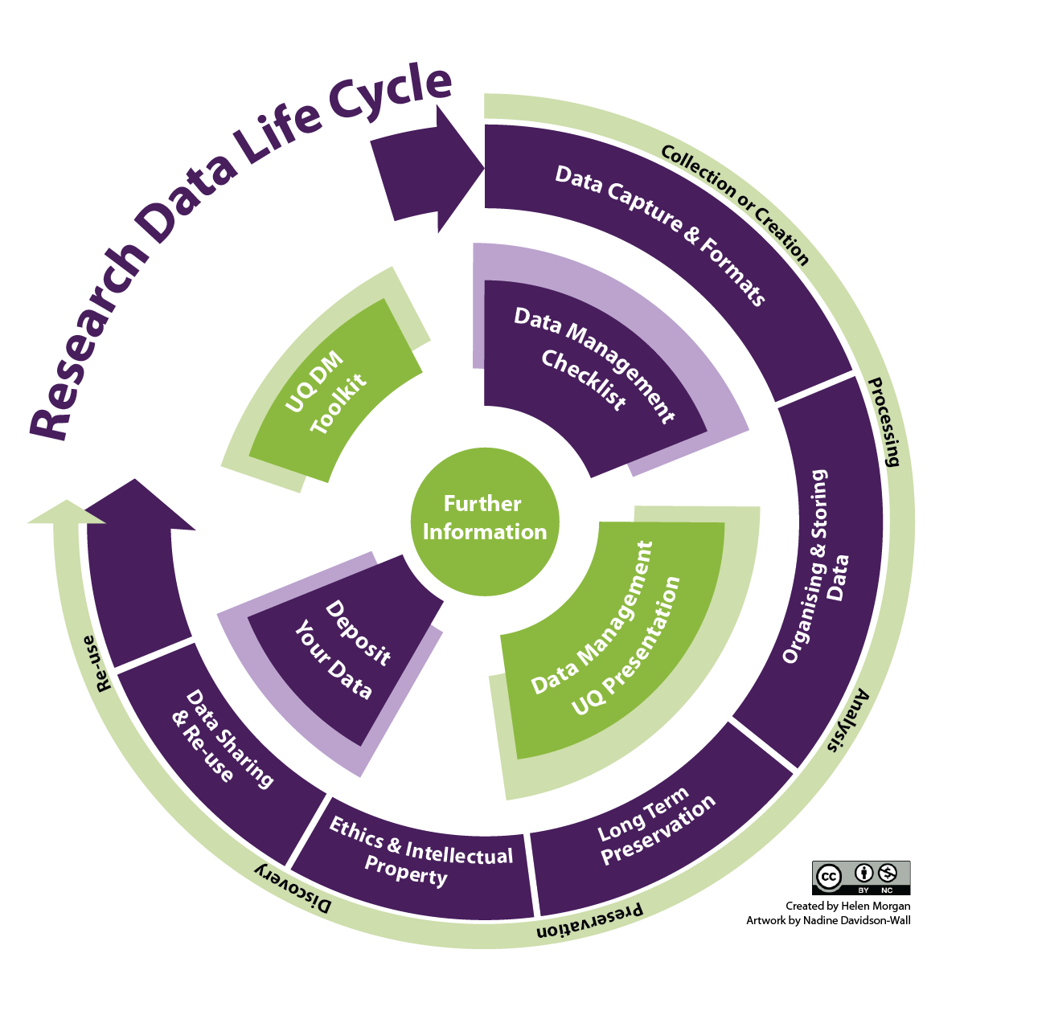
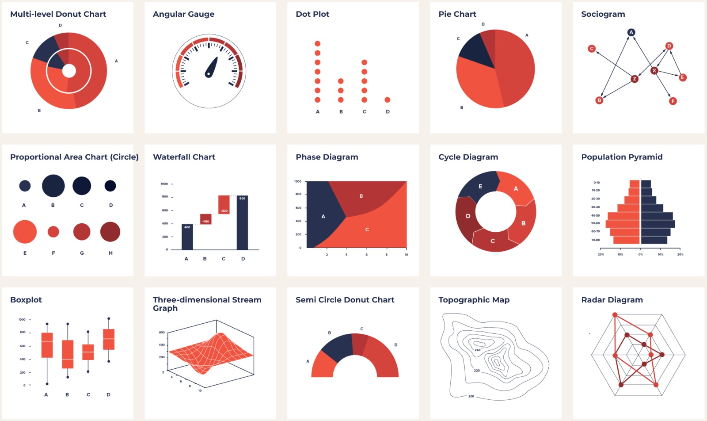
Data presentation
This Photo by Unknown Author is licensed under CC BY-SA-NC

Slide 8
Bad news doesn't get better with age

Slide 9
Problems need solutions or options

Slide 10
Know the second and third level of detail

