Slide 1
DEAMS LINE OF ACCOUNTING
Josh Ingram
Contractor

Slide 2
What is SFIS
The Standard Financial Information Structure (SFIS) is the Department of Defense (DoD)-mandated Line of Accounting (LOA) structure for all services
SFIS provides a common business language that enables budgeting, performance-based management, and generation of financial statements
SFIS is a comprehensive data structure that supports requirements for budgeting, financial accounting, cost/performance, and external reporting needs across the Department of Defense (DoD) enterprise

Slide 3
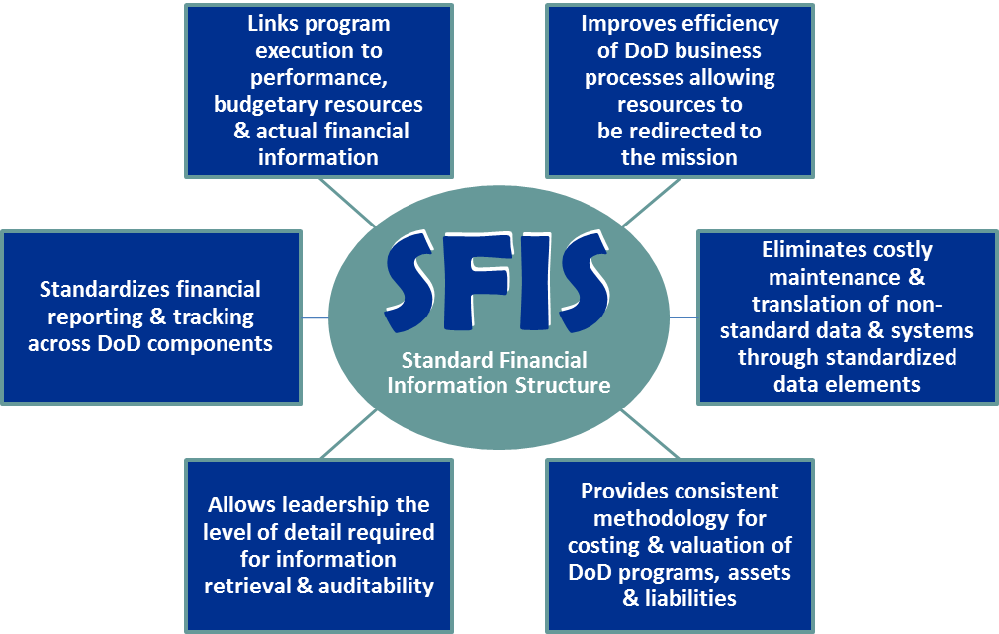
What is SFIS

Slide 4
DEAMS, SFIS & Accounting Flex Fields
SFIS values in DEAMS are loaded into Accounting Flex Fields (AFF)
AFFs provide flexible accounting structures that accommodate the needs of DEAMS while supporting compliance with the new standards
While SFIS requires users to learn new terminology and processes, the payoff of increased efficiency and transparency across the Air Force is well worth the effort
As more legacy systems adopt SFIS, additional savings will be gained as data flows seamlessly throughout the Air Force

Slide 5
Fund
057000340000000002121D|F7887|3A2426|260.3312|01010000011Z|999900.999961|0101126F|2021|387700|103000000|057000340000000002121D|7C|NA
057
000
3400
000
0000
2121
D
DEPT REGULAR
(A1)
017 = Navy
021 = Army
057 = Air Force
096 = Corp of Engineers
097 = Dept. of Defense
MAIN ACCOUNT
(A3)
3400 = Operation and Maintenance
3500 = Military Personnel
3600 = RDT&E
0745 = Family Housing O&M
SUB-ALLOCATION
(B12)
The limitation identifies components and sub-components that receive allocations under Defense Agencies. It is also used to identify accounts charged for program gains and losses related to foreign currency exchange rate fluctuations .
REIMBURSABLE FLAG (A9)
D = Direct Classification
R = Reimbursable Classification
DEPT TRANSFER
(A2)
This THREE digit code identifies a transfer of obligation authority.
000 = Congress
011 = Executive Office of the President
SUB-ACCOUNT
(A4)
This THREE digit code is used to further identify the Main Account. It is the last element of the Treasury Account Symbol and will normally be “000”.
PERIOD OF AVAILABILITY
(A27/A28)
First two digits are the beginning POA
Last two digits are the ending POA
Top = 2021-2021 : Below = 2018-2020
Clearing = FFFF : Receipt = RRRR : No Year = XXXX
097
000
0130
000
1873
1820
R
https://fmdqs.cce.af.mil

Slide 6
Operating Entity
057000340000000002121D|F7887|3A2426|260.3312|01010000011Z|999900.999961|0101126F|2021|387700|103000000|057000340000000002121D|7C|NA
F
78
87
FUNDING CENTER IDENTIFIER
(CA1)
SERVICE
Identifies the service that is utilizing the funding
F = Air Force
OAC
A two-position alphanumeric code for a major high-level organizational unit within the Air Force to which HQ USAF allocates funds.
78 = ACC : 64 = AETC
OBAN
A two-position code synonymous with allotment serial number assigned by the operating agencies (MAJCOMs, POAs) to identify specific funding points.
87 = Ellsworth AFB : 28 = Columbus AFB
F
64
28
https://fmdqs.cce.af.mil

Slide 7
Cost Center
057000340000000002121D|F7887|3A2426|260.3312|01010000011Z|999900.999961|0101126F|2021|387700|103000000|057000340000000002121D|7C|NA
3
A
24
26
COST CENTER IDENTIFIER
(CA3)
POSITION 1
Identifies, at a major level, who is utilizing the funding.
3 = Wing/Group Standard
POSITION 2
Identifies, at a slightly lower level, who is utilizing the funding.
A = MSG : 3 = OG
POSITION 3-4
Identifies, at an even lower level, who is utilizing the funding.
24 = Logistics Readiness
00 = Commander
POSITION 5-6
Identifies, at the lowest level, who is utilizing the funding
26 = Material Management
00 = Commander
3
3
00
00
https://fmdqs.cce.af.mil

Slide 8
Object Class/Obj Sub Class
057000340000000002121D|F7887|3A2426|260.3312|01010000011Z|999900.999961|0101126F|2021|387700|103000000|057000340000000002121D|7C|NA
260
.3312
OBJECT CLASS
(B6)
Identifies the nature of services and items acquired for immediate consumption or capitalization.
260 = Supplies/Materials
210 = Travel/Transportation of Personnel
COST ELEMENT CODE
(CA6)
More specific identification of services and items acquired for immediate consumption or capitalization.
260.3312 = GPC Purchases
210.1104 = TDY to Schools/Training
210
.1104
https://fmdqs.cce.af.mil

Slide 9
Budget Line Item Number
057000340000000002121D|F7887|3A2426|260.3312|01010000011Z|999900.999961|0101126F|2021|387700|103000000|057000340000000002121D|7C|NA
Identifies a further sub-division of the Treasury Account Fund Symbol Appropriation, below the Budget Sub- Activity level.
The Budget Line Item Number can and will vary in length depending on the type of funding that is being utilized.
02
01
0000
02
1
Z
03
05
0000
83508K
BA
0 & AG
Space Holder
BA
AG
SAG
BA
3rd of BPAC
Space Holder
_
Operations & Maintenance
Procurement
BPAC
06
06
0000
6606TS
65807F
BA
1st of PEC
Space Holder
BPAC
_
PEC
RDT&E
Utilize the Project Identifier (CA4) to identify the correct DEAMS BLIN for the funding being utilized
https://fmdqs.cce.af.mil

Slide 10
USSGL Account Code (T2)
057000340000000002121D|F7887|3A2426|260.3312|01010000011Z|999900.999961|0101126F|2021|387700|103000000|057000340000000002121D|7C|NA
The Chart of Accounts provides the basic structure for the U.S. Government Standard General Ledger (USSGL). It incorporates both proprietary and budgetary accounts. The proprietary and budgetary sets of general ledger accounts are self-balancing (the total debits equal total credits).
1 Series
2 Series
3 Series
4 Series
ASSETS
LIABILITIES
NET POSITION
BUDGETARY
5 Series
6 Series
7 Series
8 Series
REVENUE & FINANCING
EXPENSES
GAINS/LOSSES/MISC
MEMORANDUM
9 Series
DEFAULT
https://fmdqs.cce.af.mil

Slide 11
Program
057000340000000002121D|F7887|3A2426|260.3312|01010000011Z|999900.999961|0101126F|2021|387700|103000000|057000340000000002121D|7C|NA
RDT&E and PROCUREMENT
BUDGET LINE ITEM IDENTIFIER (B4)
06
02
203
F
Other than RDT&E and PROCUREMENT
PROJECT IDENTIFIER (CA4)
POSITION 1-2
Identifies the Major Force Program (MFP) that contains the PE
06 = Research and Development
09 = Administrative Activities
POSITION 3-4
Identifies the Program Category within the MFP and is MFP specific
02 = Exploratory Development
(Within MFP 6 – R&D)
POSITION 5-7
Provides unique identification for that specific element
203 = Aerospace Propulsion
527 = Financial Operations
POSITION 8-10
Identifies the Service or Defense Agency that has cognizance over that particular PE
F = US Air Force
DBD = DFAS DWCF
09
01
527
DBD
https://fmdqs.cce.af.mil

Slide 12
Operating Budget Year
057000340000000002121D|F7887|3A2426|260.3312|01010000011Z|999900.999961|0101126F|2021|387700|103000000|057000340000000002121D|7C|NA
2021
OPERATING BUDGET YEAR
Identifies the year in which the transaction occurred
2020
https://fmdqs.cce.af.mil

Slide 13
Agency Accounting Identifier (O3)
057000340000000002121D|F7887|3A2426|260.3312|01010000011Z|999900.999961|0101126F|2021|387700|103000000|057000340000000002121D|7C|NA
667100
387700
525725
DFAS LIMESTONE
DEAMS (DFAS-LI)
CMA MILITARY PAY
The Agency Accounting Identifier (AAI) identifies the organization responsible for providing field level accounting support within DoD. The AAI identifies the agency that maintains the accounting information for a specific commitment or obligation in a procurement instrument. The AAI code may be the identification of Field Sites or unique accounting installation that support the budget execution of a specific base, post, camp or station.
DFAS COLUMBUS
DFAS JAPAN
DFAS INDIANAPOLIS
503000
668800
380100
https://fmdqs.cce.af.mil

Slide 14
Line of Business
057000340000000002121D|F7887|3A2426|260.3312|01010000011Z|999900.999961|0101126F|2021|387700|103000000|057000340000000002121D|7C|NA
103000000
118060310
STRATEGIC NATIONAL & THEATER DEFENSE
SAAM - ORGANIC
The Line of Business is a data element that is primarily used with Working Capital Funds to further identify the overall type of business that the expenditures belong to. Specific to DEAMS, unless you are operating out of a Working Capital Fund, you will almost always utilize the 103000000 Line of Business
C-17 COSTS
AIR TRANSPORTATION - OTHER
118060920
118060000
https://fmdqs.cce.af.mil

Slide 15
Intercompany Fund
057000340000000002121D|F7887|3A2426|260.3312|01010000011Z|999900.999961|0101126F|2021|387700|103000000|057000340000000002121D|7C|NA
057
000
3400
000
0000
2121
D
DEPT REGULAR
(A1)
017 = Navy
021 = Army
057 = Air Force
096 = Corp of Engineers
097 = Dept. of Defense
MAIN ACCOUNT
(A3)
3400 = Operation and Maintenance
3500 = Military Personnel
3600 = RDT&E
0745 = Family Housing O&M
SUB-ALLOCATION
(B12)
The limitation identifies components and sub-components that receive allocations under Defense Agencies. It is also used to identify accounts charged for program gains and losses related to foreign currency exchange rate fluctuations .
REIMBURSABLE FLAG (A9)
D = Direct Classification
R = Reimbursable Classification
DEPT TRANSFER
(A2)
This THREE digit code identifies a transfer of obligation authority.
000 = Congress
011 = Executive Office of the President
SUB-ACCOUNT
(A4)
This THREE digit code is used to further identify the Main Account. It is the last element of the Treasury Account Symbol and will normally be “000”.
PERIOD OF AVAILABILITY
(A27/A28)
First two digits are the beginning POA
Last two digits are the ending POA
Top = 2019-2019 : Below = 2017-2019
Clearing = FFFF : Receipt = RRRR : No Year = XXXX
097
000
0130
000
1873
1820
R
https://fmdqs.cce.af.mil

Slide 16
Contingency Code (B8) / Activity Identifier (CA5)
057000340000000002121D|F7887|3A2426|260.3312|01010000011Z|999900.999961|0101126F|2021|387700|103000000|057000340000000002121D|7C|NA
7C
CONTINGENCY CODE /ACTIVITY IDENTIFIER
This data element is intended to identify, for tracking purposes, special unplanned events, for which expenditures and costs are to be tracked, whereby funding might or might not have been previously established for contingency events, e.g., the "Tsunami Disaster" or the "9/11/01 Terrorist Attacks" or other similar unforeseen events. The purpose of the contingency code is to identify the budget execution records process for contingency events that occur, in order to provide a basis for recouping funds expended, i.e., to justify requests for resources needed to fund the contingency event after the fact.
QA
https://fmdqs.cce.af.mil

Slide 17
Questions?
Where Can I Find SFIS Training & Related Materials?
DEAMS Outreach Portal (https://go.usa.gov/xmZXJ)
FM Distributed Learning Center (https://lms-jets.cce.af.mil/moodle/)
SYS115 - DEAMS 202: SFIS and PTEO Familiarization WBT
Instructional Supplements/How To’s (https://cs2.eis.af.mil/sites/10194/Documents2/Shared%20Documents/Instructional%20Supplements)
SFIS_and_PTEO_Familiarization_version_2.1

