Slide 1
Basics And Best Practices For Your Home Network
George Diehl
HQ AFMC/FMC
24 November 2020
Version 7

Slide 2
Purpose
To introduce basic networking concepts, discuss some best practices, and provide information which could save you money.

Slide 3
Overview
Introduction
Home Network
WiFi
Best Practices
Signal and Router Placement
Hardware - Rent vs. Buy
Teleworking
Megabits vs. Megabytes
Summary
Resources
Questions
Notes:
Questions are encouraged via chat, chiming in via mic, can use Raise Hand button

Slide 4
Introduction
Modem and router are most critical devices in you virtual life
Often overlooked
WiFi is a family of protocols
Radio signal
Cyber Hygiene
Notes:
Internet Service Provider (ISP)
Internet Protocol Address (IP Address) – address for every device connected to a network (e.g., 198.97.67.50)
Local Area Network (LAN) – a group of devices that share a server connection
Modem – connects to ISP to obtain IP address for you to use
Router – creates a LAN
Firmware vs. Software
Internet of Things (IoT) – catch-all term for the growing collection of “smart” devices (e.g., TVs, outlets, thermostats, refrigerators, lights)
Cyber Hygiene – practices used which ensure the health of your virtual life

Slide 5
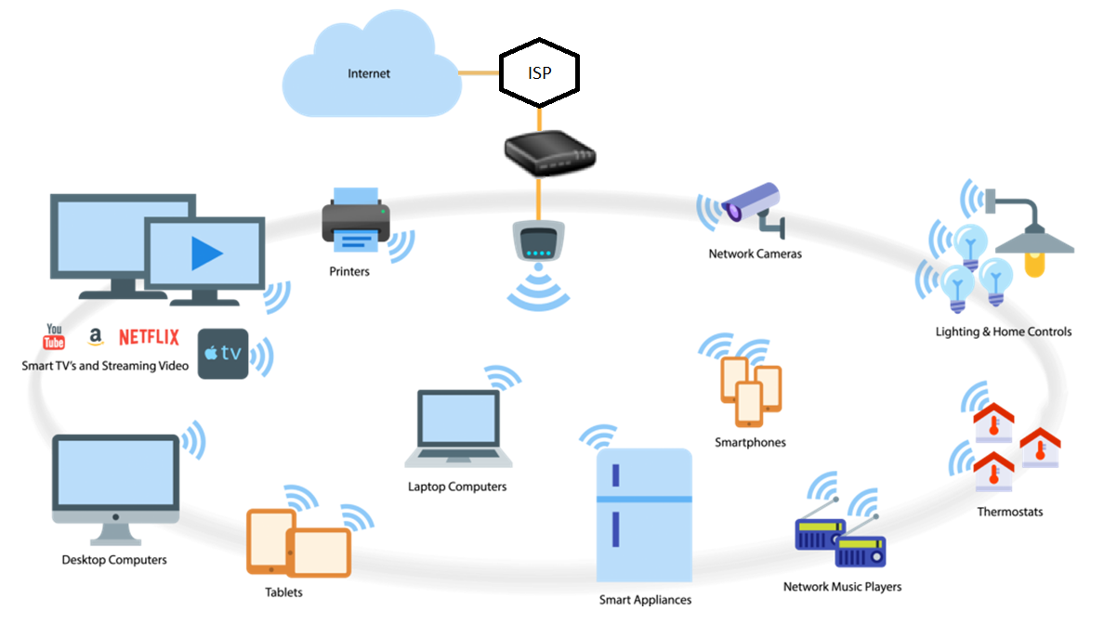
Home Network
Notes:
Your home network used to be a single device connected to a modem.
Now, it is a true network with all of your devices connected to the internet through your router.
This makes your router the single most important piece of your digital life’s security.
Some users have a single modem/router device

Slide 6
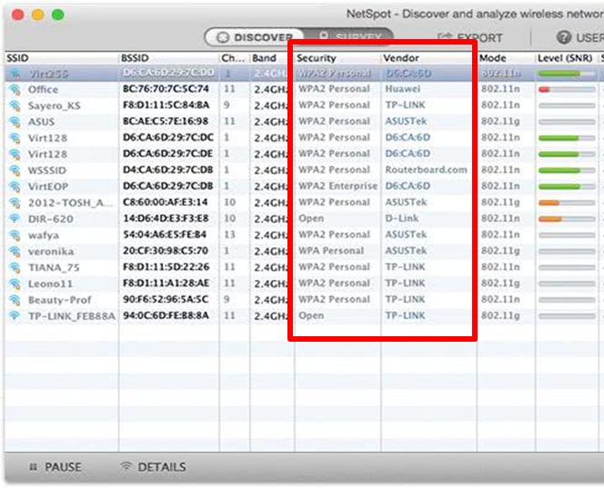
WiFi
Two bands available for WiFi connections
2.4 GHz
5 GHz
Dual-band routers are able to provide both 2.4 GHz and 5 GHz
Guest networks
Notes:
2.4 is the original WiFi band, it has wider range with lower bandwidth
This is not just WiFi, for example cordless house phone, a very crowded band
5 provides increased bandwidth at a reduced range, tends to experience less interference
Most users will not notice the speed benefits of 5 GHz so you may not need a dual-band router if you do not need the speed and do not experience interference
Guest networks are a separate network your router creates where none of the devices connected can see or talk to each other.
If you have an infected device on your guest network, the rest of your devices are isolated and safe.
Devices connected to your guest network are unable to access the router’s settings.
Your WiFi is a radio signal which you broadcast out into the world. Passwords are what encrypt the information you are broadcasting.

Slide 7
Best Practices

Slide 8
Best Practices: Passwords
Router may have up to five passwords
Router Admin Password
2.4 GHz Password
5 GHz Password
Guest version of each WiFi network
Use strong passwords:
Each password should be different
WiFi passwords should be 16-20 characters long with letters, numbers, special characters, uppercase, and lowercase
Use at least WPA2 encryption
Notes:
Most users should have a 2.4 GHz network with a Guest network. This would be two different network names and different passwords.
NEVER USE THE DEFAULT PASSWORDS
The login password to your router’s settings should be different from all of the other WiFi passwords.
Your router’s settings can only be accessed by directly connecting your device to the router with an Ethernet cable (i.e., LAN or network cable) OR by the non-guest WiFi

Slide 9
Best Practices: Recommendations
Change default settings:
Admin Password
WiFi network name (a.k.a. SSID) and password (a.k.a. passphrase) for each network
Most devices (e.g., IoT/Smart devices, children, and guests) should be on a guest network
Check for firmware updates at least quarterly
Notes:
THESE ARE THE TWO MAIN POINTS TO TAKE FROM THIS WHOLE PRESENTATION:
Do not use the default passwords or WiFi names (i.e., SSIDs)
Any device which does not need to access another device (e.g., printer) or any device you do not do any PII based work (e.g., banking) should be placed on your guest network

Slide 10
Signal and Router Placement

Slide 11
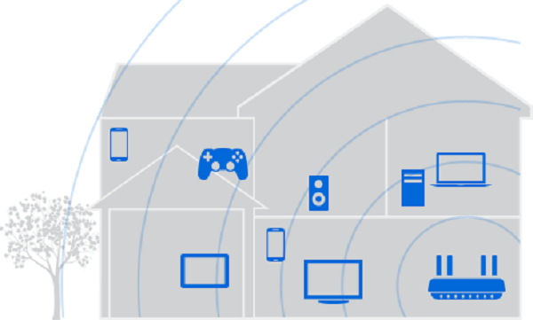
WiFi Signal: Common Router Placement
Notes:
WiFi is a weak radio signal which can be blocked by walls, appliances, and any other physical barriers between your device and the router.
Placing your router at the point where your cable/DSL connection enters your home may not be the ideal placement for your router.

Slide 12
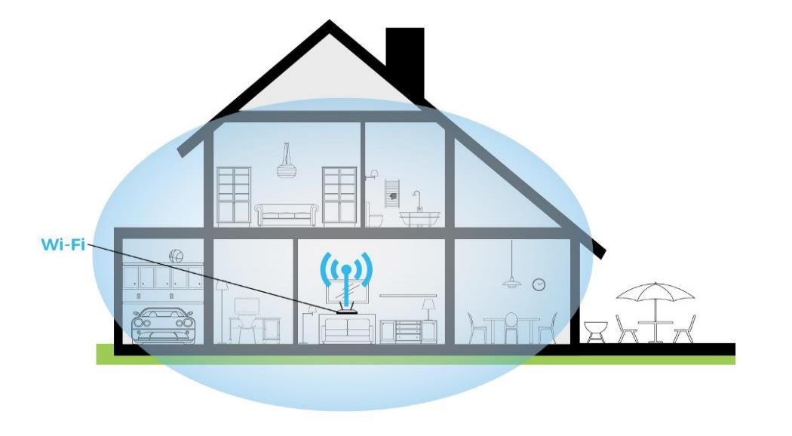
WiFi Signal: Ideal Router Placement
Notes:
Placing your router in a more central point in your home is the best place. It ensures more coverage across your whole home and minimize the amount of signal which bleeds outside your home.

Slide 13
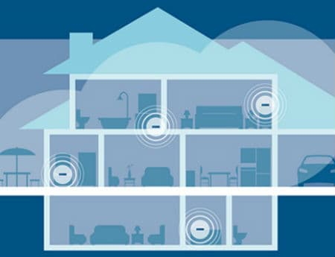
WiFi Signal: Mesh Networks
Notes:
Boosters, extenders, repeaters, etc. are a way to extend your WiFi range if you are unable to physically move your router to the center of your home.

Slide 14
Hardware - Rent vs. Buy

Slide 15
Hardware - Rent vs. Buy
Renting
Buying
Pros:
Easy
Hardware guaranteed to be compatible with ISP
Could have one device serving as modem, router, and more
Cons:
After 9-12 months, you have spent enough money to purchase your own hardware
ISP may have access to your router settings
Limited security features and firmware updates
Pros:
Access to more secure features and firmware updates
More control over your network setup
Ability to change ISPs without changing hardware
Cons:
Requires some effort
Must ensure hardware is compatible with ISP
ISP will provide limited support for personal hardware
Notes:
In short, if you are using the same ISP for about a year, the cost of renting hardware will begin to exceed the cost of buying the hardware yourself. Buying your own hardware does require a little extra research on your end to ensure it offers the features you want or need (e.g., security settings, parental controls, range) but you will have more control over your network’s security.

Slide 16
Teleworking

Slide 17
Teleworking
VPN Clients
USAF
JRSS
Personally Owned Equipment (POE)
Equipment you can connect to your Government Furnished Equipment (GFE)
Includes monitors, wired mouse, wired keyboard, any devices which do not process/store information
Does NOT include wireless mouse/keyboard, smart TV, personal printers, etc.
Peak VPN Hours
Mid morning and mid afternoon
Wednesday appears to be the peak day
Notes:
You should use the global option for the USAF VPN and it will pick the best location for you to go through and you will retain access to the network drives.
Huawei, ZTE, Hikvision, Hytera, and Dahua brand devices should NEVER be connected
Do not plug anything into your government computer beyond a monitor and wired mouse/keyboard
Ask your cyber liaison/IAO if you are unsure about what can be used
POE training should be completed by any user intending to use personal devices, see your local cyber liaison/IAO for information

Slide 18
Megabits vs. Megabytes
Megabyte (MB) is a common measurement of file size
Megabit (Mb) is a common measurement of data transfer speed
1 Megabyte = 8 Megabits
If you buy 40 megabits per second (Mbps) download speed, then you are getting 5 megabytes per second (MBps)*
At this speed, a 40 MB picture will take 5 seconds to download, not 1 second as many people may think
*Your actual internet speed will generally be lower than what you pay for
Notes:
Your ISP may provide 40 Mbps but you are not the only customer. During peak times, their bandwidth is being stressed which reduces the speed you actually get. Physical factors (e.g., poor quality connection at your home, bad cables, node outages) can affect the data speed you get.

Slide 19
Summary
Your WiFi router may be the most important piece of hardware in your digital life
The default settings are easily identified and exploited
This is a balancing act between security and convenience
When in doubt about plugging something into your GFE, consult your cyber liaison
Backup your data
Notes:
Your router is extremely important and should not be ignored.
Do not use the default passwords or network names for anything.
Use a guest network for most of your connected devices.
After 3-5 years, you may want to consider replacing your router if you are noticing signal drop outs or have not received a firmware update in a long period of time. (security will likely become outdated before hardware fails)
Storage of data in a secondary location from which it can be restored when needed
If the loss of a datum would cause serious issues, then it should be backed up
Frequency of backups will depend on a variety of factors (e.g., automation, convenience, importance of data)
If a data is only stored in one physical location (e.g., multiple copies on the same computer), then it is not backed up
Clean up files before backing up (i.e., delete any data which will not be used again)

Slide 20
Resources
Broadband speed guide:
https://www.fcc.gov/reports-research/guides/broadband-speed-guide
Household broadband guide:
https://www.fcc.gov/research-reports/guides/household-broadband-guide
WPAFB – May I use POE while teleworking?
https://usaf.dps.mil/teams/22629/Lists/WPAFB%20FAQ/Flat.aspx?RootFolder=%2Fteams%2F22629%2FLists%2FWPAFB%20FAQ%2FMay%20I%20use%20personally%2Downed%20equipment%20while%20teleworking&FolderCTID=0x012002003FD96C7DEC187645819A496988186105
Your local Cyber Liaison/Information Assurance Officer

Slide 21
Questions

Slide 22
Zoom Thanksgiving Gift
Zoom announced via Twitter a couple days ago that it will temporarily lift its 40 minute time limit on free meetings. From 0001 November 26th to 0600 November 27th (Eastern Time), free users will be able to host meetings without worrying about the cutoff after 40 minutes.

Slide 24
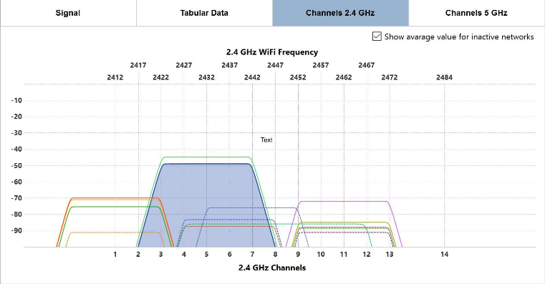
Channels
Notes:
Much like the radio stations you listen to, the 2.4 GHz WiFi band only has 12 channels can quickly become congested depending on how many neighbors you have and how close they are to your home.
It is the same effect you experience when you have two radio stations on the same frequency. You start hearing pieces of both and information becomes jumbled.
Your router should be using channels 1, 6, or 12 to minimize overlap with other signals. Many routers default to Auto where they go to the channel with the least noise when they startup.

Slide 25
Key Terms
Internet Service Provider (ISP)
Internet Protocol Address (IP Address) – address for every device connected to a network (e.g., 198.97.67.50)
Local Area Network (LAN) – a group of devices that share a server connection
Modem – connects to ISP to obtain IP address for you to use
Router – creates a LAN
Firmware vs. Software
Internet of Things (IoT) – catch-all term for the growing collection of “smart” devices (e.g., TVs, outlets, thermostats, refrigerators, lights)
Cyber Hygiene – practices used which ensure the health of your virtual life
Notes:
Some general terms than may be used throughout this discussion.

