Slide 1
Mr. James “JD” Lawson
Chief, Financial Services
Air Force Research Laboratory
27 August 2020

Slide 2
Introduction
Why look to children for leadership lessons?

Slide 3
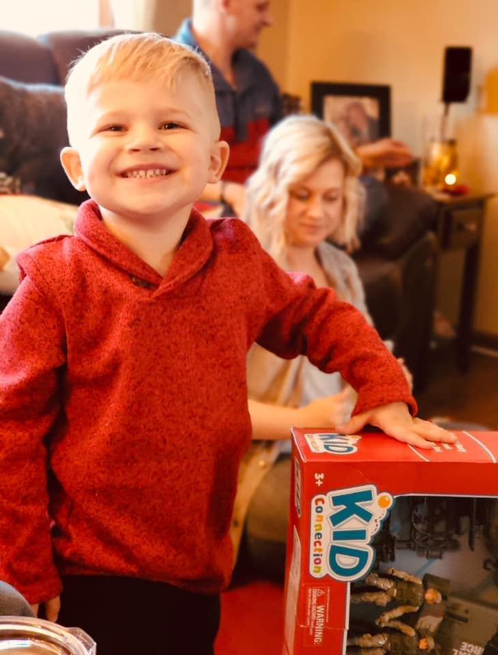
Thirst for Knowledge
Desire to know more about everything
Children are constantly trying to understand
They don’t shy away from asking “why”
Curiosity of a Child is Incomparable
They’re not afraid to try new activities
They’ll belly flop, jump out of a swing, etc.

Slide 4
Empathy & Humility
Kids don’t shun people that are different than they are
Big-hearted and kind to all
Compassion
Equality
Nonjudgmental

Slide 5
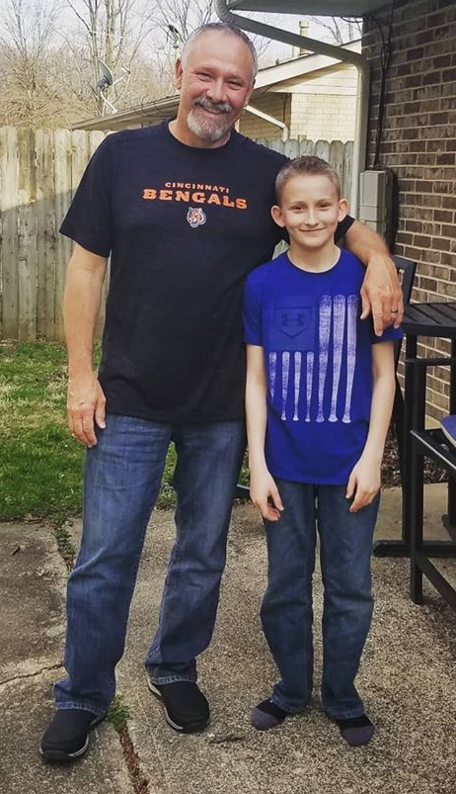
Being Optimistic
When faced with a new challenge they think of alternatives
They don’t think of what could go wrong
Be fearless in new situations

Slide 6
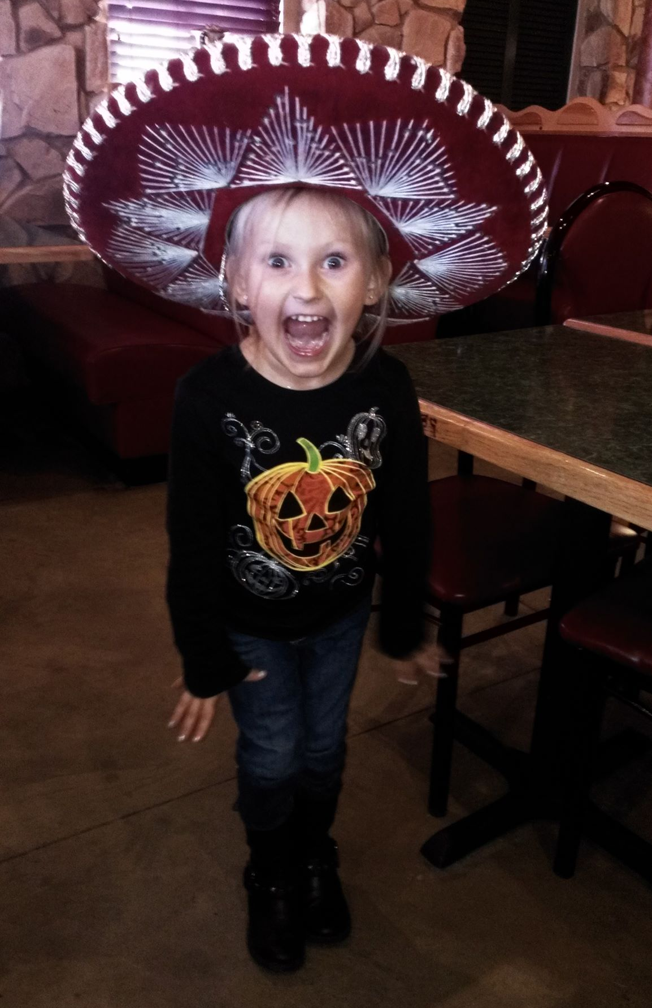
Passion & Energy
Kids are enthusiastic about everything!
Get excited about new opportunities that come every day – every day is a new day!

Slide 7
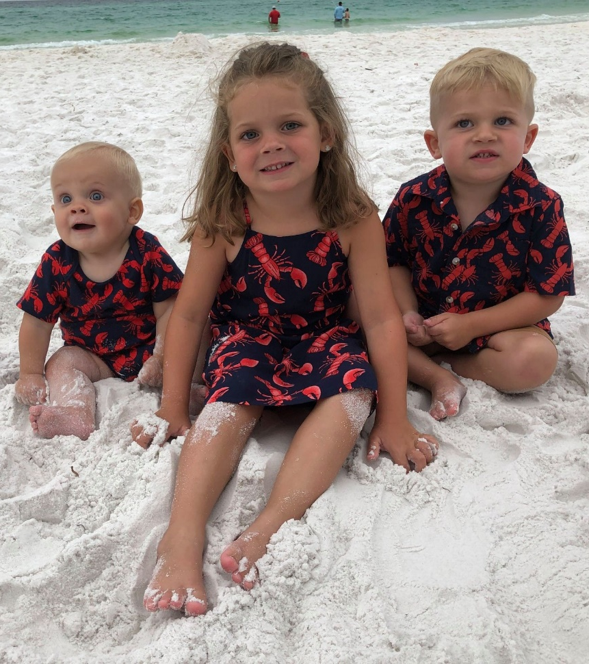
Learn to Adapt & Stay Resilient
Unfamiliar environments can be scary
It takes everyone time
Be ready to meet new people/challenges

Slide 8
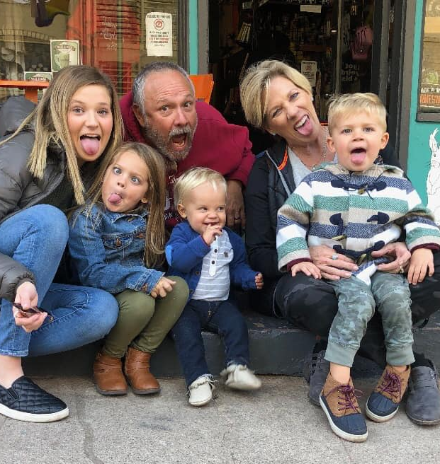
Honesty
Kids are brutally honest☺
Tell it like you see it
Don’t sugar coat
Communicate clearly

Slide 9
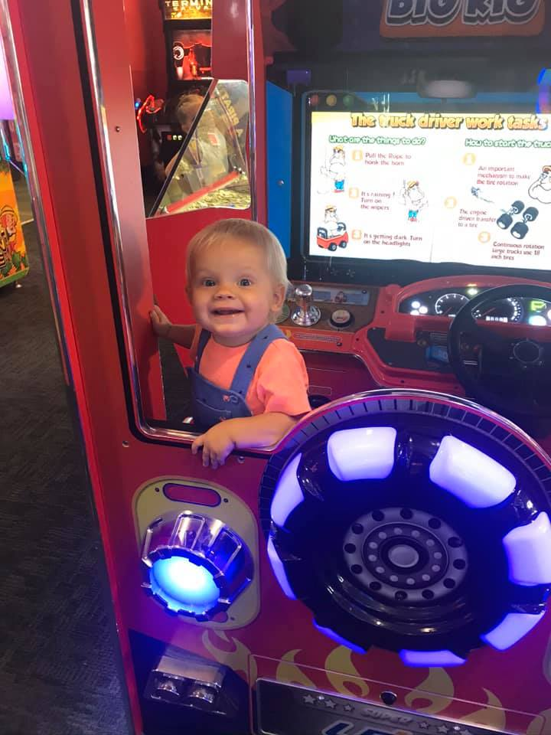
Going Outside Your Comfort Zone
Kids are not scared to try new things
No Fear of failure or embarrassment
Easy paths might not help you meet your goals

Slide 10
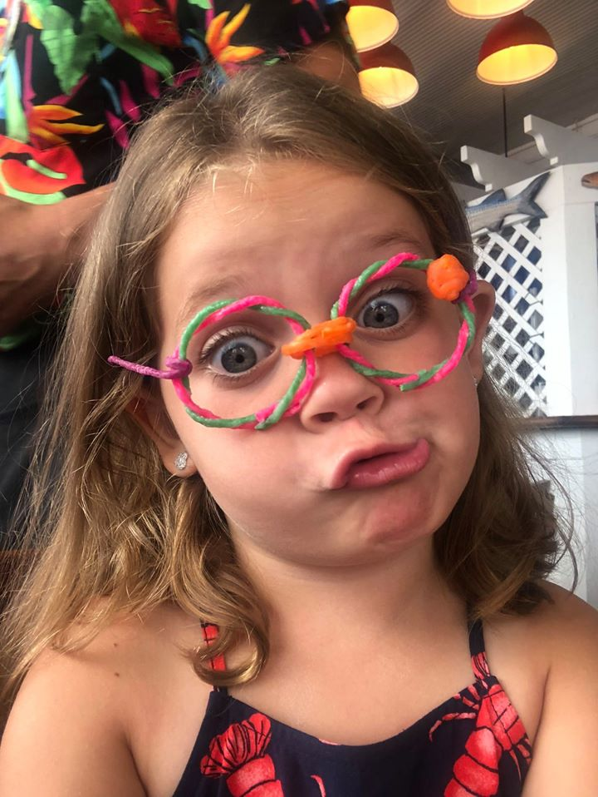
Laugh
Finding the silly
Especially in the bad times

Slide 11
Key Takeaways
Thirst for Knowledge
Empathy & Humility
Being Optimistic
Passion & Energy
Learn to Adapt & Stay Resilient
Honesty
Going Outside Your Comfort Zone
Laugh

Slide 12
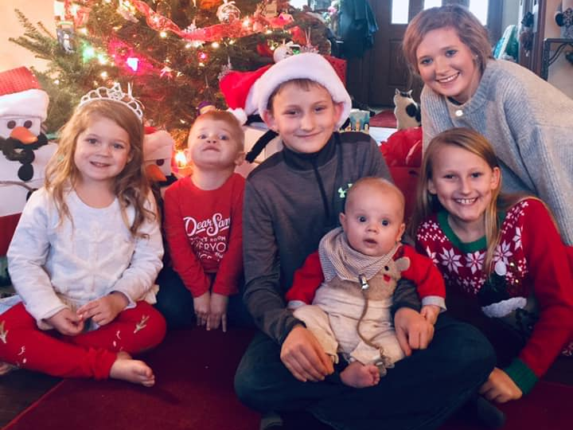
Questions

Slide 13
Resources
https://www.intelivate.com/team-strategy/10-ways-to-be-a-powerful-leader-a-childs-way
https://hbr.org/2008/11/how-leadership-can-be-childs-p.html
https://medium.com/earthvillage/7-leadership-lessons-to-learn-from-kids-ab8dc01671a9
https://www.inc.com/heidi-zak/6-powerful-lessons-my-children-taught-me-about-being-a-better-leader.html
https://sloanreview.mit.edu/article/leadership-lessons-from-your-inner-child/
https://yourstory.com/2017/05/leadership-lessons-from-kids

