Slide 1
FM Challenges as AFLCMC Innovates
ASMC Aviation Chapter 2019 Mini-PDI
Col Tina Nguyen
16 May 19

Slide 2
AFLCMC Innovations
Rapid Sustainment Office
Agile Software Development
Section 804
Agile Manpower Resourcing

Slide 3
Rapid Sustainment Office (RSO)

Slide 4
RSO Vision & Mission
Vision
  Center of excellence and partner of choice of the logistics and sustainment enterprise
Mission
  Rapidly field airworthy sustainment capabilities by leveraging mature, new, and emerging technology to reduce sustainment costs and improve readiness

Slide 5
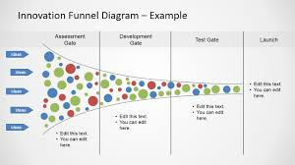
RSO Approach
Robust Innovation Portfolio
Apply
Scale
ID
Each Circle = RSO Aligned Project
Color of Circle = Technology/Process Innovation Provider
Leveraging Innovation CoE / Best of Breed / Optionality at Scale

Slide 6
Current Approved RSO Efforts
Agile Manufacturing, to include Additive Manufacturing (AM) and Cold Spray
Condition-Based Maintenance Plus (CBM+)
Automation and Lasers

Slide 7

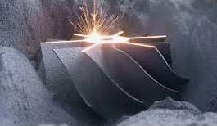
Additive Manufacturing (AM)
Additive Manufacturing:
  Technologies that build 3D objects by adding layer-upon-layer of material, such as metal or polymer (plastic)
  Sometimes referred to as 3D Printing or Rapid Prototyping
AM Part Selection Considerations
More Suitable | Less Suitable
Smaller Metal & Polymer Parts | Electronics (circuit board)
Diminishing source of supply | High quantity
Complex design | Simple designs
Long lead time items | Low cost parts
Low quantity cast parts with tooling unavailable | Sheet metal parts
Labor intensive (high machining/welding) | Very large parts (consider print area)
Potential for combining multiple parts in an assembly | Easy to manufacture using conventional methods

Slide 8
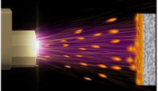
Cold Spray
Cold Spray:
  A coating deposition method using a high-speed gas jet to accelerate particles toward a substrate upon which the particles deform and consolidate on impact
What makes it “Cold”?
In this process, the heating of the substrate is minimal; no melting and solidification happen. The adhesion mechanism is purely mechanical.
Because the adhesion mechanism is mechanical, the technology allows spraying thermally sensitive materials and use of highly dissimilar material combinations.

Slide 9
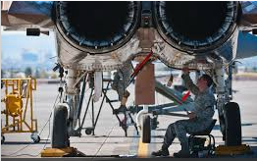
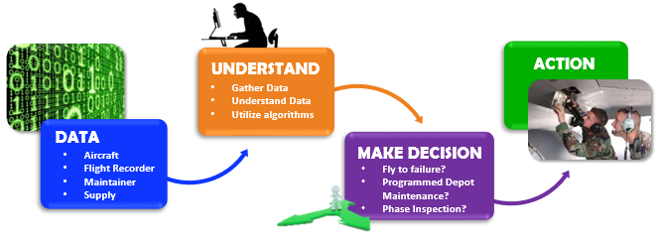
Condition Based Maintenance Plus
(CBM+)
CBM+:
  A set of maintenance processes and capabilities derived from real-time assessment of a weapon system’s condition obtained from embedded sensors
  Goal of CBM is to perform maintenance only upon evidence of need

Slide 10
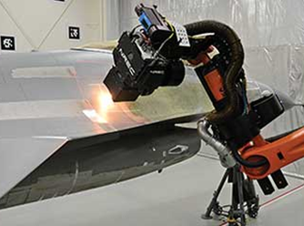
Automation and Lasers
Robotics enable integrated process flow using common components
When teamed with Lasers, an advanced approach to coatings removal and surface prep results
The same robotics system can be multi-purposed to offer additional functionality, including painting and cleaning

Slide 11
RSO FM Challenges
How much are we willing to waste to fail fast?
Budget through corporate process
  Trying to find $500M in next 18 months
  Struggle to get funding in FY21 POM
Budget phasing can be out of whack
Need funding, but need ROI to get funding
Which appropriation should fund RSO innovations?
  Could make argument for RDT&E, Production, O&M
  RSO currently funded w/O&M for Sustaining Engineering
Biggest budget challenge: getting Air Force to approve funding

Slide 12
RSO FM Challenges
Additive Manufacturing
  Data: what is candidate list → universe of the possible
  More expensive to print huge quantities of same part
Automation and Lasers
  MILCON: build new facility to house robot

Slide 13
RSO Cost Challenges
Calculus for AF is always lethality
Difficult to estimate new ways of doing business
Don’t have visibility at lower levels, i.e. CAM
Have to make assumptions
User determine what we’re going to do because they have the money
  How do you estimate/capture what the user says?
  User wants more than the business side
How do we determine valuation of our mission?

Slide 14
RSO Cost Challenges
Overarching pressure at top: act like a business
Risk aversion high because somebody’s life is on the line
  May overestimate cost to mitigate risk → break another program to fund
Biggest cost challenge: data availability and understanding

Slide 15
Agile Development Operations (Agile Dev Ops)

Slide 16
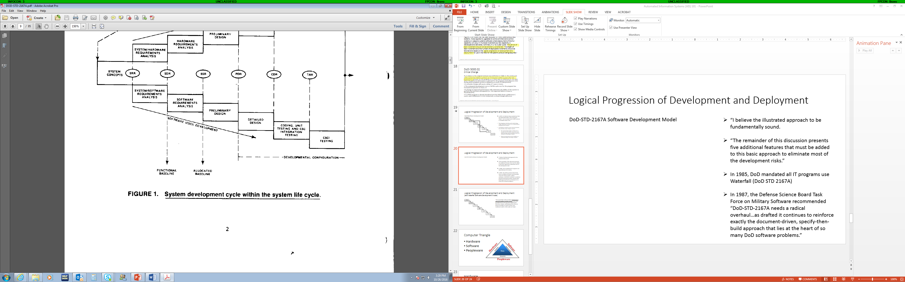
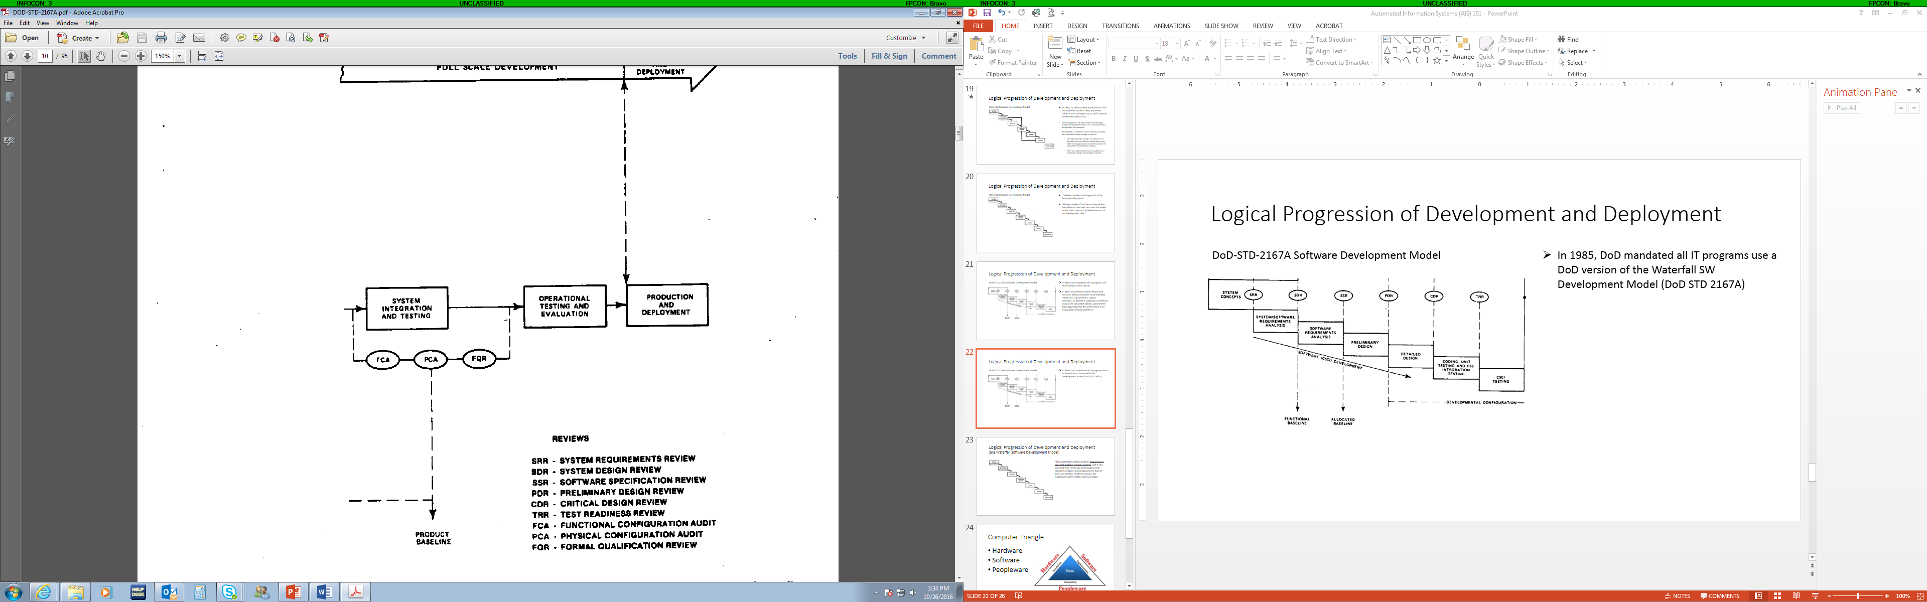
Software Life Cycle Models
Waterfall
In 1985, DoD mandated all IT programs use a DoD SW Development Model (DoD STD 2167A) based on the Waterfall Model
DoD-STD-2167A Software Development Model

Slide 17
Software Acquisition and Practices (SWAP) Study
Current approach to software development broken; leading source of risk to DoD
  Takes too long
  Too expensive
  Exposes warfighters to unacceptable risk
DoD develops software like hardware → linearly
  Fixed set of specifications
  Procured after meeting specifications
  Maintained by block upgrades
DoD’s current approach is major driver of cost and schedule overruns for MDAPs

Slide 18
Cultural Processes at Odds
Traditional “Industrial Age” |  | vs. | Agile “Informational Age”
ATTRIBUTES Long Risk Burndown Push Decision Higher Cost Driven Tradeoffs | Defined / Rigid / Static | Requirements | Fluid (Late-Breaking) | ATTRIBUTES Short Risk Burndown Autonomy – Fail Fast Value Driven Tradeoffs
 | Single Release | Delivery Cycles | Short / Iterative Releases
 | Deviation From Baseline | Perspective of Change | Expected Part of Iteration
 | Firm Fixed Price | Contracting | CPFF, Time & Material, IDIQ
 | Intensive | Documentation | As Needed
 | “Marathons” – Big Events | Test | Consistent “Sprints”
Performance
Cost
Schedule
Fixed
Value
Driven
F-22 Capability Pipeline
Traditional Programs
Plan
Driven
Flexible
Cost
Schedule
Performance
Traditional DoD acquisition norms must evolve to enable Agile

Slide 19
Software Solutions
Update software that works for its users at speed of mission need
Software must be continuously improved through its life cycle
  Can’t be linearly developed
New statutes/regs for software
DoD needs to change how software procured and developed

Slide 20
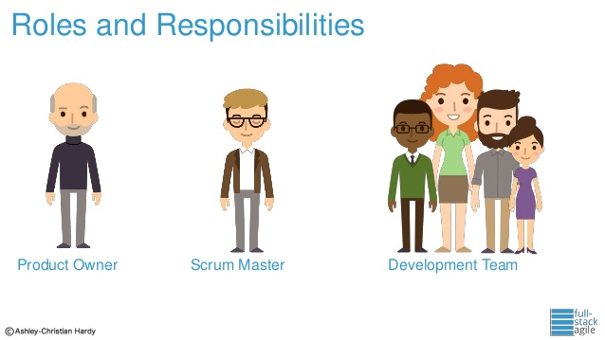
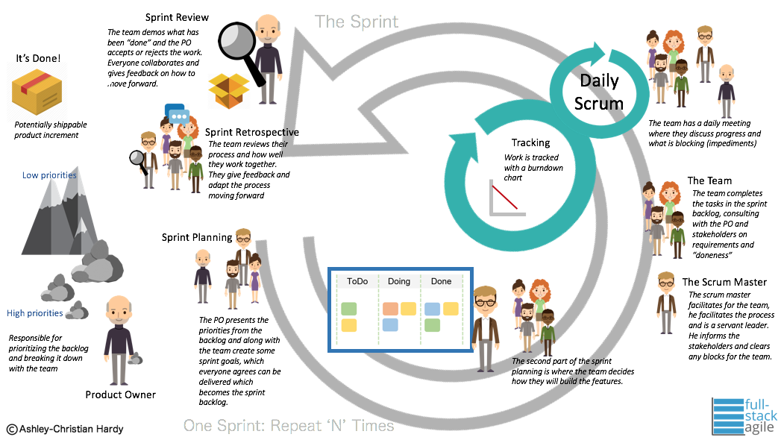
Scrum
Sprint
Review
SW
Sprint
Retrospective
Sprint
Planning
Daily
Scrum
Sprint Backlog
24
Hrs
Product
Backlog

Slide 21

Kessel Run Vision & Mission
VISION
Build a “software company” that can sense and respond to conflict in any domain, anytime, anywhere.
MISSION
Continuously deliver war-winning software our Airmen love.

Slide 22
Kessel Run
Different, more agile culture
  Located in Cambridge, MA (not on Hanscom AFB)
  Mindset of going fast (i.e. warp speed)
  Scrum
  Flat organization
  Small teams
  Willing to take more risks
Team software coders w/Pivotal Labs
AOC 2.0 was cancelled → AOC Pathfinder

Slide 23
Kessel Run Successes
Fielded SIPR DevOps at Al Udeid Air Base in 130 days → AOC 10.2 took 10 years ($430M)
15 capabilities in ops
  Saves ~1,100 AOC man-hours per month in AFCENT Target Development, ABP Development and Mission Reporting
  Reduced CPD & COD daily ATO plan & execution workflows 70%
  Reduced deliberate targeting workflow 85%
  Decreased MISREP reporting sys downtime 99%

Slide 24
F-22 Legacy Program Challenges
Traditional programmatic alignments drive inefficiencies
  Multiple technical baselines with serial dependencies
  Each baselined program (Inc 3.1, Inc 3.2A, Update 5, Inc 3.2B) had exclusive use of labs & flight test, creating conflicts
  Government required all-or-nothing “Big Bang” delivery, drove late sell-off... Inc 3.2A took 7 software drops in OT to resolve defects
  Conflicting contract incentives did not provide enterprise focus... drove in-fighting among Inc 3.2B, Update 6, TACLink 16 & TACMAN
12
Years
Time between Inc 3.2B requirement approval and first CAF retrofit
42%
Test aircraft availability for Update 6, due to 42K flying hour requirement & parts shortages
7
Years
Time to complete all Inc 3.1 CAF retrofits
103,028
Man-Hours
Time to draft & staff 50 documents for
Inc 3.2B Milestone B, 60% is staff review
That’s 49.4
Man-Years!

Slide 25
F-22 Capability Pipeline
FOR OFFICIAL USE ONLY – PRE-DECISIONAL
Link 16
Capability Backlog
Sustainment Updates
Capability Slices Developed in Priority Order
Sensor Enhancements
Special Projects
Software Development
Factory
Capacity
Production
…
Design
Production
Design
Test
Build
…
Hardware Development
Test
Build
Sprint Cadence
…
Continuous Lab Test
Continuous Test
Continuous Flight Test
…
Optional Releases
HW+SW
SW
HW+SW
…
Fleet Delivery
Fleet Mods
F-22 Capability Pipeline to inform more appropriate processes, metrics & reporting

Slide 26
F-22 Agile Cost Estimating
A New Paradigm
Agile Approach to F-22 Development (3600 - Modernization)
Monolithic Approach to F-22 Development (3600 - Modernization)
F-22 Infrastructure (Lab, CTF, Small Projects, etc)
F-22 Infrastructure (Lab, CTF, Small Projects, etc)
F-22 Prime Development / Integration (RACR – Buy the integration Factory)
Independent F-22 Modernization Programs (TACLink, TACman, SeE, etc)
F-22 Sub Ktr Development (DO16, MIDS-J, SeE HW, CRPA Ant DO, EGI-M, etc)
F-22 Modernization 3600 Program Total Requirements
Current Strategy: Historical / Analogies – non-constrained
F-22 Modernization 3600 Program Total Requirements

Slide 27
Agile Dev Ops FM Challenges
Agile Dev Ops not compatible w/PPBE
Kessel Run: just give us money, and trust us
PMs don’t want CSDR or EVM reporting
Don’t use SLOC to estimate Agile software
  Ends up LOE
  Difficult to estimate because no defined requirement
  Don’t know what’s going to be prioritized
Challenge for corporate structure
  Not used to it

Slide 28
Section 804

Slide 29
Section 804 Background
2016 NDAA
Also known as Middle Tier of Acquisition (MTA)
  Not MDAPs (no ACAT levels)
Focuses on delivering capability in 2-5 years
Not subject to JCIDS or DoD 5000.01
2 acquisition pathways
  Rapid Prototyping – provide operational capability w/in 5 yrs
  Rapid Fielding – upgrading proven technology
    Start production in 6 months, complete field in 5 yrs
Reporting requirements
  Quarterly reports (1-2 pages)
  Spreadsheet
  Triannual reports
  Cost data reporting required for MTAs w/$100M+ expenditures
Provides greater flexibility to respond to evolving threats

Slide 30
Rapid Acquisition Streamlining
Section 804 & Tailored 5000.02
  Minimize required documentation
  Delegate approving authorities to lower levels
Section 804 only
  Use simplified tracking parameters for cost, schedule, performance
  Establish unique program decision points
  Customize key criteria for decisions based on unique program attributes
AF MTA Century Goal: save 100 years (current expected savings 84.75 years)

Slide 31
AFLCMC Section 804 Programs
PEO Armament
  Air-Launched Rapid Response Weapon (ARRW)
  Hypersonic Conventional Strike Weapon (HCSW)
PEO Fighters & Bombers
  B-52 Commercial Engine Replacement Program (CERP)
  F-16 Electronic Warfare (EW)
  F-22 Capability Pipeline
PEO Digital
  Integrated Strategic Planning & Analysis Network Inc 5 (ISPAN)
PEO C3I & Networks
  Unified Platform
AFLCMC Section 804 Programs projected to save 21 years

Slide 32
Congressional Feedback on Section 804 Programs
HASC/SASC staffers concerned about Air Force usage of Section 804
Staffers looking for tangible proof (metrics) to demonstrate progress
HAC-D doesn’t want to see significant reprogramming efforts to account for section 804
Likely that HASC/SASC will modify FY20 NDAA to constrain scope of Section 804

Slide 33
Section 804 Challenges
Some PMs not comfortable
Requirements change, don’t know what the end will be
Paradigm change
Brave New World: Requires culture change

Slide 34
Sec 804 FM Challenges
Cost reporting is deal breaker for non-traditional companies trying to do innovation
Budget challenge: limited ability to pull funding forward or when you need it
SMLs don’t want to do POE because it slows them down

Slide 35
Agile Manpower Resourcing (AMR)

Slide 36

Agile Manpower Resourcing
Acquisition Workforce
Endstate
resourced at affordable steady state levels,
utilizing flexible tools to manage within a dynamic environment
FY21 Planning Choice Explore Other Options as Required
FY19 Planning Choice Approved Agile Manpower Resourcing Construct – DCA
Enablers
FY18 POM/PB Approved RDT&E Civ Pay Transition (3400 to 3600)
Ability to reprogram funds into civ pay to mitigate risk
GOVERNANCE
Disconnects Submitted in POM Process
Request Direct AF funded authorizations
If not funded, utilize Agile Manpower Resourcing construct to mitigate risk
Strategic Resource Management (SRM)
Foundation
Governance
Risk Based Tiering (RBT)
Workload Master List
UMD Management
PEO Assignment
Work Breakdown Structure (WBS)
Human Competency Management
New Work Process
ASU Model
Validated PEO Estimate

Slide 37
Agile Manpower Resourcing (AMR)
Weapons system direct cite construct (Direct Cite Authority [DCA]
  Maintains 8 centrally funded RDT&E civ pay PECs
  Continue lead AMR governance structure to ensure lead MAJCOM transparency and support
Direct language added to FY19 J-Books
Congress supported for FY19
49 programs approved for DCA
  886 positions approved
  767 affordable positions
Provides additional flexibility to use program funds for civ pay to buy down program risk

Slide 38
AMR FM Challenges
8 Civ Pay PECs to manage – some PECs overexecuting, others underexecuting
Civ Pay mark – removed ability to BTR funds
Direct Cite positions not filled

Slide 39
Overarching FM Challenges to Innovation
Lack of data
Requirements aren’t set
Which appropriation to use?
PPBE vs going fast
Budget phasing
PM vs FM mindset

Slide 40
Possible FM solutions
Separate approp for all software
  Not embedded in weapon system
  “S-Docs”
Training our folks
Team coster w/operator

Slide 41
AFLCMC is becoming more agile and innovative, FM will need to find ways to overcome challenges

Slide 42
Backup Charts

Slide 43
Waterfall Method Stats
IT projects over $10M
  94% over cost, over schedule, or delivered broken
  40% cancelled before they make it to users
Waterfall acquisition process produces capabilities with no or even negative value to end users
  2/3 of the time when replacing a legacy capability
  Up to 90% of the time when building a capability for 1st time
  40% of time spent in acquisition planning (pre MS-B) wasted
31% of industry not using principles and practices necessary for digital transformation
~75% of industry IT resources spent sustaining legacy capabilities instead of innovating

Slide 44
Estimating Scrum
Agile SW Development Cost Impacts
Life Cycle Cost Element | Cost Impact Range
 | Best Case | Worst Case
Software Development | - | =
System Engineering | = | +
Program Management | = | +
ST&E | - | =
Training | + | ++
Data | = | +
Support Equipment | = | +
CLS | -- | -
++ significant increase, + increase, = no impact, - decrease, -- significant decrease
MITRE, https://aida.mitre.org/agile/agile-cost-estimation/

Slide 45
Collecting Metrics
A recent study on agile software effort estimation shows that projects frequently use:
  Story Points (SP) – 61%
  Function Points (FP) – 17%
  Use Case Points (UCP) – 10%
  Expert Judgment – 12%
Less frequently used:
  Source Lines of Code (SLOC)
Not available at
early stages in
the development
life cycle

Slide 46
AF MTA Century Goal Details
Current as of 10 May 2019
Tailored 5000.02 Programs |  | Exp Sched Savings
5th to 4th Generation Gateway (524 GW) Urgent Operational Need (UON) |  | 0.5
5th to 4th Generation Gateway (524 GW) Urgent Operational Need (UON) #2 |  | 1
Battlefield Airborne Communications Node (BACN) - Aircraft Sustainment |  | 3
BLU-137/B (A2K) |  | 2.5
C-5 Communication Navigation Surveillance (CNS)/Air Traffic Management (ATM) Production |  | 1
C-5 Core Mission Computer (CMC)/Weather Radar (WxR) Production |  | 0.25
C-5 Large Aircraft Infrared Counter-Measure (LAIRCM) Blk 30 Upgrade |  | 2
Corner Series #1 | Modular/lightweight payload capability that when employed achieves D5+M (Deny, Disrupt, Destroy, Deceive, Degrade, Manipulate) effects to unique target sets | 0.8
Corner Series #2 |  | 0.5
Enhanced Polar System Recapitalization (EPS-R) |  | 3
F-15 Eagle Passive Active Warning Survivability System (EPAWSS) |  | 1.5
F-15 Infrared Search and Track (IRST) |  | 1.5
Mk21A RV |  | 0.25
Cyber Mission Platform |  | TBD
Presidential and National Voice Conferencing (PNVC) Integrator |  | N/A
Approved MTA Programs | Exp Sched Savings
Air Operations Center (AOC) Modifications | 3
Airborne High Frequency (HF) Radio Modernization | 1.5
Air-Launched Rapid Response Weapon (ARRW) | 5
AWACS Communications Network Upgrade (CNU) | 1
AWACS Electronic Protection | 1
AWACS Mode 5 Acceleration | 5
B-52 Commercial Engine Replacement Program (CERP) Spiral 1 | 3.5
B-52 Commercial Engine Replacement Program (CERP) Spiral 2 | Included in Total Above
Classified Programs | 2.75
Combat Search And Rescue – Pedro King (CSAR PK) | 0.5
Evolved Strategic SATCOM (ESS) | 2
Extended Range Weapon (ERWn) | 7
E-4B SSHF | 1
F-16 EW | 4.5
F-22 Capability Pipeline | 2
Family of Advanced Beyond Line-of-Sight Terminals (FAB-T) Force Element Terminal (FET) | 1
Hypersonic Conventional Strike Weapon (HCSW) | 5
ICADS 7 and SIGHTS Ground Integration and Fielding | 0.4
Integrated Correlation and Display System (I CADS) 7 Prototype | 0.4
Integrated Strategic Planning and Analysis Network Increment (ISPAN) Inc 5 | 2.5
MAF Modernization - Agile Global Mobility (AGM) | 1
Military GPS User Equipment (MGUE) (Inc 2) Miniature Serial Interface (MSI) Receiver Application Specific Integrated Circuit (ASIC) | 2.5
Military GPS User Equipment (MGUE) (Inc 2) Modernized Handheld Receiver | 4
Next Generation Overhead Persistent Infrared (Next Gen OPIR) Space (GEO and Polar) | 3.5
Nuclear Planning and Execution System (NPES) Recap | 1
Open Skies Aircraft Recapitalization (OSAR) | 1.5
Protected Tactical Enterprise Service (PTES) | 1.5
Protected Tactical SATCOM (PTS) | 3
Resilient-Embedded GPS/INS (R-EGI) | 2
Spectral Imaging Geolocation Hyper-Temporal Sensor (SIGHTS) Ground Prototype | 0.4
Unified Platform (UP) | 3.5
USNDS 7 UGNT Fielding | 0.4
USNDS 7 Universal Ground NOS Terminal (UGNT) Prototype | 0.4
New Programs

Slide 47
Direct Cite Update
49 programs approved for DCA YTD
Utilize hiring events and other hiring initiatives to maximize hiring efforts
 | Total Direct Cite Approved* |  | Affordable Direct Cite | Assigned | Delta (Affordable to Assigned) |  | Actions in Progress
AQ | 145 |  | 145 | 50 | 95 |  | 41
COS | 177 |  | 77 | 24 | 53 |  | 40
DP | 0 |  | 0 | 0 | 0 |  | 0
EN | 317 |  | 309 | 48 | 261 |  | 72
FM | 53 |  | 53 | 15 | 38 |  | 12
IN | 0 |  | 0 | 0 | 0 |  | 0
IP | 15 |  | 15 | 4 | 11 |  | 8
LG | 129 |  | 121 | 30 | 91 |  | 24
PK | 50 |  | 47 | 10 | 37 |  | 15
NFA | 0 |  | 0 | 0 | 0 |  | 0
TOTAL | 886 |  | 767 | 181 | 586 |  | 212
*Includes 4 O&M programs (PLM (3), SCARS (16), LVC (8) & Airborne High Frequency Radar Modernization (7)
374 DCA positions do not have fill plans
Programs without funding: AOC Pathfinder (100); T106 (4); T-53 (2); TENCAP (4); TF34 Sustainment (4); RQ-4 (3)

