Slide 1

Air Force Accounting
Operations Center (AFAOC)
Data Analytics & Innovation
Mr. James “JD” Lawson
Director, Air Force Accounting Operations Center
SAF/FMFS

Slide 2
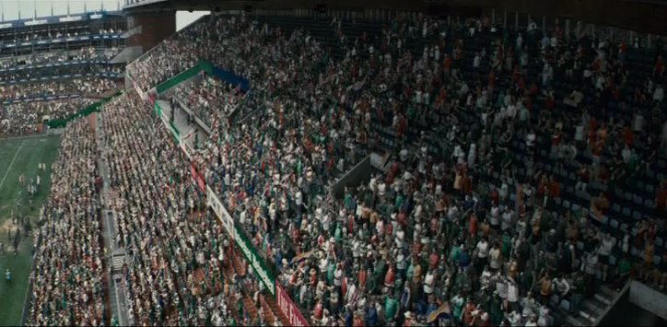
Invictus

Slide 3
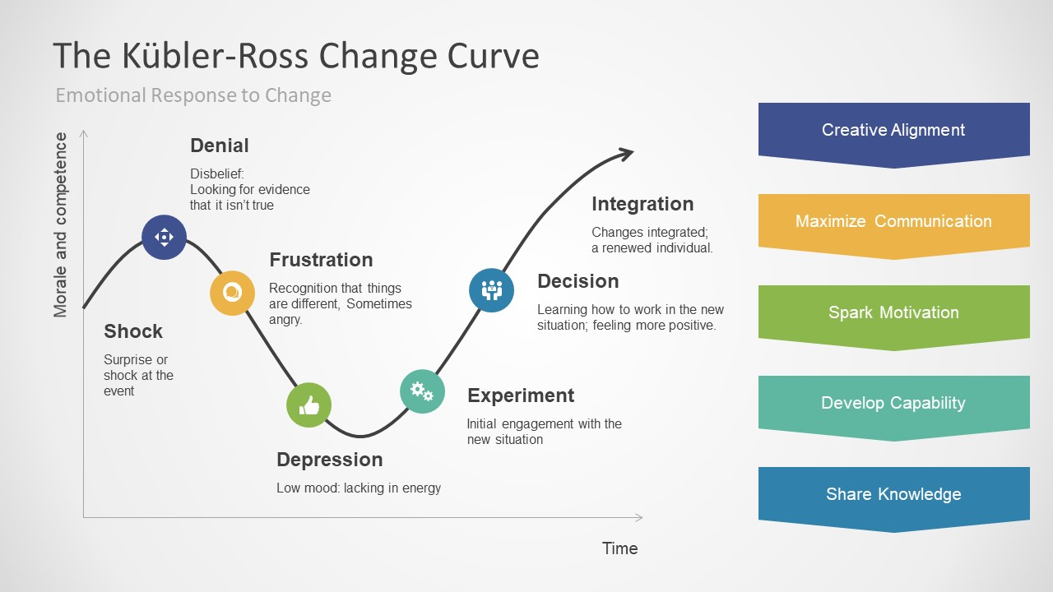
Rule #1: Know Your DEAMS Audience, JD!
YOU ARE PROBABLY HERE
Into the Lions’ Den – I ain’t scared!

Slide 4

Overview
AFAOC Alignment with SAF/FM Strategic Plan
AFAOC Overview & History
Powering Innovation
AFAOC Teams
AFAOC Tools & Support

Slide 5
AFAOC Alignment
with SAF/FM Strategic Plan
SAF/FM FY19–23 Strategic Plan
AFAOC GOALS
Goal 1: Develop and Take Care of the FM Team
Objective 1.1: Implement Human Capital Strategy
Objective 1.2: Save Airmen Time
Goal 2: Deliver Financial Management Excellence
Objective 2.1: Provide Excellent Financial Customer Service
Objective 2.2: Provide High-Quality Programming, Cost Estimating, Budget Development, and Execution
Objective 2.3: Provide Accurate and Auditable Accounting Support
Goal 3: Provide Financial Management Leadership
Objective 3.1: Build Airmen/FM Leaders
Objective 3.2: Support Contingency/Joint Operations
Objective 3.3 Grow Resource Management Capability
Provide world-class customer support to end users
Promote self-sufficiency and enhance accounting support
Enhance accounting support through shared knowledge
Improve accounting support through data analytics
Monitor interface trends and system operability
Strengthen user proficiency and AF accountability through continuing education, targeted assistance, system operations and monitoring, data analytics, and strategic communications
AFAOC MISSION

Slide 6

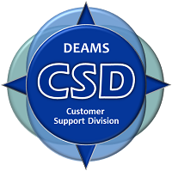


AFAOC Overview & History
Evolution of AF Accounting Support
SPIRAL 2
AFFSO
CSD
DOC
Legacy*
DEAMS
~1.3K Users
4 Locations
6 HD Support Staff
Account Management;
Training Support
~1.5K Users
6 Locations
9 HD Support Staff
No change in support;
relocation to WPAFB
~7.1K Users
44 Locations
16 Support Staff
User Support; CSD SME; Improved Comm; Continuing Education; Performance Metrics; Workflow Monitoring
~12.8K Users
142 Locations
42 Support Staff
User Support
Interface Monitoring;
MAJCOM/COCOM SMEs
~80.6 K Users
AF Worldwide
~15.5K Users
163 Locations
90+ Support Staff
Data Analytics
Strategic Communications
Help Desk Support
Field Support
Training
DEAMS Compliance
DEAMS SME Support
DEAMS Interface Monitoring
DEAMS MCSME Support
2015
2017
2010
2012
2015
2019
AFFSO (Legacy) Systems
Full Functional and Technical Support
AFM
AFTR
CRIS
eFinance
FMDLC
FMSuite
FM Workflow
JOCAS II
Leaveweb
Serena
WAWF
*NOTE: AFFSO retains direct technical system support
Notes:
Note: Spiral 2 was a lone organization located at Scott AFB

Slide 7
Powering Innovation
The AF Accounting Operations Center drives innovation through data analytics, trigger actions, and robotics process automation tools
  Increasing accounting correction velocity, exposing new insights more quickly, and reducing time spent correcting errors
  Centralizing expertise promotes synergy, enables leveraging best practices/processes, and encourages streamlined knowledge sharing
  Integrating the use of Robotic Process Automation (RPA) to increase efficiency and improve the accuracy of AFAOC Compliance reviews and user account provisioning
How can we save airmen time?
What capabilities can we use to our advantage?
What’s next?

Slide 8
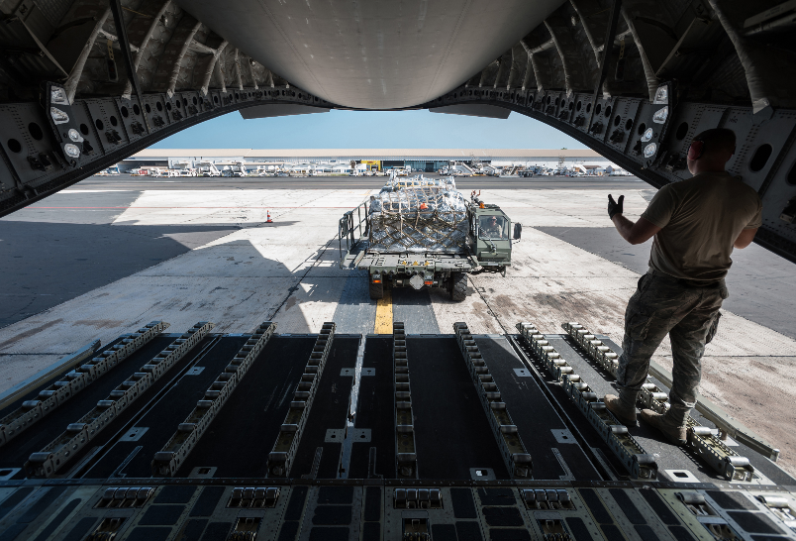
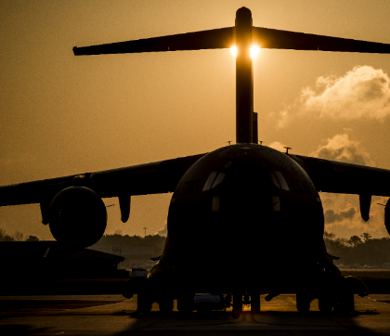
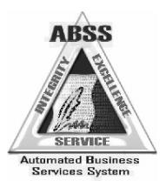



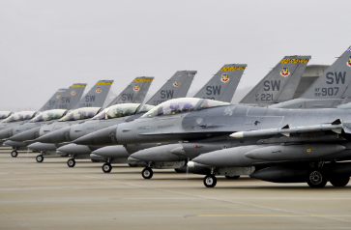





AFAOC Teams
Customer Support Division
Help Desk (Legacy and DEAMS)
  One-on-one user assistance
  Provide personal interaction to answer
  wide array of questions

Slide 9
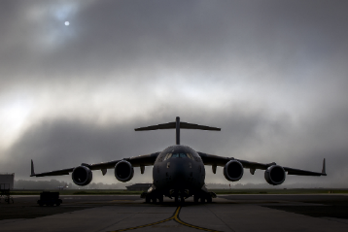
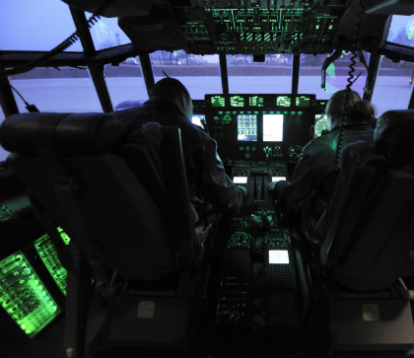
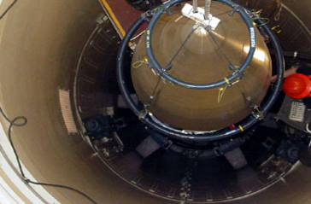
AFAOC Teams
Customer Support Division
DEAMS SMEs
  Provide thorough analysis and detailed resolutions to customer issues
  Provide value-added SME perspective during webinars and other training events
  Review training material and recommend updates to improve or clarify DEAMS processes
  Provide SME support to special projects/tasks as assigned

Slide 10
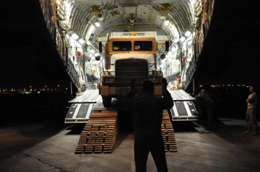
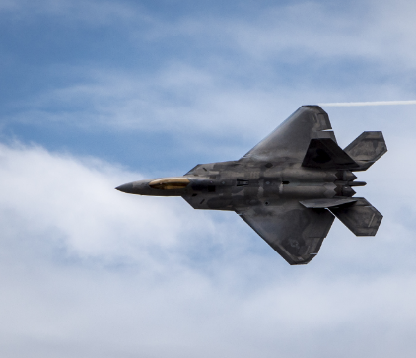
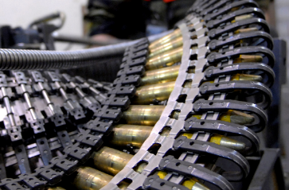





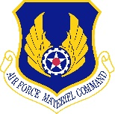

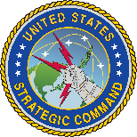

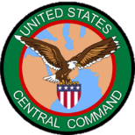

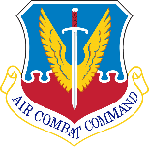


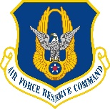



AFAOC Teams
Customer Support Division
DEAMS MAJCOM/COCOM SMEs
  Provide targeted assistance for users across the enterprise, based on MAJCOM/COCOM affiliation
  Review DEAMS Critical Task results to identify potential functional areas across bases requiring targeted assistance
  Prepare and deliver weekly DEAMS communication to MAJCOMs and Bases

Slide 11
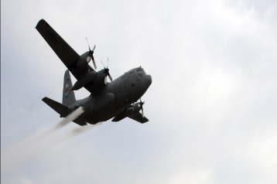

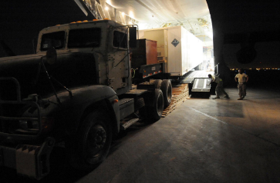
AFAOC Teams
Customer Support Division
Training (Legacy and DEAMS)
  Review/Maintain/Create assigned FM Systems courses
  Facilitate course reviews with functional SMEs
  Provide webinar/in-residence/on-site courses for FM Systems
  Develop FM Systems Web-Based Training (WBT) courses

Slide 12
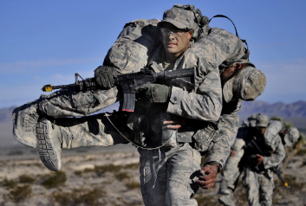
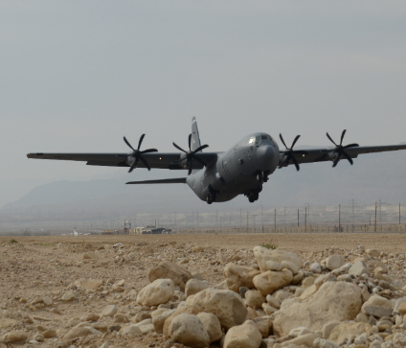
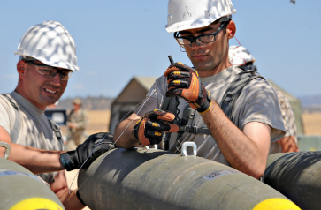
AFAOC Teams
Technical & Field Support Division
Interfaces (DEAMS)
  Perform system monitoring
  Conduct system maintenance support
  Monitor and validate interface files received
  Initiate concurrent manager requests upon demand

Slide 13



AFAOC Teams
Interfaces Overview
INBOUND SYSTEM
INTERFACES (50)
OUTBOUND SYSTEM
INTERFACES (40)
BUSINESS AREAS
BUSINESS AREAS
P2P | P2P and O2C
AROWS (2) | CDS (5)
AROWS-R (2) | CEFT (1)
CARE (AxOL) (3) | DCMS/IBS (2)
SBSS/ILS-S (2) | GAFS-DTIM (2)
APVM (1) | DAAS/DoDAFF (2)
DIFS (1) | DSAMS/DSCA (2)
PPVM (1) | DTS/DTMO (2)
SMAS (3) | O2C
COINS (1) | JOCAS II (2)
BSME/EC (1) | DCBS (2)
KYLOC (1) | B2R
WAWF (iRAPT) (2) | NexGen (1)
PowerTrack (1) | GAFS-BL (2)
PDS (SPS/CON-IT) (1) | Civilian Pay
PRDS (CCaRS) (1) | DCPD (1)
RTS (1) | DCPS/CPAB (2)
P2P | P2P and O2C
AROWS (2) | CDS (3)
AROWS-R (2) | CEFT (1)
RTS (1) | DCMS/IBS (4)
DTS (1) | GAFS-DTIM (2)
PRDS (SPS/CON-IT) (1) | B2R
iRAPT/WAWF (1) | CRIS (3)
1099 TRP (1) | FMSuite (1)
APVM (1) | NexGen (1)
BAM (1) | AUD-IT (1)
DIFS (1) | BEIS/DCDW (1)
PPVM (1) | CMCS (1)
O2C | DDRS (1)
JOCAS II (1) | GAFS-R (1)
DCBS (1) | P2P and B2R
 | PMRT (CCaR) (5)
Trading Partners
41
Interfaces
90
As of 20 Feb 2019
Denotes SFIS Compliant

Slide 14
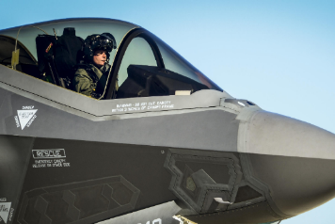
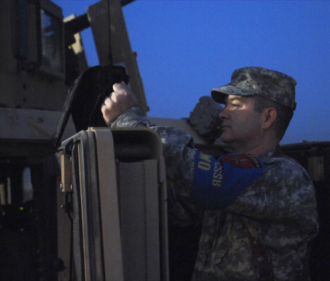
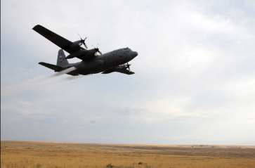
AFAOC Teams
Technical & Field Support Division
Data Analytics & Field Support
  Develop and maintain Funds Balance with Treasury (CCAS) reconciliation tool
  Work with DFAS and MAJCOM/base POCs on unprocessed transactions, identify root cause,
  and improve the process
  Create and sustain easy to use tools
  consolidating multiple DEAMS reports, allowing
  for immediate analysis of specific entities
  and documents (CTL Tool, DIMES Tool)
  AF Liaison to OSD FIAR Directorate for TAR
  AF Liaison between DFAS and MAJCOMs for outstanding GPC accounts, travel questions
  (RTS, DTS, CBA), HHG, and NTS
  Facilitate Monthly Accounting Calls and FYE
  Closeout

Slide 15
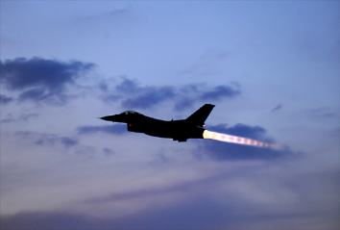
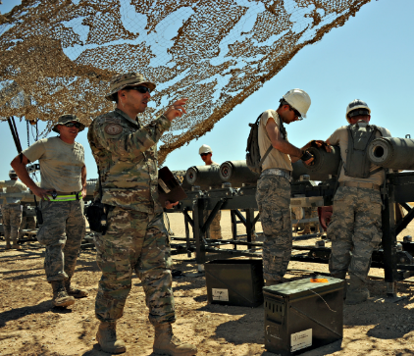
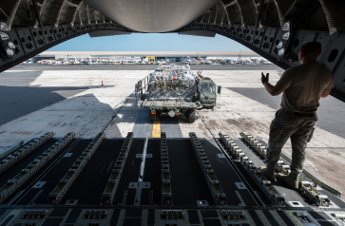
AFAOC Teams
Technical & Field Support Division
Strategic Communications
  Develop and distribute all communication
  products to AFAOC and DEAMS users
    DEAMS News
    Fact Sheets/Quick Reference Guides
    DEAMS Top 10
  Manage and maintain Outreach Portal
  Coordinate and manage monthly information
  sharing sessions, internal and external
    Monthly Users Forum
    Monthly Accounting Calls (from AFAFO)

Slide 16
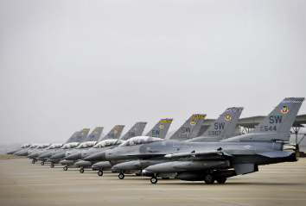
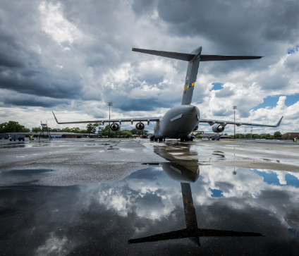
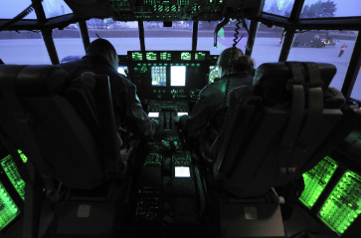
AFAOC Teams
Technical & Field Support Division
Audit Compliance
  Identify, document, and test key internal controls and business processes
  Perform monthly, quarterly, and annual compliance reviews
  Develop and implement audit strategy
  Assist with system preparations for Statement of Budgetary Resources
  (SBR) and financial statement audits

Slide 17
AFAOC Tools & Support

Slide 18
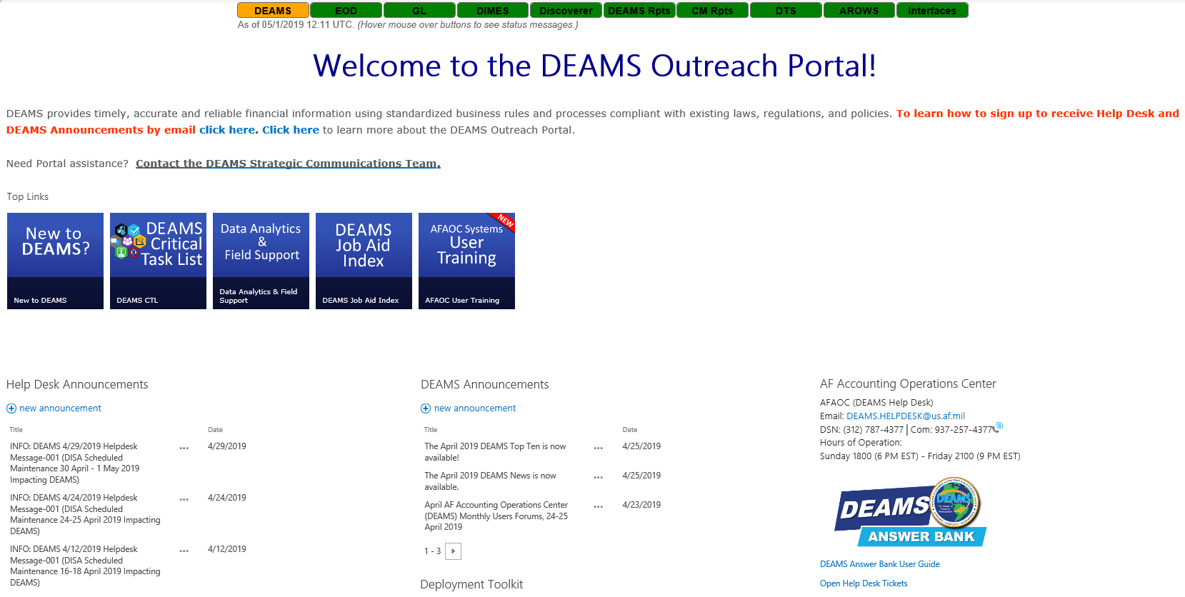
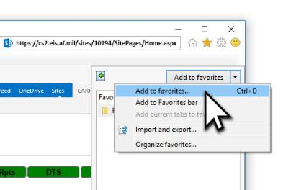
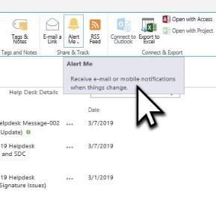

DEAMS Outreach Portal
The authoritative source
for DEAMS information
DEAMS and Help Desk Announcements
DEAMS News (monthly newsletter)
Fact Sheets (“need to know” topics)
Deployment Toolkit (deploying locations)
Customer Support Division (Help Desk)
DEAMS Answer Bank
Training Guides and Job Aids
Continuing Education
DEAMS Data Analytics
Top Ten…and much more!
DEAMS Outreach Portal
Add Portal as favorite
by bookmarking the
DEAMS Outreach Portal as
a favorite in your browser
https://go.usa.gov/xRPxd
Set SharePoint alerts
to have DEAMS and Help
Desk Announcements sent
to your us.af.mil account
Access for non-Air
Force organizations
Non-Air Force organizations may be unable to access the DEAMS Outreach Portal until their account is provisioned for AFNET access. Email your name, organization, and EDIPI/DOD ID number (located on the back of CAC) to the DEAMS Strategic Communications inbox
at AF.DEAMS.StratComms@us.af.mil to request your account be provisioned.

Slide 19
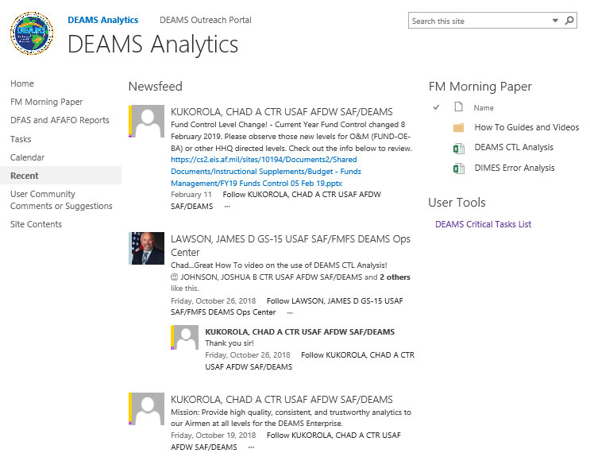

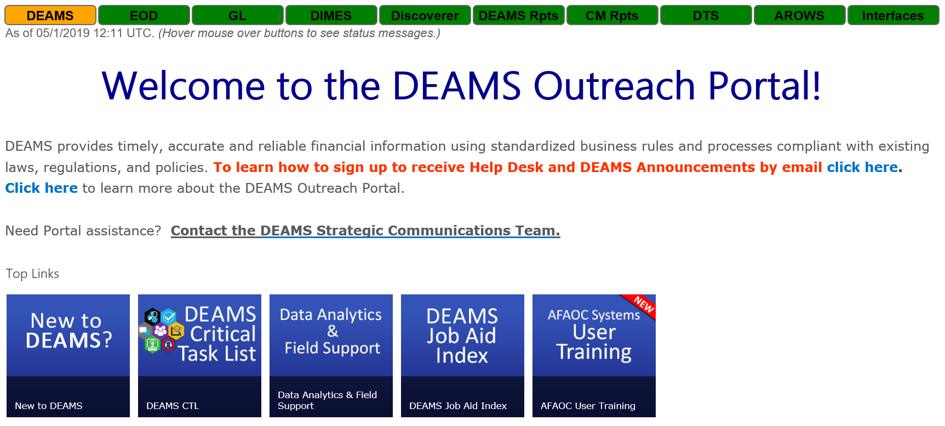
FM Morning Paper
Increases productivity and
saves airmen time
Data Analytics tools
can be found on the Data Analytics and Field Support SharePoint site
Can also connect through DEAMS Outreach Portal
SAF.FMF.DEAMSdataanalytics
@us.af.mil
FM Morning Paper link
DEAMS Outreach Portal link

Slide 20
Recurring Critical
Task List (CTL)
# | Task
1 | Overspent Funds. | Review and correct. (OPR: FMA, OCR: RA)
2a | Obligation Authority. | Balance direct obligation authority against FAD/OBAD for all by AAI/ADSN prior to EOM. (OPR: FMA, OCR: MAJCOM)
2b | Target Load Accuracy. | Review previous day’s target load transactions for accuracy (daily audit). (OPR: FMA, OCR: RA)
3 | Reimbursement Funds. | Review for timely billing and execution. (OPR: FMA, OCR, RA)
4 | Purchase Orders. | Review and work all pre-approved and rejected POs. (OPR: FMA, OCR: RA)
5 | SF 1081s & JVs. | Review and work open documents. (OPR: FMA, OCR: RA)
6 | GPC Releases. | Review and correct GPC release errors. (OPR: FMA, OCR: RA)
7 | MORDs. | Review open MORDs and de-obligate when required. (OPR: FMA, OCR: RA)
8 | Open Document Listing. | Reconcile, validate open documents including unobligated commitments (requisitions), unliquidated obligations (purchase orders) against supporting documents and ensure each meets valid criteria. (OPR: RA, OCR: FMA)
9 | Travel Orders. | Review outstanding travel orders and take follow-up, reconciliation, adjustment, collection, suspense action. (OPR: FMA, OCR: RA)
10 | Invoices. | Review invoices on hold and work with RAs and DFAS to correct. (OPR: FMA, OCR: RA)
11 | AROWS Requisitions. | Review and cancel duplicate AROWS requisitions. (OPR: FMA, OCR: RA)
12 | PTEOs. | Audit PTEO creations and updates for accuracy to include LOA data element validation against FM DQS. (OPR: FMA, OCR: RA)
13 | Requisitions. | Review and validate requisitions not yet approved. (OPR: FMA, OCR: RA)
Monitoring funds execution
Includes recommended
frequency, reports, OPR/OCR,
and instructions
The CTL is similar to MICT
(Management Internal Control
Toolset) for FM
CTL identifies potential execution areas of concern to be researched
Innovative delivery of on time data; sharpens analysis capability

Slide 21
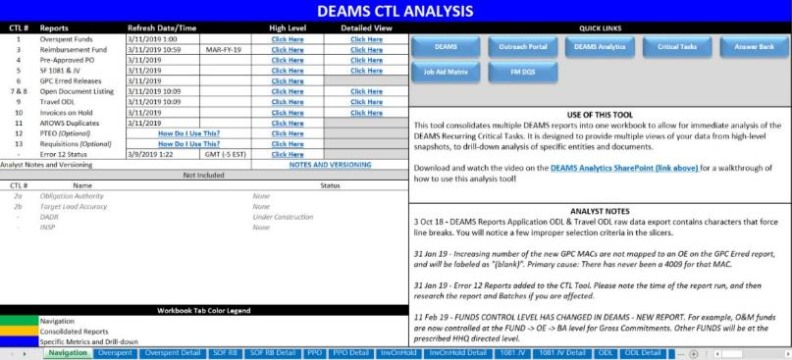
Critical Task List Analysis Tool
Provides data to support CTL
Provides ready-to use,
pre-pulled data
Consolidates multiple DEAMS reports into ONE workbook
Updated every morning (Eastern Time M–F)
FM DQS utilized to map the OE to base name and Command
Regular, meaningful, actionable, and trustworthy information
DEAMS CTL Analysis can be found on the DEAMS Analytics SharePoint site
Reduces research time and improves analysis capability
Notes:
Note 1: The CTL Tool does not cover/address all CTL reports, only those business logic may be applied (no PTEO or ODL reports)
Note 2: The CTL Tool is updated every morning M-F, pay attention to the Refresh Date/Time

Slide 22
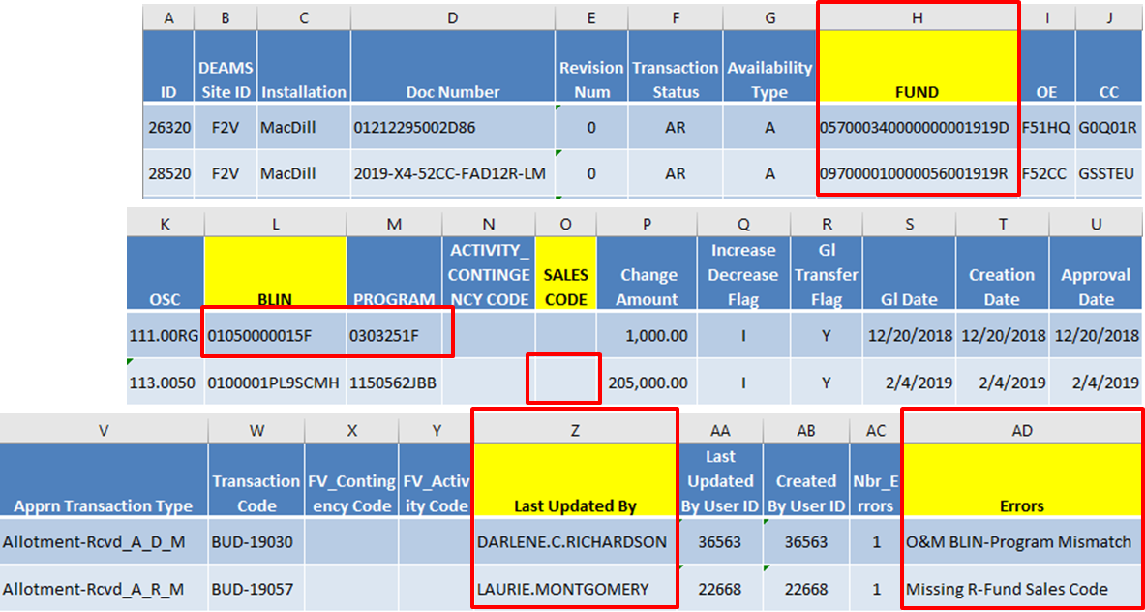
Target Load Accuracy Tool
Prevents errors before
transactions posted to GL
prior to approving
transactions
Review and validate target
load transactions prior to
“Approve” action
TLAT Error Report
specifically identifies
anomalies and presents
a clear description of
problem
Identifies who to contact, what to research, and what to fix
Notes:
Target Load Accuracy Tool (TLAT) used prior to “Approve” action prevents errors before transactions posted to GL
From the TLAT error report, Column Z tells you WHO to contact
Column AD identifies WHAT needs researched
The RED boxes and yellow headers point to areas to fix top 2 errors of O&M to BLIN mismatch and R-Fund Sales Code.

Slide 23
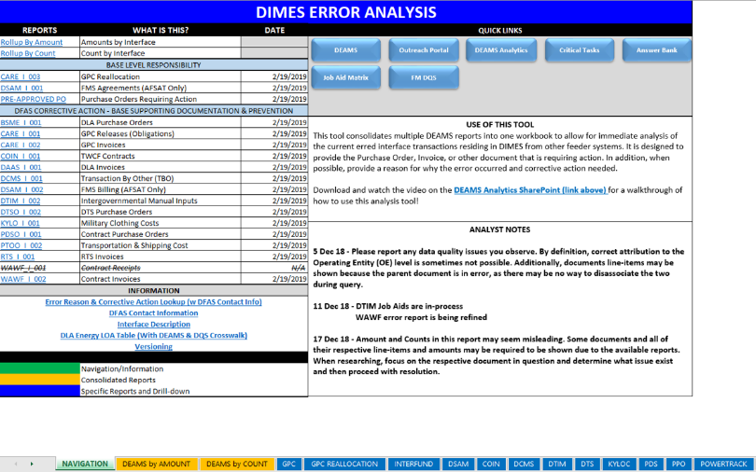
DIMES Reporting Tool
IDs transactions not reflected
on DEAMS execution reports
DEAMS includes an interface error
handling module called DEAMS
Interface Metrics Error handling
and Status tracking (DIMES)
Provides visibility of “unprocessed transactions”
(errors) not posted to DEAMS General Ledger/SOF
Job Aids available demonstrating common errors and recommendations on how to research and take corrective actions
Combines 17 queries into a single tool

Slide 24
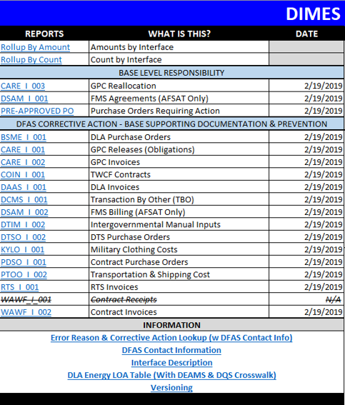
DIMES Responsibilities
How does the Air Force assist
with fixing interface errors?
BASE LEVEL RESPONSIBILITY
AF researches and corrects GPC
Reallocations, FMS Agreements,
and POs
  Currently building webinar to provide
  comprehensive instructions
  concerning CARE-I-003 DIMES
  corrections
DFAS CORRECTIVE ACTION
AF researches errors and provides DFAS required supporting documentation to clear errors
  Each error indicates corrective
  action(s) and DFAS contact information
Visibility of transaction errors previously only accessible to DFAS through Suspense Log

Slide 25

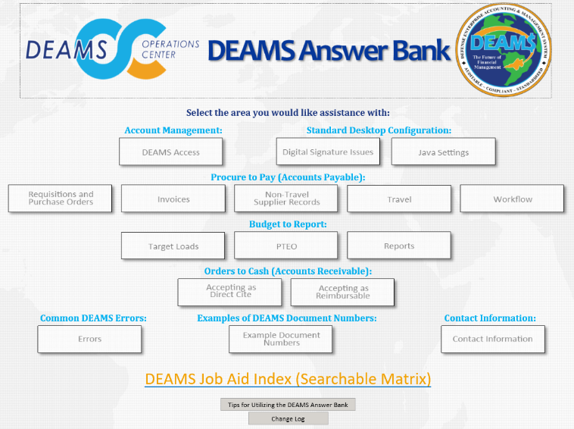
DEAMS Answer Bank
Helps users solve
issues independently
Walks users through a
step-by-step decision tree,
usually no more than five or six
questions
Drilldown options provide
information with relevant
screenshots to resolve commonly
asked questions
The answer displays, with links to Job Aids providing more detailed support for performing the task and resolving the issue
DEAMS Answer Bank link
Dynamic application developed to replicate Help Desk calls
Notes:
Suggestion: Mention new modules that have recently come out

Slide 26
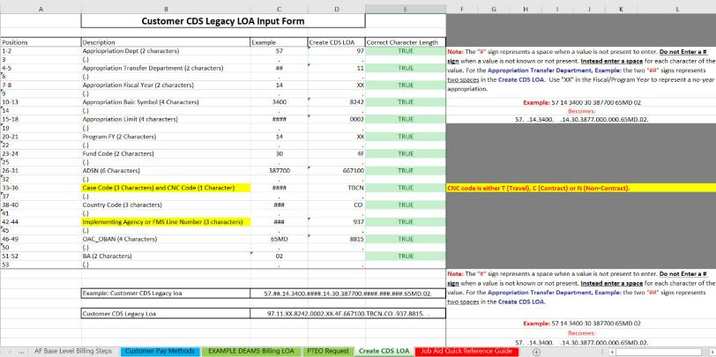
DEAMS Reimbursement
(O2C) Process Packet
Reviews each step
needed to begin and finalize
a reimbursement in DEAMS
Consolidates required
actions and Job Aids
Primary sections include the following
  DEAMS O2C 1080 Billing Solution Summary
  AF Base Level Billing Steps
  Customer Pay Methods
  PTEO request information
  DEAMS Project Billing User Job Aid Quick Reference Guide
DEAMS Reimbursement (O2C)
Process Packet
Assists users in understanding the reimbursement process

Slide 27
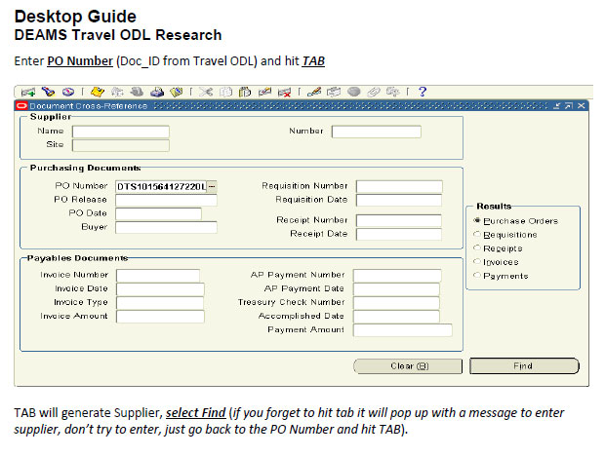
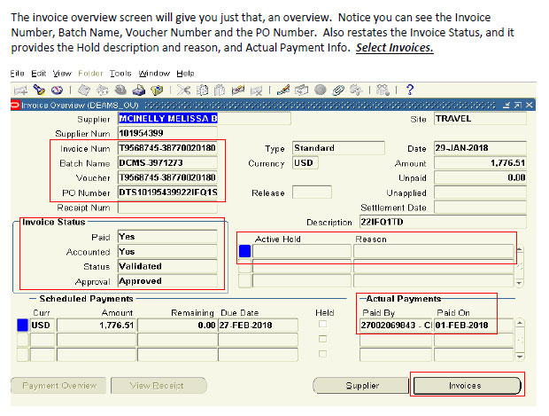
Desktop Guide to DEAMS
Travel ODL Research
In-depth analysis on
the DEAMS Travel ODL
Documents process to troubleshoot common travel-related errors
Provides examples and details
for using internal tools, queries,
and reports on any type of order (DTS, RTS, AROWS)
Desktop Guide to DEAMS Travel ODL Research
Screenshots of Document
Cross-Reference Tool
The best place to begin Travel ODL research is in DEAMS

Slide 28
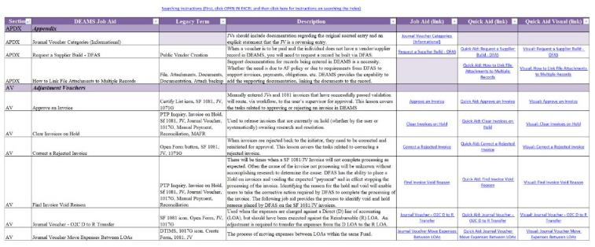
DEAMS Job Aid Index
Searchable repository
for documented DEAMS
procedures
Detailed guidance on more than
200 topics
Job Aids provide step-by-step
instructions including visual guides and screenshots
Index is searchable by: Section, Job Aid title, Legacy term,
or Description
Includes links to each Job Aid, Quick Aid, and Quick Aid Visual
Includes a link to instructions on how to search the Job Aid Index within Excel
DEAMS Job Aid Index link
Centralized hyperlinks to desktop guides
Notes:
These are the same job aids referenced while utilizing DEAMS AnswerBank

Slide 29
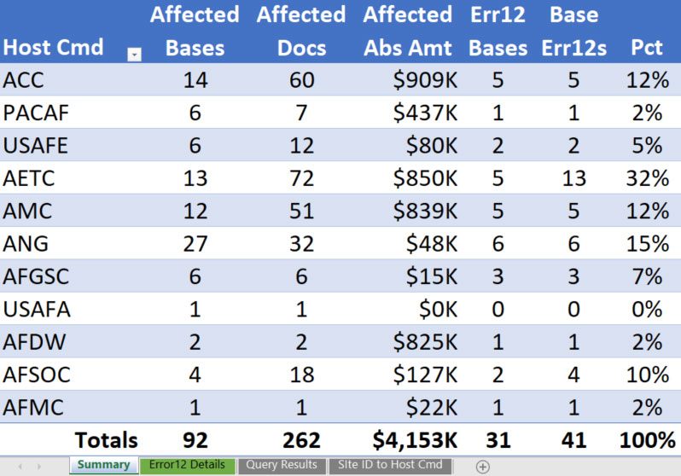
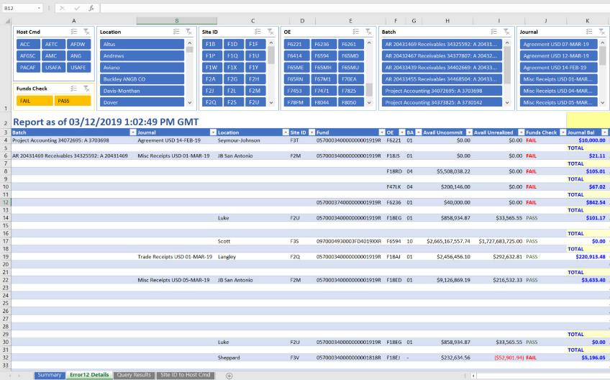
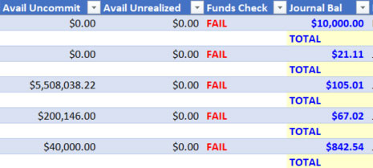

Error12 Report
Confirm funds availability
Unfunded transactions impact all other
funded transactions in the same batch
Identifies journal batches with
Accounts Receivable (Agreements) unable
to post to the GL due to insufficient funding;
provides specific document numbers
that “FAIL” and need to be corrected
Report updated at 0800, 1600,
and 2030 Eastern Time (M–F)
Error12 Report and instructions link
DEAMS portal > MCSME > 01_Master Library
> Error12_Batches
Because these fail…
…These can’t post
Identifies Agreement and Collection transactions not posted and presents reason
Notes:
Similar to Legacy CSR Management Notice
- exception that GAFS allows transactions to post; while DEAMS requires available funds

Slide 30
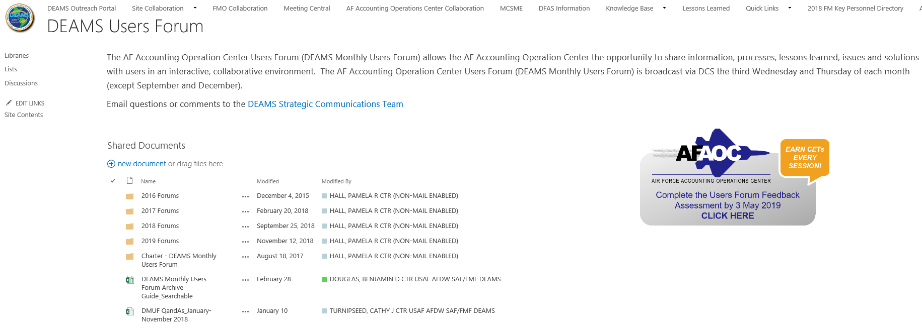

AFAOC Monthly Users Forum
Accelerate user
knowledge and skills
Monthly via Defense Collaboration
Services (DCS) telecom to share
information and tips from SMEs,
answer questions, and provide an
opportunity for user discussion
Briefings provided by Legacy and DEAMS Help Desks, AFAFO, DFAS, and MAJCOM/COCOM SMEs
Four sessions held every third Wednesday and Thursday of the month (excluding September and December)
  USAFE: Wed, 0800–0900 ET
  CONUS 1: Wed, 1000–1100 ET
Monthly Users Forum link
  CONUS 2: Thu, 1600–1700 ET
  PACAF: Thu, 1900–2000 ET
Interactive knowledge sharing and training in a virtual work environment
Notes:
Suggestion: Mention that they earn CET
In the event you cannot attend any of the sessions, the briefing slides and recorded session are available

Slide 31

Robotic Process Automation
Aged Travel - Reduces hours spent researching and manually entering the transactions to close stagnant travel obligations in DEAMS using RPA technology
DD2875s - Automate FM DD2875 forms; validate fields, provision accounts, and verify accesses
Compliance Reviews - Continue to define and develop BOTs technology for application into compliance reviews
Notes:
RPA
UiPath is the RPA software application used for Travel BOT– Artificial Intelligence (AI) platform authorized for use on AFNET
BOT technology = Automates repetitive tasks; can be used on any high-volume, business-rule driven, repeatable process
Frees up time, provides a structured format, allows for more effective analysis
2875s
Form validation = All fields are complete and accurate; user selections are appropriate, guidelines are met, etc
Access validation = Access is provisioned correctly; only as authorized by the Information Owner

Slide 32

VISION
Success through Customer Focus
MISSION
Strengthen user proficiency and Air Force accountability through continuing education, targeted assistance,
system operations and monitoring, data analytics,
and strategic communications

Slide 33
Together…we can make it happen!

