Slide 1
Driving growth through rapid innovation
And the change management support that follows

Slide 2
Introduction
We Were Invited
  We always say Yes to our customers
  It’s exciting to see industry and the government come together to share different perspectives and learn from each other
  Conference Theme “Preparing Way For Rapid Innovation stuck to us.
  FTI is known in the community as an Innovation Leader and is one of the more successful Dayton based Small Business Innovation Government Contractors.
  FTI really is very much focused on Rapid Innovation to better support the War Fighters.
We Said Yes – But What Topic
  Different business model – Language (i.e. working capital) – Financial Statements – etc.
  Similar complicated environment that requires innovation to be successful– Compliance (FAR/DFAR/CAS) – Less is more – Tough labor market
  Given the changing & complicated environment, we decided to go with change management as the topic
About Me
  Accounting/Finance background with an MBA & CPA
  Over 20+ of total experience, 10+ years in the government contracting sector with companies ranging from multi-hundred to multi-billion
  Focus has been on change management

Slide 3
Agenda
Introduction
FTI Background
FTI Rapid Innovation
  Phase III
  SBIR Technologies
Financial Infrastructure Change Management
  Culture
  Alignment& Performance Measurement
  People & IT
  Integration & Partnership
Q&A

Slide 4
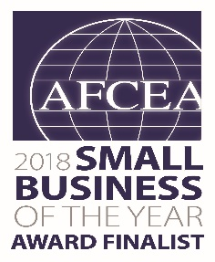
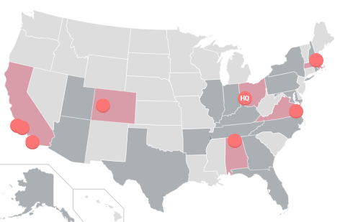

FTI Background
Helping the Department of Defense and other government agencies solve hard problems and implement informed and wise decisions
  Headquartered in Dayton, Ohio
  Operating in 28 states
  ~ 350 Employees
Cage Code: 1BP53 DUNS: 153927827

Slide 5
FTI Background
FTI started in 1985 in Santa Barbara, CA
Our Founder, Lavon Jordan, was an incredible man who believe in employee ownership
  We are now employee owned
FTI is anchored by the 4 Cs: Core Values, Commitment, Compassion & Charity
Focused on Aerospace Analysis supporting DoD decision making
Immediately opened a Dayton, Ohio office with a focus on Small Business Innovation Research (SBIR)
  Biggest part of DoD SBIR is USAF SBIR
  USAF SBIR starts in Dayton
FTI developed numerous SBIR technologies via WPAFB research organizations, 150+
WPAFB technologies are clear leaders in DoD
  FTI promoted those technologies to other services

Slide 6
FTI Background
Since that time the growth of FTI and our Dayton presence has continue to grow aggressively.
  Despite our focus on innovative technologies, our growth rate has been so incredible, we have had to be innovative in how we run this Dayton based company
  Has grown from employees in 2 states that were primarily USAF oriented,
  To employees that are now in 28 states serving most of the DoD organizations.
Next thing you know, we are:
  Doubling the company every 24 months for 4 years running and a few years into the future
  Hired 150+ people in the last year
Our growth has fundamentally been tied to the SBIR Program
  It enabled us to develop technologies organizations needed
  It enabled us to get on contract via the Phase III SBIR laws.
Growth has been exciting, but with many challenges
Joining FTI :
  Culture
  Growth
  Challenges
  Opportunities

Slide 7





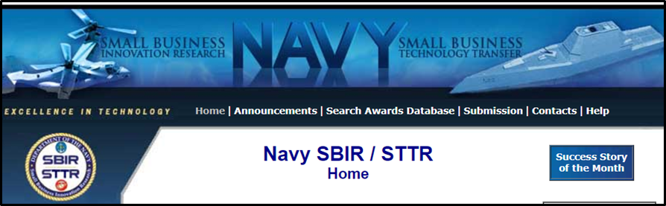
Small Business Innovation Research (SBIR) Program
The SBIR Program is structured in three Phases:
SBIR Phase I An Idea or Concept | SBIR Phase II Prototype | SBIR Phase III Functional Capability
Determines the scientific and technical merit and feasibility of a proposed effort | Typically a demonstration phase in which prototypes are built and tested | Work that derives from, extends, or completes a SBIR Phase I or II effort
Competitive SBIR funds used | Competitive SBIR funds used | Non Competitive SBIR funds cannot be used
The SBIR Program is under the Small Business Administration (SBA)

Slide 8
Rapid Innovation Through SBIR
We both are in an environment that has some inefficiencies within the current procurement process
  Can take 18 to 24 months
Yet opportunities like the following can rapidly change the culture
  OTA’s
  Phase III SBIR Awards
Front-End
Phase III
SBIR Technologies
Mid Point
Execution – Decision Making & Data Analytical
SBIR Technologies
Preparing the way for rapid innovation!

Slide 9







FTI SBIR Technologies
Decision Analysis
&
Program Management
Logistics and Wargaming
Big Data Analytics
Prognostic Health Management
MPAE™
(Metric Progress Analysis Engine)
RAE™
(Readiness Assessment Engine)
I-CAIV ®
(Integrated Cost As An Independent Variable)
ICETM
Integrated Cost Estimation®
LOOM
Linking Outputs to Outcomes Model
ISWAT
Integrated Sustainment and Wargaming Analysis Toolkit
LCOM ATK
Logistics Composite Model Analysis Toolkit
Extensible Load Adaptive Processing System
Integrated Sensor Analysis Tool
Test Data Management System
NormNet®
(Predictive Analytics)
Strategic
Lifecyle
Solutions
Frontier Technology Inc
ISWAT
ELAPS ®
I-SAT®
TDMS
Notes:
Take dates off footer and add page number

Slide 10
Air Force Programs Leveraging FTI’s SBIR Tools
  Washington DC and San Antonio
    HQ Air Force A1
  Wright Patterson Air Force Base
    Training Systems Program Office Basic Ordering Agreement
    B-2 Program Management Office
    Light Attack Aircraft Program Management Office
    Intelligence Surveillance Reconnaissance Program Office
    Air Force Research Laboratory (AFRL) Combat Identification
    Air Force Materiel Command (AFMC) A6
    Air Force Life Cycle Management Center (LCMC) EZ
    Air Force Business Enterprise Systems
    AFMC A5 Wargaming
  Robins Air Force Base
    Air Force Distributed Common Ground Station (DCGS) Program Office
  Florida and Colorado
    AFRL AC-130 Gunship Wind Sense Project
  Los Angeles and Colorado
    Space and Missile Systems Center

Slide 11
What ICETM is….and isn’t
Automated cost estimation based on multiple, accepted cost models
Provides development, production costs, and O&S costs in CAIG/CAPE format
SEER-MFG
OSMIS
SEER-IT
ICETM Environment
Integrated models
Integrated databases
Links to other models / data
Graphical User Interface
Additional models and Calculators to be added
SEER-IT
PRICE-S
VAMOSC
PRICE-S
PRICE-H
PRICE-H
Parts Obsol
AFTOC
Parts Obsol
OSD Facility
Parts Obsol
OSD Facility
User Input
User Defined
User Input
ILCM
ILCM
ILCM
SEER-SEM
CORE
SEER-SEM
SEER-H
SEER-H
For Mods, Enhancements or New Systems
Relating to Currently Fielded Systems
AFI
65-503
Relating to Future Systems
Future R&D
Costs
Future Prod
Costs
Future
O&S Costs
Completed
Projected
O&S Savings
Acquisition
Costs
Planned
Life Cycle
Cost
Total Return
& Savings
ROIs
BCAs
Not a cost model, but a collaboration of cost models and data sources – Helping the AF
with LCC Decisions

Slide 12


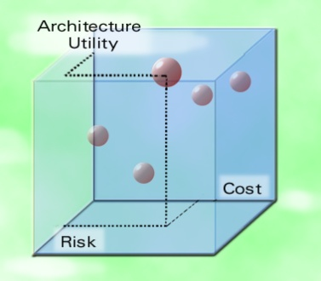

Integrated Cost As an Independent Variable (I-CAIV®)
Decision Stakeholders
Remote
Stakeholders
I-CAIV
Decision Trade Space
I-CAIV® Tool
Decision Criteria (requirements) prioritization
Optional phase
Measures of Effectiveness (MOEs) prioritization
Cost data
Risk data
Criteria
(Capabilities -
Requirements)
Schedule data
Decision Alternatives scoring and prioritization
Measures of Effectiveness
Subject Matter
Expert Input
System or design options
Test or M&S data
Utility Function Generator

Slide 13
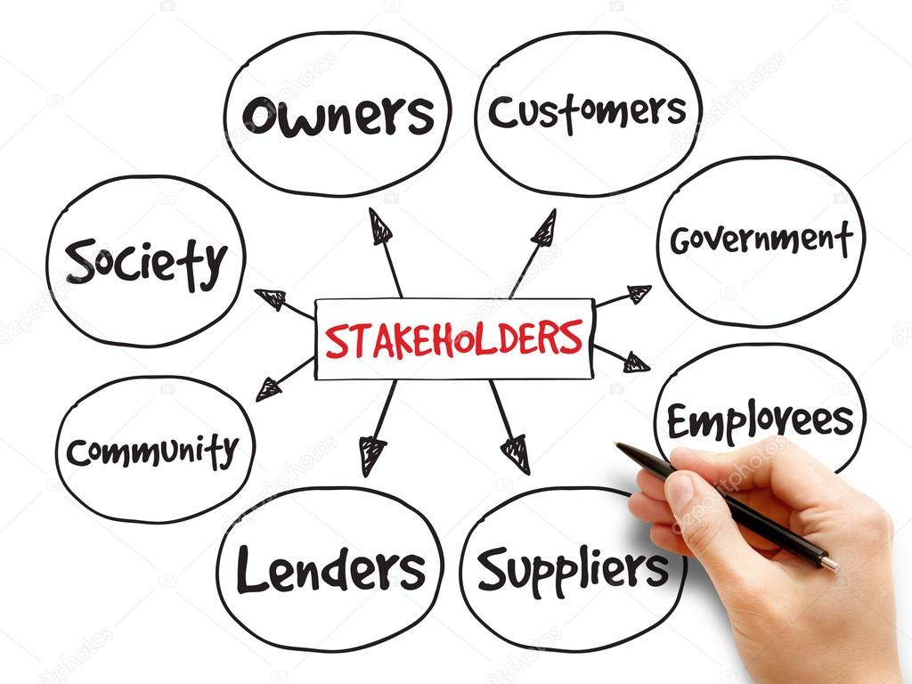
CHANGE MANGAEMENT – Opportunities & Challenges
Doubling every other year & into next 3-5 years – had to reassess, needed to be innovative to meet expectations
  Alignment, People & IT
  Integration & Partnership
  Reporting & Performance Measurement
Growth is great, but it has created infrastructure stress
  Reorganization
  New talent – Developing current talent
  Invoice process dysfunctional
  Customer reporting – (underrunning)
    EVMS
  Indirect rates - forecasting
  Approved Procurement & Estimating Systems
New requirements
  For examples:
    DCMA - FTI’s financial position
    DCAA – Audits, etc.
    Lender - New Nationally Recognized Financial Auditors
    Customers - More visibility into our operation/progress
Growth Leads to Many Stakeholders – At current size & beyond, FTI is required to balance them all!

Slide 14
CHANGE MANGAEMENT – Opportunities & Challenges
We all face similar challenges
  Limited resources
  Providing value to our customers
  Competing for the right talent
  Managing change
Internal Controls
Accounting
Schedule
Budget
Unallowable
Communication
Operational Efficiencies & Visibility
Auditing
FAR/DFAR
Systems
Business Case Analysis
Cost Analysis
Risk Management
People
Growth Leads to Many Stakeholders – At current size & beyond, FTI is required to balance them all!

Slide 15
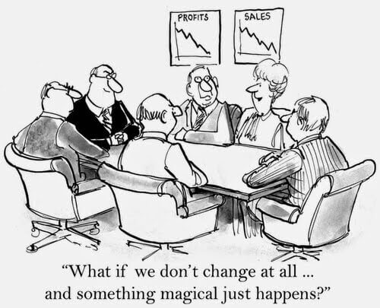
A BIT OF HUMOR
Change is complicated!

Slide 16
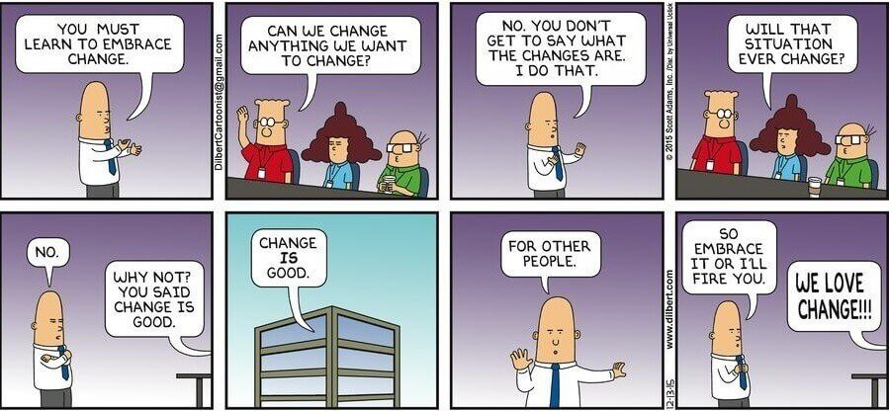
A BIT OF HUMOR
Change Management buy-in can’t be forced!

Slide 17
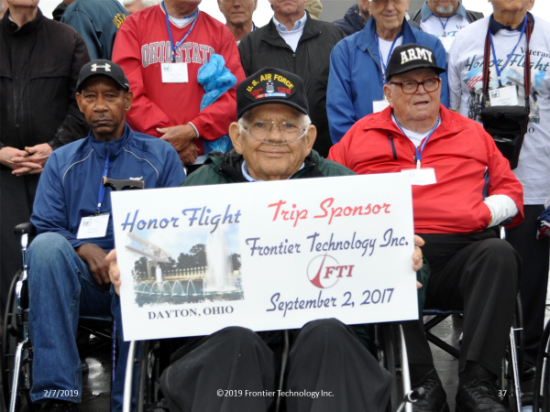
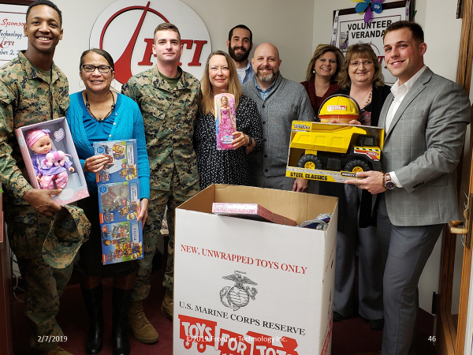
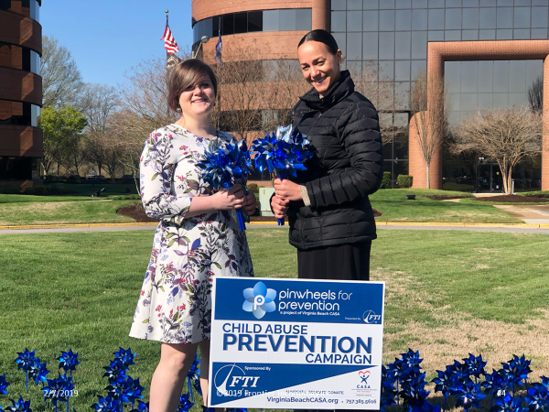

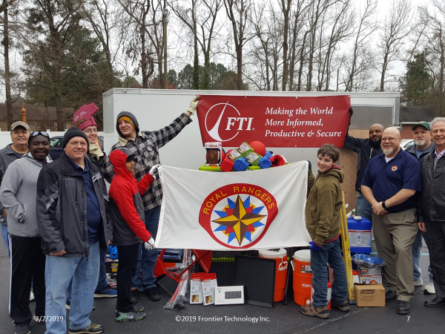

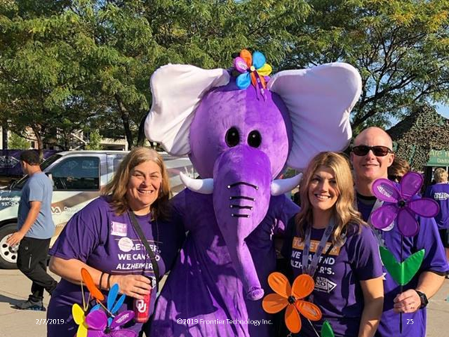
4th C
“I’m proud to work here because of our commitment to charity.”
“This company is very much into charity. It’s very exciting to know our CEO is on board to supporting our local community”

Slide 18





4th C Summary and Culture
Our culture is to “love our neighbor”
4th C is an active part of our company’s culture
The goal is to amplify the passions of our employees- not just to fund their requests
Ideally the employee is already actively involved in the charity and has recruited others to join them in the event
FTI then comes alongside the employees and contributes to help make their involvement and donation even greater
Very proud of our culture.
04/26/2019

Slide 19

CHANGE MANGAEMENT – The Ongoing Friction
Shareholder Value
Fiduciary Duty – Meet Goals & Objectives
Meet Customers’ Expectations
Meet ROI on Investments
Risk Management
Protect Shareholder Value
Balancing long-term goals against short-term needs
Core Values (4Cs)
Our Identity
Community
Control Spending
Increase free cash flow
Compliance Requirements
Execution Risks
External Risks
Flexibility: Right Amount of Change Management
Ethical
Compassion
What Won’t We Do
Balance Between Shareholder Value, Risk Management & 4Cs Is Complicated

Slide 20
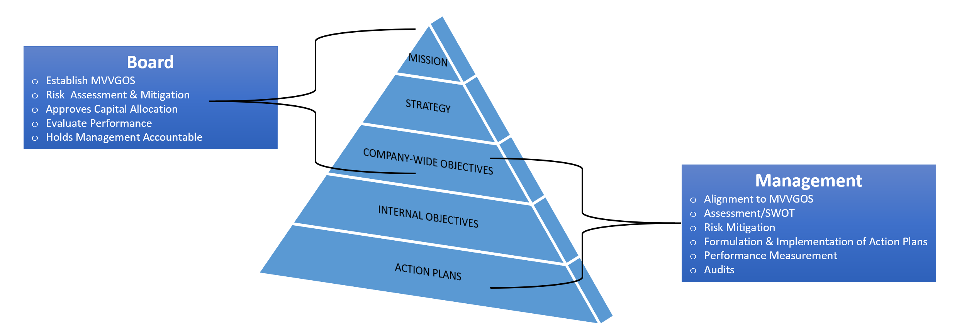
CHANGE MANGAEMENT - Alignment
Alignment
  Mission & Vision
  Core Values
  Goals & Objectives
When do we know
  Visibility – Reporting
  Performance Measurement
What must we do well?
  Initiatives
Monitoring
  Continuous assessment
  Risk Management
    Flexibility to adjust
Narrow Span of Attention – Limited Resources

Slide 21
Change Management – Alignment – Capital allocation
Walk the walk
  Limited resources
  Must fund activities that are going to help met:
    Goals & Objectives
    Satisfied stakeholders
  Stay within Core Values Parameters
80/20 Rule – Capital Allocation
  Fund Strategic Bets & Increment Growth/Efficiency Investments
Reduce non-value activities
  Maintenance Investments
High
Incremental Impact on FTI Performance
Strategic
Investments
Incremental Growth/Efficiency Investments
Maintenance Investments
Low
Here

Slide 22

Increase Shareholder Value
CHANGE MANGAEMENT– Implementation
Mission-Vision-Values-Goals-Objectives (MVVGO)
KPIs: CPARs, On Time Delivery, Increase in Cash, # of Audit Deficiencies
Start with MVVGO – Planning is a top guided approach
Define Goals & Objectives
Determine how you measure performance

Slide 23
Increase Shareholder Value
CHANGE MANGAEMENT– People – IT – Core Values
People
employee competencies
hire, retain & develop
compensation & benefits
performance management
Technology
network
enterprise solutions
information security
Corporate Culture
4 Cs
Implementation is a bottom up approach
Simply put – It starts with having the Right People
  If you don’t, you are just working to get tired
Technology – Infrastructure is next
  Digital Transformation
  Must automate & provide needed data efficiently & effectively
Culture– Culture – Culture – Culture
  Peter Drucker: Culture Eats Strategy for Breakfast

Slide 24
CHANGE MANGAEMENT IMPLEMENTATION– Integration & Partnership
Run the Business
Advance the Business
Earn Trust
Improve delivery of customer deliverable through partnership both internally & externally
FP&A/Operation Integration – Policies, processes & systems
Timely & accurate monthly financial reporting (internal & external)
EVMS Implementation
Compliance with FAR, GAAP, DOL, Federal & State regs, etc.
Finance must partner with Operations
  We’re here to support operations customers’ needs
  Finance can facilitate the discussion among the operational groups and they can entrust finance with doing the financial analysis
  Must balance standards with meeting end goal
    Many ways to help get around
  Providing visibility and a balance financial perspective goes a long way
  One TEAM Approach

Slide 25
Increase Shareholder Value
CHANGE MANGAEMENT – Complete View
KPIs: CPARs, On Time Delivery, Increase Cash, # of Audit Deficiencies, Backlog, Etc.
Increase Shareholder Value within FTI’s 4 Cs
Improve Working Capital
Improve Customer Satisfaction
Risk Management
to
2019 Business Plan Alignment:
Reporting
Communication
Scalability
Efficiencies
Regulatory Compliance
Realize the
Strategy
that
Run the Business
Advance the Business
Earn Trust
Improve delivery of customer deliverable through partnership both internally & externally
FP&A/Operation Integration – Policies, processes & systems
Focused Actions
Timely & accurate monthly financial reporting (internal & external)
executes
Compliance with FAR, GAAP, DOL, Federal & State regs, etc.
EVMS Implementation
achieve ROI excellence through corporate & operational processes
improve internal & external customer value through integrated & automated processes & meaningful reports
become a good corporate citizen through regulatory processes
Our Talented, Empowered Workforce
VP of HR, VP of Contract, FP&A Corporate Controller, Sr. Director , others
Unanet – CLM – ATS – IT Infrastructure -Others
Corporate Performance Management System
Strategy Map by Robert S. Kaplan & David P. Norton

Slide 26
Increase Shareholder Value
Takeaways
You will be required to do more with less
  Innovation is a must
Understand who you are and what’s important
  Culture
Ensure alignment to mission, vision, values, goals & objectives
You must have the right people
Digital transformation must be part of the process
Change will happen, it’s up to you whether you embrace or not!

Slide 27
Increase Shareholder Value
DRIVING GROWTH THROUGH RAPID INNOVATION
QUESTIONS

