Slide 1

FIAR/AUDIT UPDATE for ASMC
19 Jun 2019
Mr. Todd Green
Technical Director, AFLCMC/FM-FZ
937-255-3013
Providing the Warfighter’s Edge…

Slide 2
Audit Update
Why We Care

Slide 3
Audit Update
Public Law
Auditable Financial Statements - Required by law!
The Chief Financial Officer (CFO) Act of 1990 requires that all executive agencies produce auditable financial statements
Section 1003 of the 2010 National Defense Authorization Act (NDAA) required the DOD to ensure its financial statements are ready for audit by September 30, 2017
  On 4 August, the Air Force issued its notification of audit readiness as of 30 September 2017 to OUSD for consolidation into the DoD wide assertion
DOD Inspector General is responsible for identifying the auditor and serves as the contracting officer for the audit efforts
Good Stewards of Public Funds
CFO Act Agency | FY 2016 Audit Opinion
Department of Agriculture (USDA) | Unmodified/Not Audited
Department of Commerce (DOC) | Unmodified
Department of Defense (DOD) | Pending
Department of Education (Education) | Unmodified
Department of Energy (DOE) | Unmodified
Department of Health and Human Services (HHS) | Unmodified
Department of Homeland Security (DHS) | Unmodified
Department of Housing and Urban Development (HUD) | Pending
Department of the Interior (DOI) | Unmodified
Department of Labor (DOL) | Unmodified
Department of Justice (DOJ) | Unmodified
Department of State (State) | Unmodified
Department of Transportation (DOT) | Unmodified
Department of the Treasury (Treasury) | Unmodified
Department of Veterans Affairs (VA) | Unmodified
United States Agency for International Development (USAID) | Unmodified
Environmental Protection Agency (EPA) | Unmodified
General Services Administration (GSA) | Unmodified
National Aeronautics and Space Administration (NASA) | Unmodified
National Science Foundation (NSF) | Pending
Nuclear Regulatory Commission (NRC) | Unmodified
Office of Personnel Management (OPM) | Unmodified
Small Business Administration (SBA) | Unmodified
Social Security Administration (SSA) | Unmodified
Audit Objective: To provide independent assurance the AF, in its financial statements, has presented an “accurate and fair” view of an entity’s financial performance and position

Slide 4

AF Audit
Reporting Phase Audit Opinion
Unmodified “Clean” Opinion – financial statements are free of material misstatements
Modified Opinion – pervasiveness of misstatements qualify the type of modified opinion rendered
  Qualified Opinion: misstatements are material but not pervasive
  Adverse Opinion: misstatements are material and pervasive
Disclaimer of Opinion: no opinion is rendered
  Auditor cannot obtain sufficient audit evidence to render an opinion
  Auditor unable to complete testing required, due to scope limitation
Climbing the Ladder – auditability is an incremental process
Audit Reports for both the FY2018 GF and WCF Financial Statements were Disclaimers of Opinion

Slide 5
Audit Update
Who’s Involved

Slide 6
Audit Update
Who’s Involved in Audits
The Audit is more than just SAF/HAF responsibility
External parties with whom the organization transacts business (including Service Providers, Services, Components, OSD, DFAS, system owners)
Internal parties at all levels that are responsible for the end-to-end business processes (Base, MAJCOM, Program Offices, A4, System owners, etc.)
Audit (IPA)
SAF/HAF
System Owners
Functional Owners
(e.g., Base, MAJCOM, Center)
Service Providers

Slide 7
FIAR Compliance and MEV
Air Force Assessable Units

Slide 8
Audit Update
AF Assessable Units
Assessable Unit4 | Schedule of Budgetary Activity | General Fund | Working Capital Fund
Civilian Pay | X | X | X
Military Pay | X | X | N/A
Military Standard Requisitioning and Issue Procedures | X | X
Vendor Pay | X | X | X
MOCAS/Large Contracts | X | X | X
Reimbursable Budget Authority and Execution | X | X
Net Outlays | X | X | X
Travel (Temporary Duty Assignment Civilian Permanent Change of Station, Military Permanent Change of Station) | X | X | X
Fund Balance with Treasury Reconciliation | X | X | X
Financial Statement Compilation and Reporting | X | X | X
Funds Receipt & Distribution | X | X
Property, Plant, & Equipment - Aircraft, Satellites, Weapon Systems |  | X
Property, Plant, & Equipment - Real Property |  | X | X
Property, Plant, & Equipment - General Equipment |  | X | X
Property, Plant, & Equipment - Internal Use Software |  | X | X
Inventory & Related Property - Spare Engines |  | X
Inventory & Related Property - Munitions |  | X
Inventory & Related Property - Other |  | X
Inventory & Related Property - Inventory (Depot, Base & Medical/Dental) & (Operating Materiel & Supplies (Operating Material and Supplies) Spare Parts (Depot, Base) |  | X | X
Environmental Liabilities |  | X
Contract Authority |  |  | X
Revenue/Spending Authority (Flying Hours, Depot Maintenance, Financial Inventory Accounting & Billing System, Integrated Logistics System-Supply, Medical/Dental) |  |  | X
Expenses/Obligations (Supply, Depot Maintenance, Medical/Dental) |  |  | X

Slide 9
AF Audit
Audit Phases

Slide 10

Audit Update
Audit Phases
Financial Statement Audit consists of four phases:
Planning: Plan the audit approach including testing scope and site visit locations for walkthroughs of business processes
Internal Control: Evaluate the effectiveness of internal controls
Testing: Test the validity and completeness of the source documentation in the financial statements & compliance with laws and regulations
Reporting: Report the results

Slide 11
Audit Update
The Four Audit Phases

Slide 12
AF Audit
Notice of Finding and Recommendations

Slide 13
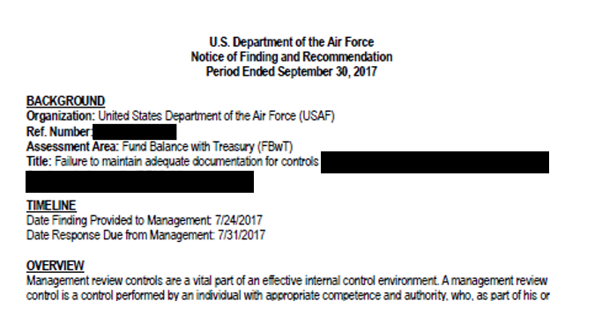
AF Audit
Notice of Finding and Recommendations
Following audits and/or examinations, management receives formal documentation, known as Notices of Findings and Recommendations (NFRs), from IPA regarding identified deficiencies
NFRs are typically issued before final audit report is delivered - management provides written comments on the findings (e.g. concurrence or non concurrence) within a specified timeframe
NFRs have the following information:
  Timeline - Finding issued and management response deadline
  Condition - Identified deficiency details describing specific audit failure points
  Cause - Testing results and management responses leading to why test failed
  Criteria - Rqmts used to test sample(s)
  Effect - Risk and impacts of failures
  Recommendation - Methods for mitigating known deficiencies
  Concurrence - Management’s acknowledgment of control failure
  Signature - Signature from SES

Slide 14
Corrective Action Plans
What Are CAPs?

Slide 15
Corrective Action Plans
Once management reviews the NFR and provides the IPA with concurrence, the next step is to develop and implement a corrective action plan to remediate the identified deficiency
A Corrective Action Plan (CAP) is a step-by-step plan to achieve targeted outcomes for resolution of identified deficiencies in an effort to:
  Identify the most cost-effective actions that can be implemented to correct error causes
  Develop and implement a plan of action to improve processes or methods so that outcomes are more effective and efficient
  Achieve measureable improvement in priority areas
  Eliminate repeated deficient practices
Example CAPs
  Conduct timely Physical Inventories
  Timely completion of key supporting documentation for Acquisitions and Disposals
  Timely completion of APSR Reconciliations
  Ensure appropriate requirements are built into contracts for financial reporting

Slide 16
Corrective Action Plans
The five phases of CAPs are:
  Confirm: document and agree to the deficiencies, assign Office/OPR/OCR/AO and determine priority levels
  Plan: perform root cause analysis, identify responsible organizations, merge similar findings across AUs into combined CAPs, and determine resources
  Design: develop milestones, tasks, and timeline
  Implement: execute the milestones
  Validate: confirm the CAP(s) addressed the deficiency
Ongoing- Monitor & Report: Inform management of progress at regular intervals (occurs throughout all phases of the CAP process

Slide 17
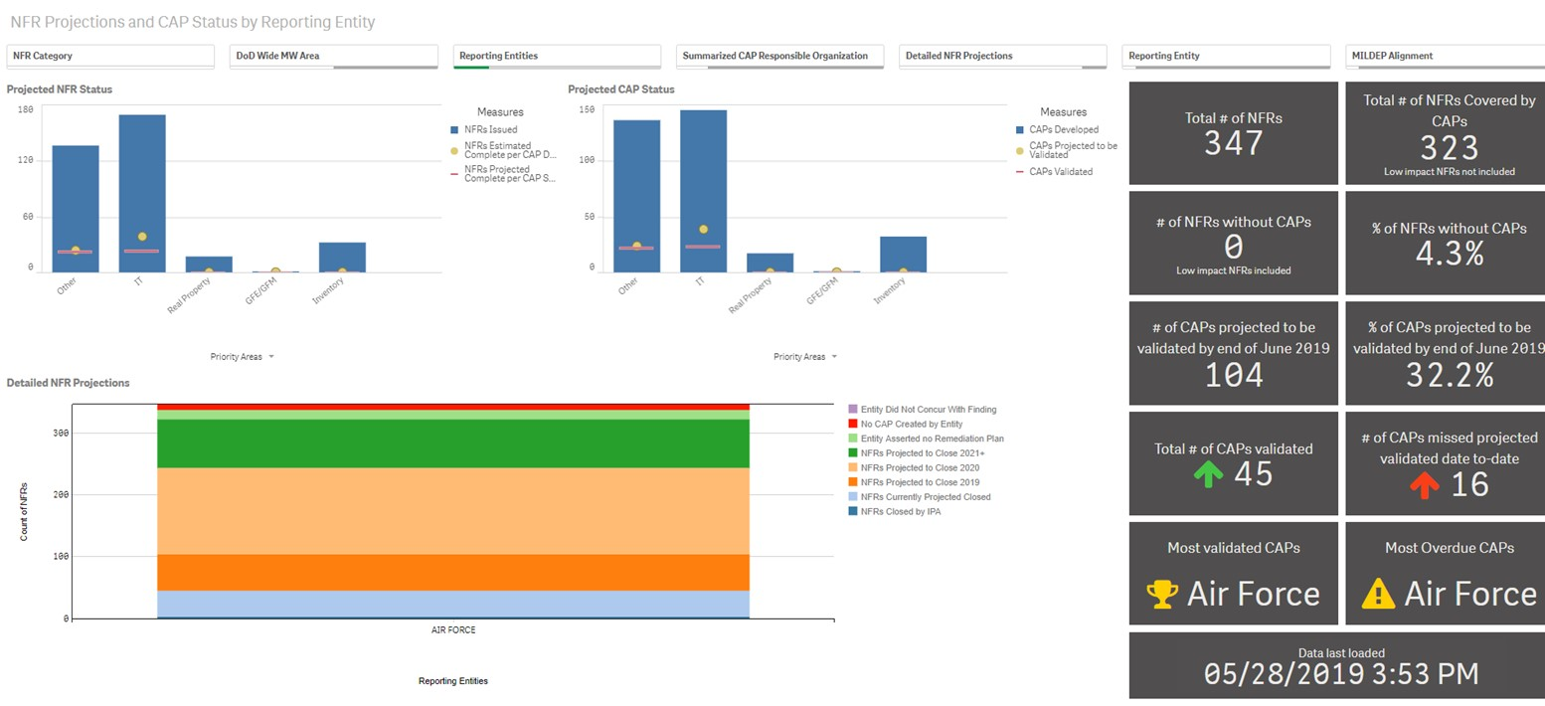
CAPs

Slide 18
AF Audit
FY19 SECDEF Audit Priorities

Slide 19
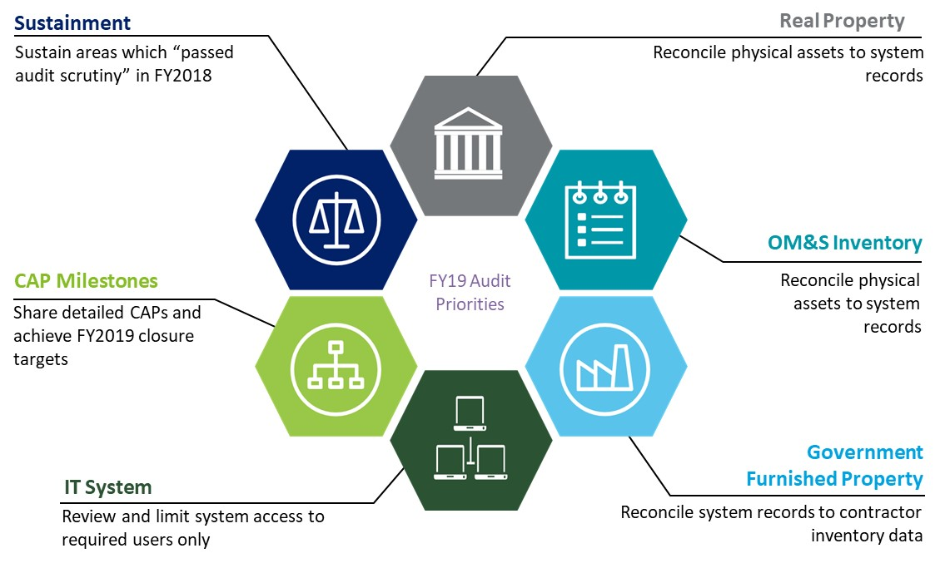
SECDEF FY19 Audit Priorities

Slide 20
FIAR Compliance and MEV
General Property, Plant, and Equipment
Military Equipment Valuation

Slide 21
AFLCMC MEV
What MEV Entails
Accounting requirements for Federally owned property, plant, and equipment (PP&E) are captured in Statement of Federal Financial Accounting Standards 6
  Tangible Assets that (1) have an estimated useful life of 2 or more years, (2) are not intended for sale in the ordinary course of business, and (3) are intended to be used or available for use by the AF
    Assets include Aircraft/Modifications, Remotely Piloted Aircraft, Ground Control Stations, Mine Resistant Ambush Protected Vehicles, PODs, Special Tools/Equip
    AF has established a Capitalization Threshold of $1M for general PP&E
Military equipment valuation requires capitalization of the total acquisition cost of an asset (e.g. Aircraft or Modification), greater than $1.0M, on the AF financial statements and depreciating the total asset cost over its useful life
Assets, acquisition costs, and useful life are entered into the Accountable Property System of Record – Reliability and Maintainability Information System (REMIS) for MEV
Depreciation is calculated automatically in REMIS
REMIS feeds financial data to the AF financial statements
Program Managers must perform monthly reconciliations and sign an Annual Attestation that the information in the APSR is accurate
AFLCMC has created a MEV Standard Process to assist PEOs/Program Offices

Slide 22
AFLCMC MEV
Deemed Cost Approach
AF working to establish MEV opening balances on AF financial statements
Accounting standards permit alternative methods for establishing Opening Balances
Permits AF to make an unreserved (unconditional) assertion the financial statements, or one or more line items addressed by the Statement, are presented fairly in accordance with Generally Accepted Accounting Principles
Deemed Cost is an acceptable alternate valuation method for general PP&E
  Surrogate for initial amounts otherwise required to establish opening balances
  Available to the AF only once per line item (For example: MEV)
Deemed Cost should be based on one, or combination, of the following valuation methods:
Replacement Cost – amount required to replace remaining service potential of asset
Estimated Historical Costs
  Cost of similar assets at the time of acquisition;
  Current cost of similar assets discounted for inflation since time of acquisition; or
  Other reasonable methods (budget, appropriations, engineering docs, contracts)
Fair Value – amount at which the asset could be exchanged in current transaction between willing parties, other than in a forced liquidation or sale
Depreciation – Accumulated depreciation/amortization is recorded based on estimated costs and the number of years the asset has been in use relative to its estimated useful life
AFLCMC is using Deemed Cost to establish MEV opening balances

Slide 23
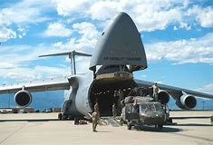
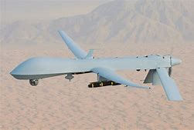
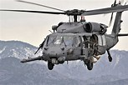
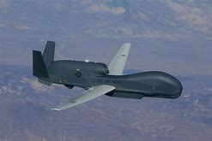
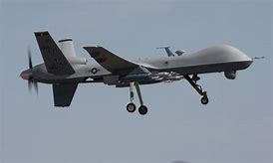
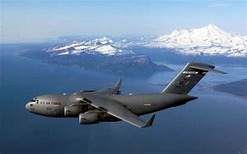
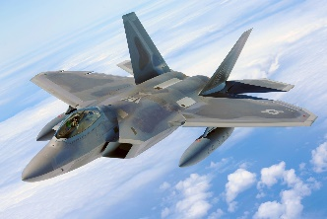
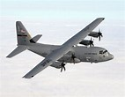
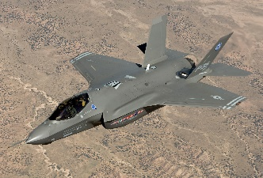

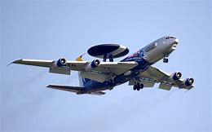
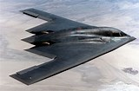
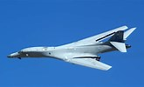
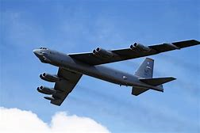
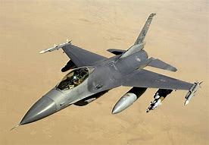
AFLCMC MEV
Deemed Cost Approach
Air Force Property, Plant, Equipment – General Equipment
AFLCMC MEV efforts encompass 64 programs across 7 PEOs

Slide 24
AFLCMC MEV
Go Forward Approach
Once MEV opening balances are established, federal accounting standards (SFFAS 4 & 6) for Federally owned PP&E must be followed
  All general PP&E will be recorded at cost
    All costs incurred to bring asset to a form and location suitable for its intended use
  Cost of acquiring PP&E may include:
    Amount paid to vendors
    Transportation charges to point of initial use
    Handling and storage costs
    Labor and other indirect production costs (for assets produced/constructed)
    Acquisition and preparation costs of building and other facilities
    Direct costs of inspection, supervision, and administration of construction contracts
  PP&E shall be recognized when title passes to the acquiring entity or when the PP&E is delivered to the entity or to an agent of the entity
    In the case of constructed PP&E, the PP&E shall be recorded as construction in process until placed in service, at which time balance shall be transferred to general PP&E
AF is currently evaluating options for meeting the Go Forward approach

Slide 25

AFLCMC MEV
Go Forward Approach
Accrual/Expenditure Based Methodology
Construction in Process
Indirect Costs
Key Supporting Documents

Slide 26
AF MEV
Impact to AF and Industry
May impact way we contract – alternatives under consideration are:
  Option 1: Separate contract CLIN for each asset – not a lot of support for this
  Option 2: A new CDRL – For each invoice paid by DFAS, prime contractors provide expenditure breakout for each asset in production (Capital vs. Expense)
    Is use of CDRL to capture expenditures by asset a feasible alternative?
    If AF provides breakout of capital vs. expense CLINs, can contractor accounting systems provide expenditure data by asset?
    Would CDRL drive added costs to Programs?
  Option 3: Change Invoices – Breakout of capital expenditures by Asset
    Is there possibility of changing invoices to provide this data without adding a CDRL?
  Looking at other options that might help achieve Go-Forward solution
Does Industry have other recommendations the AF should consider to comply with SFFAS 6?
Processes MUST change for AF to meet Federal Accounting Standards
  What approach minimizes impacts to program offices and industry
The AF MUST reach an “Unmodified” audit opinion – we welcome Industry feedback to help implement a process that will minimize impacts to all

Slide 27
Audit Update
Questions?

